Slide 1
Event Consortium
4-5-18

Slide 2
Reserve Location
Ball Annex – South of Zach Curlin Parking Garage and North of Ball Hall
By appointment Only

Slide 3
Event Consortium Check-out Process
Items can be checked out by appointment only Monday – Friday
Monday, Wednesday, and Friday – 9:30 a.m. – 11:00 a.m.
Tuesday and Thursday – 1:30 p.m. – 3:00 p.m.
Call (3043) or e-mail (mhatsell) for an appointment
Items can be checked-out the day before an event and returned the next day
Check-out form must be completed
Departments are responsible for items broken or not returned
Items to picked-up from and returned to Reserve location only

Slide 4
Event Consortium Web Page
Marketing and Communications Home Page
Brand Standards (left side)
Resources
Event Consortium
http://www.memphis.edu/logo/resources/event_consortium.php

Slide 5
University Event Calendar
http://www.memphis.edu/calendar/
To Request an Event Be Added
Click on Submit Event
Complete Form
Request will be Reviewed
If Approved for the Master Calendar it will be Added

Slide 6
New Items in Reserve
Bar Lights
Coat Rack
Flower Coolers
Drink Coolers
Stanchions

Slide 7
Care of Items
Up-Lights
Turn off before packing
Pack properly in case in divided sections
Make sure all cords are packed in front zipper
Vertical Banners
Do not let them retract quickly
Feed banner into base slowly and evenly to ensure that the caps do not pop off

Slide 8
Care of Items
Tablecloths
Not meant for food tables
Fold neatly and return to hanger
When checking in tell us of any known spots or marks
Acrylic Centerpieces
Do not stack without a layer in between each panel
Pack each section in one pillowcase

Slide 9
Care of Items
Puck Lights
Light may come with batteries from a prior event but we cannot ensure their strength
Turn off before packing
Be sure to include remote when packing
Blue and White “M”
Separate sections
Pack each M in one pillowcase

Slide 10
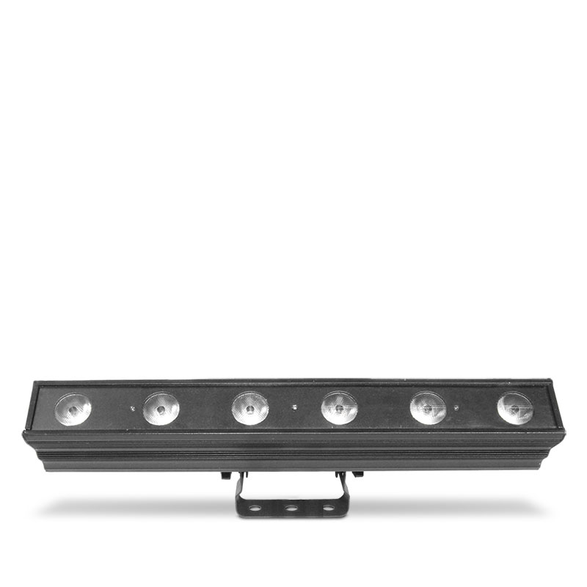
Bar Lights

Slide 11
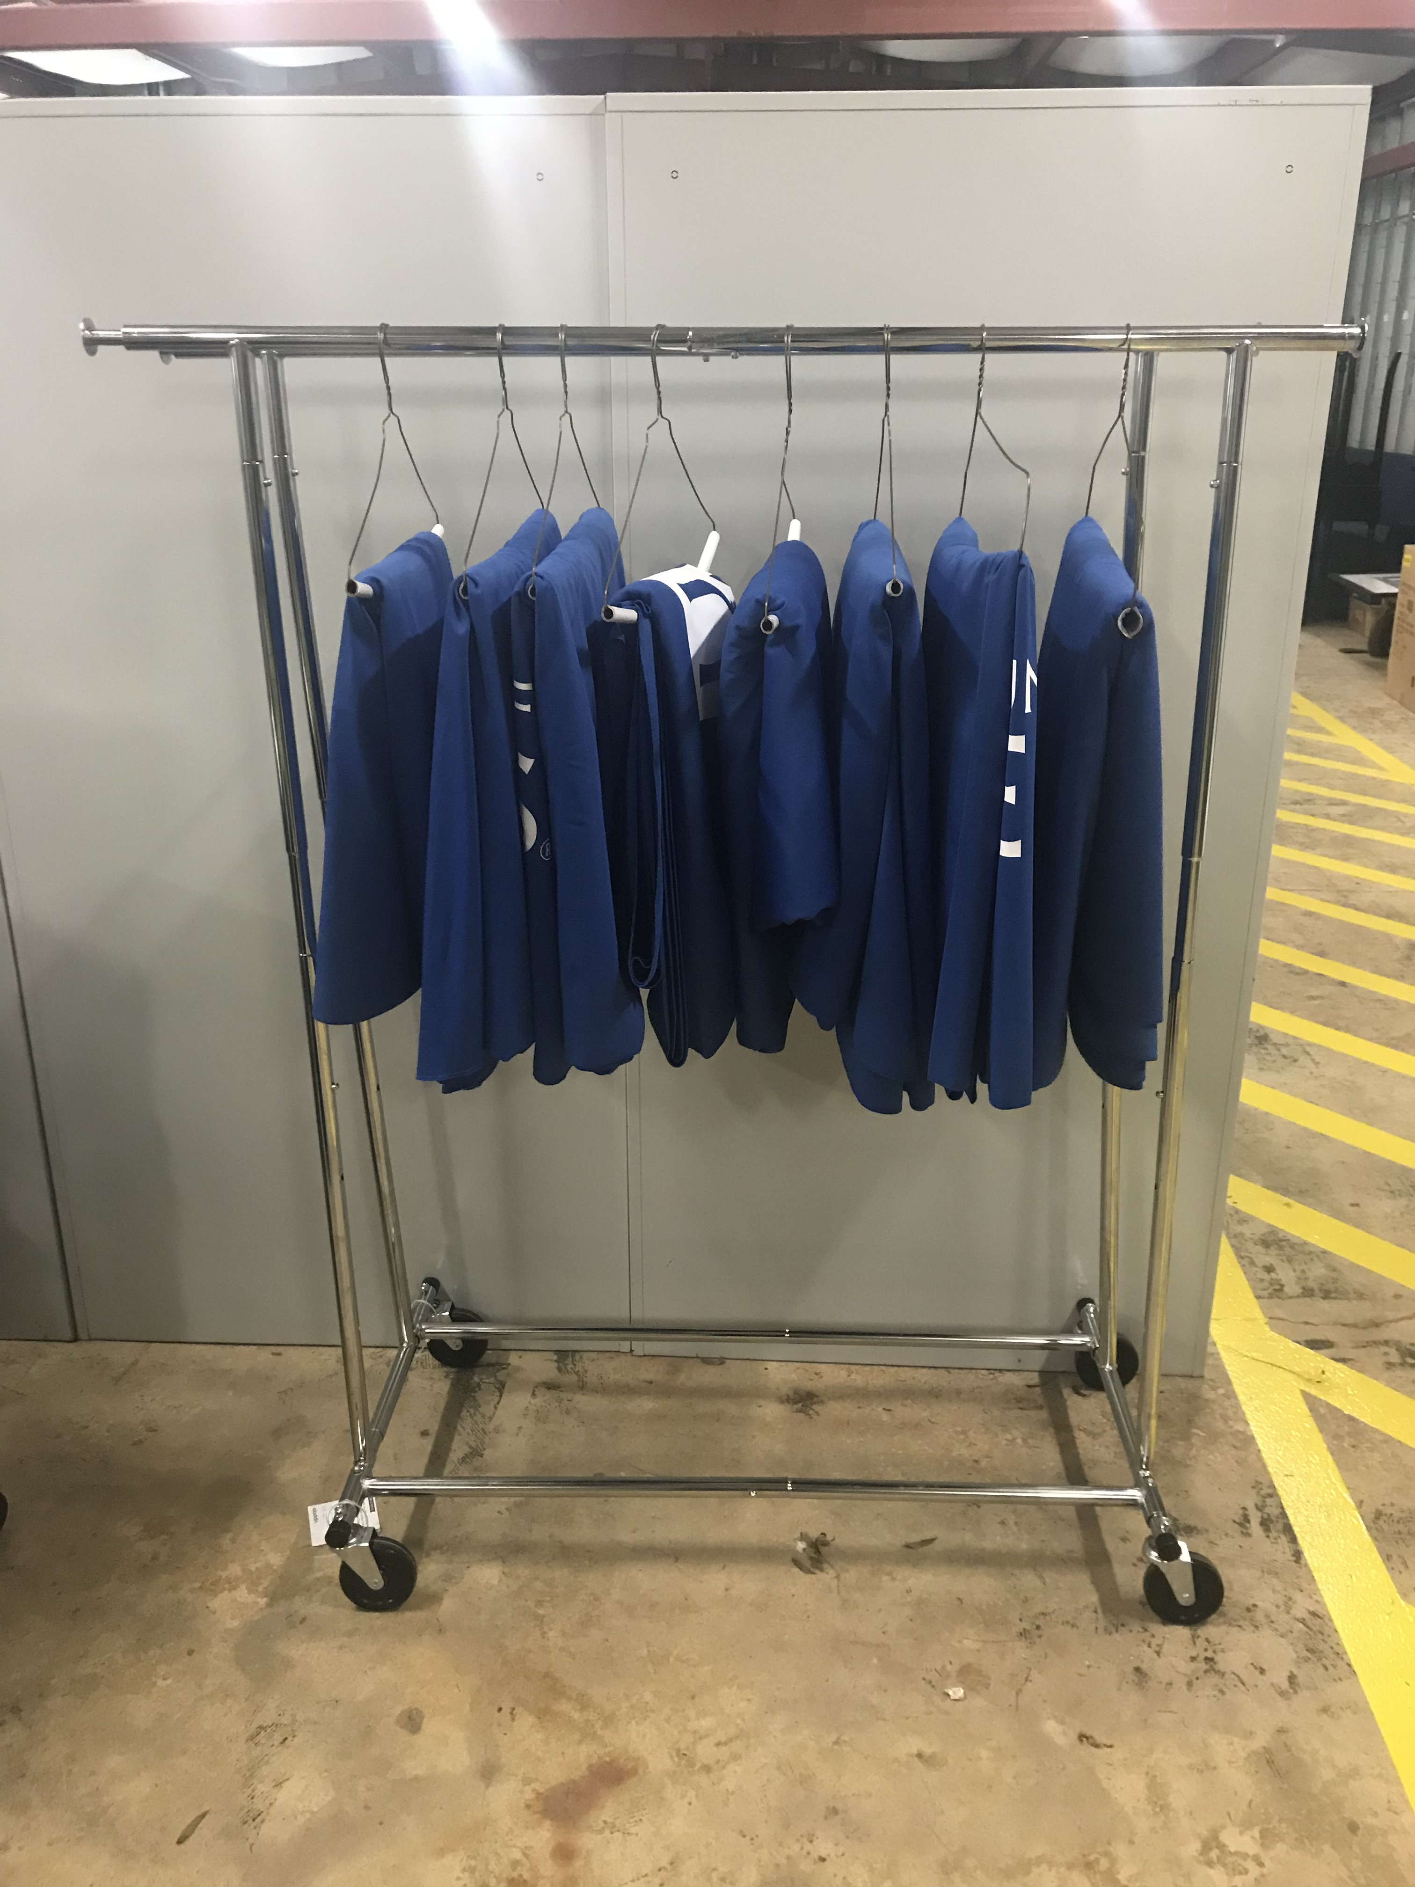
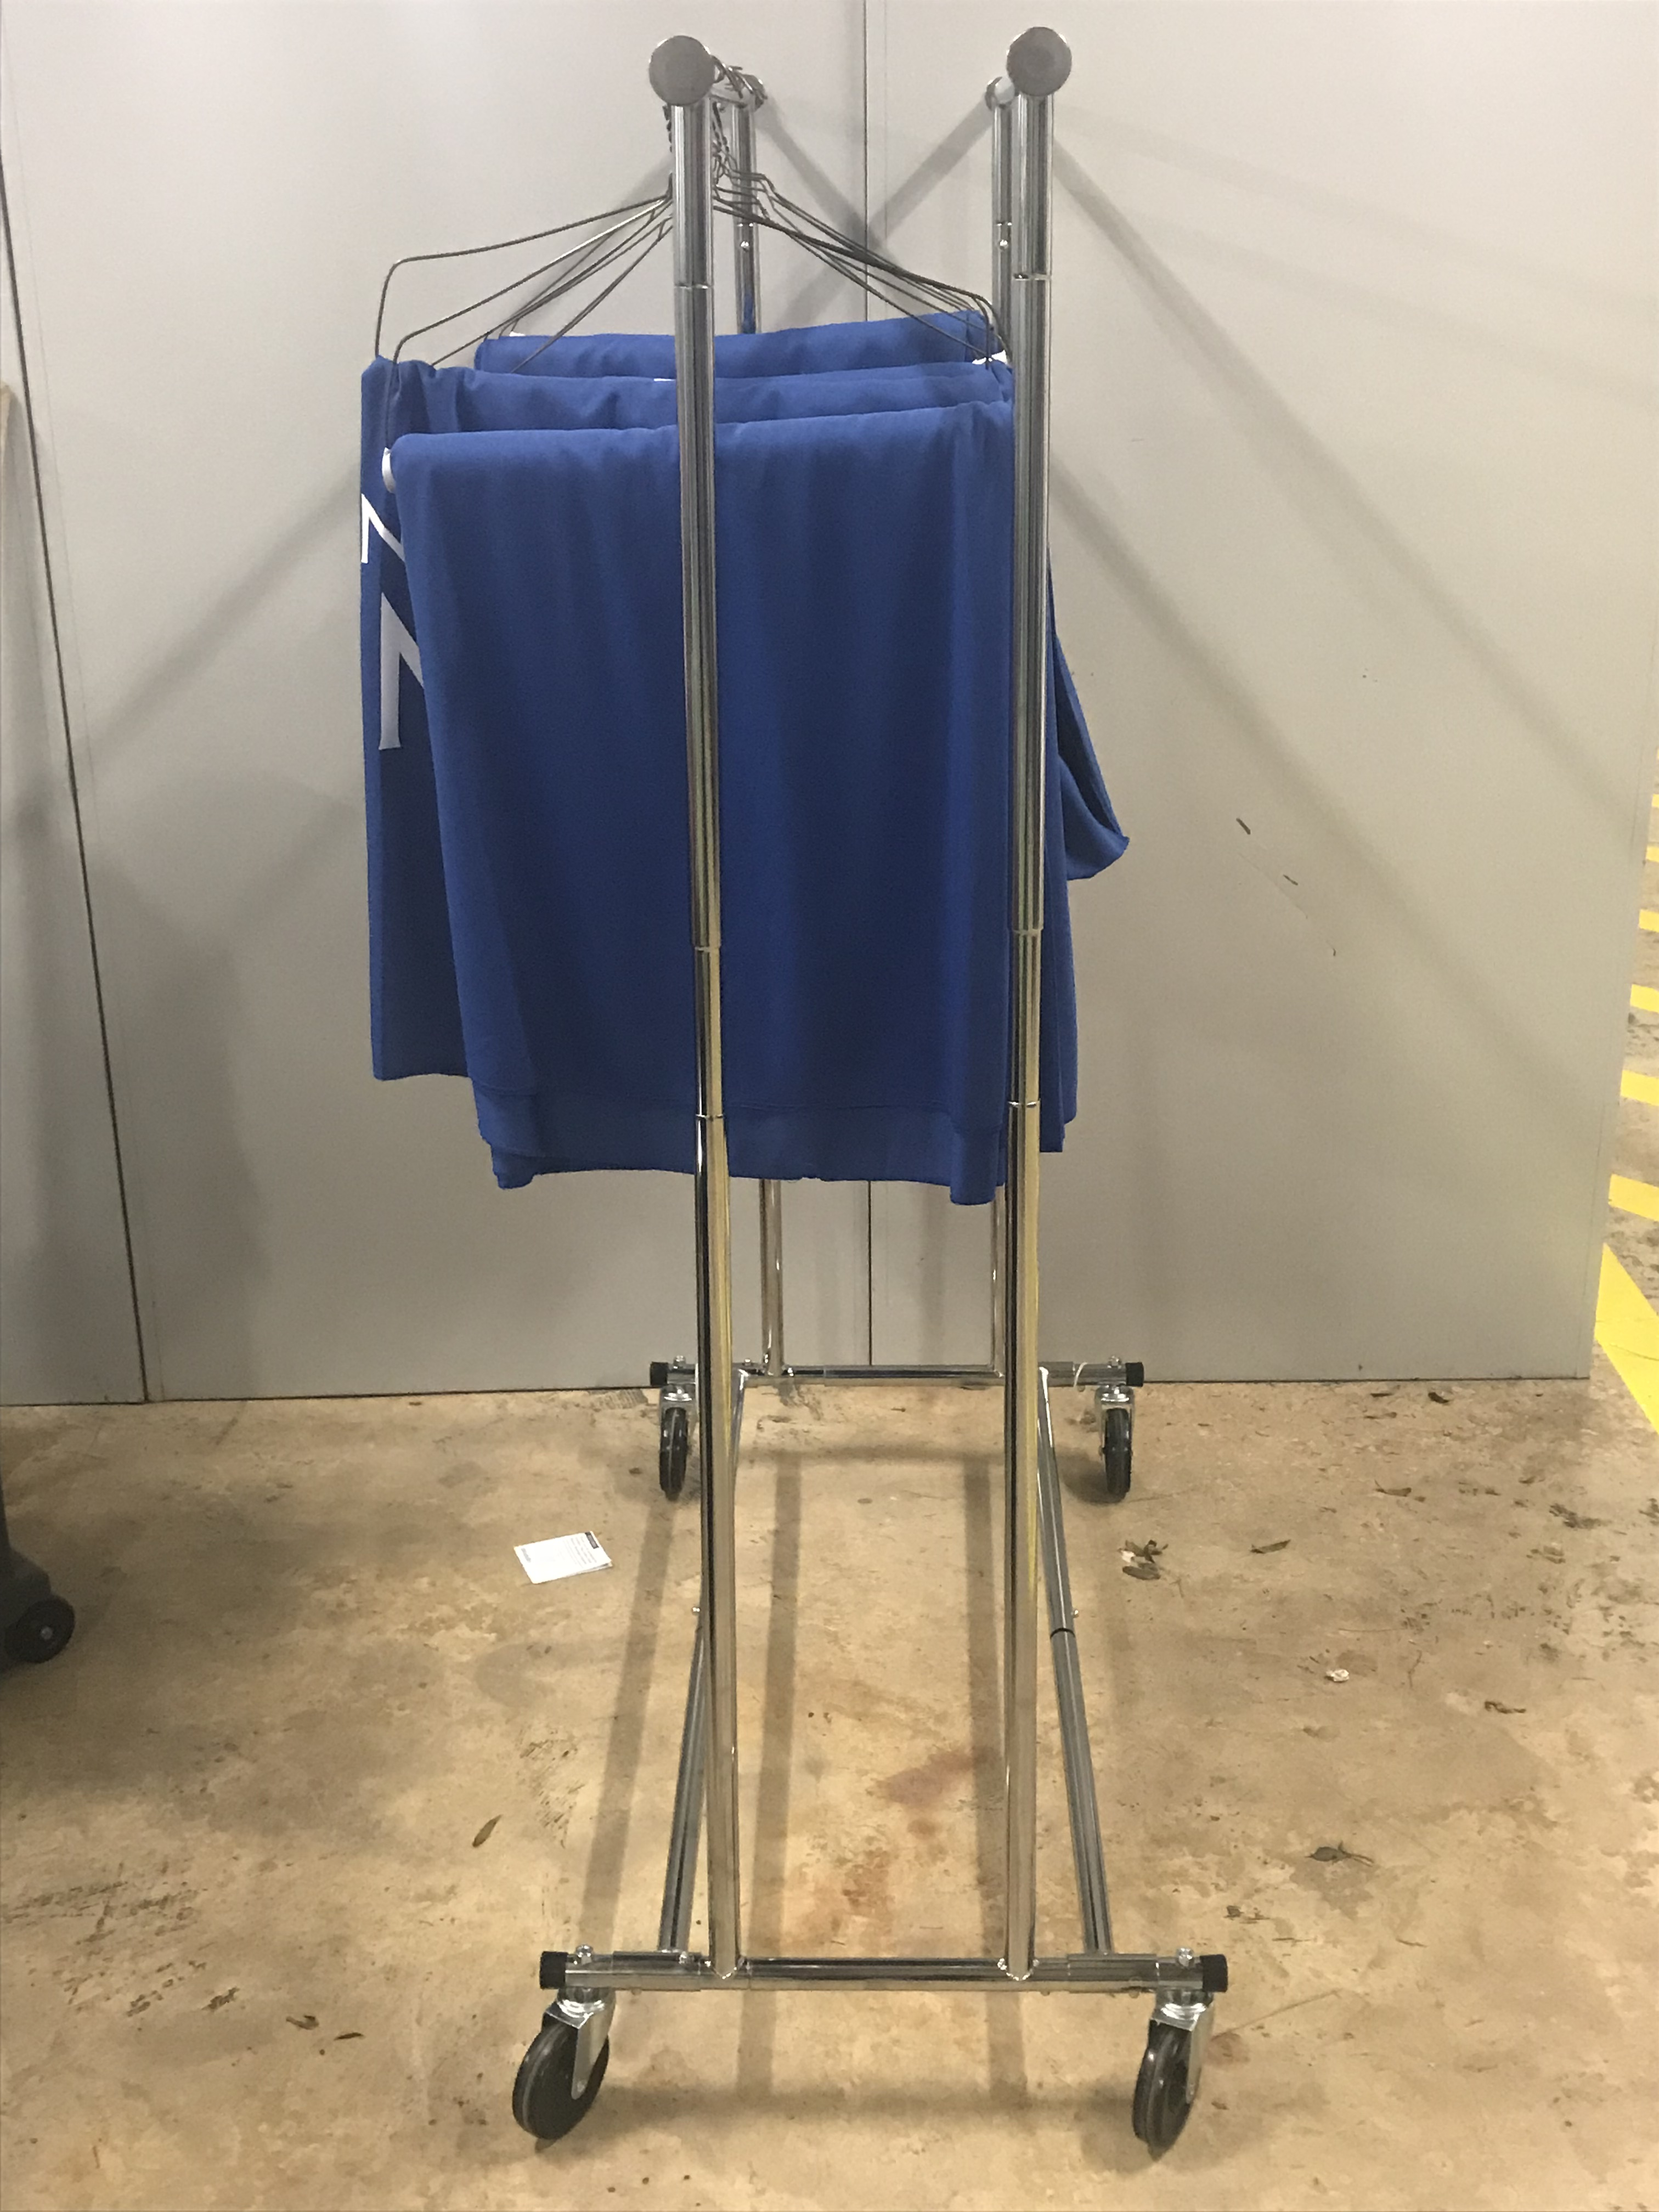
Coat Rack

Slide 12
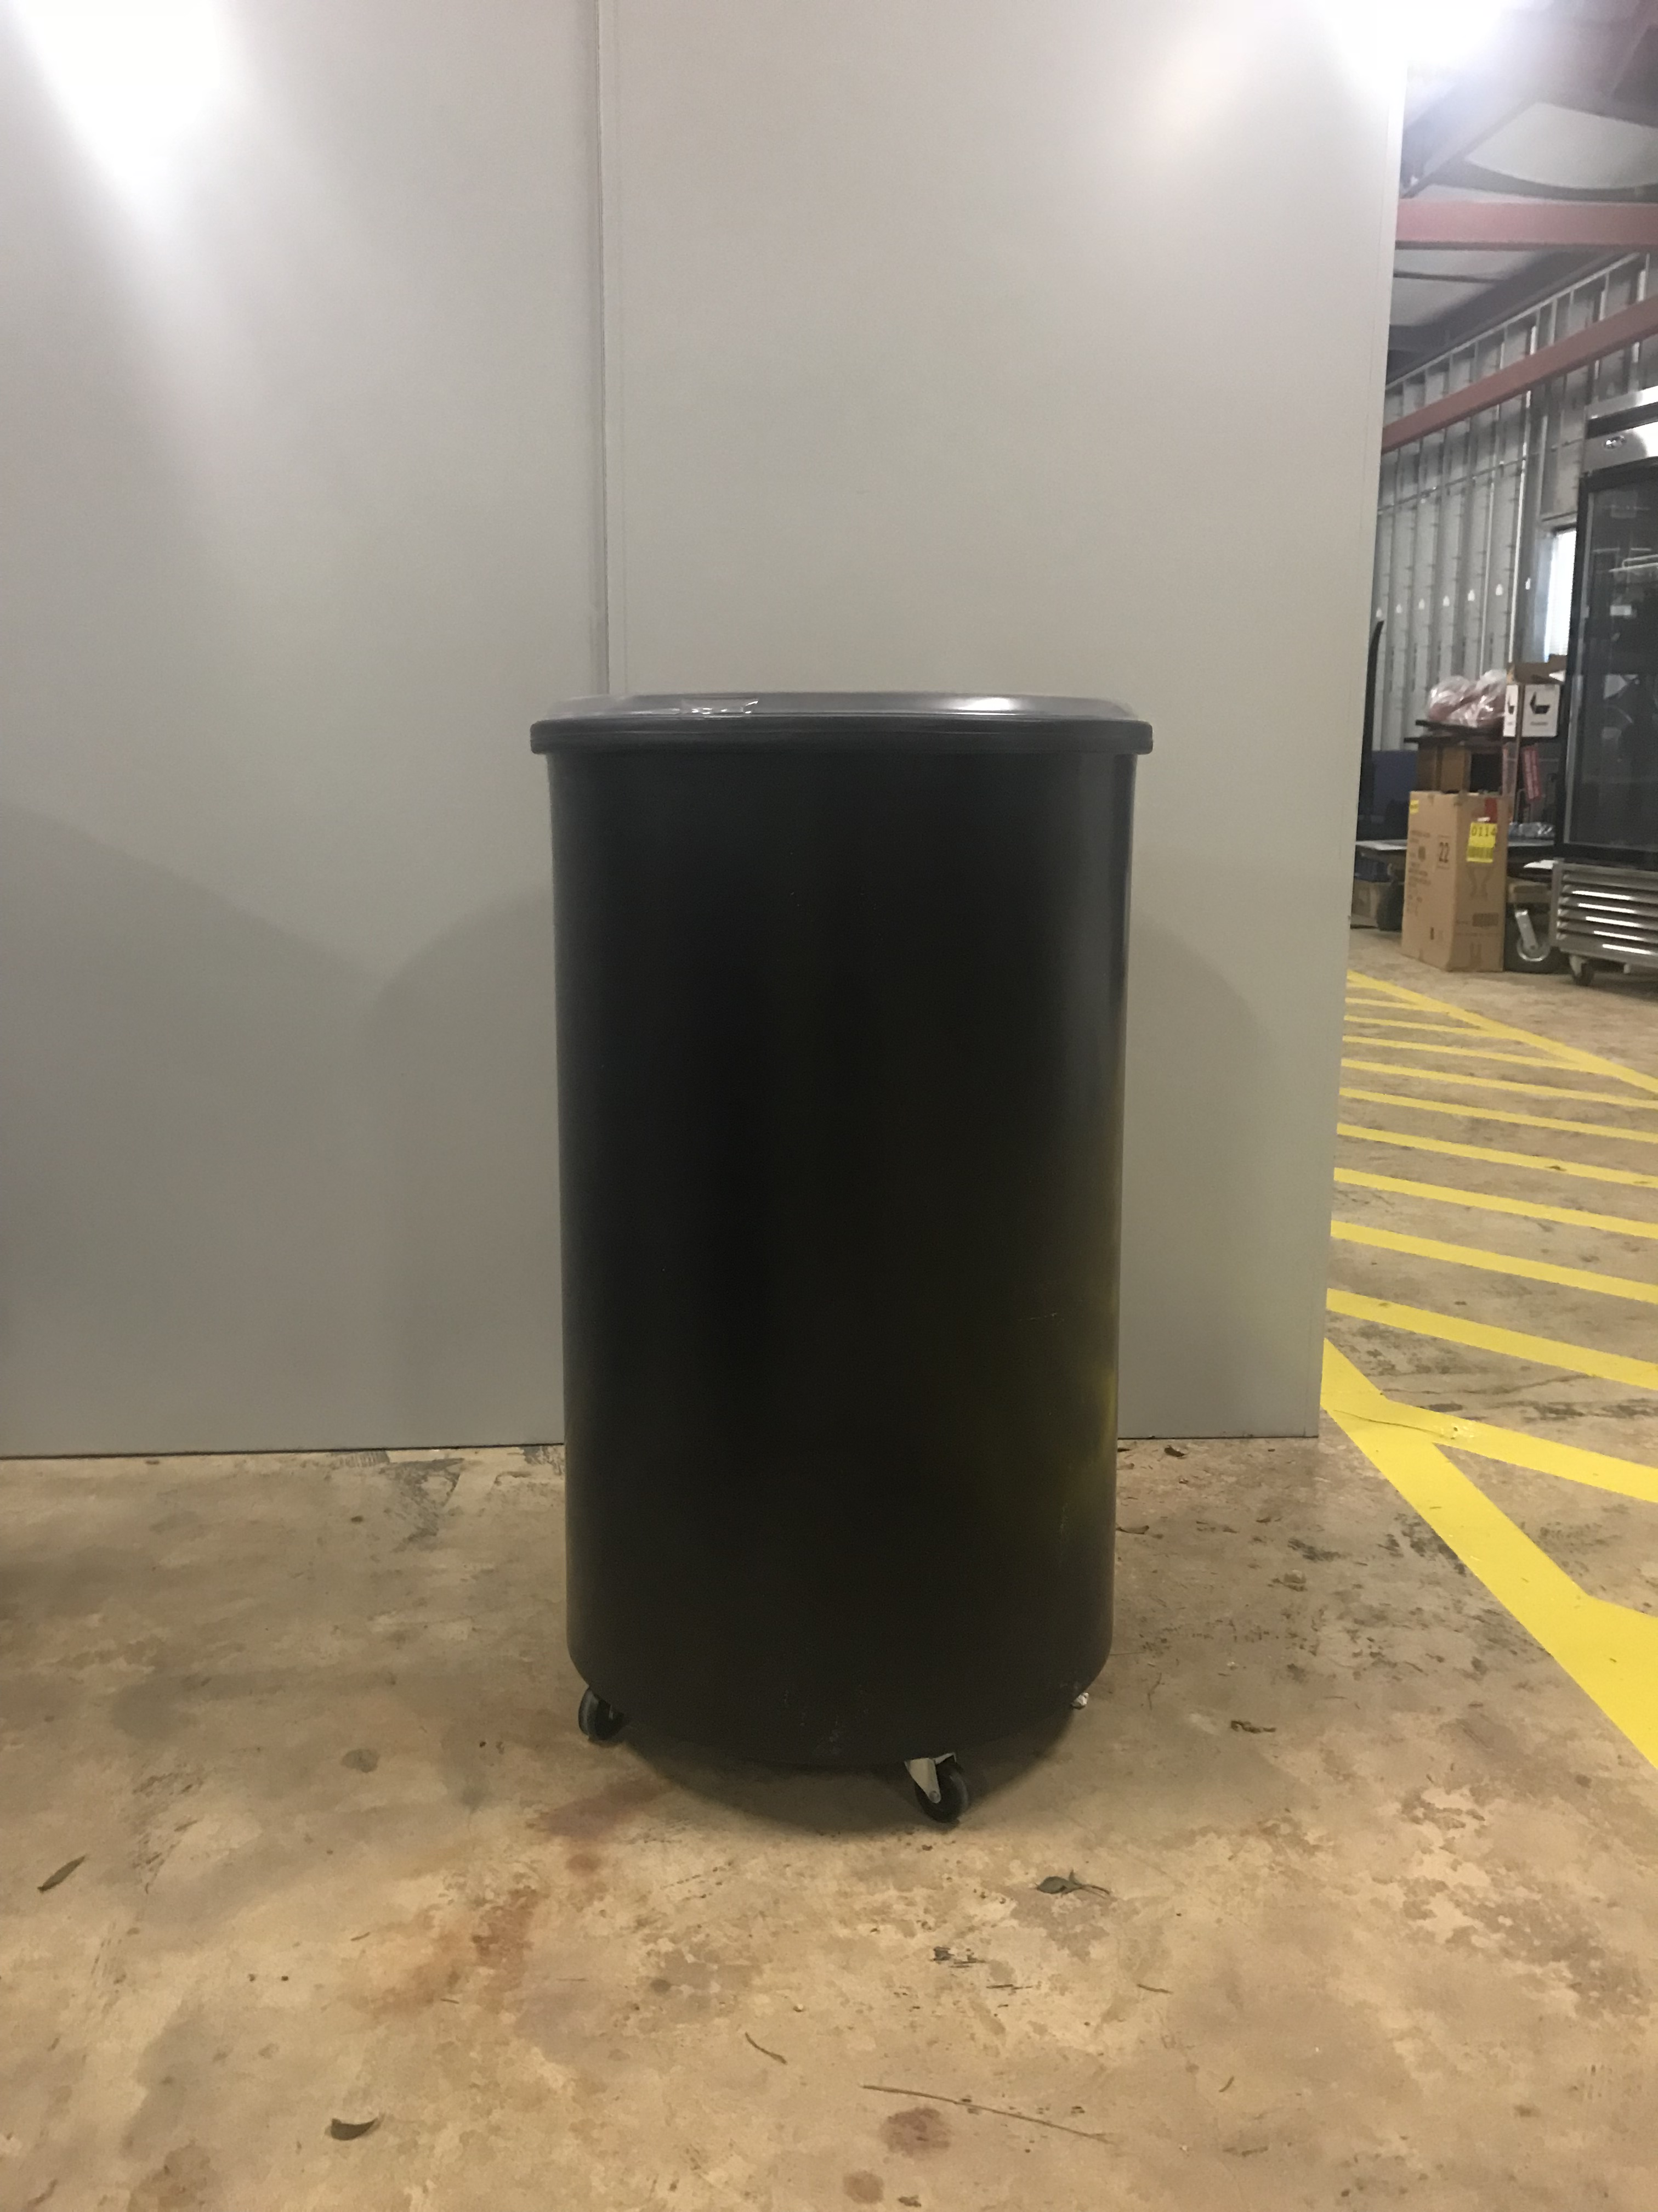
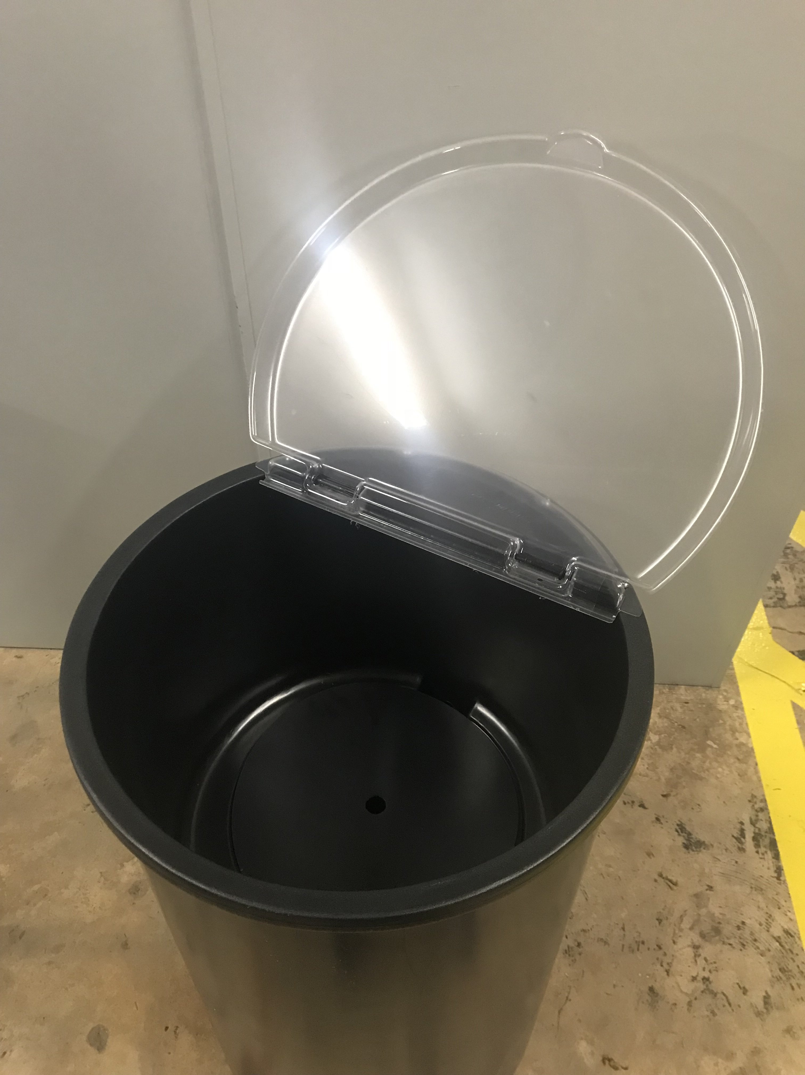
Drink Coolers

Slide 13
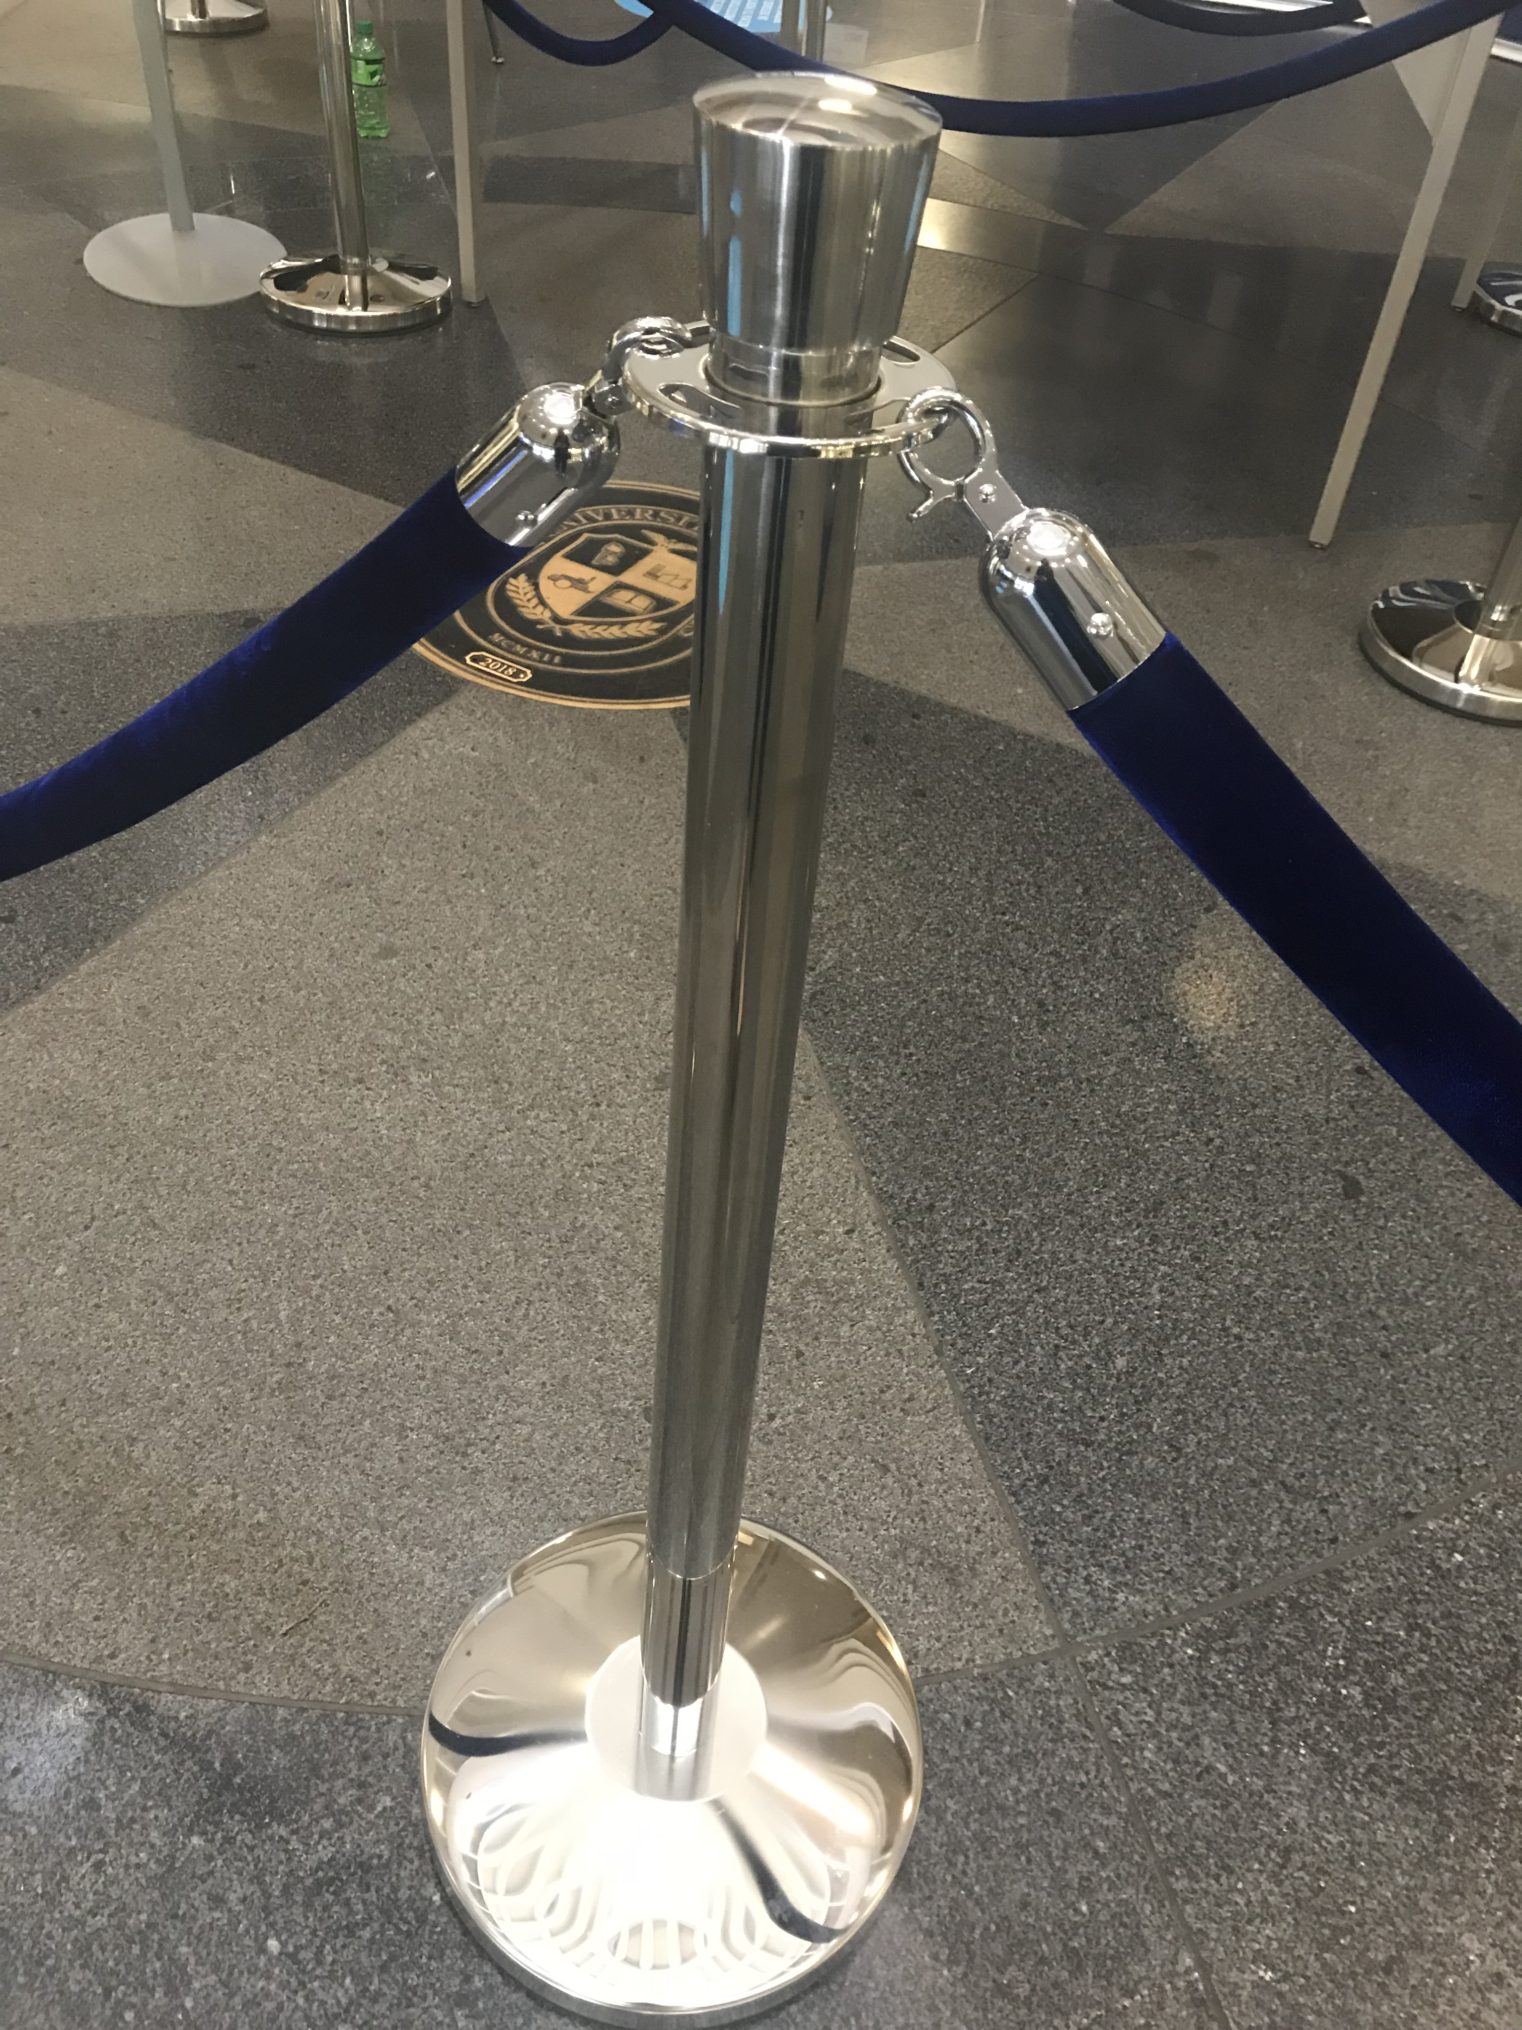
Stanchions
28 Stanchions
36 Ropes
150 Feet

Slide 14
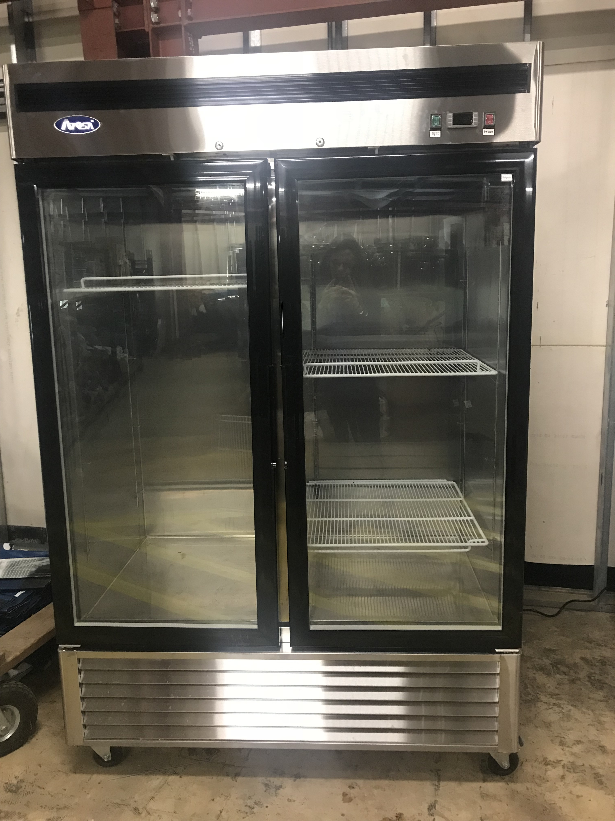
Flower Coolers

Slide 15
Join the Flower Club
Can contact Meredith at mhatsell to see if there are any flowers available in the Reserve for a University Event
You can donate flowers from your event to the Reserve to used by other departments

Slide 16
Next Meeting
Fall of 2018

