Slide 1

General Faculty Meeting
August 22, 2019

Slide 2

University Successes

Slide 3

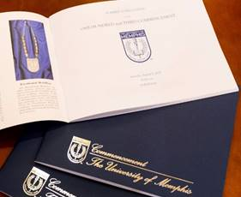
Degrees Awarded Continue at Near All-Time Highs
Near record number of degrees awarded Spring 2019
2018-2019: remained near highest number of degrees ever awarded set last year
Spring 16 | Spring 17 | Spring 18 | Spring 19
2,302 | 2,313 | 2,326 | 2,324
2014-15 | 2015-16 | 2016-17 | 2017-18 | 2018-19
4,080 | 4,267 | 4,357 | 4,391 | 4,207

Slide 4
Graduation Rates
Increases in Six Year Graduation Rates
Cohort | Graduation Rate
Fall 2013 | 53%
Fall 2012 | 48%
Fall 2011 | 44%
Fall 2010 | 43%
Fall 2009 | 45%
Fall 2008 | 43%
Increases in Four Year Graduation Rates
Cohort | Graduation Rate
Fall 2015 | 30%
Fall 2014 | 28%
Fall 2013 | 28%
Fall 2012 | 23%
Fall 2011 | 19%
Fall 2010 | 18%

Slide 5
Record Numbers: Graduation Rates
Record high 30% 4-year graduation rate projected for Fall 19
Almost doubled in less than 10 years
Record high 53% 6-year graduation rate from UM
Was 43.6% two years ago
Almost 57% when including those who completed elsewhere
Substantial increases in first generation, Pell, and African American graduation rates
Each up around 10 or more percentage points from 5 years ago

Slide 6
Freshman Class 2019
Projected to be 7% larger than last year’s class, about 175 more students
Lambuth projected to be 7% larger than last year’s class
About half of the new enrollment is from non-resident (out-of-state) students
Coming from 36 states and 18 countries
Maintaining and in some cases increasing the unique diversity of our student body
Average High School GPA of admitted and enrolled students is 3.38 (compared to 3.34 last year)

Slide 7

Helen Hardin Honors College
Fall 2019 Honors Enrollment
Admitted 633 Honors Freshmen (1 of 4 Freshmen is in the Honors College – largest entering class!)
Average ACT = 28; HS GPA = 3.96 (weighted)
Total Honors Enrollment = 2,110
Undergraduate Research
Continues to fund “Research Fellows” program for work-study undergraduates to work on faculty research projects
Published 6th volume of Quaesitum
“The Last Lecture Series”
New lecture series featuring UofM faculty this fall

Slide 8
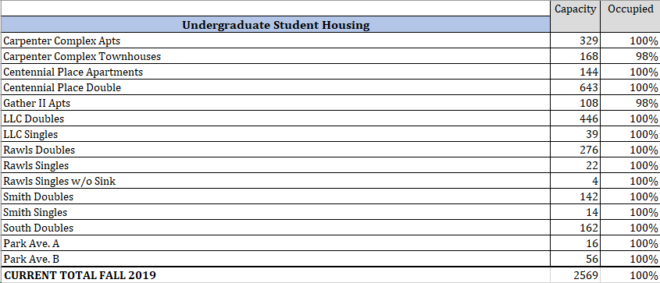
Housing Status

Slide 9
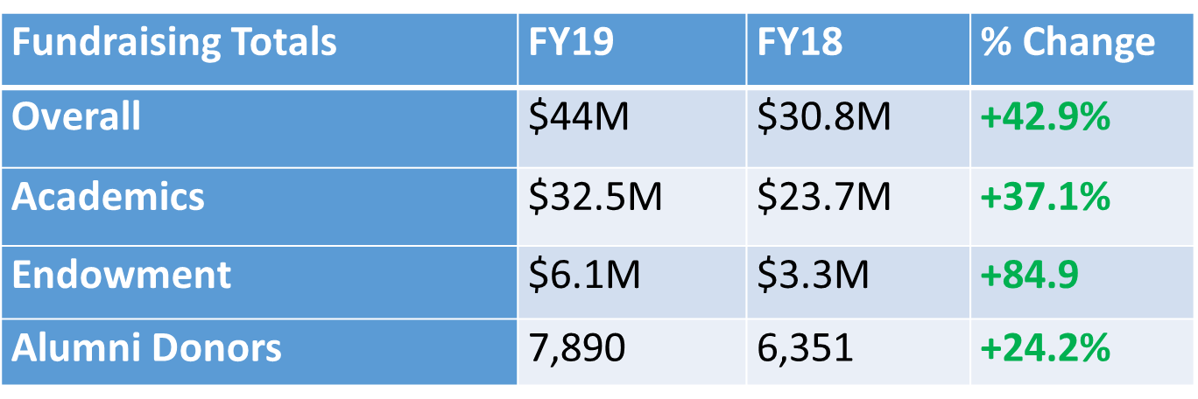
Fundraising Accomplishments
Records set in Academic fundraising two years in a row, FY18 and FY19
Overall record (including Athletics) set in FY19 with $44M secured compared to previous record of $38M in FY16
Number of alumni donors increased from 6,351 in FY18 to 7,890 in FY19

Slide 10
Addressing Access & Affordability
FY19 UofM Initiatives
4-tier tuition structure; lower out of state and international rates.
Guaranteed tuition plan for First Time, First Year undergraduate (Tn Resident, Non-Resident, International and UMGlobal)
Uniform tuition rates for traditional and on-line courses; cap credit hours for TN residents
New Student Fee Structure
Restructure drop for non-payment process – early outreach approach

Slide 11
Access Memphis:
The UofM’s Commitment to Affordability and Accessibility
0% Tuition Increases in two of the last six years

Slide 12
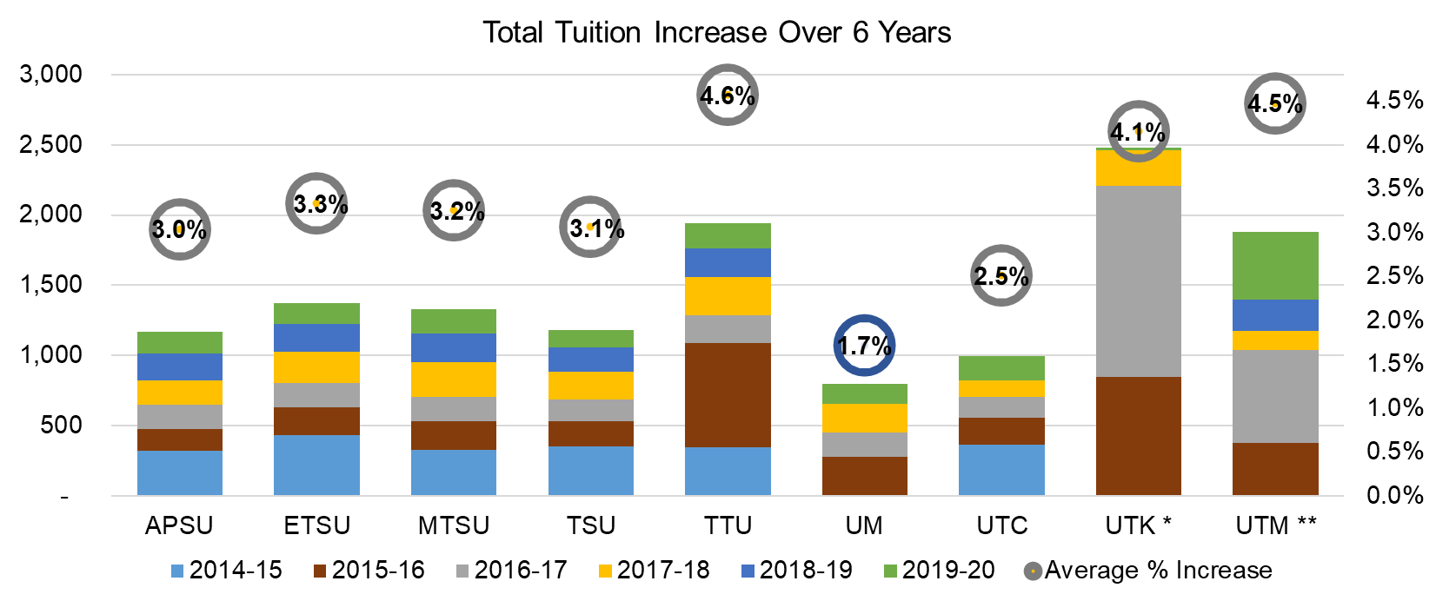
The UofM’s Commitment to Affordability and Accessibility
UofM - lowest average tuition increase 1.7% over the last 6 years

Slide 13
FY2019 – 2020 July Budget
Total Unrestricted and Restricted Revenues

Slide 14
Faculty and Staff Investments
Faculty
Across the board raises
Merit raises
Equity raises
Staff
Across the board raises
Merit raises

Slide 15
Faculty
New Faculty
75 total
31 Arts & Sciences
9 Communication & Fine Arts
4 Education
11 Business & Economics
4 Engineering
5 Nursing
1 Professional & Liberal Studies
5 Health Sciences
2 Hospitality and Resort Management
2 Public Health
1 Communication Sciences and Disorders
Current Faculty 908 full time faculty
604 tenure/tenure track
304 non-tenure track

Slide 16
Marketing
Integrated and innovative marketing strategies
Digital Marketing Campaigns
Environmental Branding
Digital Monitor Graphics
UofM Website Event Calendar
Weekly Digital Newsletters (Student eNews, This Week, MPress)
UofM Values
Accountability - Integrity, transparency, excellence and the highest standards govern everything we do.
Collaboration - We seek partnerships both within and beyond the University to enhance our actions and our outcomes.
Diversity and Inclusion - Everyone is respected, included and given the opportunity to excel.
Innovation - We consistently seek a better way, and we embrace challenges.
Service - Our purpose is to benefit our students and society through knowledge and effort.
Student Success - We provide every student with the opportunity to excel.

Slide 17
Tiger Athletics –We’ve Got Momentum!
Sports
Football: 5 consecutive bowl games in program history; back to back West Division champs in the American Athletic Conference
Basketball: Had the nation’s largest average attendance increase last season; signed the No. 1 recruiting class in the country for this season
Women’s basketball: highest ranked recruiting class in program history
Academic excellence in athletics
All time high GPA’s in 2018-19 in women’s and men’s basketball, softball, rifle, baseball, football, and women’s cross country
Highest Graduation Success Rate - 100% in women’s and men’s golf, women’s tennis, men’s tennis, rifle
202 Student Athletes received All-Academic Team Honors (3rd season that Memphis Athletics has had over 200 student-athletes receive this recognition)
Hired new Director of Athletics – Laird Veatch

Slide 18


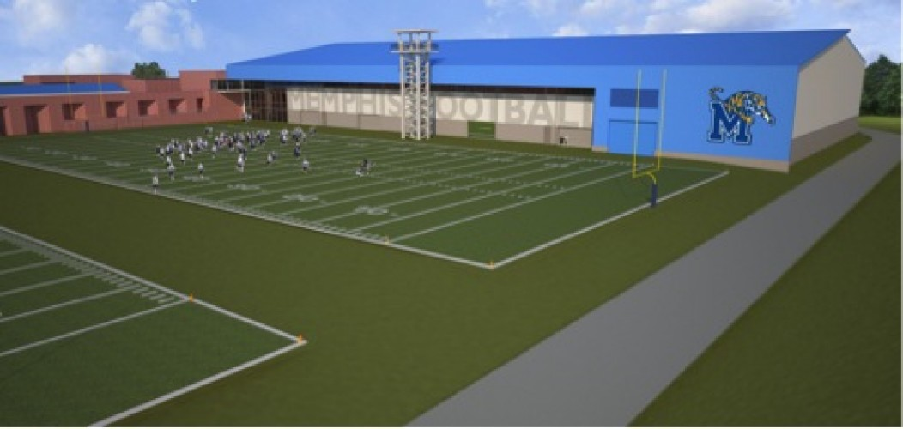
Campus Enhancements
Hunter Harrison Memorial Bridge, Alumni Mall Amphitheatre and Parking Garage
Mike Rose Natatorium
Student Wellness and Fitness Center
Athletics: Football Training Center

Slide 19
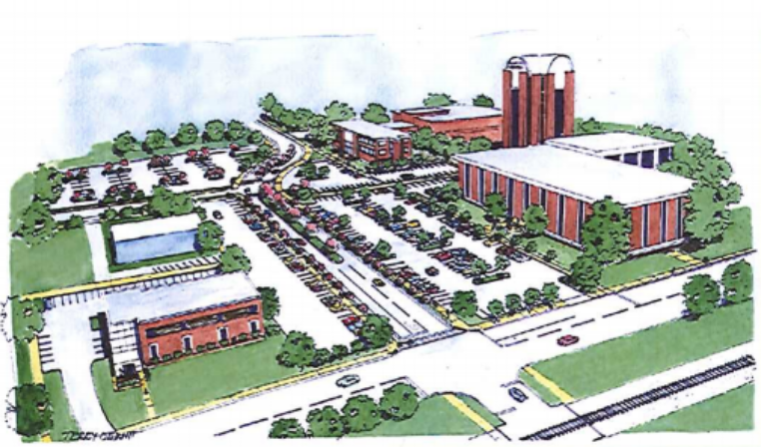
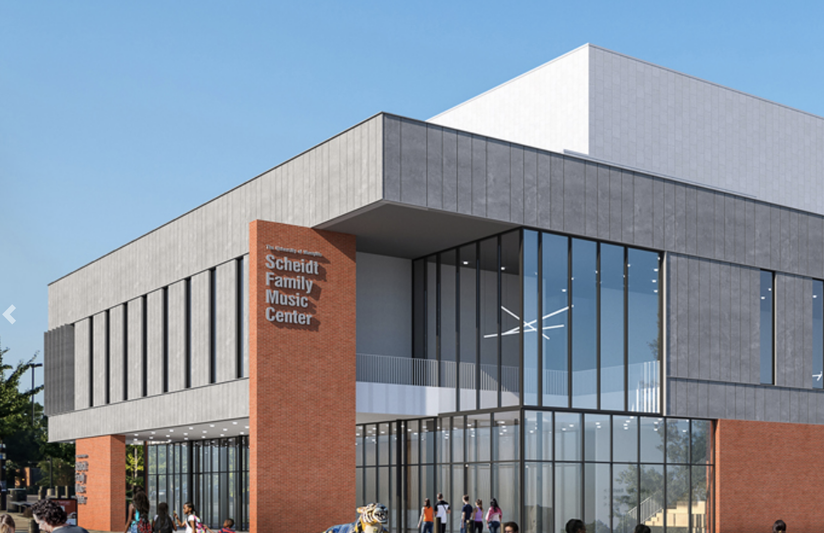
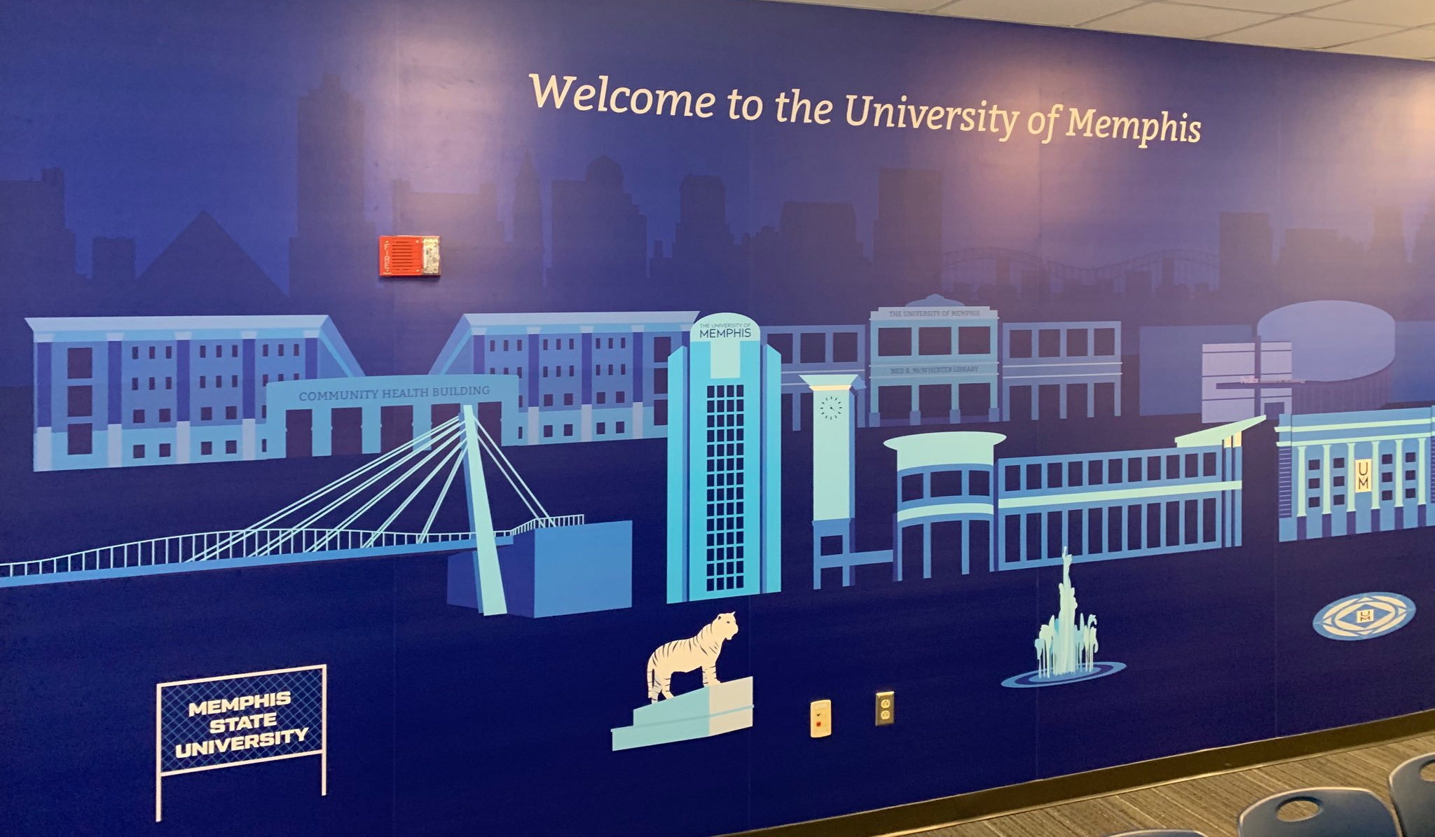
Campus Enhancements
Patterson Avenue Realignment
Partnership to renovate Leftwich Tennis Center
Scheidt Family Music Center
Lambuth: Wilder Student Union, Sprague Hall
Wilder Tower: 12th Floor Student Recruitment Center

Slide 20
Consolidation of Academic Affairs and Student Affairs
Consolidation of senior administrative divisions
Reduction of vice president positions by two through reassignment of duties to existing positions
Research and Innovation - consolidation of Sponsored Programs and Research
Student Affairs now integrated under Provost and Academic Affairs

Slide 21

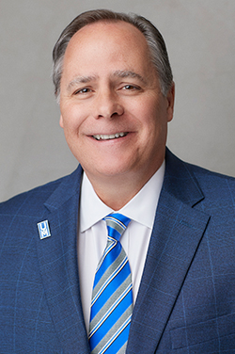
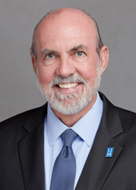
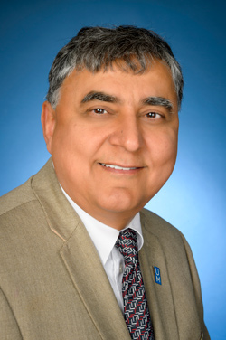
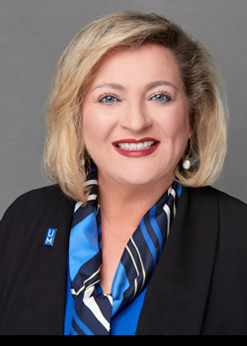
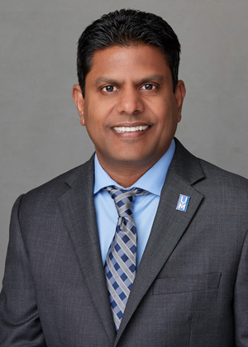
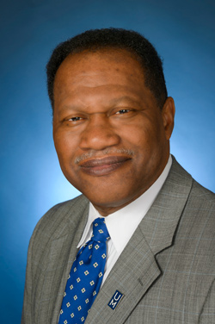
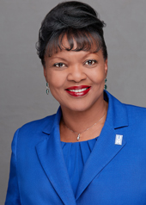
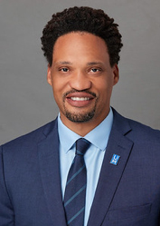
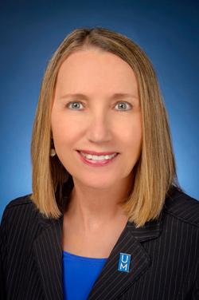
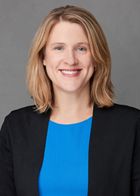
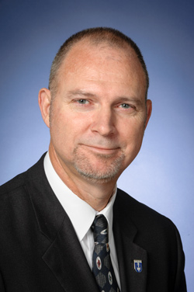
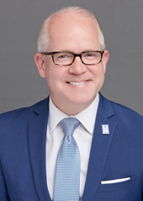
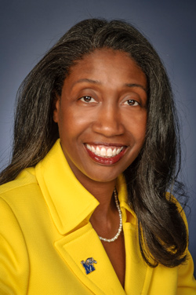
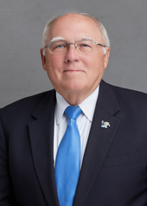
President’s Council
Anita Boykins
Loewenberg College of Nursing
Dr. M. David Rudd President
Dr. Tom Nenon Executive Vice President for Academic Affairs and Provost
Dr. Jasbir Dhaliwal Executive Vice President for Research and Innovation
Tammy Hedges Executive Vice President for University Relations
Raaj Kurapati Executive Vice President and Chief Financial Officer
Ron Brooks Vice President for Physical Plant
Dr. Karen Weddle-West Vice President for Student Academic Success
Kenneth Anderson Chief Compliance Officer, Director of Office for Institutional Equity and Title IX Coordinator
Stephanie Beasley Chief of Staff
Joanna Curtis Chief Advancement Officer
Robert Jackson Chief Information Officer
Ted Townsend Chief Economic Development and Government Relations Officer
Melanie Murry University Counsel
Allie Prescott Interim Athletic Director

Slide 22
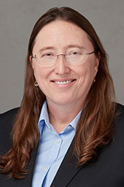
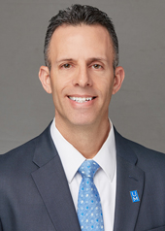
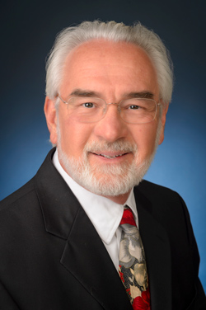
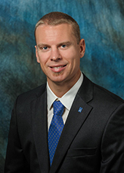
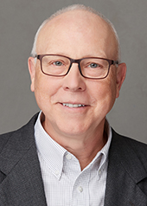
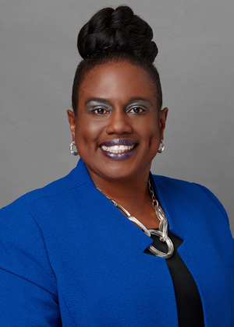

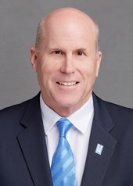
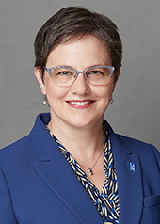
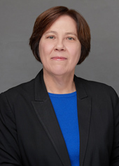
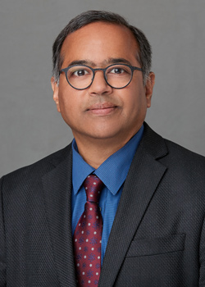
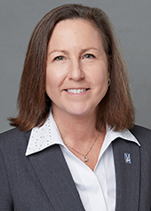
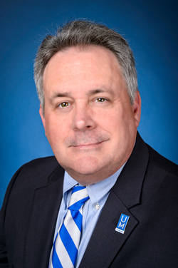
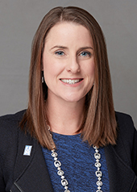
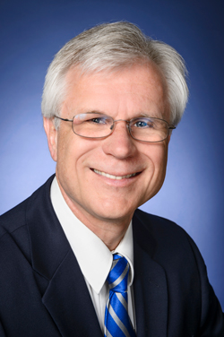
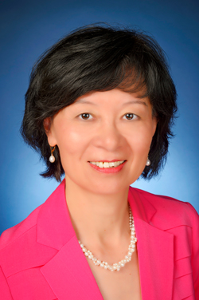
Academic Deans
Anita Boykins
Loewenberg College of Nursing
Dr. Abby Parrill-Baker Dean of the College of Arts & Sciences
Dr. Richard Bloomer Dean of the School of Health Sciences
Dr. John E. Evans Executive Director & Associate Dean of Libraries
Dr. Damon Fleming Dean of the Fogelman College of Business and Economics
James Gurney Dean of the School of Public Health
Dr. Kandi Hill-Clarke Dean of the College of Education
Dr. Anne Hogan Dean of the College of Communication and Fine Arts
Dr. Richard Irwin Executive Dean, UofM Global & Academic Innovation
Dr. Linda Jarmulowicz Dean of the School of Communication Sciences and Disorders
Dr. Melinda Jones Director of the Helen Hardin Honors College
Dr. Radesh Palakurthi Dean of the Kemmons Wilson School of Hospitality and Resort Management
Dr. Robin Poston Dean of the Graduate School
Dr. Niles Reddick Dean, UofM Lambuth; Chief Operating Officer, Lambuth and Millington Campuses
Katharine Traylor Schaffzin, Esq. Dean of the Cecil C. Humphreys School of Law
Dr. Richard Sweigard Dean of the Herff College of Engineering
Dr. Lin Zhan Dean of the Loewenberg College of Nursing

Slide 23
Faculty Tenure
&
Promotions

Slide 24

Faculty Promoted to Full Professor

Slide 25
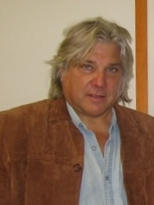
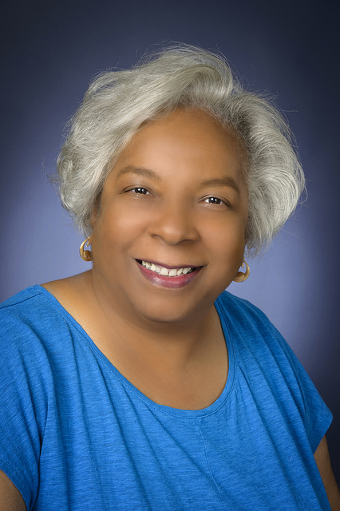
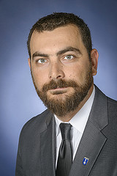
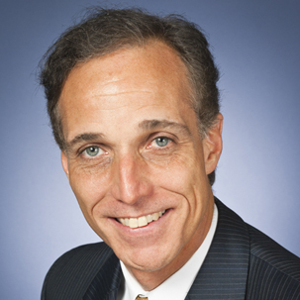
Faculty Promoted to Full Professor
Lee Allen
Instruction Curriculum Leadership
Beverly Bond
History
Jack Cooper
Music
Michail Gkolias
Civil Engineering

Slide 26
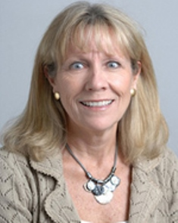
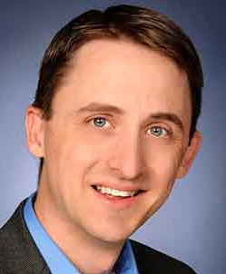
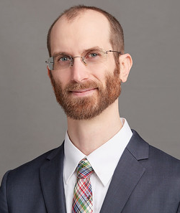
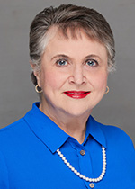
Faculty Promoted to Full Professor
Carol Irwin
School of Health Studies
Duane McKenna
Biology
Andrew Olney
Psychology
Mary Ransdell
Instruction and Curriculum Leadership

Slide 27
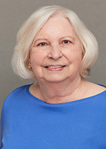
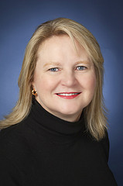
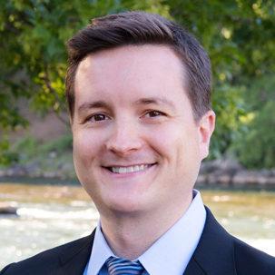
Faculty Promoted to Full Professor
Kay Reeves
Instruction and Curriculum Leadership
Leslie Robinson
Psychology
Kevin Sanders
Music

Slide 28
Faculty Promoted to Associate Professor and Granted Tenure

Slide 29
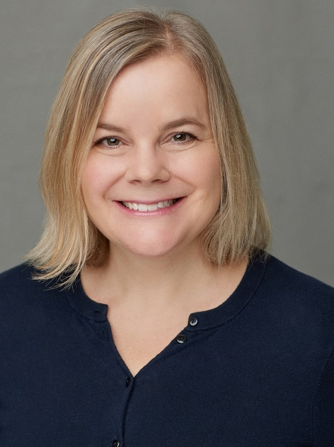

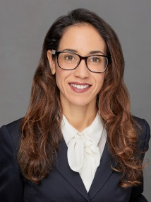

Faculty Promoted to Associate Professor and Granted Tenure
Rebecca Adams
English
William Alexander
Chemistry
Carmen Astorne-Figari
Economics
Madhu Balasubramanian
Electrical/Computer Engineering

Slide 30




Faculty Promoted to Associate Professor and Granted Tenure
Kevin Berisso
Engineering Technology
Elise Blatchford
Music
Jason Braasch
Psychology
Bert Burraston
Criminal Justice

Slide 31




Faculty Promoted to Associate Professor and Granted Tenure
Su Chen
Mathematics
Melanie Conroy
World Languages and Literatures
William Duffy
English
Susan Elswick
Social Work

Slide 32




Faculty Promoted to Associate Professor and Granted Tenure
Kyle Ferrill
Music
Demetria Frank
Law
Donal Harris
English
Katherine Fredlund
English

Slide 33




Faculty Promoted to Associate Professor and Granted Tenure
Matthew Haught
Journalism and Strategic Media
Amanda Johnson
Criminal Justice
Andre Johnson
Communication and Film
Jong Lee
Business Information and Technology

Slide 34




Faculty Promoted to Associate Professor and Granted Tenure
Jennifer Mandel
Biology
James McCutcheon
Criminal Justice
Susan Nordstrom
Counseling, Educational Psychology & Research
DeAnna Owens
Instruction and Curriculum Leadership

Slide 35




Faculty Promoted to Associate Professor and Granted Tenure
Anthony Pellecchia
Theatre/Dance
Ryan Parish
Earth Sciences
Paige Powell
School of Public Health
Joshua Roberson
Art

Slide 36




Faculty Promoted to Associate Professor and Granted Tenure
Jennifer Thompson
Architecture
Micah Trapp
Anthropology
Marie van der Merwe
School of Health Studies
Marcus Wicker
English

Slide 37
Faculty Promoted to Associate Professor and Granted Tenure
Brian Wright
Instruction and Curriculum Leadership

Slide 38
Faculty Promoted to Clinical Associate Professor

Slide 39




Faculty Promoted to Clinical Associate Professor
Renee Morris
Loewenberg College of Nursing
Rebecca Adkins
Loewenberg College of Nursing
Shkendie Papraniku
Loewenberg College of Nursing
Mary Catherine Schallert
School of Health Studies

Slide 40
Faculty Promoted to Clinical Professor

Slide 41


Faculty Promoted to Clinical Professor
Christie Manasco
Loewenberg College of Nursing
Rosemary McLaughlin
Loewenberg College of Nursing

Slide 42
Faculty Promoted to Research Associate Professor and Granted Tenure

Slide 43

Faculty Promoted to Research Associate Professor and Granted Tenure
Carolyn Kaldon
Center for Research in Educational Policy

Slide 44
Faculty Promoted to Associate Professor

Slide 45

Faculty Promoted to Associate Professor
Rhema Fuller
Kemmons Wilson School of Hospitality & Resort Management

Slide 46
Faculty Granted Tenure

Slide 47


Faculty Granted Tenure
Anita Boykins
Loewenberg College of Nursing
Gerald Chaudron
University Libraries

Slide 48
Please join me in congratulating these professors for promotion and tenure!

Slide 49
Carnegie Classification Goal: R1/Research University/ Very High Activity

Slide 50
U.S. News & World Report Rankings
-Online Online Bachelor's (58 2018: 125) Online Nursing Program - Graduate (17 2018: 15) Online Criminal Justice - Graduate (43 2018: 51-67) Online MBA (70 2018: 89) Online Education - Graduate (139 2018: 150) -Undergraduate (On-Campus) Business (147 2018: 128) Engineering (162 2018: 139) -Graduate (On-Campus) Audiology-Graduate (17) Speech-Language Pathology-Graduate (24) Rehabilitation Counseling-Graduate (21 2018: 20) Legal Writing (Law) - Graduate (29) Health Care Management—Graduate (33 2018: 47) Healthcare Law (Law) - Graduate (64) Clinical Training (Law) - Graduate (80) Social Work-Graduate (96 2018: 123)
Biomedical Engineering - Graduate (101 2018: not ranked) Clinical Psychology-Graduate (102) Part-Time MBA (109 2018: 182) Earth Sciences-Graduate (111 2018: 106) Public Affairs-Graduate (123 2018: 115) Math-Graduate (127 2018: 126) Intellectual Property (Law) -Graduate (131) English - Graduate (133) History - Graduate (134) Nursing-Graduate (135 2018: 209) Law-Graduate (138 2018: 140) Trial Advocacy (Law) - Graduate (144) Fine Arts-Graduate (147) Psychology-Graduate (148) Education-Graduate (157 2018: 180) International Law (Law) - Graduate (167) Biological Sciences - Graduate (190 2018: 209)

Slide 51
Top 25 Programs (Ranked by Online Sites)
Accounting (online)
1 – BestChoiceSchools.com
2 – AffordableColleges.com
2 – Online-Accounting-Degrees.net
18 – Master-of-Finance.org
24 – TopAccountingDegree.org
25 – BestColleges.com
Business Administration (online)
14 – AffordableColleges.com
22 – SuccessfulStudent.org
Business Administration - Graduate (Online)
25 - Princeton Review
1,15,21 – OnlineMBAToday.com
Communications (online)
1,3 – AffordableColleges.com
5 – BestColleges.com
9 – TheBestSchools.org
10 – BestCommunicationDegrees.com
12 – BestDegreePrograms.org
22 – GuideToOnlineSchools.com
Computer Science
2 – ComputerTrainingSchools.com
5 – GradSchoolHub.com
Criminal Justice
1 – SuccessfulStudent.org
17 – Best College Reviews
Criminal Justice (online)
10 – GuideToOnlineSchools.com
11 – AffordableColleges.com
16 – GreatValueColleges.net
19 – Top-Criminal-Justice-Schools.net
Criminal Justice – Graduate (online)
21 - GoGrad.org
Education
2 – ToBecomeATeacher.org
Education- Graduate
3 – ToBecomeATeacher.org
4 – TopEducationDegrees.org
Education - Graduate (online)
24 – AffordableCollegesOnline.org

Slide 52
Top 25 Programs (Ranked by Online Sites)
Educational Leadership – Graduate (online)
17 – CollegeValuesOnline.com
Educational Psychology – Graduate (online)
4 – CollegeChoice.net
5 – Online-Psychology-Degrees.org
5 – TopEducationDegrees.org
8 – CollegeChoice.net
9 – BestColleges.com
9 – BestMastersDegrees.com
9 – OnlineMasters.com
10 – BestCollegesOnline.org
10 – BestCollegeReviews.org
11 – TopCounselingSchools.org
14 – BestValueSchools.com
14 – BestMastersinPsychology.com
English (online)
2 – TheBestSchools.org
6 – AffordableColleges.com
8 – OnlineColleges.com
10 – AffordableCollegesOnline.org
10 – CollegeChoice.net
11 – BestColleges.com
11 – GuideToOnlineSchools.com
15 – BestValueSchools.com
24 – OnlineU.org
English – Graduate (online)
6 – TopEducationDegrees.org
15 – OnlineCourseReport.com
19 – BestMastersDegrees.com
20 – AffordableCollegesOnline.org
Environmental Nutrition – Graduate (online)
2 – GoGrad.org
11 – GuideToOnineSchools.com
18 – OnlineU.org

Slide 53
Top 25 Programs (Ranked by Online Sites)
Finance (online)
12 – BestDegreePrograms.org
12 – GreatValueColleges.net
12 – CollegeChoice.net
17 – GuideToOnlineSchools.com
18 – OnlineSchoolsReport.com
Graphic Design
1 0 AnimationCareerReview.com
Healthcare Administration – Graduate
12 – TopMastersInHealthcare.com
Healthcare Administration – Graduate (online)
2 – TheBestSchools.org
9 – BestMastersDegrees.com
Health Education – Graduate (online)
5 – GuideToOnlineSchools.com
5 – OnlineU.org
8 – OnlineMasters.com
History (online)
6 – TheBestSchools.org
9 – AffordableCollegesOnline.org
12 – BestValueSchools.com
16 – GuideToOnlineSchools.com
22 – BestColleges.com
History – Graduate (online)
3 – TheBestSchools.org
5 – GuideToOnlineSchools.com
7 – CollegeValuesOnline.com
10 – GoGrad.org
11 – AffordableCollegesOnline.org
14 – AffordableColleges.com
16 – BestColleges.com
16 – OnlineU.org
17 – OnlineMasters.com

Slide 54
Top 25 Programs (Ranked by Online Sites)
Instruction & Curriculum Leadership – Graduate (Online)
1, 12 – AffordableSchools.net
5, 16 – GuideToOnlineSchools.com
8 – TopEducationDegrees.org
12 – BestValueSchools.com
12 – TheBestSchools.org
22 – CollegeValuesOnline.com
23 – OnlineMasters.com
Journalism (online)
6– GuideToOnlineSchools.com
9 – OnlineU.org
11 – GreatValueColleges.net
12 – CollegeChoice.net
Journalism – Graduate (online)
4 – BestColleges.com
4 – TheBestSchools.org
5 – GradSchoolHub.com
6 – OnlineMasters.com
9 – BestValueSchools.com
17 – GraphicDesignDegreeHub.com
Liberal Studies – Graduate (online)
11 – OnlineMasters.com
12 – BestMastersDegrees.com
15 – MastersProgramGuide.com
Management (online)
16 – CollegeChoice.net
Marketing (online)
4 – AffordableColleges.com
10 – CollegeChoice.net
20 – GuideToOnlineSchools.com
Nonprofit Administration (online)
10 – OnlineColleges.com
Nursing (BSN/RN-to-BSN online)
9 – TheBestSchools.org
13 – BestValueSchools.com
15 – Best College Reviews
18 – AffordableCollegesOnline.org
23 – AffordableColleges.com
25 – BestCollegesOnline.org

Slide 55
Top 25 Programs (Ranked by Online Sites)
Philosophy (online)
5 – BestColleges.com
10 – OnlineU.org
Political Science (Online)
15 – BestColleges.com
22 – TheBestSchools.org
Professional Studies - Various (online)
2 – OnlineMasters.com
5, 11, 14 – BestColleges.com
12 – CollegeChoice.net
20 – ValueColleges.com
Psychology (online)
9 – AffordableSchools.net
17 – BestValueSchools.com
18 – GreatValueColleges.net
19 – SuccessfulStudent.org
Psychology – Graduate (online)
15 – GoGrad.org
16 – TopCounselingSchools.org
24 – AffordableColleges.com
Public Health – Graduate (online)
1, 3 – MastersPublicHealth.net
6 – GreatValueColleges.net
9 – BestValueSchools.com
9 – TopMastersInPublicHealth.com
12 – CollegeChoice.net
15 – MastersProgramGuide.com
23 – AffordableColleges.net
23 – AffordableCollegesOnline.org
23 – TopMastersInHealthcare.com
25 – Best College Reviews
Real Estate (online)
1, 6 – CollegeChoice.net
2 – BestValueSchools.com
3 – BestColleges.com
10 – OnlineColleges.com
Sociology (online)
11 – GreatValueColleges.net
13 – TheBestSchools.org
20 – AffordableColleges.com
20 – BestColleges.com
Sport Management – Graduate (onine)
12 – Best College Reviews
15 – TheBestSchools.org
16 – Top-Business-Degrees.net

Slide 56
Ranked For Quality and Affordability
View Full List Onine at Memphis.edu/academics/rankings.php

Slide 57
Colleges, Schools, and Support Units in Academic Affairs

Slide 58
College of Arts and Sciences
Student success: F13 cohort graduation is up at least 4% to 57.6%
Academic excellence/Brand enhancement: 11 nationally-ranked graduate programs
Research: Externally-sponsored research expenditures up 17% from $24.4M to $28.6M
Diversity: 41% of tenure-track hires improve faculty diversity
Community partnerships: 377 partnerships involving 648 students and 40 SUAPP faculty in research (20 projects), teaching (23 courses), and internships (225)
Sustainability: Donor commitments = $5.1M (target was $1M)

Slide 59
Fogelman College of Business and Economics
Two (2) new Chair of Excellence faculty (1-Accounting, 1-Business Information Technology) to lead research and PhD programs
Six (6) new Assistant Professors (1-Business Information Technology, 1-Economics, 4-Management)
Department of Finance received research grants from the US Federal Reserve, US Securities and Exchange Commission, and US Treasury
Marketing & Supply Chain Management hosted approximately 90 faculty and doctoral students from nine peer universities at the 3-day Southeastern Marketing Symposium (SMS)

Slide 60
College of Education
One-year enrollment growth of 7.6% from F17 to F18
Doctoral degree growth of 45% since 2014-15
Rehabilitation Counseling Graduate program is ranked #20 by US News & World Report
Increased donor base of 58% in F17 to F18
Over $4.5 million raised for the River City Partnership Teacher Scholars program
CEPR department approved for CACREP accreditation
Peer Power Institute housed in Ball Hall
Co-hosted the National Association for Multicultural Education conference with over 600 attendees

Slide 61
Herff College of Engineering
Achieved 50% increase in annual BS degree production since 2013
Sponsored research expenditures up 19.8% since last year
Opened Metal Additive Manufacturing Lab with two 3D metal printers and supporting equipment
Preliminary approval by THEC for online MS in Engineering Management
Reached private funding goal for fall 2019 launch of Construction Management concentration
Revitalized Herff College Strategic Plan

Slide 62
College of Communication and Fine Arts
CCFA Events and Performances attracted over 628,000 Attendees
Economic Impact ≈ $1,020,000 In-kind Contributions to the Community (Media and Public Relations Campaigns, Professional Consultation, Education Outreach, etc.)
Central Avenue Arts Corridor:
Scheidt Family Music Center secures final approval to begin construction
Upcoming launch of the ‘Central to the Arts Hub’
Expanded Network of Arts and Culture Partnerships
Established the university wide ‘Arts and Health Research Initiative’
4.9% Overall Increase in UG enrollment Fall 2015-2018:
UG Art 27.31%⬆; JRSM 18.39%⬆; Music Industry 16.51%⬆; Theatre 11.57%⬆

Slide 63
Loewenberg College of Nursing
Dr. Anita Boykins received $2.7MM HRSA grant (4 years) to prepare family nurse practitioners (FNP) to meet the primary care needs of rural underserved populations in 8 West TN Counties;
Dr. Genae Strong received $422.6K funding (3 years) from TN Department of Health to Implement a Lactation Support Program across UofM campuses;
Dr. Shirleatha Lee & Jill Dapremont et al received $24K (1 year) funding from TBR to facilitate minority associate degree nursing students to transition to BSN program;
The first PhD Program enrolled 7 students in Spring 2019;
Online MSN programs ranked #17 by USNWR (2019);
Met student success metrics: Undergraduate: >80% degree completion; >90% NCLEX pass rates; >90% employment rates; Graduates - 95% FNP certificate pass rates; 100% employment rates.

Slide 64
School of Communication Sciences and Disorders
Professional student success:
>95% graduate on time, 100% pass Praxis, 100% job placement
New Graduate program developments
PhD Concentration in Neuroscience
Grad Certificate in Alternative and Augmentative Communication
New Undergraduate expansion
American Sign Language now satisfies BA language requirement
Minor in American Sign Language
Community engagement and service
500+ attendees at the 49th Annual Midsouth Conference on Communicative Disorders (student run)
Speech & Hearing Center appointments up 34% over last year
Record-breaking year for Client Assistance Program that helps with speech/language/hearing healthcare expense

Slide 65

School of Health Studies
Expanded enrollment to an all-time high (~1600 students)
Awarded an all-time high number of degrees (~300 degrees)
Added close to 50 community partners to our internship site inventory
Started a minor in Medical Assisting
Started the Health Sciences program at the UofM Lambuth campus
Completed close to 40 cell culture, animal, or human research projects
Published close to 60 peer-reviewed manuscripts/book chapters
Created a biochemistry/molecular biology facility to support research
Created a new student lounge/study area within the Fieldhouse
Expanded summer “Camp CHEF” to include over 40 campers
Started the Healthy Conversations seminar series (with UofM Alumni)

Slide 66
School of Public Health
New M.S. degree program in Biostatistics
New Master of Public Health (MPH) concentration in Urban Health
New Ph.D. concentration in Biostatistics (w/in Epidemiology PHD)
New Executive MHA degree program (online)
New B.S. in Public Health degree program approved by BOT – anticipated start date Fall 2020 (online and on campus)

Slide 67
University Libraries
Acquisition of 60 filing cabinets and 500 boxes containing Commercial Appeal morgue files
University Libraries held and hosted almost 100 events
Librarians taught 6,545 students in 325 library sessions over 339 hours, and provided 305 one-on-one research consultations
the sandbox. Technology and Spaces continue to grow
Library faculty published in College & Research Libraries, Journal of Pacific History, portal: Libraries and the Academy, Research & User Services Quarterly, Tennessee Libraries, and more

Slide 68
Kemmons Wilson School of Hospitality & Resort Management
The Kemmons Wilson Culinary Institute (KWCI) opens Fall 2019
Culinary classes for credit, dual-enrollment, general education, continuing-education, recreational classes, summer camps, and culinary-based study abroad classes
32,000 custom-built culinary training facility that includes: six kitchens, eight classrooms, computer lab, library, office space and parking – located at 1245 N Germantown Pkwy, Cordova, TN 38016
“Order in the Court” Cafe in the Law School – run as a teaching lab for students in the hospitality program
KWS named Top Hospitality School by Hotel Management Magazine - 2018

Slide 69
College of Professional & Liberal Studies (formerly University College)
Rebranded to the College of Professional & Liberal Studies effective fall 2019; rebranding efforts and a celebration will be forthcoming
Graduated >360 undergraduates for AY 18-19; >20% are honors graduates
Increased Fall 19 student enrollment by 30%
Admitted 20 students in first year of DLS program
Launched Commercial Aviation, now near capacity enrollment
Continue to maintain an iIMPACT grant for Child Development (CDFS) and the Keep TN Beautiful Grant funded by the TN Dept of Transportation
Continue to partner with the FedEx LiFE program using college’s Organizational Leadership concentration
Continue to increase dual enrollment opportunities at area high schools

Slide 70
Lambuth Campus
4% headcount enrollment growth
$6m funding for Sprague Hall renovation for Loewenberg College of Nursing
Hosted Mid-South Psychology Conference, Law School Alumni CLE Seminar, UofM Football camp/scrimmage, Southwest TN superintendents, principals, counselor meetings, and Tennessee Music Awards
Coordinated Madison Academic High School relocation plan to UofM Lambuth
Largest True Blue (alumni) Day ever - approximately 250

Slide 71
Cecil C. Humphreys School of Law
Named as one of the "Top Law Schools for Health Law" & included in preLaw Magazine's Health Law Honor Roll.
Consistently ranked as a "Best Value" Law School.
87% full-time employment rate (Classes 2016-18) & included in preLaw Magazine's 2019 Employment Honor Roll.
Legal Writing Program Top 30 in U.S. News & World Report.
Named the "Best Law School Building & Facility in the Country" by The National Jurist & preLaw Magazine (two-time winner).
Nationally-ranked Clinical Training Program in U.S. News.

Slide 72
The Graduate School
Increased enrollments of 2.9% Fall 2018, 1.5% Fall 2017
Implemented new application system to improve process/visibility
Sponsored recruitment campaigns with social media, Keystone worldwide, & videos of top 40 ranked programs
Hosted Fall and Spring Graduate School Information Fairs, Student Research Forum, Graduate Education Week daily events
Automated Graduate Student Association travel funds and membership voting process, and graduation forms
Organized new thesis/dissertation workshops & seminars
Added 7 Certificates, 7 Concentrations, PhD Nursing, MS Biostats

Slide 73
Educational Initiatives
Lipman ELRC has increased enrollment to serve 50 new families including UofM students with children ages 2-6 years old
Campus School will be adding Kindergarten in Fall 2020
University Middle is opening this Fall with a project-based learning curriculum serving 80 sixth graders in partnership with six academic departments and Shelby County Schools
The University Schools Research Consortium was developed to inspire research activity across all three schools
All have been reorganized under a new structure and new leadership. For more info email universityschools@memphis.edu

Slide 74
Center for Service Learning & Volunteerism
Over 20,000 hours of service were logged in the 2018/19 academic year through an online service tracking dashboard that can be used to track individual service and service within courses
5 Days of Service and 5 Alternative Break trips were held, and are planned again for the 2019/2020 academic year
Faculty participating in Engaged Scholarship can partner with the Center to facilitate and track community partnerships and student engagement
The UofM’s Americorps VISTA program will continue for a second year, providing 240 hours per week of support for six partners

Slide 75
UofM Global Status
Headcount: Fully online UofM Global students (unduplicated)
Spring 2017 = 2,317 (Global launched)
Fall 2019 = 3,236 (Growth of 40%)
Global online academic programs offered
Spring 2019 = 78
Spring 2020 = 100
Undergraduate student demographics
Age 25 or older = 61%
Black student enrollment = 42%

Slide 76

FedEx LiFE
Learning inspired by FedEx (LiFE) launched August 2018
LiFE offered to 18,000 FedEx Express employees in five cities: Memphis, Indianapolis, Los Angeles, Newark, and Oakland
Expanded January 2019 to include FedEx Logistics
230 LiFE students enrolled in classes U19 and/or F19
LiFE students have earned 1600+ credit hours since F18

Slide 77

Finish Line
615 graduates since Fall 2013 launch
Funding formula equivalent: 1,100
Student profile
Age 36
GPA 2.6
Only 11 hours needed for graduation
Cost of $1,800
325 students in progress
75 graduating in 2019
Finish Line Graduate, Chris with his daughter at graduation

Slide 78
Enrollment Services Undergraduate Admissions & Orientation – Financial Aid/Scholarship – Registrar – One-Stop Service Center
Increased the average ACT and GPA of the freshmen class two years in a row (fall 2018 average high school GPA 3.46/ ACT 22.94).
Increased our recruiting initiatives out-of-state and implemented a digital marketing initiative.
Enrolled a record number of students (1,582) in our high based Dual Enrollment program at 23 area high schools in fall 2018.
Moved FedEx Life, Finish Line, IEI, ELC, and Tiger Life programs into Banner for improved enrollment tracking.
Awarded over $214,000,000 in financial aid for the 2018/19 academic year.
Implemented improvements to our customer service call center for inbound telephone calls including the TOPDesk ticketing system.
Implemented the campus-wide “program of studies” initiative required for federal financial aid.

Slide 79
Institutional Effectiveness, Accreditation, and Academic Assessment
Successful completion of the SACSCOC Institutional Effectiveness evaluator training
Year 3 Quality Assurance Funding score of 92
Completed a readiness audit in preparation for the 5th Year Interim Report
Established writing teams for the 5th Year Interim Report

Slide 80
The Office of Multicultural Affairs
The Office served over 1374 Students and The Office hosted 12 Cultural related Programs
Partnership with Baptist Memorial Hospital with a $20,000 sponsorship to host Empowered Men of Color Conference
Registered Student Organizations hosted 57 unique events
2019 Black History Month Programs had an estimated attendance of 3,810
2019 Black History Month hosted over 30 events collaborating and partnering with 25 campus and community partners
The Diversity Ambassadors Program had 32 graduates

Slide 81

Center for International Education Services
Inaugural issue of Worldwide magazine highlighting the university’s footprint across the globe.
Successful implementation of on-line software to manage student and scholar immigration application
Collaborated with the Engineering, Computer Science and Business school to recruit international students
7 Gilman and 1 Fulbright scholarship recipients

Slide 82
Student Academic Success
Faculty partnerships integrating career and professional development into curriculum. PSYC 1300 Careers in Psychology (300 students)and Chemistry Lab 1111 (312 students)
Career Services engaged 8,308 students in career and professional development
294 students in attendance of the Inaugural Student Leadership & Professional Competencies (SLPC) Conference
5,957 average number of service hours completed each semester by U of M Students
Over 1,450 students came for personal counseling for 7,850 counseling sessions
203 individual students visited Tiger Pantry and 540 Tiger Meal Swipes (donated guest meals) distributed to students.
Partnership with several departments resulted in 101 military transcripts being evaluated with almost 1,400 credit hours being awarded in PLA.
Enrollment checklist for Student Veterans created that combined all the requirements for enrollment, benefits certification and prior learning assessment. https://www.memphis.edu/veterans/pdf/new-military-student-checklist.pdf

Slide 83
Student Academic Success
Academic Coaching for Excellence (ACE) Program- >1000 students have moved from AW (academic warning) to good academic standing via 5 or more coaching sessions
Student Success: Food Insecurity / Housing Insecurity/ Clothing
“Suit Yourself”/Partnership with JCPenney - >270 students have been issued vouchers to go to JCPenney and purchase suits and other professional attire for career fairs, interviews, professional events.
“Tigers Fight Hunger” program is a student-led Meal Drive. Students donate unused guests meals on cards. We collect and then redistribute the meals on cards to students in need. 1160 meals were served to Students in Need
Supplemental Nutrition Assistance Program (SNAP): Partnership and Outreach plan: Tables and information booths are set-up in the University Center and staffed by personnel in the Division of the Student Academic Success who invite students in need to apply for SNAP assistance to reduce food insecurities.
Partnership with the Mid-South Food Bank: The University of Memphis is one of only two campus partners with the Mid-South Food Bank. Our partnership facilitates students’ access to food when needed.
Tiger Food Pantry is a choice pantry open to current University of Memphis students and carries non-perishable food items, basic toiletries household items. 150 students served per semester

Slide 84
Graduate Programs
Increased enrollments of 2.9% Fall 2018, 1.5% Fall 2017
Implemented new application system to improve process/visibility
Sponsored recruitment campaigns with social media, Keystone worldwide, & videos of top 40 ranked programs
Automated Graduate Student Association travel funds and membership voting process, and graduation forms
Successful implementation of on-line software to manage student and scholar immigration application
7 Gilman and 1 Fulbright scholarship recipients

