Slide 1
Salaries, Wages & Benefits Growth
(Audited)

Slide 2
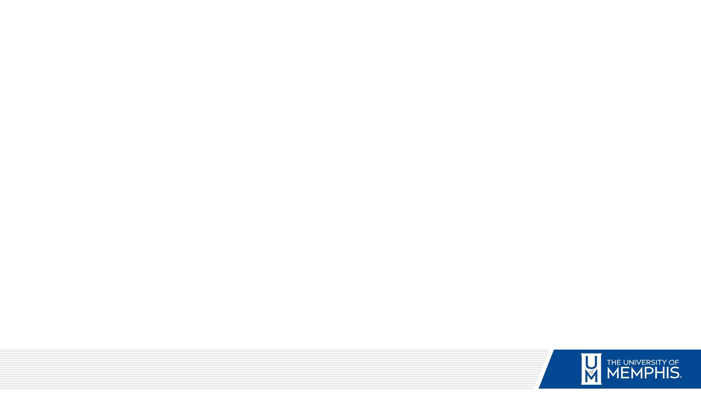
Total Operating & Non-Operating Revenue Growth
(State Appropriations, Gifts and Grants)
(Audited)

Slide 3
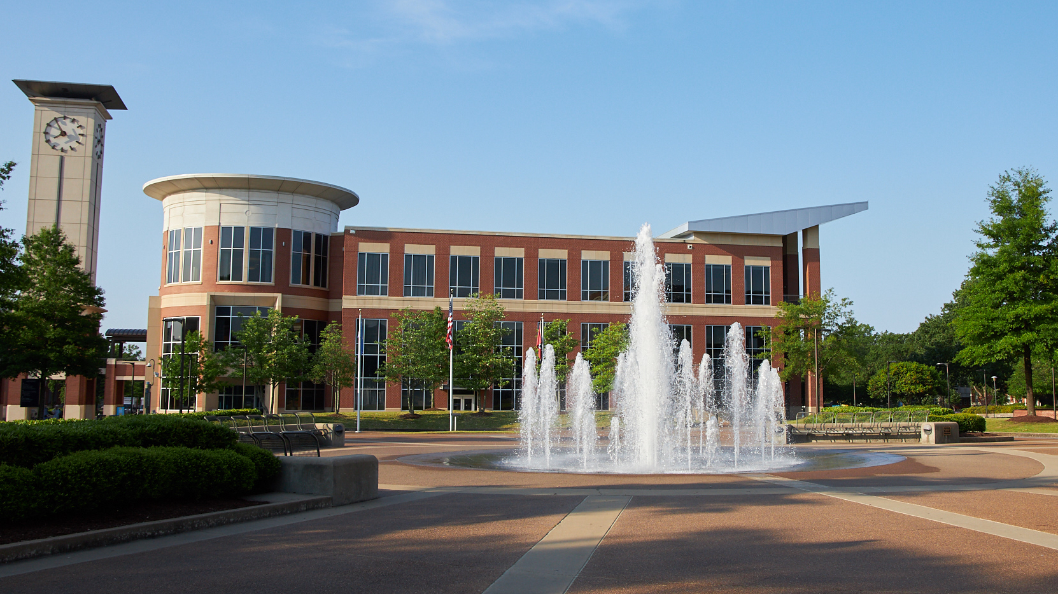
Personnel Making Over $150,000
(Faculty, Academic Leadership and Administrative)
Faculty - 13
Academic - 9
Administrative - 2

Slide 4
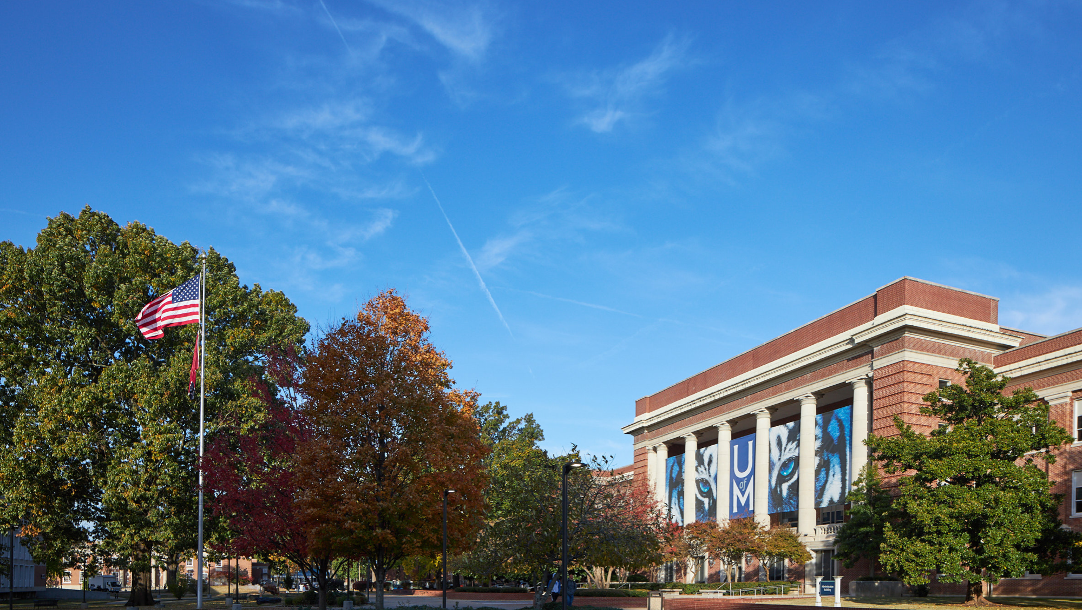
During FY16-18, UofM was working through addressing a $20M structural deficit while keeping tuition and fees affordable.

Slide 5


No ATB/Merit salary increases in FY16, FY17 & FY18

Slide 6
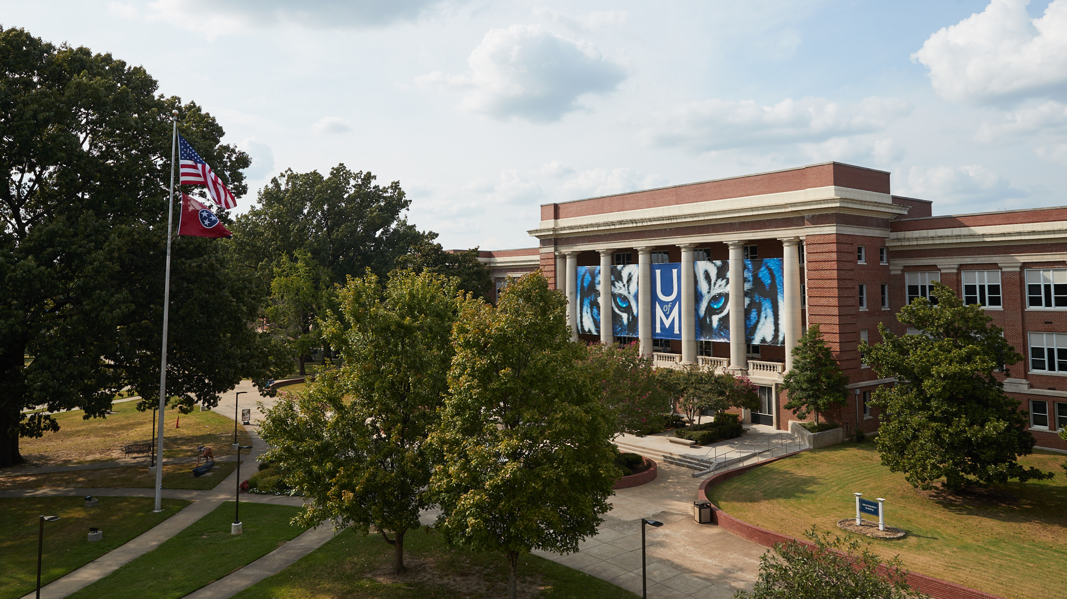
Cumulative Annual Investment in Faculty Promotions | $ 1,823,898.54

Slide 7

SUMMARY OF CAPITAL EXPENSES (Audited)
Total State Funded Capital Projects | Total Locally Funded Capital Projects
93,521,548 | 88,559,431
* - Includes Gifts for capital projects. These fund are restricted to capital expenditures.

Slide 8

Appreciation of Total Assets
In FY2019, we strategically consolidated the Herff Trust assets ($27M) previously not included in our balance sheet.
Notes:
Herff Trust consolidation in FY2019

