Slide 1
Faculty and Staff Salary Trends
Fall 2014- Fall 2020
Office of Institutional Research, October 20, 2020

Slide 2
Data Sources and Definitions
Source: Banner Data with November 1 Effective Date from 2014-2019, and as of October 20 for 2020.
Only Full Time Employees are included.
Coaches are excluded.
No adjustments are made for inflation.
Employee Groups:
Faculty (Eclass = F9,FA,FD,F1,AF).
Non-TT Faculty: Non-Tenure Track Faculty. (Campus Schools, Librarians, Research, Visiting, Clinical, Post-Docs, Instructors, etc.)
T/TT Faculty: Tenure/ Tenure Track Faculty. (9/12-month faculty with Tenure or on Tenure Track)
Staff: All other employees

Slide 3
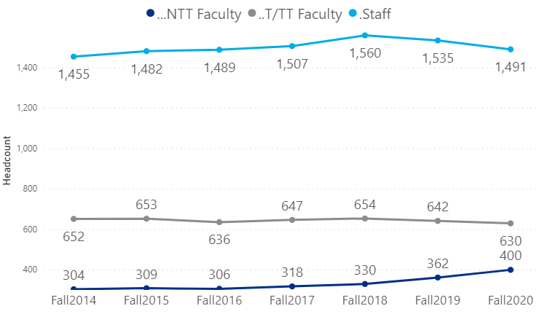
Number of Employees

Slide 4
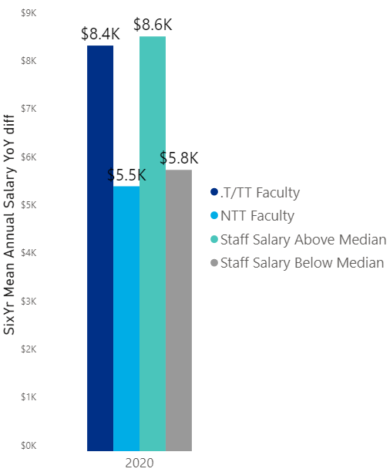
2014 to 2020 Change in Average Salary
Headcount & Average Annual Salary
Year | NTT Faculty | T/TT Faculty | Staff Above Median | Staff Below Median
2020 | 400 $59,749 | 630 $94,762 | 749 $72,740 | 741 $33,305
2019 | 362 $60,609 | 642 $94,009 | 781 $71,104 | 753 $32,006
2018 | 330 $58,957 | 654 $92,635 | 786 $69,032 | 773 $30,616
2017 | 318 $57,678 | 647 $90,877 | 756 $67,748 | 750 $29,184
2016 | 306 $55,217 | 636 $88,497 | 766 $63,657 | 722 $27,784
2015 | 309 $54,249 | 653 $88,038 | 761 $64,661 | 720 $27,985
2014 | 304 $54,242 | 652 $86,329 | 738 $64,118 | 716 $27,457

Slide 5
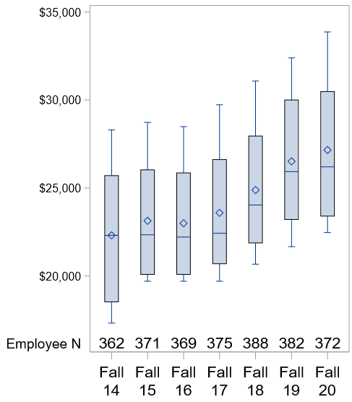
2014 to 2020 Lowest Quartile Staff Salaries
Maximum Value
75% Quartile
Mean
Median
Lowest Quartile Average Salaries 2014-2020
Employee Skill Class | 2014 | 2020 | Change in Mean Salary
Clerical and secretarial | $24,979 | $30,015 | $5,036
Other professionals | $26,470 | $31,567 | $5,097
Service/ Maintenance | $19,613 | $24,218 | $4,605
Skilled crafts | $24,930 | $30,408 | $5,478
Technical and paraprofessional | $26,041 | $31,829 | $5,788

Slide 6
Average Faculty Salary, 2014 to 2020
Employee Group and Rank | 2014 |  | 2020 |  | % Change in Median Salary | $ Change in Median Salary
 | Headcount | Median Salary | Headcount | Median Salary
NTT Faculty (Research Professors, Visiting, Clinical, Post Doc, Librarians, Campus School, etc.)
Assistant Professor | 77 | $58,937 | 82 | $65,238 | 11% | $6,301
Associate Professor | 32 | $72,568 | 29 | $75,700 | 4% | $3,132
Instructor | 153 | $40,697 | 193 | $51,250 | 26% | $10,553
Professor | 8 | $81,543 | 19 | $86,622 | 6% | $5,079
T/TT Faculty
Assistant Professor | 185 | $60,900 | 187 | $68,140 | 12% | $7,240
Associate Professor | 237 | $68,241 | 239 | $75,056 | 10% | $6,815
Professor | 229 | $100,729 | 204 | $105,163 | 4% | $4,434

Slide 7
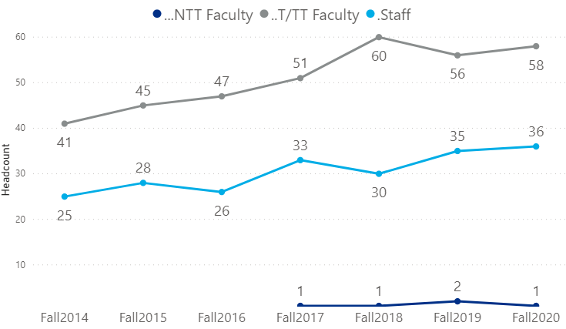
Salaries Above $150,000
More faculty moved into the $150k-175k range, so median salary decreased but overall faculty salaries increased.
 | 2014 |  |  | 2020 |  |  | Median Difference 2014-2020 | Mean Difference 2014-2020
Employee Group | Head-count | Median Salary | Mean Salary | Head-count | Median Salary | Mean Salary
T /TT Faculty | 41 | $185,000 | $185,243 | 58 | $173,867 | $187,188 | -6% | 1%
Staff | 27 | $195,020 | $217,456 | 38 | $210,747 | $233,954 | 8% | 8%

Slide 8
Frequencies are cumulative within years

Slide 9
Frequencies are cumulative within years

Slide 11
Frequencies are cumulative within years

Slide 12
Frequencies are cumulative within years

Slide 13
Frequencies are cumulative within years

