Slide 1



memphis.edu/benhooks

Slide 2
Economic Challenges Facing Black Men and Boys
Hooks Institute Open House and Policy Papers Presentation
October 28, 2019
Lowell Ricketts, Lead Analyst
*These are my own views, and not necessarily the views of the Federal Reserve Bank of St. Louis, Federal Reserve System, or the Board of Governors

Slide 3
Overview
Demographics of Wealth Essay Series
  Income and Wealth Gaps by Race and Ethnicity
Intergenerational Economic Challenges Facing Black Men and Boys
  Raj Chetty’s team show that black boys’ opportunities depend on the presence of black fathers and a low level of racial bias.
  Majority of black boys grow up in low-opportunity neighborhoods.

Slide 4




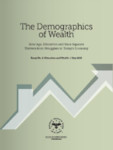
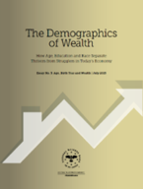
The Demographics of Wealth Series
2018 Series
HFS essay series links income, wealth and other socio-economic outcomes to a family’s:
  Race/ethnicity
  Education (own and parents’)
  Age and birth year.
Your race/ethnicity, education and birth year are strongly related to your adult outcomes.
2015 Series
stlouisfed.org/hfs

Slide 5
Black & Hispanic Income Gaps Closing Slowly
Typical (median) income of black and Hispanic families has moved closer to that of white families but remains 40% lower.
The typical “other-race” family has surpassed the typical white family’s income.
White level

Slide 6
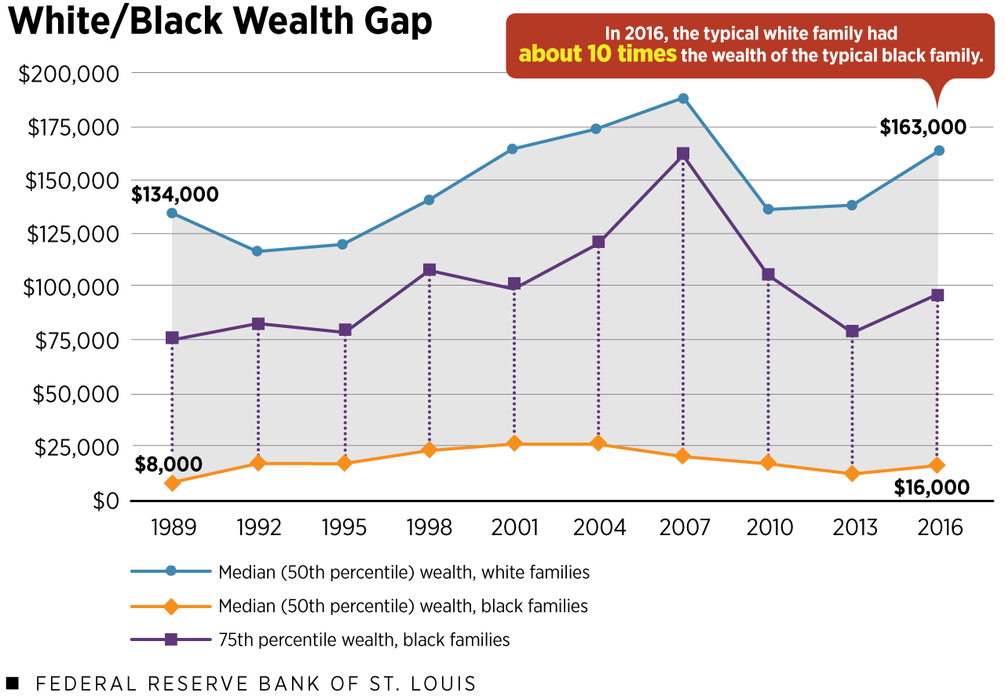
Racial/Ethnic Wealth Gaps are Wide and Persistent
Despite some fluctuation, the large racial and ethnic wealth gaps remain essentially unchanged.
Typical white families had about 10 times wealth of typical black families.
Even wealthier black families (75th percentile) fall short of white medians (50th percentile).

Slide 7
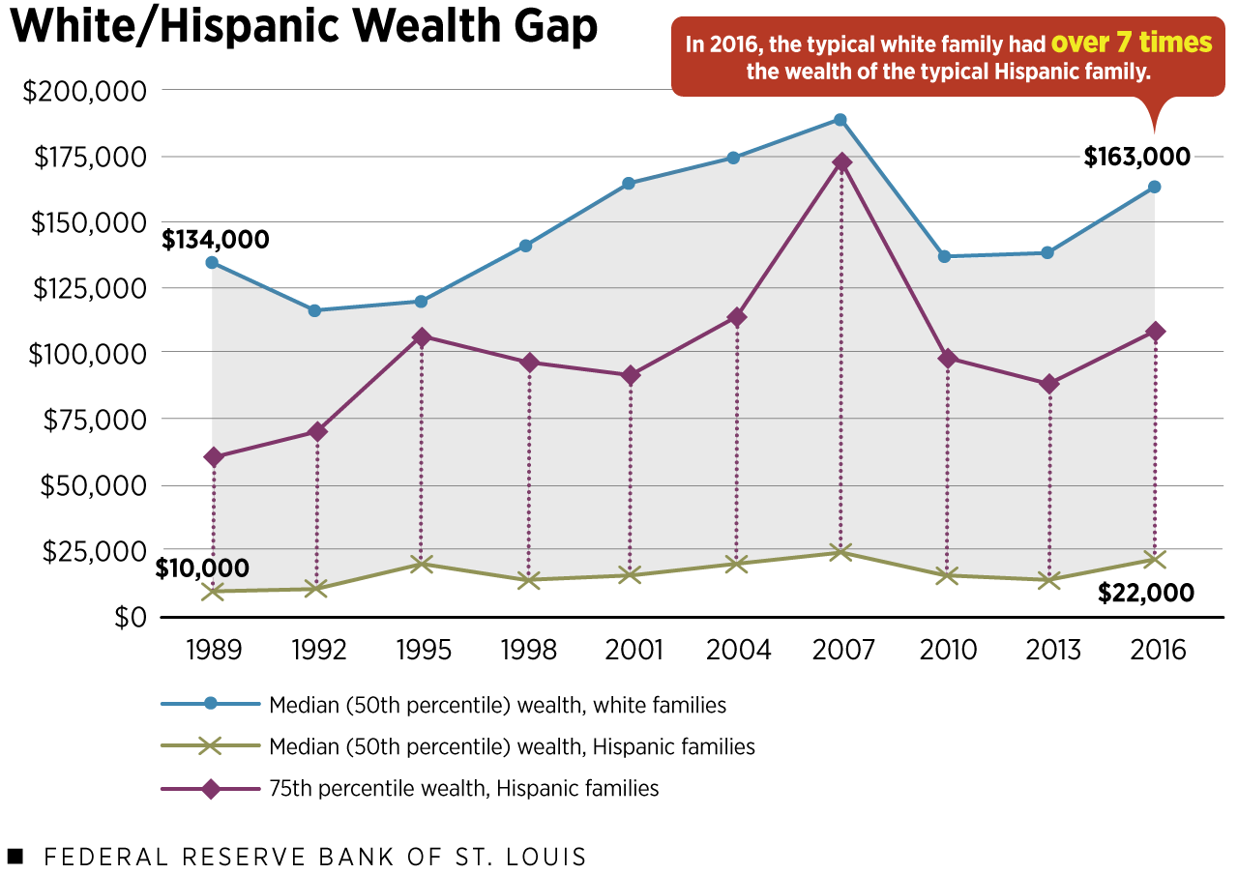
Racial/Ethnic Wealth Gaps are Wide and Persistent
Over a nearly three-decade period, the U.S. has seen very little progress in narrowing racial and ethnic wealth gaps.
In terms of the total wealth pie, white families in 2016 owned 89% of it, while black and Hispanic families owned 3% each.
Notes:
This is especially troubling given the changing racial makeup of the population. More than 1 in 4 families are headed by a black or Hispanic person, up from 1 in 5 in 1989. Yet their slivers of the economic pie have barely budged.

Slide 8
Can Higher Education Close These Gaps?
A college education is widely held as a powerful source of upward mobility.
Can higher education close the racial wealth gap?
We find that a college degree is associated with higher expected earnings and wealth accumulation for all families, regardless of race or ethnicity.
However, the returns are unequal across groups at even the highest levels of education.

Slide 9
Racial Wealth Gaps Remain Despite College
Importantly, a college degree is associated with greater median wealth for all groups.
However, the racial wealth divide remains even among college-educated families.
Among college-educated peers, the black-white gap is 17 cents per dollar.

Slide 10
Why Are Wealth Outcomes So Unequal?
We conclude that structural, systemic or other unobservable factors related to race and ethnicity may be important drivers of wealth inequality (Emmons and Ricketts 2017).
Historical discrimination and disadvantage created large wealth gaps in the past, which profoundly affect today’s children and adults.
Ongoing structural and systemic barriers make it difficult to narrow wealth gaps.

Slide 11
Intergenerational (IG) Income Mobility
Measure parents’ income while a child is a teenager.
Measure the child’s income in his/her 30s (20 years later).
Two extreme cases:
  Perfect IG income rigidity: You end up exactly like your parents.
  Perfect IG income mobility: Your parents’ income doesn’t predict your adult income; everyone equally likely to end up rich or poor.
U.S. data: Somewhere in-between; differences by race and location.

Slide 12
Raj Chetty et al. Have the Best Dataset Ever Assembled for Studying IG Mobility
Results reported in the New York Times, Mar. 19, 2018:
  “Extensive Data Shows Punishing Reach of Racism for Black Boys,” Link.
Underlying research paper and website:
  Raj Chetty, Nathaniel Hendren, Maggie R. Jones and Sonya R. Porter, “Race and Economic Opportunity in the United States: An Intergenerational Perspective,” NBER working paper, Mar. 2018, Link.
  Opportunity Insights, opportunityinsights.org.

Slide 13
Parents’ Incomes Differed Greatly by Race and Ethnicity in the 1990s
Source: Chetty, Hendren, Jones, Porter (2018), Appendix Tables V and VIII

Slide 14
Little IG Mobility for White, Black Children
Source: Chetty, Hendren, Jones, Porter (2018), Appendix Tables V and VIII

Slide 15
On Current Trends, Little Further Racial-Group Income Mobility Is Likely
Source: Chetty, Hendren, Jones, Porter (2018), Appendix Tables V and VIII

Slide 16
Why Has Black Upward Mobility Stalled?
Low rate of upward IG mobility (doing better than parents) among low-income black children.
High risk of downward IG mobility (doing worse than parents) among high-income black children.
Chetty et al: “Black children continue to fall behind their white peers even if their parents catch up.” (pg. 18)

Slide 17
The Main Fault Line: Black Boys vs. Girls
Black girls are just as upwardly mobile as white girls with the same parental income.
Black boys are not—they’re much more likely to earn incomes far below white boys even with the same parental income.
Interesting fact: Black girls’ high-school completion and college-attendance rates are higher than those of white boys.

Slide 18
Large Regional and Neighborhood Variation in IG Mobility
More IG income mobility for black children—especially boys—in some parts of the South, Northeast and West.
Very poor outcomes for black boys in the industrialized cities of the Midwest.
Black boys are especially vulnerable to bad (low-opportunity) neighborhoods, regardless of income.
In general, Memphis is in-between—better than Chicago but not as good as New Orleans or parts of New York.

Slide 19
What Makes Chicago Neighborhoods So Much Worse than New Orleans for Black Boys?
It’s not primarily due to individuals “race-related shortcomings,” because black girls do much better than black boys (and white girls and boys, in some respects).
It’s not primarily due to family structure or marriage rates because it’s share of neighborhood dads present that matters most, not presence of the child’s own dad.
It’s not primarily due to environmental factors like school quality because black boys do worse even in good schools.

Slide 20
What Makes Chicago Neighborhoods So Much Worse than New Orleans for Black Boys?
According to Chetty and coauthors, it is due to:
  High fraction of fathers present in the neighborhood: Dad in the house is good, many black dads in the neighborhood are even better.
  Low levels of racial bias: Racial hostility expressed by local whites hurts black boys and black girls more than Hispanic or Asian boys or girls… White hostility hurts low-income whites, too.
Unfortunately, Chicago is more typical than New Orleans: Neighborhoods with low poverty, many black fathers present and low racial hostility from whites are rare.

Slide 21
In Sum: Black Men and Boys Face Immense Economic Challenges
Black-white income and wealth gaps are large and intractable because black IG income and wealth mobility are low.
Raj Chetty’s team believes the key is increasing the opportunities facing black boys.
Policy challenge: How do we shield black boys from poverty, increase the presence of black dads and decrease whites’ racial hostility?

Slide 22

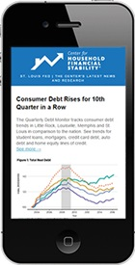
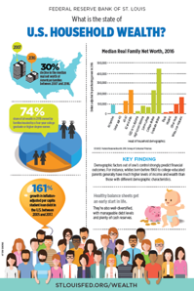




Connect With Us
STLOUISFED.ORG/HFS
Newsletter

Slide 23
memphis.edu/benhooks

Slide 24
Workplace Settings and Job Types as Determinants of
Health Disparities
Shelley I. White-Means, Ph.D.
Professor of health economics
College of graduate health sciences
Consortium on health education, economic empowerment and reseach (CHEER)
University of tennessee health sciences center

Slide 25
Health Disparities
Recent emphasis on social determinants of health additionally reveals that health disparities result from inequalities in where you live, work and play Add your first bullet point here
This paper explores how where you work (i.e., the type of job you hold) impacts your access to health insurance, and thus indirectly influences your health.
Notes:
Health disparities are preventable differences in the burden of disease, injury, violence, or opportunities to achieve optimal health that are experienced by socially disadvantaged populations.
Insights about these relationships are critical for Memphis because Memphis has some of the worse health disparities in the nation. For example, in 2012, Memphis was noted to have the largest racial gap in breast cancer mortality among the major metropolitan cities in the nation (Whitman, Orsi, and Hurlbert, 2012).

Slide 26
The Link Between Job Choice and Health Disparities
Job Choice
Traditional
Health Insurance Choice
Employer Coverage
Health and Health Care
Access to or affordability of health care
Uninsured
Health Outcomes
Non-Traditional
Public Insurance or Private Option
Notes:
Nonstandard work arrangements include contingent workers and workers in alternate employment arrangements.
Contingent workers have jobs that are temporary or are not expected to last for non-personal reasons; they do not have a contract for long-term work (White-Means and Hersch, 2005; United States Bureau of Labor Statistics, 2018).
Alternative employment arrangements include workers paid by contract firms and temporary help agencies, as well as on-call or day laborers and independent contractors (White-Means and Hersch, 2005; United States Bureau of Labor Statistics, 2018b).

Slide 27
Workers in alternative arrangements as a percent of total employed
Fe |  | Feb 1995 |  | Feb 2005 | May 2017
Independent Contractors |  | 6.7 |  | 7.4 | 6.9
On-call Workers |  | 1.7 |  | 1.8 | 1.7
Temporary help agency workers |  | 1 |  | 0.9 | 0.9
Workers provide by contract firms |  | 0.5 |  | 0.6 | 0.6
All alternative workers |  | 9.9 |  | 10.7 | 10.1
Notes:
Most of what we know about the nation’s nonstandard employment market is based on data from the Current Population Survey (CPS). The CPS reports statistics related to the main jobs held by U.S. workers.
May, 2017, there were 10.6 million independent contractors, 2.6 million on-call workers, 1.4 million temporary help agency workers, and 933,000 workers for contract firms (U.S. Bureau of Labor Statistics, 2018a). The trend toward work in alternative employment as one’s sole
Among workers in the alternative arrangement sector, independent contractors are the largest percentage of workers and they also represent the largest percentage of workers in the nonstandard work sector, i.e., 6.9 percent compared to 3.8 percent employed in contingent work (Bureau of Labor Statistics, 2018b).
While CPS data suggest that the non-standard employment sector is stable and slightly decreasing in its role as a source of employment, the data tend to underrepresent two employment trends. First, CPS data do not capture data on nonstandard employment as a secondary source of employment income, as an opportunity to stretch one’s income when one’s primary job is associated with wages insufficient to provide a living-income.
CPS estimated about 21 million workers in the nonstandard employment sector, while data from Upwork reported 57 million, a growing number of workers fleeing to the “gig” market in order to survive (Novello and Stettner, 2018). The growth of the numbers of workers for firms such as Uber and Lift also supports the supposition of a growing number of workers in the nonstandard employment sector who are underestimated.

Slide 28
Racial Divide in Employment Sectors
Notes:
Second, there are differences between white workers and black and Hispanic workers in how they are represented over time (2005 vs. 2017) in the contingent and alternative work arrangement sectors.
Between 2005 and 2017, there was a decline in the percent of white workers who were employed in the contingent sector and increases of 12 percent and 10 percent for black and Hispanic workers.
Between 2005 and 2017, there was a decline in the percent of white workers who were employed in alternative work arrangements and increases of 41 percent and 46 percent for black and Hispanic workers.
Novello and Stettner (2018) attribute these trends to a growing racial divide in employment sectors due to racial unemployment and wage differentials in the traditional labor market driving more minority workers than white workers to the nontraditional sector.

Slide 29
Health Insurance and Work Arrangements
Health insurance coverage varies by whether one is employed in the traditional employment sector vs the nonstandard sector.
Coverage also varies by race/ethnicity
Employer coverage (1995-2001) was 71, 72, and 58 percent for white, black and Hispanic workers in the traditional job market
Employer coverage (1995-2001) was 32, 26, and 21 percent for white, black and Hispanic workers in the nonstandard job market
Notes:
The primary reason that employers develop nonstandard workforce agreements is to save money. In manufacturing, the use of workers from temporary help agencies increased from 30 percent in 2005 to 39 percent in 2017 (Novello and Stettner, 2018). Sometimes nonstandard workers are used as the alternative to raising wages of workers in standard work arrangements (Houseman, Kalleberg and Erickcek (2003). Such strategies may be used to avoid paying overtime wages of time and one-half and reduce expenditures on fringe benefits.

Slide 30
Health Insurance and Work Arrangements
By 2005, 56 percent of workers in traditional jobs and 18 percent of workers in the nonstandard jobs had employer coverage
By 2017, there were still gaps in employer provided coverage in the traditional and nonstandard sectors; gap was reduced due to increasing insurance coverage in the nonstandard job market.
    53 percent of workers in traditional jobs had health insurance coverage under their employer’s plan and 25 percent of contingent workers had coverage
    28, 13 and 41 percent of on-call workers, temporary help agency workers, and workers provided by contract firms had employer coverage
Notes:
By 2005, During this time period, employer sponsored health insurance coverage declined in both traditional and nonstandard sectors as growth in health insurance costs tended to exceed growth in wages, health insurance premiums and co-payments increased and employee take-up rates declined.
By 2017, there were still gaps in employer provided coverage in the traditional and nonstandard sectors, but the gap was reduced primarily because of increasing insurance coverage in the nonstandard job market.
Both the economic recovery of 2008 and the passage of the Affordable Care Act (ACA) have been credited with this expansion in employer provided health insurance coverage. Specific changes implemented under the ACA that potentially led to greater employer health insurance coverage for workers in nonstandard jobs included: small employers were offered the opportunity to purchase affordable health insurance via state health insurance marketplaces, employers with 50 or more full-time employees were required to offer coverage that met minimum value or affordability standard, and individuals were mandated to purchase qualified health insurance (Su et al., 2019). Yet again, employer sponsored health insurance coverage of workers in nonstandard employment remained half or lower than that of workers in traditional job markets.

Slide 31
Health Insurance and Health Disparities
The Institute of Medicine (2002) reports that uninsured persons:
  1) receive less preventive screenings,
  2) are less likely to receive health care services in a timely manner,
  3) receive substandard care, and
  4) have a higher risk of dying prematurely, including higher rates of death in the hospital.
Health insurance also influences racial and ethnic health disparities in use of preventive and screening services and also cardiovascular disease services. Economically vulnerable populations have greater improvements in health due to increases in health insurance.
Since health insurance status is so closely linked to health status and health disparities, especially for economically vulnerable populations, and given that job sector employment has critical implications for health insurance status, workplace settings and job settings are de facto determinants of racial and ethnic disparities in health.

Slide 32
Memphis and Non-traditional Sector Employment
ESC region, where Memphis is the largest city, has a similar distribution of workers across the non-traditional work sector as the national distribution.
The ESC region has a slightly lower likelihood of independent contractors and slightly higher likelihood of workers employed by temporary help workers.
Notes:
Herein lies the health insurance concern for residents of Memphis. National data indicate that workers employed by temporary help agencies were the least likely to have employer provided health insurance (only 13 percent had coverage in 2017 and only 8 percent in 2005), and workers in the ESC region were more likely than workers in the nation to fall in this category. Indeed, the coverage rates for these workers is extremely low, suggesting severe limitations in access to health care services for those employed by temporary help agencies. These workers also are most likely to be black or Hispanic (U.S. Bureau of Labor Statistics, 2018a).

Slide 33
Public Policy Implications
Minimum Wages and Employment in Alternative Work Settings
Health Insurance and the Workplace
Notes:
Doubling the minimum wage is a popular policy recommendation. It is basically justified by arguments that wages need to be high enough so that what workers in effect receive is a living wage, i.e., a wage that allows families to move out of poverty. Opponents of changes in the minimum wage focus on how additional wage costs would increase the cost of doing business and drive down profits. However, what both proponents and opponents of a rising minimum wage often fail to consider are the valuable health impacts of rising wages. As we explored in this paper, there is a connection between higher workplace benefits and improved health outcomes. As health improves, productivity increases, and employers receive higher returns on their investments in workers. Thus, both employers and workers gain as disparities in wages and disparities in health decline.
2) Rising minimum wages would make employment in the alternative work sector less needed and/or desirable. Thus, higher burdens of long-term health risks faced by black and Hispanic workers would decline.
3) Currently, the workplace setting has a significant influence on health insurance coverage, as well as ones health, quality of life and life expectancy. It is not clear why such a connection between the workplace and life expectancy is necessary or desirable. Why don’t we separate this connection by giving serious consideration to universal health insurance coverage? Whether it is an extension of the ACA that fills gaps in coverage or an overhaul of the health insurance system that is replaced by some variation of Medicare-for All, it is not clear whether the additional costs of financing these new health insurance systems outweigh the benefits. This is because most calculations of the cost of a new health insurance system compare health care expenditures under the new system with health care expenditures under the current system, and then questions are asked about whether we can afford the additional costs associated with the new system. No adjustments are made in these cost calculations for the benefits of the new system, such as reductions in the costs of premature deaths, disability days, and pain and suffering associated with greater and early access to health care. A reconsideration of our health insurance system is critical for persons who must work in alternative employment arrangements in order to secure a living-income for their families.

Slide 34
memphis.edu/benhooks

Slide 35
A Memphis Mirage:
How Home Mortgage Alternatives and
Increased Private Equity Ownership Diminish Wealth in Low-Income Communities
By: Wade Rathke & Diné Butler

Slide 36
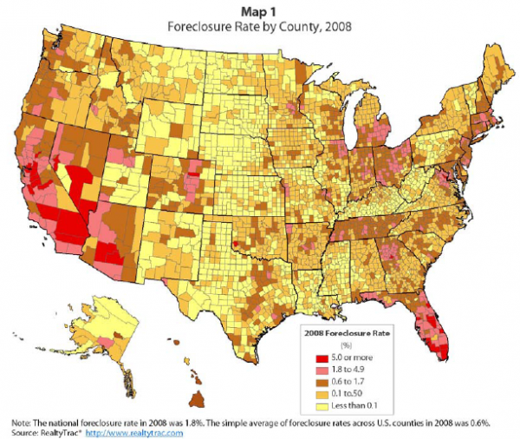
The
Foreclosure
Crisis
Notes:
The foreclosure crisis flooded markets around the country with vacant homes and equity firms took advantage

Slide 37

What went up, should go down!
Outside investors purchase homes
Rental stock increases
Alternative mortgages increase
Eviction filings increase
Improve Local Policies

Slide 38

Private equity firms become largest owner of single-family homes
in Memphis.
Significant increase in highly concentrated in minority areas.”

Slide 39
Land Installment Contracts come back on a national and local scale.

Slide 40
The Impact: Change in rates of homeownership and rentals in Shelby County
Race | 2009 | 2013 | 2017 | # change from 2009 to 2018 | % Change from 2009 to 2017
Hispanic / Latino
Owner | 5369 | 6298 | 7579 | 2210 | 41.16%
Renter | 7666 | 9963 | 9757 | 2091 | 27.28%
Black or African American
Owner | 105221 | 104496 | 103959 | -1262 | -1.20%
Renter | 96100 | 105556 | 121181 | 25081 | 26.10%
White not Hispanic / Latino
Owner | 194150 | 187876 | 179332 | -14818 | -7.63%
Renter | 57443 | 57623 | 59073 | 1630 | 2.84%
Table 1: Change in Ownership and Rentals by Race/Ethnicity between 2009 and 2017
Source: ACS 2013-2017 TN-AR-MS Shelby County MSA

Slide 41
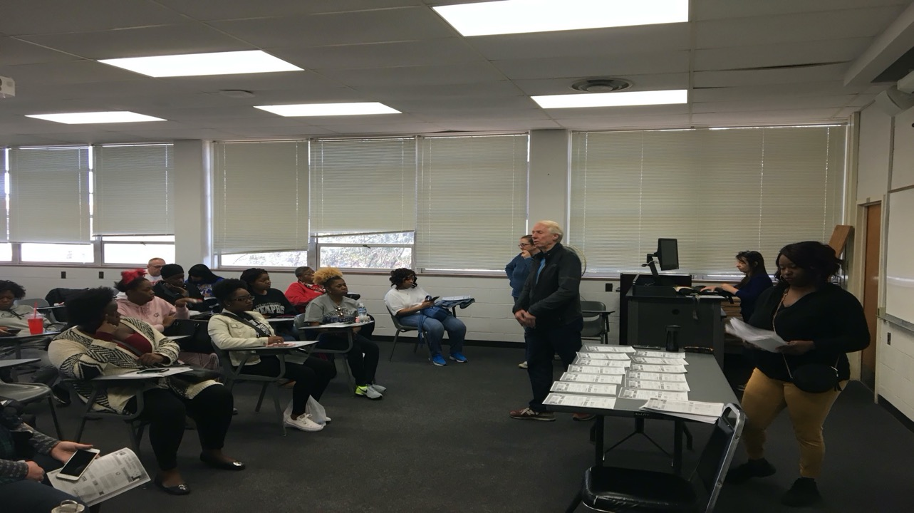
Methodology
Quantitative-style survey distributed to 80 people in Memphis, TN with 25 questions conducted by University of Memphis Social Work volunteers

Slide 42
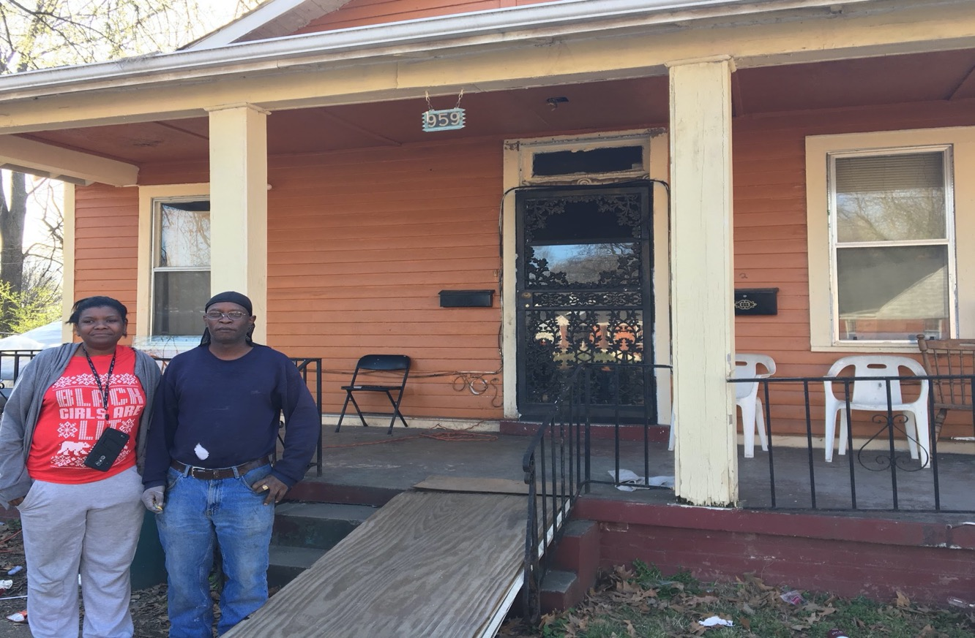
What does this mean for local families?
The Memphis Clarks
This family takes care of their children, one of whom uses a wheelchair. Due to the instability of their land installment contracts they were worried about eviction and the financial and emotional turmoil of starting all over,

Slide 43
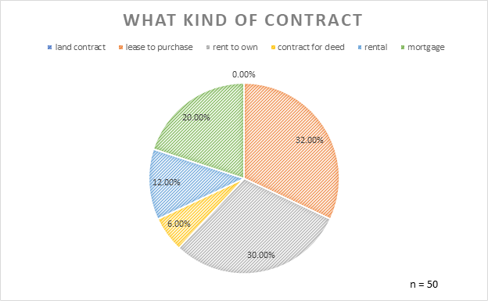
Findings and Analysis

Slide 44
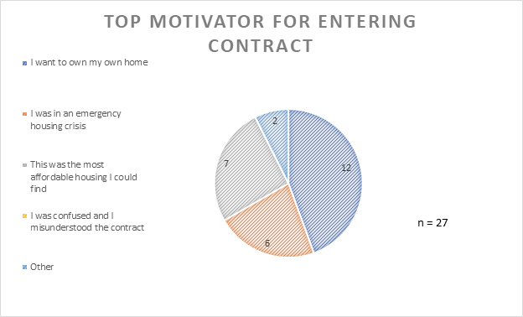
Findings and Analysis

Slide 45
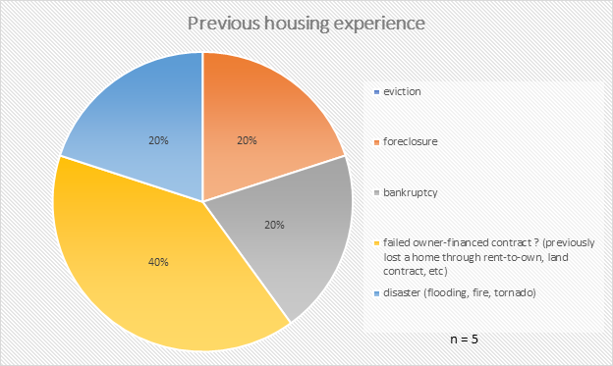
Findings and Analysis

Slide 46


We need
Equity Protection Acts for tenants and land installment contract buyers
+
We need to pass rental regulations
Look at Model Legislation
Source: travel.trade.gov

Slide 47
Policies moving forward
Mortgage alternatives should be treated like mortgages
Programs and funding are needed
Pass regulations, fines, and penalites
Quotes for illustration purposes only

Slide 48
Contact
Wade Rathke
chieforganizer@acorninternational.org
Diné Butler
dine.butler@gmail.com

Slide 49
memphis.edu/benhooks

