Slide 1

Economic Challenges Facing Black Men and Boys: Beyond the Data to Lived Experience
William R. Emmons
Center for Household Financial Stability (HFS)
Federal Reserve Bank of St. Louis
February 19, 2019
These views are mine alone and not necessarily those of the Federal Reserve Bank of St. Louis.

Slide 2
Economic Challenges: The Data
Part 1: Trends in family income and wealth
Large and persistent gaps exist across race and ethnicity.
College does not level the playing field.
Part 2: Unique economic challenges facing African-American men and boys
Raj Chetty’s research shows that black boys have more difficulty achieving and maintaining upward mobility than others.
Profound structural disadvantages include poverty and racial bias.

Slide 3
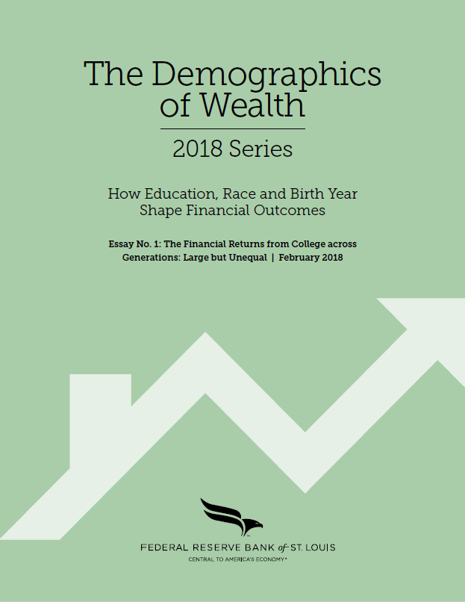
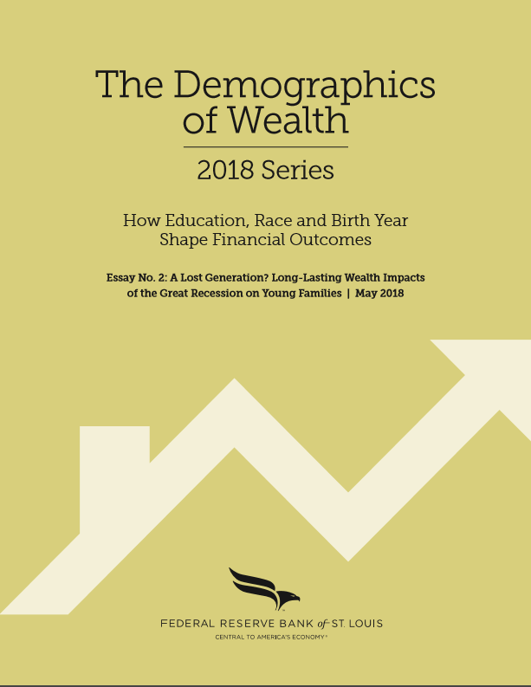
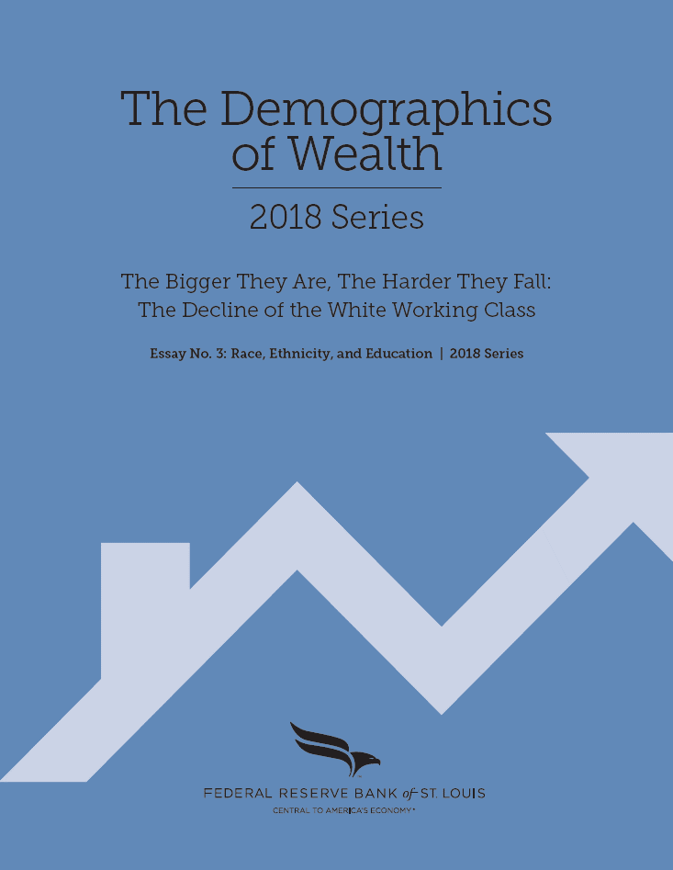
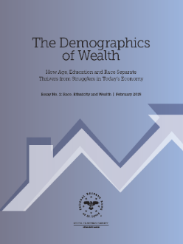
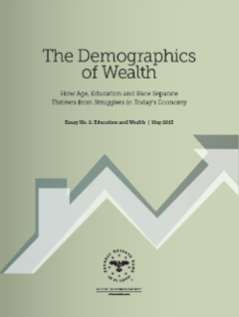
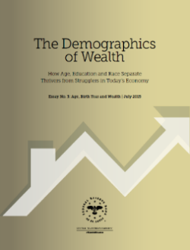
Part 1: The Demographics of Wealth Series
2018 Series
HFS essay series links income, wealth and other socio-economic outcomes to a family’s:
Race/ethnicity
Education (own and parents’)
Age and birth year.
Your race, education and birth year are strong predictors of your adult outcomes.
2015 Series
www.stlouisfed.org/household-financial-stability/

Slide 4
Black & Hispanic Income Gaps Closing Slowly
Typical (median) income of black and Hispanic families has moved closer to that of white families but remains 40% lower.
The typical “other-race” family (mostly Asian) has surpassed the typical white family’s income.
White level

Slide 5
Racial/Ethnic Wealth Gaps Are Very Large
Racial/ethnic wealth gaps vis-à-vis the typical white family are wider than income gaps
Black families (-90%)
Hispanic families (-87%)
Other families (-39%).
Black-white wealth gap: -90%

Slide 6
Racial/Ethnic Wealth Gaps Are Persistent
Wealth of the typical black and Hispanic family has improved a bit since 1989, but the gaps remain close to 90 percent.
Other nonwhite families’ wealth has increased faster than that of whites during the last decade.

Slide 7
Can Higher Education Close These Gaps?
Our findings: College alone does not close the gaps.
The good news: A four-year college degree usually brings higher earnings and wealth accumulation for graduates of all races and ethnicities.
However, the income and wealth benefits of college are unequal across racial and ethnic groups.
College grads born in the 1970s and 1980s are earning somewhat less and accumulating much less wealth than older college grads—especially black and Hispanic grads.

Slide 8
Large Racial Wealth Gaps Also for College Grads
A college degree brings greater median wealth for all groups.
However, the racial wealth divide is almost as large among college-educated families.
Four-year college degree narrows the black-white gap only from 89 to 83 percent.
Black-white wealth gap, 4-year college: -83%
Black-white wealth gap, no college: -89%

Slide 9
Why Are Wealth Outcomes So Unequal?
We conclude that structural, systemic or other unobservable factors related to race and ethnicity are very important sources of wealth inequality—it’s not just “bad individual choices” (Emmons & Ricketts 2017).
Historical discrimination and disadvantage created large wealth gaps in the past, which continue to affect today’s adults and children because wealth is intergenerational.
Continuing structural and systemic barriers make narrowing of income and wealth gaps very slow.

Slide 10
Part 2: Intergenerational (IG) Income Mobility
Measure your parents’ income when you were a teenager.
Measure your income in your 30s (20 years later).
Two extreme cases:
Perfect IG income mobility: Your parents’ income doesn’t predict your adult income; everyone equally likely to end up rich or poor.
Perfect IG income rigidity (no mobility): You end up exactly like your parents (you are poor if they were poor and vice versa).
U.S. data: Somewhere in-between—some IG movement with important differences by race and location.

Slide 11
Raj Chetty (Harvard Economist) Has Best Dataset Ever Assembled for Studying IG Mobility
Results reported in the New York Times, Mar. 19, 2018:
“Extensive Data Show Punishing Reach of Racism for Black Boys,” https://www.nytimes.com/interactive/2018/03/19/upshot/race-class-white-and-black-men.html.
Underlying research paper and website:
Raj Chetty, Nathaniel Hendren, Maggie R. Jones and Sonya R. Porter, “Race and Economic Opportunity in the United States: An Intergenerational Perspective,” NBER working paper, Mar. 2018.
See the website of their Equality of Opportunity Project: http://www.equality-of-opportunity.org/.

Slide 12
Parents’ Incomes Differed Greatly by Race and Ethnicity in the 1990s
Percentiles run from 0 (lowest) to 100 (highest) | Mean income percentile rank (median Income) of parents in 1990s when kids were in their teens
White | 58% ($70,600)
Asian | 49% ($53,000)
Hispanic | 36% ($33,100)
Native American | 37% ($34,900)
Black | 33% ($29,200)
Source: Chetty, Hendren, Jones, Porter (2018), Appendix Tables V and VIII

Slide 13
Little IG Mobility for White or Black Children
Percentiles run from 0 (lowest) to 100 (highest) | Mean income percentile rank (median Income) of parents in 1990s when kids were in their teens | Mean income percentile rank of children in 2014-15 when they were in their 30s
White | 58% ($70,600) | 56 (-2 notches)
Asian | 49% ($53,000) | 61 (+12)
Hispanic | 36% ($33,100) | 46 (+10)
Native American | 37% ($34,900) | 37 (--)
Black | 33% ($29,200) | 35( +2)
Source: Chetty, Hendren, Jones, Porter (2018), Appendix Tables V and VIII

Slide 14
On Current Trends, Little Further Racial-Group Income Mobility Is Likely
Percentiles run from 0 (lowest) to 100 (highest) | Mean income percentile rank (median Income) of parents in 1990s when kids were in their teens | Mean income percentile rank of children in 2014-15 when they were in their 30s | Chetty et al’s predicted long-run mean income percentile rank by racial/ethnic group
White | 58% ($70,600) | 56 (-2 notches) | 54 (-2 notches)
Asian | 49% ($53,000) | 61 (+12) | 63 (+2)
Hispanic | 36% ($33,100) | 46 (+10) | 49 (+3)
Native American | 37% ($34,900) | 37 (--) | 36 (-1)
Black | 33% ($29,200) | 35( +2) | 35 (no change)
Source: Chetty, Hendren, Jones, Porter (2018), Appendix Tables V and VIII

Slide 15
Why Has Black Upward Mobility Stalled?
Low rate of upward IG mobility (doing better than your parents) among low-income black children.
Generational poverty
Plus high risk of downward IG mobility (doing worse than your parents) among high-income black children.
Chetty et al: “Black children continue to fall behind their white peers even if their parents catch up.” (p. 18)

Slide 16
The Main Fault Line: Black Boys vs. Girls
Black girls are just as upwardly mobile as white girls with the same parental income.
Black boys are not—they’re much more likely to earn incomes far below white boys even with the same parental income.
Interesting fact: Black girls’ high-school completion and college-attendance rates are higher than those of white boys.

Slide 17
Large Regional and Neighborhood Variation in IG Mobility
High IG income mobility for black children—especially boys—in some parts of the South, Northeast and West.
Very poor outcomes for black boys in the industrialized cities of the Midwest—Chicago, Milwaukee, Cleveland.
Black boys are especially vulnerable to “low-opportunity” neighborhoods, regardless of income.
In general, Memphis is in-between—better than Chicago but not as good as New Orleans or parts of New York.

Slide 18
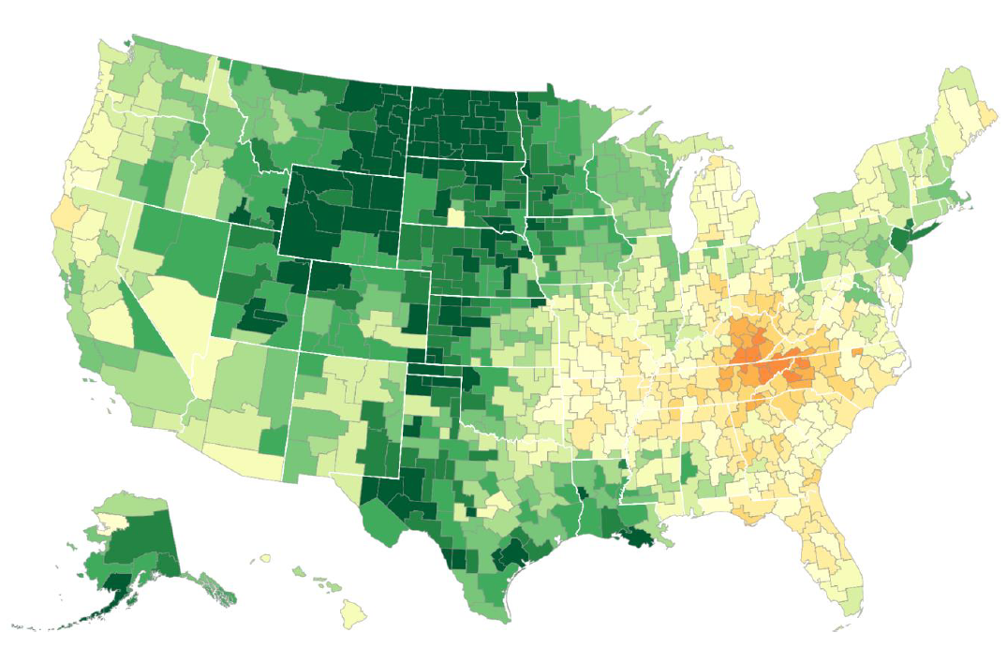
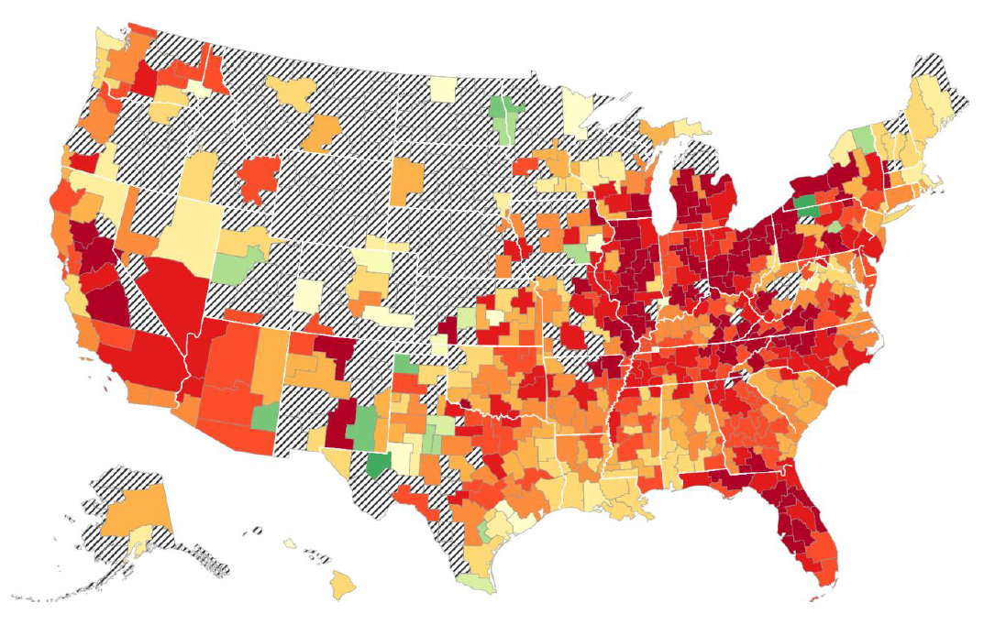

Average Incomes of White and Black Men Who Grew Up in Low-Income (25th-%-ile) Families
White Men
Black Men
Not enough data
Source: Chetty, Raj; Hendren, Nathaniel; Jones, Maggie; and Porter, Sonya. R (2018)

Slide 19
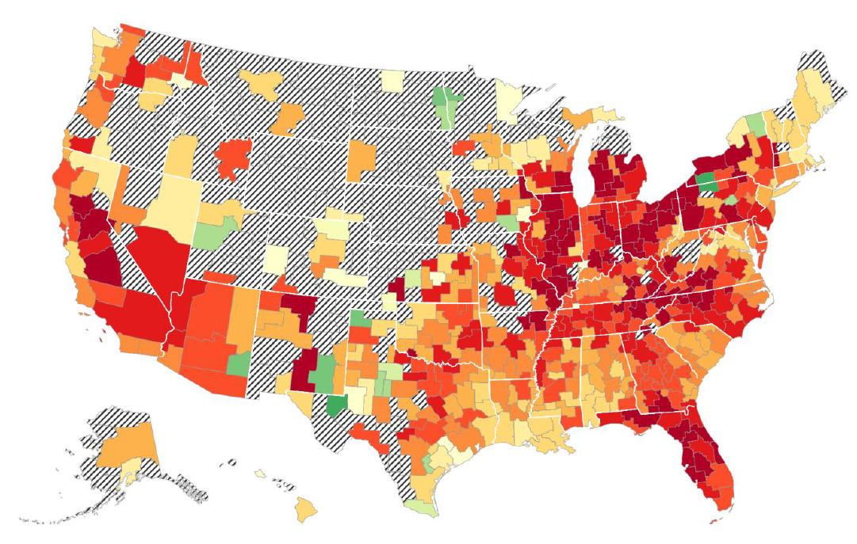
Intergenerational Income Mobility of Black Men Who Grew Up Poor
Green is High, Red is Low
Below average
Not enough data
Above average
Below average
Average
Below average
Above average

Slide 21
Examples of Good Neighborhoods Where Black Boys Are More Likely to Thrive
Poor neighborhoods: Average family income at 25th percentile ($27,000); most black fathers are present; relatively low poverty rate. |  | Rich neighborhoods: Average family income at 75th percentile ($94,000); most black fathers are present; relatively low poverty rate.
Washington DC | Downtown Silver Spring, Woodside Park, Woodside Forest | Newport News VA | Richneck, Newport News County
 | College Park, Prince Georges' County | Baton Rouge | East Baton Rouge, East Baton Rouge County
 | New Carrolton, Prince Georges' County | New Orleans | Terrytown, Jefferson County
 | Greenbelt, Prince Georges' County |  | Woodmere, Jefferson County
New York City | Queens Village, Queens
 | Laurelton, Queens
 | Wakefield / Eastchester, Bronx
Source: Chetty, Hendren, Jones, Porter (2018), Appendix Table XV

Slide 22
Examples of Average Neighborhoods Where Black Boys Do About Average
Poor neighborhoods: Average family income at 25th percentile ($27,000); many black fathers are present; moderate poverty rate. |  | Rich neighborhoods: Average family income at 75th percentile ($94,000); many black fathers are present; moderate poverty rate.
Houston | Ost-South Union, Harris County | Chicago | Harvey, Cook County
 | Sunnyside, Harris County |  | South Holland, Cook County
Memphis | White Haven, Shelby County | Memphis | Hickory Ridge-South Riverdale, Shelby County
 | Coro Lake, Shelby County
Source: Chetty, Hendren, Jones, Porter (2018), Appendix Table XV

Slide 23
Examples of Bad Neighborhoods Where Black Boys Do Worse than Average
Poor neighborhoods: Average family income at 25th percentile ($27,000); few black fathers are present; high poverty rate. |  | Rich neighborhoods: Average family income at 75th percentile ($94,000); few black fathers are present; high poverty rate (among blacks).
Chicago | Robert Taylor Homes/Fuller Park, Cook County | Chicago | Humboldt Park, Cook County
 | Bronzeville, Cook County |  | West Garfield Park, Cook County
 | Garfield Park, Cook County | Detroit | Harper Woods, Wayne County
 | Englewood, Cook County |  | Hamtramck, Wayne County
Detroit | Chandler Park, Wayne County
Cincinnati | South Fairmont, Hamilton County
Los Angeles | South Los Angeles/Watts, Los Angeles County
Source: Chetty, Hendren, Jones, Porter (2018), Appendix Table XV

Slide 24
What Makes Chicago Neighborhoods So Much Worse than New Orleans for Black Boys?
It’s not primarily due to individual “race-related shortcomings,” because black girls do much better than black boys (and white girls and boys, in some respects).
It’s not primarily due to family structure or marriage rates because it’s share of neighborhood dads present that matters most, not presence of the child’s own dad.
It’s not primarily due to environmental factors like school quality because black boys do worse even in good schools.

Slide 25
What Makes Chicago Neighborhoods So Much Worse than New Orleans for Black Boys?
According to Chetty, good outcomes are due to:
High fraction of fathers present in the neighborhood: Dad in the house is good but many black dads in the neighborhood is even better.
Low levels of racial bias: Racial hostility expressed by local whites hurts black boys and black girls more than Hispanic or Asian boys or girls.
Note: White hatred hurts low-income whites, too.

Slide 26
What Makes Chicago Neighborhoods So Much Worse than New Orleans for Black Boys?
Unfortunately, Chicago is more typical than New Orleans for most African-American children.
It’s unusual to find neighborhoods containing many African-American families with all of these characteristics:
Low poverty
Many black fathers present
Low racial hostility from whites.

Slide 27
In Sum: Black Men and Boys Face Immense Economic Challenges But We Know What Helps
Black-white income and wealth gaps are large and slow to change because of:
Cumulative discrimination and disadvantage: Structural racism.
Upward black intergenerational (i.e., parent-to-child) income and wealth mobility are low.
Raj Chetty’s team believes the key to breaking out of this pattern is increasing the opportunities facing black boys.

Slide 28
Our Challenges
How do we shield black boys from poverty and its effects when it is prevalent in so many neighborhoods?
How do we increase the neighborhood presence of black dads?
How do we decrease whites’ racial hostility, which harms both non-white and white Americans?

Slide 29
www.stlouisfed.org/household-financial-stability/

