Slide 1
Board of Trustees Meeting
March 10, 2021
Zoom Video Conference

Slide 2
Call to Order and Opening Remarks
Chairman David North
Notes:
Notes:

Slide 3
Roll Call and Declaration of Quorum
Secretary Melanie Murry

Slide 4
Approval of Minutes
December 2, 2020
Chairman David North

Slide 5
President’s Update
President M. David Rudd

Slide 6
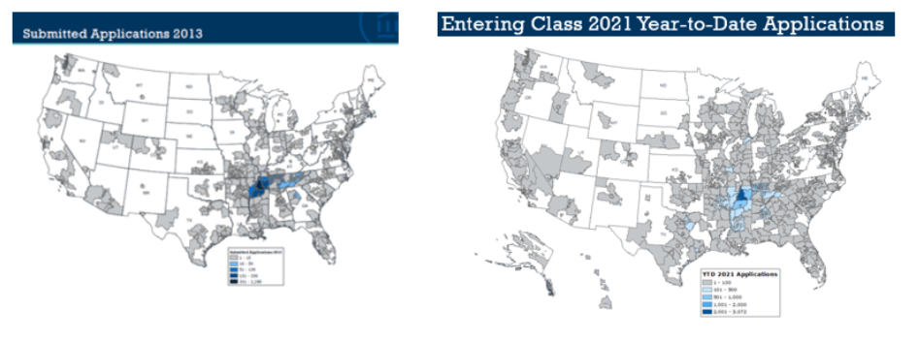

Slide 7
How COVID-19 Impacted Our Students
Desiree’ Dyson, Student Body President
Student Government Association

Slide 8
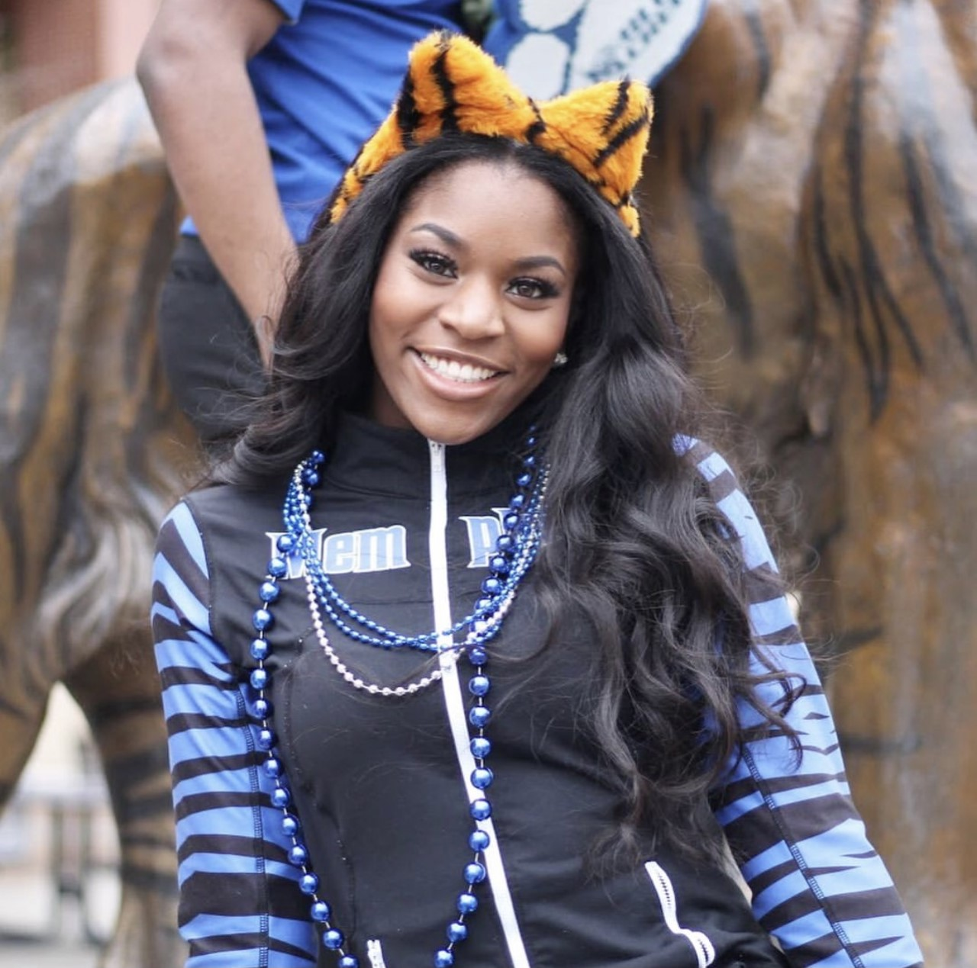
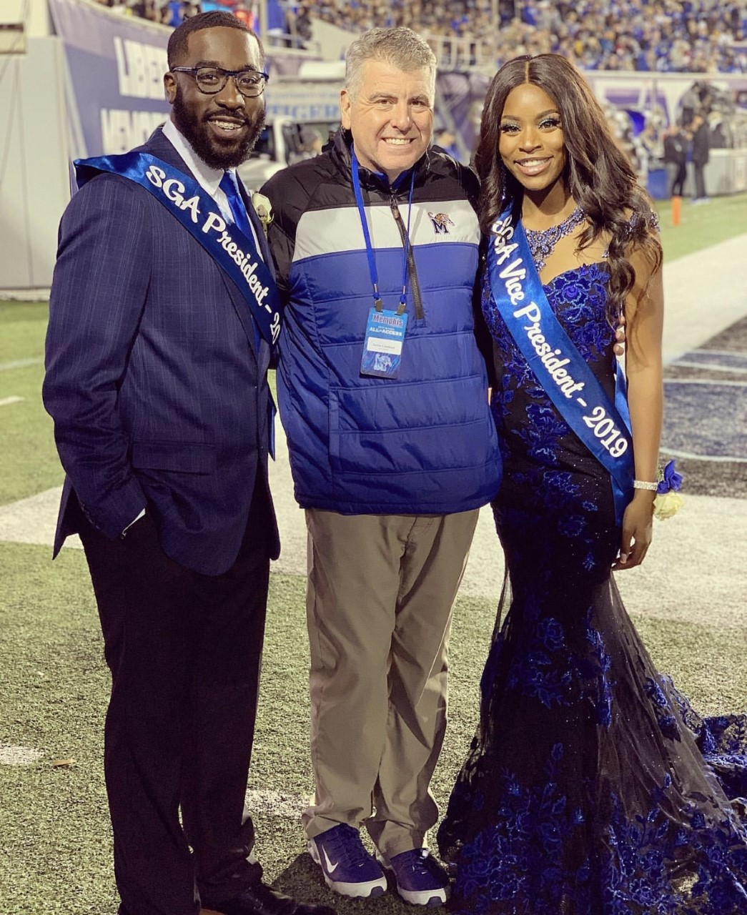
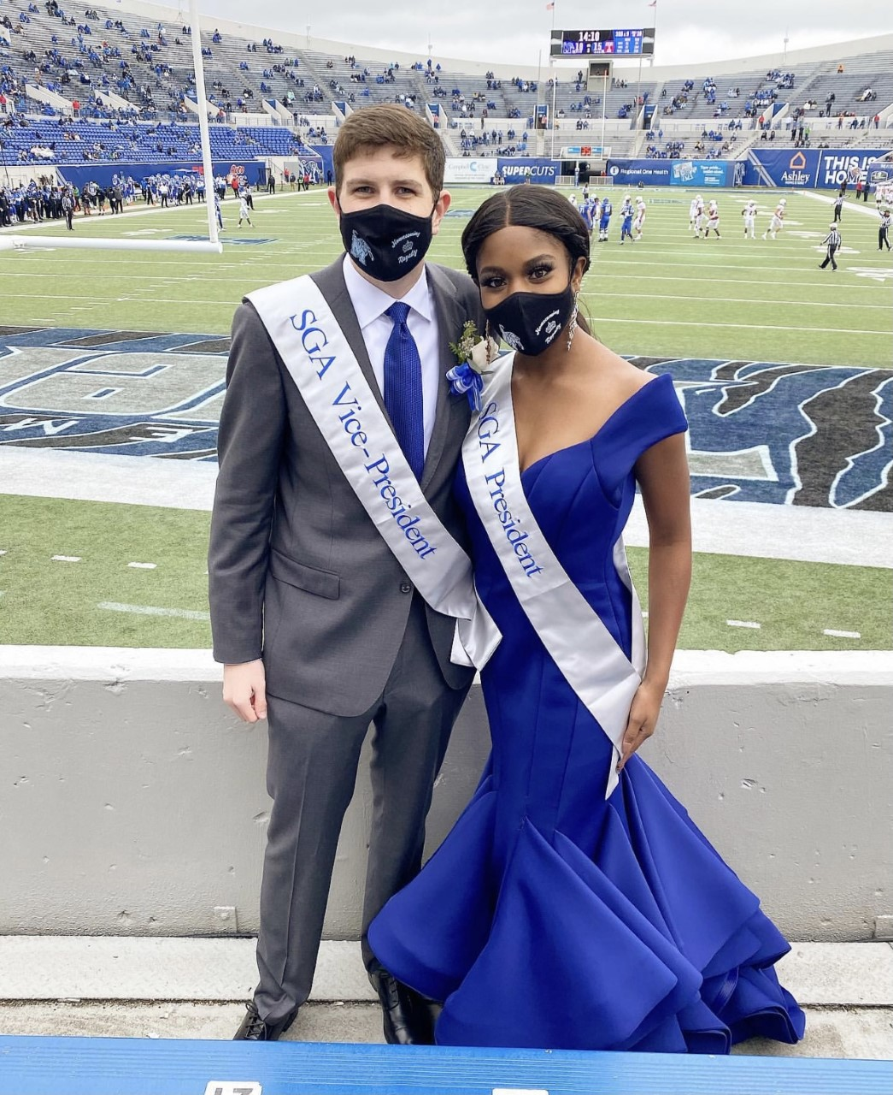
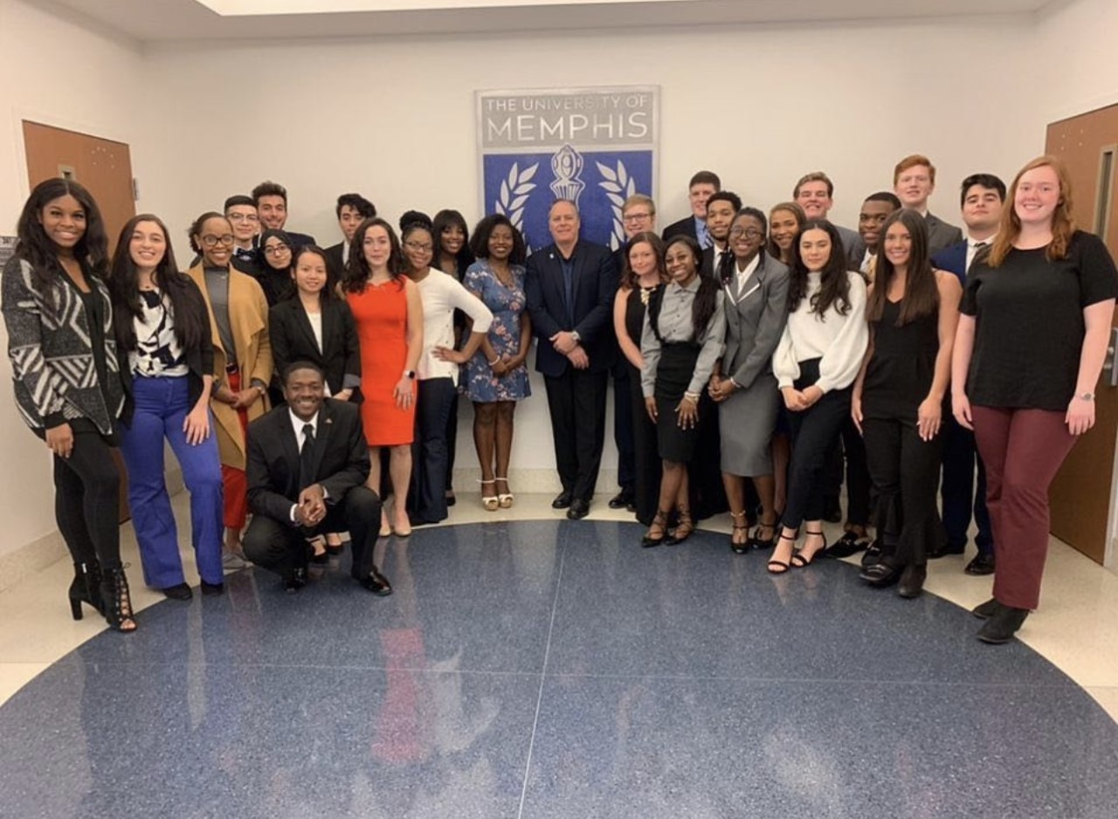
A Little Bit About Me

Slide 9
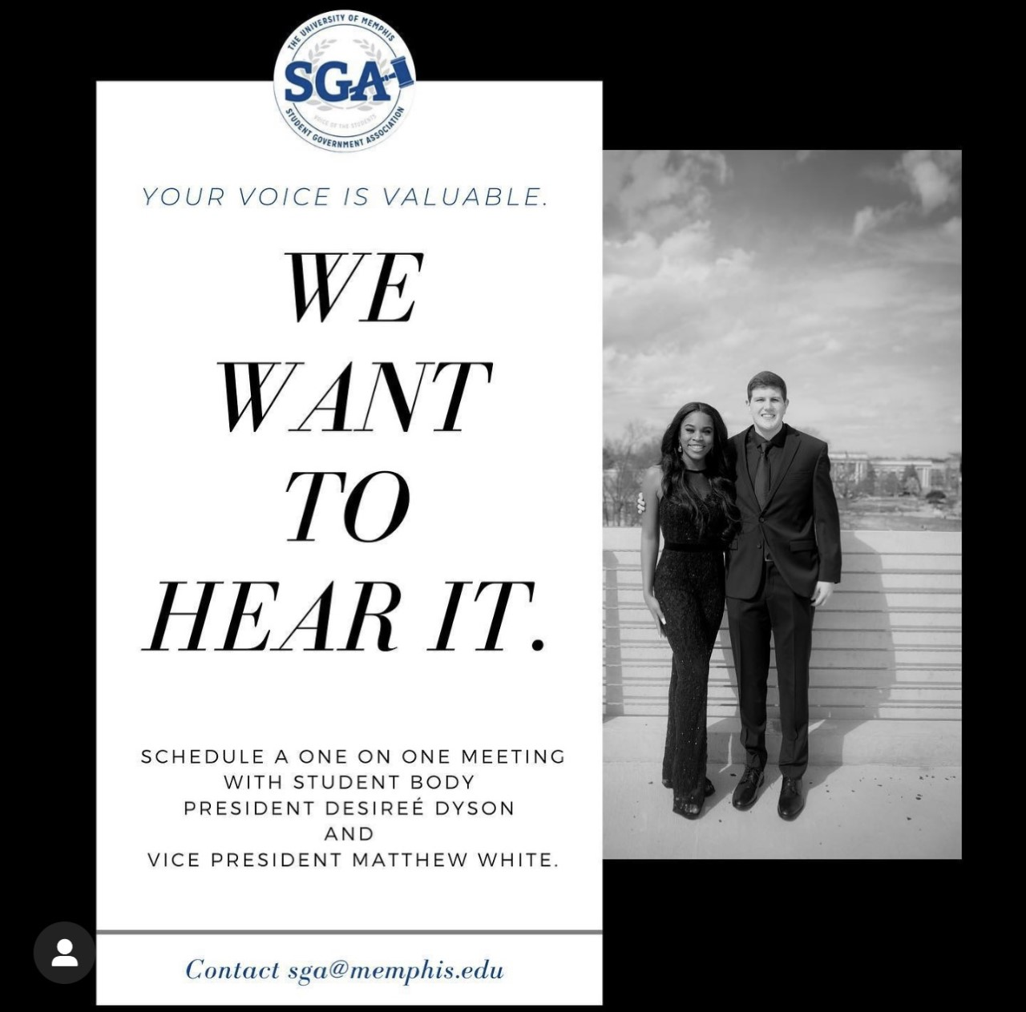
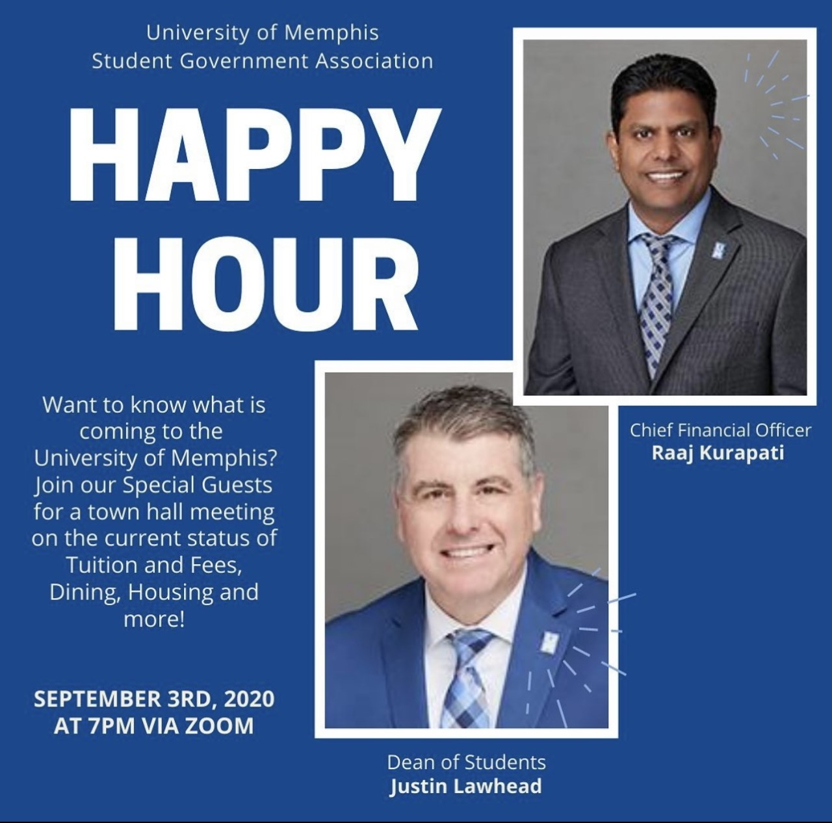
A Little Bit About SGA

Slide 10
COVID-19 Challenges
Academics
Adaptation
Mental Health
Financial Hardship

Slide 11
Academics
Daily Access
Online Learning
Work From Home Environment
What The UofM Has Done
Virtual Tutoring
Virtual Advising Appointments
Virtual Student Success Resources
Notes:
Notes:

Slide 12
Adaptation
Friendships
“Hallway Talk”
In-person Classes
On Campus Events
Sporting Events
What SGA Has Done
Social Media
Open Line Policy
Power Hours
Two on One Opportunities
Student Led Focus Groups

Slide 13
Mental Health
Loneliness
Anxiety
Stress
Other Responsibilities
The crushing uncertainty of the next few years
What The UofM Has Done
Virtual Counseling Services
Virtual Group Therapy
Virtual One on Ones
Notes:
Notes:

Slide 14
Financial Hardship
The Uncertainty of the Job Market
Books and Other Class Resources
Housing
Tuition
Food Insecurities
What the UofM Has Done
CARES ACT
Student Emergency Fund
Tiger Pantry
Notes:
Notes:

Slide 15
What Can Be Done Moving Forward?
Planning Ahead
Expand Access
More Small Gatherings
More Funding for Students During Crisis
More Interactive Social Media Posts
More Widespread Interactive Virtual Events Year Round
Hand Hygiene and Respiratory Etiquette Courses
Adequate Supplies Readily On Hand For All

Slide 16
Thank you for listening

Slide 17
Cecil C. Humphreys School of Law: Student Trustee Update
Danielle Fong, Student Trustee
Director of Events, Student Bar Association

Slide 18
Memphis School of Law: Student Bar Association
COVID-19 CHALLENGES & ACCOMPLISHMENTS
Lessons Learned Moving Forward
Town Hall
Mental Health
Mentorship Program
Diversity
How can we adapt – not react?
Shift to Virtual Events
Orientation
Trivia Night
Community Service
Drive for the Children Advocacy Center
How can we contribute to our local community?
How can we help students in need?
Notes:
Notes:

Slide 19
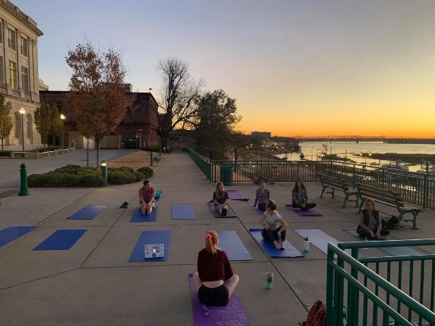
Memphis School of Law: Student Bar Association
STUDENT SUPPORT INITIATIVES: Mental Health
Mindfulness Initiatives
Commission on Lawyer Assistance Programs - Mindfulness in Law Society
Lawyer-led support groups for students
Counselling Center & Telehealth Opportunities
Student Practicum
Additional in-person support for law students
Scheduling days according to semester schedule
Equivalent Access to Main Campus Wellness Programming
Notes:
Notes:

Slide 20
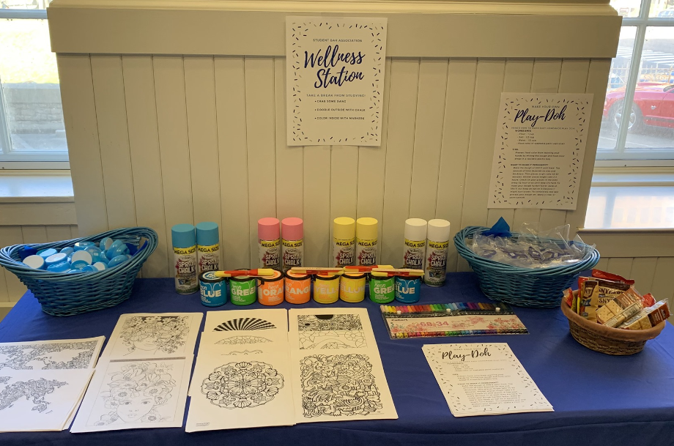
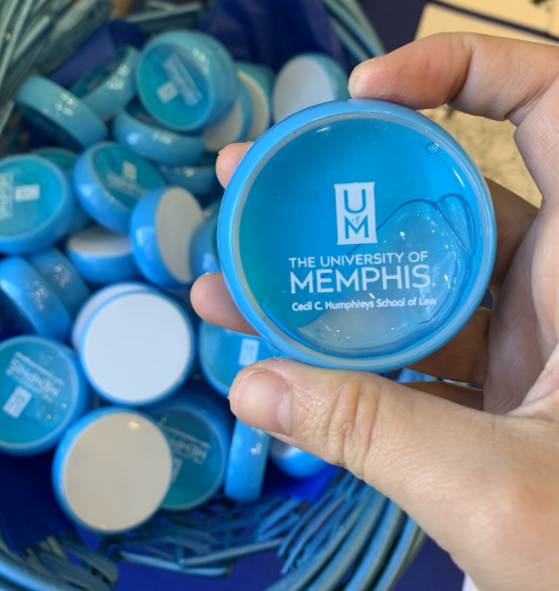
Memphis School of Law: Student Bar Association
STUDENT SUPPORT INITIATIVES: Physical Health
Fitness Programming
YMCA & other local businesses
Student-led groups
Wellness Room
School of Health Sciences Collaboration
Opportunities for both HS and law students
Smoothie Bar
Notes:
Notes:

Slide 21
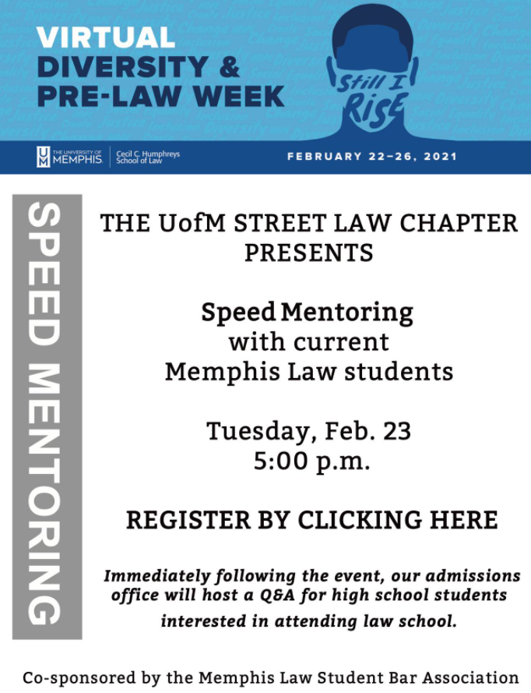
Memphis School of Law: Student Bar Association
STUDENT SUPPORT INITIATIVES: Diversity
Committee on Diversity
Event programming
Diversity Week
Student Panel
Speed Mentoring Event
Reconsideration of Student Organizations
How can SBA better support ALL its students?
How can SBA ensure that ALL students are represented?
Notes:
Notes:

Slide 22
Student Trustee
INITIATIVES FOR THE STUDENT COMMUNITY
Expanding access to wellness programming
Continued, permanent use of telehealth
Eliminate limitations on the number of sessions
Competitive salary for counsellors
Communications between graduate schools and main campus
Increasing opportunities for student input
Collaborating on mutual goals
Notes:
Notes:

Slide 23
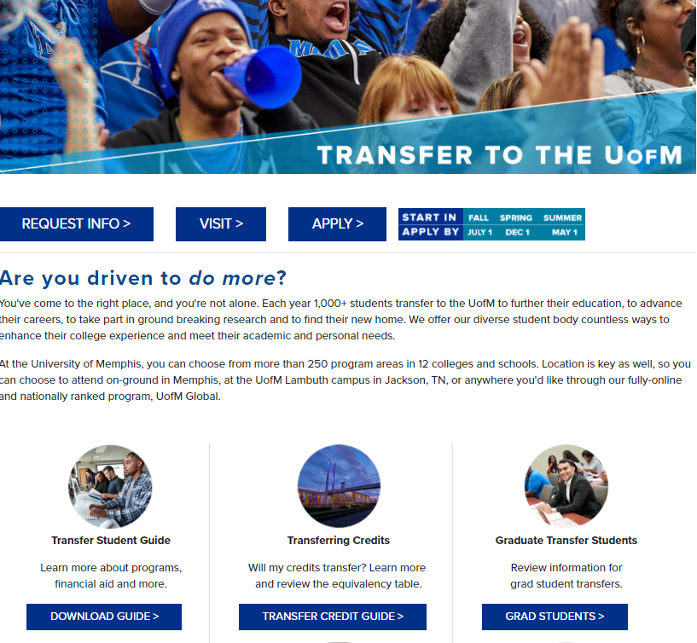
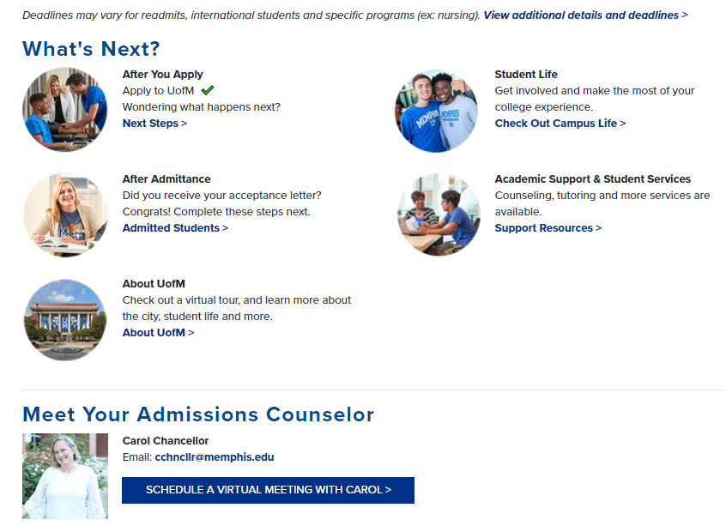
Student Trustee
INITIATIVES FOR THE STUDENT COMMUNITY
Support to incoming transfer students
Web page exclusively for transfer students
One Step Closer Program
Partnerships with local community colleges’ administrators
Mentorship
Notes:
Notes:

Slide 24
Student Trustee
SUCCEEDING STUDENT TRUSTEE GUIDANCE
Increased Communication
Regular meetings with administrative and student leaders, and with relevant Board of Trustees (BOT) committees
Quarterly or monthly meetings with prior student trustee
Structured guidance memorandum
Preceding trustee’s ongoing projects and initiatives
Suggested projects to undertake
Issues currently confronting the university
What to expect, who to communicate with and when
Creating a regular forum for ALL student input
Town Halls
Communication between the undergraduate schools, graduate schools, and student trustee
Meetings with all student leaders
Increased representation of graduate and doctoral students
Notes:
Notes:

Slide 25
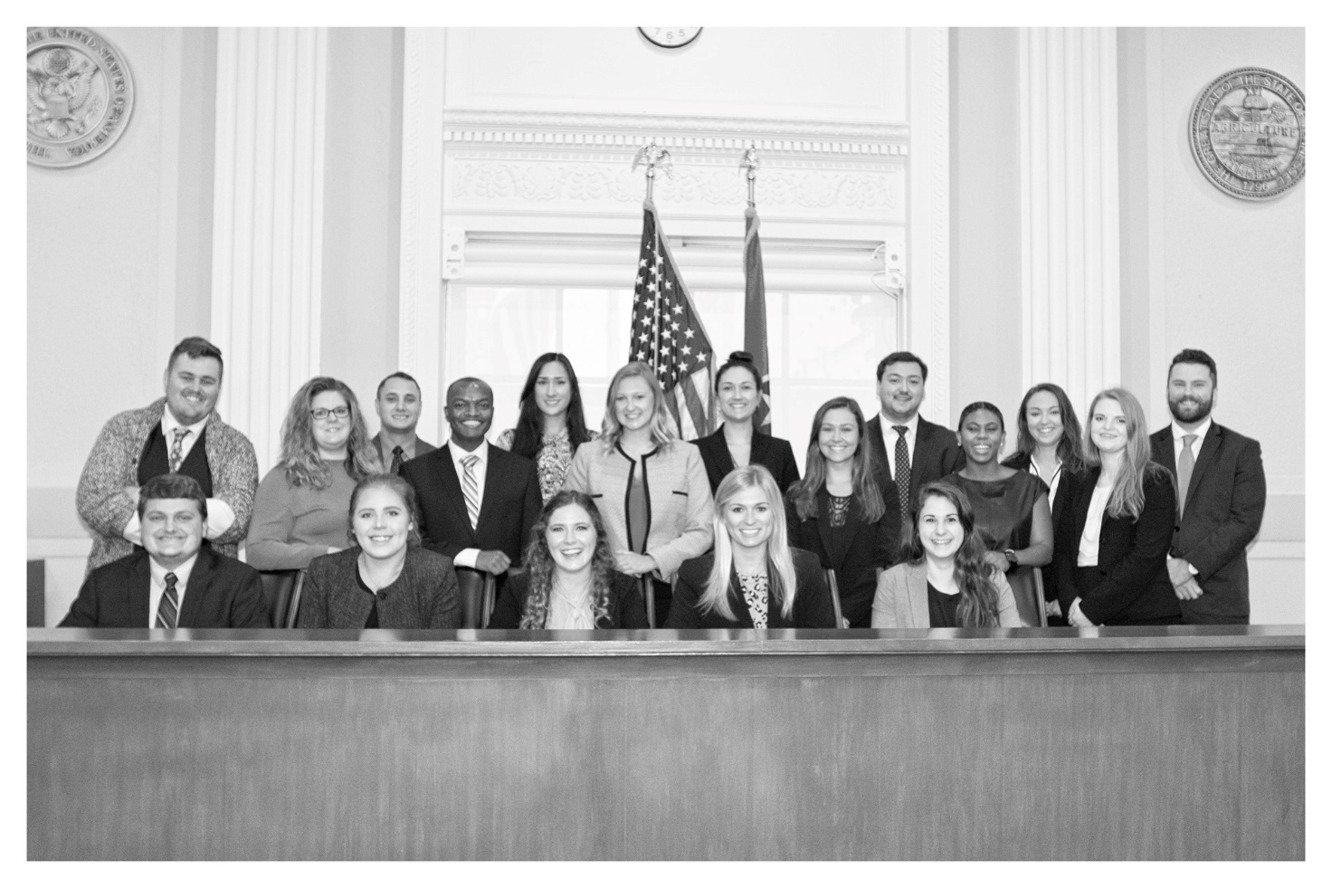
Thank you for your consideration!

Slide 26
Eradicating Systemic Racism and Promoting Social Justice Initiative Update
Dr. Karen Weddle-West, Vice President of Student Academic Success
Daphene McFerren, Esq., Executive Director, Benjamin L. Hooks Institute for Social Change
Linda G. Hall, Associate Dean of Multicultural Affairs

Slide 27
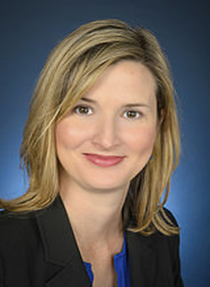
Closing Gaps in Retention and Completion of Students from Historically Underrepresented, First-Generation and Low-Income Populations
Co-Leads
Workgroup Members
Dr. Bill Akey, Clinical Professor, Leadership Department, College of Education
Dr. Barbara Bekis, Assistant Director, Educational Support Program
Kaylon Bradford, Director, Student Leadership and Involvement
Julia Byrd, Student, Biomedical Engineering
Ryan Crews, Coordinator, Student Success, Student Academic Success
Dr. Russ Deaton, Associate Dean for Academics, Herff College of Engineering
Marlon Dechausay, Associate Athletic Director, Student-Athlete Welfare, Athletics
Dr. Olusegun George, Professor, Department of Mathematical Sciences, College of Arts & Sciences
G.L. Guy, Coordinator/Counselor II, Center for Academic Retention & Enrichment Services (CARES)
Melvyn Harding, Director, Student Success Programs (TRIO)
MJ James, Coordinator, Veterans and Military Services
Andrew Linn, Associate Director, Student Financial Aid
Dr. Linh Luu, Associate Director, Training Director-Internship and Practicum, Counseling Center
Braden Mangavalli, Student, Mechanical Engineering Major
David Martinez, Student, International Relations
Trellis Morgan, Manager, Academic Advising, Fogelman College of Business & Economics
Shelia Moses, Academic Services Coordinator, Herff College of Engineering
Jennifer Murchison, Assistant Director, Disability Resources for Students
Kyle Nixon, Director of Recruitment & Orientation, Undergraduate Admissions and Orientation
Dr. Lavonnie Perry Claybon, Research Asst. Professor/Director, Mid-South Access Center for Technology
Dr. Chuck Pierce, Associate Dean, Academic Programs, Fogelman College of Business & Economics
Dr. Eric Stokes, Assistant Vice Provost, Strategic Enrollment Systems
Connie Thiemonge, Assistant Director, Alumni Relations
Ryan Wade, Program Manager/Graduation Coach, Multicultural Affairs
Cortez Washington, Associate Director, Career Services
Cory Major
Director
Office of First-Generation Student Success
Dr. Stephanie Ivey
Associate Dean for Research,
Herff College of Engineering; Professor of Civil Engineering
Goal: Eliminate Completion & Opportunity Gaps
a.) Collaborate with Career Services to Create College to Career Program
b.) Develop College to Career Resources for Faculty
c.) Develop Experiential Degree Maps

Slide 28
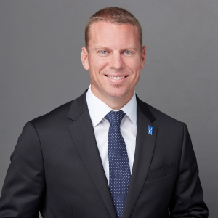
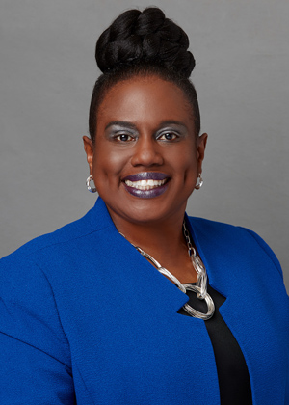
Recruiting, Hiring and Retaining Tenured and Tenure-Track
African American Faculty and Other Faculty of Color
Co-Leads
Workgroup Members
• Richard J Bloomer, Dean, College of Health Sciences
• Beverly Greene Bond, Professor of History, College of Arts and Sciences
• Rosie Phillips Davis, Professor of Counseling, Educational Psychology and Research
• Linda Jarmulowicz, Dean, School of Communication Sciences and Disorders
• Enrica N Ruggs, Assistant Professor of Management, Fogelman College of Business and Economics
• Kevin M Sanders, Director, Rudi E. Scheidt School of Music
• Katharine Traylor Schaffzin, Dean, Cecily C. Humphreys School of Law
• Richard Joseph Sweigard, Dean, Herff College of Engineering
• Lan Wang, Chair, Department of Computer Science
• Melanie Murry, Esq., University Counsel
Doctoral Student Researchers Doctoral student researchers supported the working group under the supervision of Dr. Enrica Ruggs
• Della Clark, PhD student (year 1), Department of Marketing and Supply Chain Management
• Ashley Robinson, PhD student (year 1), Department of Management
• Feigu Zhou, PhD student (year 1), Department of Management
• Darel Hargrove, PhD student (year 1), Department of Management
Dr. Damon Fleming
Dean, Fogelman College of Business and Economics; Professor of Accountancy
Dr. Kandi Hill-Clark
Dean, College of Education;
McRae Endowed Professor of School-Based Clinical Practice
Goal: Enhance Diversity in Faculty Hiring
a.) Build faculty diversity pipelines with strategic partners (i.e., MSI’s, HBCU’s)
b.) Identify, develop and report on relevant, attractive collaborations (e.g., academic programs, post-doc programs to promote win-win partnerships
(i.e., what can we offer partners and what do we need from partners) Ex. Meharry Medical College Partnership

Slide 29
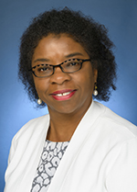
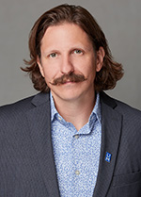
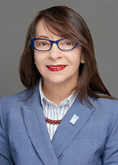
Community Engagement, Policy and Advocacy
Co-Leads
Workgroup Members
Internal
Katherine Lambert-Pennington, School of Urban Affairs and Public Policy
Zack Carr, Center for Service Learning and Volunteerism
External
Josh Spickler, Just City
Mauricio Calvo, Latino Memphis
Michael Scarborough, Greater Memphis Chamber
Justin Merrick, Center for Transforming Communities
Deveny Perry / Courtney Thomas, BLDG Memphis
Eric Robertson, Community LIFT
Mario Brown, First Horizon
Daphene McFerren, Esq.
Executive Director
Benjamin L. Hooks Institute for Social Change
Dr. Charlie Santo
Department Chair
Department of City and Regional Planning; Associate Professor
Dr. Elena Delavega School of Social Work; Associate Professor
Goal: Develop a multifaceted communications and networking strategy that increases awareness of community engagement, social justice efforts, and
engaged scholarship/other scholarship (research).
a.) Engage with University of Memphis internal and external media department to craft marketing and mass media presence
b.) Communicate research and scholarship to the community and enhance access to information, including data, research results, and publications such as
policy papers etc.

Slide 30
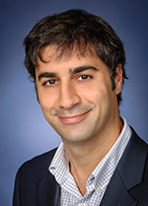
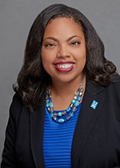
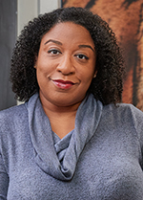
Training for Faculty, Staff and Students-Cultural Competence
Co-Leads
Workgroup Members
Wendy Bedwell-Torres (Management)
Kennedi Brown-Willis (student)
Melanie Drisdale (HR)
Steven Nelson (Education)
Kathy Lou Schultz (English)
Sarah Stuart (Facing History and Ourselves)
Dr. Aram Goudsouzian
Professor
Department of History
Kristil Davis
Director, HR Strategic Initiatives
and Talent Management
Tiffany Baker Cox
Director, Institutional Equity & Chief Compliance Officer
Goal: Develop a Diversity, Equity & Inclusion Certificate for Employees
a.) Develop a certificate program designed to provide training on fundamental aspects of intercultural competency with options for employees to deepen their development with multiple levels of learning. Earning the Certificate could be used for professional development and considered in criteria for promotions
b.) Select UofM faculty and staff qualified to develop and facilitate the curriculum for courses/training that comprise the certificate program

Slide 31
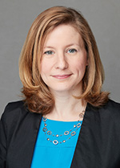
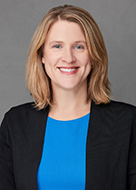
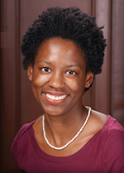
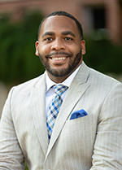
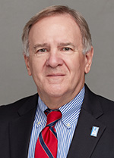
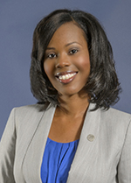
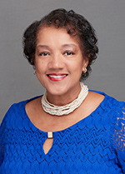
Infrastructure, Support and Assessment of Initiative
Co-Leads
Bridgette Decent Director, Office of
Institutional Research
Daphene McFerren, Esq.
Executive Director
Benjamin L. Hooks Institute for
Social Change
Joanna Curtis Chief Advancement Officer,
Office of University
Advancement
Alena Marie Allen Associate Professor, Cecil C. Humphreys School of Law
Brandon Henderson President, University of Memphis
Black Alumni Chapter
Dan Strahl, MS Associate Director of Research for the
Center for Research in Educational Policy
Summer Owens President, UofM Alumni Association
Rorie Trammel Associate Director, Benjamin L. Hooks Institute for Social Change
Goal: Increase racial minority participation in university advisory boards and search committees to reflect the student composition of the respective colleges and units.
a.) Formulate guidelines for filling advisory board and search committee positions.
b.) Create a guide and reference lists for soliciting minority participation in advisory boards and search committees.

Slide 32
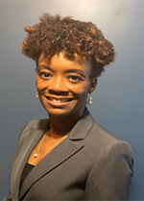
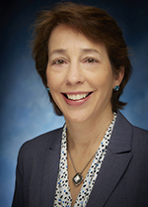
Equity in Pay and Career Progression
Co-Leads
Workgroup Members
Judy Bell - Judy Bell Consulting
Kara Leigh Bowen – Assistant Director of Admissions, University of Memphis Cecil C Humphreys School of Law
Dr. Jamein Cunningham – Assistant Professor, Department of Economics, University of Memphis Fogelman College of Business and Economics
Tony Evans - Physical Plant HVAC, University of Memphis
Dr. Dorothy Hale – Assistant Director, Student Services, University of Memphis College of Professional and Liberal Studies
Nichole Love, MBA – Memphis Airport Authority and member of Mid-South Compensation Association
Lisa Moore - President and CEO of Girls Inc. of Memphis Ceecy Reed - Sr. Coordinator of Equity Programs, University of Memphis Office for Institutional Equity
Alisha Rose Henderson – Director, University of Memphis Career Services
Minor Vawter - Physical Plant Maintenance Repairs, University of Memphis
Latosha Dexter, Esq. Deputy University Counsel,
Office of Legal Counsel
Judy Edge Corporate Vice President for HR, FedEx Corporation
Goal: Diversity, equity and inclusion are embedded into all aspects of hiring, retention, and career progression so that the University can more effectively provide for student success.
a.) Implementation of consistent communications, actions and accountability to campus community to meet AA/EO obligations and further the values of diversity, equity and inclusion
b.) Embed Affirmative Action Plan into recruitment and hiring process

Slide 33
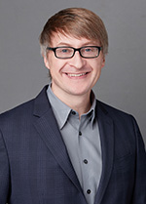
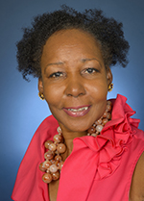
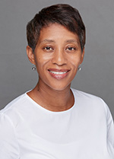
Curriculum – Infusing Diversity, Equity Inclusion and Social
Justice Into Existing Courses/Curriculum
Co-Leads
Workgroup Members
Mr. James Beasley (Graduate Student, Philosophy)
Dr. Ryan Fisher (Associate Dean and Associate Professor, College of Communication and Fine Arts)
Dr. Rhema Fuller (Associate Professor of Sport Commerce, Kemmons Wilson School of Hospitality)
Dr. Earnestine Jenkins (Professor, Department of Art)
Dr. Daniel Kiel (Professor, School of Law)
Dr. Marian Levy (Associate Dean and Professor, School of Public Health)
Dr. Kim Oller (Plough Chair of Excellence, School of Communication Sciences and Disorders)
Mr. Corey Reed (PhD Candidate, Department of Philosophy);
Dr. Brian L. Wright (Associate Professor and Program Coordinator of Early Childhood Education, College of Education & Coordinator of the Middle School Cohort of the African American Academy)
Dr. Hongmei Zhang (Bruns Endowed Professor, School of Public Health)
Dr. Remy Debes Chair and Associate Professor of Philosophy, Department of Philosophy
Dr. Beverly Cross Lillian and Morrie Moss Chair of Excellence in Urban Education at the UofM
Dr. Ladrica Menson-Furr Associate Professor, English; Director of African and African American Studies
Goal: Identify /Develop Actionable Frameworks for Diversity, Equity, Inclusion and Social Justice
a.) All existing Major Core/Required Courses in Programs/Curriculum should be reviewed and revised to assure they address how racial inequities and social justice are relevant in and to the discipline (e.g., knowledge, impact on society, connections to racism)
b.) Existing programs, majors, concentrations should be reviewed to identify the perspectives shaping them and assure that any gaps, inaccurate representations, and absence of diversity and inclusion are addressed

Slide 34
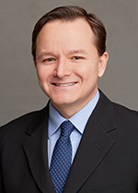
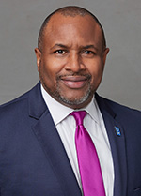
New Program Development: Race and Social Justice
Co-Leads
Workgroup Members
Dr. Will Adams, Staff Psychologist, Counseling Center
Nathaniel Ball, Media and Programs Coordinator, Hooks Institute for Social Change
Dr. Carol Danehower, Associate Professor, Department of Management and Chair, University Undergraduate Council
Dr. Will Duffy, Associate Professor, English
Terri Lee Freeman, President, National Civil Rights Museum
Dr. Joanne Gikas, Associate Dean, College of Professional & Liberal Studies
Dr. Matt Haught, Assistant Chair and Associate Professor, Department Of Journalism and Strategic Media
Dr. Robin Poston, Professor, Department of Business Information and Technology, and Dean of the Graduate School
Dr. Ron Serino, Instructor, College of Professional & Liberal Studies
Dr. Maurice Williams, Associate Director, Institute on Disability TigerLIFE (Learning Independence, Fostering Employment & Education)
Danesha Winfrey, College Academic Advisor, College of Professional & Liberal Studies
Dr. Randy Floyd Chair and Professor, Department of Psychology
Dr. Andre E. Johnson Associate Professor of Rhetoric and Media Studies, Department of Communication and Film
Dr. Ladrica Menson-Furr Associate Professor, English; Director of African and African American Studies (Liaison)
Goal: Develop a strategic plan of action to review requests for programming within the context of existing academic programs focused on race and social justice to
determine need and avoid duplication.
a.) Identify a work group and administrative representatives to seek university approval for modified or new items to appear in proposal guidelines.
b.) Ensure that proposals for new courses, majors, minors, concentrations, programs, and certificates address the goals of eradicating racism and
promoting social justice

Slide 35
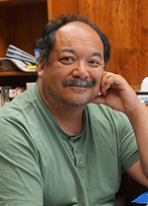
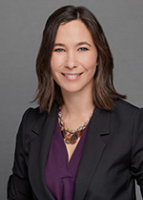
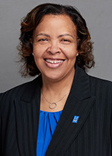
Fostering a Sense of Belonging and Support for All
Co-Leads
Workgroup Members
Lucienne Auz
Marella Baccay
Tara Marie Buchannan
Daniel A Bureau
Gloria Fulton Carr
Z U Ivy
Rebecca Howard
Latica Monique Jones
Holly Lau
Chelsea Dawn Liddell
Richard A. Lou
Amillyon Riley
Amanda Lee Keikialoha Savage
Linda Steele
Isabel Machado Wildberger
Shan'Ternera Aqua'Netta Williams
Leah Windsor
Dr. Richard Lou Professor and Chair, Department of Art
Amanda Lee Savage
Instructor & Undergraduate Advisor, Department of History
Latica Jones Business Officer III, College of Arts and Sciences
Goal: Create Symposia/Conferences on Race/Social Justice/Community Building (possibly revenue generating)
a.) Select units that will lead and support efforts for organizing conference
b.) Enlist faculty, staff and students from a broad spectrum of disciplines to collaborate on organizing and generating topics for conference, dates.

Slide 36
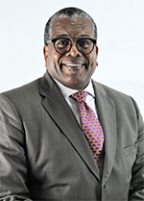
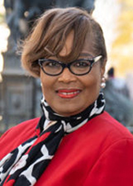
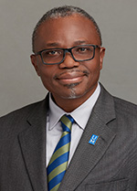
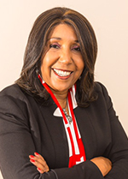
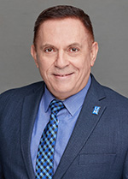
Contracting with Minority Businesses
Co-Leads
J. W. Gibson Chairman and CEO Gibson Companies
Beverly Robertson CEO, Greater Memphis Chamber
Dr. Albert Okunade Professor, Department of Economics;
George Johnson Fellow in Research,
Fogelman College
of Business and Economics
Carolyn Hardy President, Chism Hardy Investments
Nick Pappas Executive Director, Procurement and Contract Services
Goal: Enhance current diversity supplier program and establish measurable objectives connected to performance reviews.
a.) Develop appropriate staffing plan to implement the Annual Supplier Diversity Program
b.) Update current Diversity Supplier Program to reflect the evolution of University’s business requirements and objectives

Slide 37
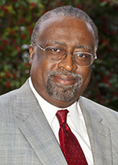
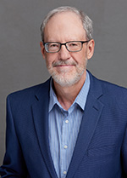
Institute for Public Service Reporting/Radio
Partnership with Crosstown Concourse
Co-Leads
Workgroup Members
Anne Hogan, dean of the College of Communications and Fine Arts
TK King, instructor and coordinator of student radio
Tori Cliff, instructor, Journalism & Strategic Media, Lambuth Campus
Venita Doggett, director of development, College of Education
Karen A. Hall, director of IT Security and Identity Management
Jeremiah Hall and Jordin Jackson, students, Journalism & Strategic Media
Yancy Villa-Calvo, Memphis artist, 2020-2021 Kennedy Center Citizen Artist Fellow
Otis Sanford Professor, Hardin Chair of Excellence in Economic and Managerial Journalism, Department of Journalism and Strategic Media
David Waters Investigative Journalist; Assistant Director of the Institute for Public Service Reporting
Goal: To explore, explain and expose systemic racism here in its many forms to inform, educate, and enlighten the public through the work of the Institute for Public Service Reporting, broadcasts on our partnership station WYXR, and the student-led campus livestream.
a.) To describe the reality and consequences of systemic racism in the Memphis area and explore efforts to address systemic racism and promote social justice.
b.) Institute faculty members, student interns, and community advisory board members will discuss ideas for print, audio and video stories that explore one or more aspects of systemic racism in Memphis; assign selected stories to faculty members and student interns for future publication in The Daily Memphian and the institution’s website.

Slide 38
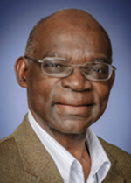
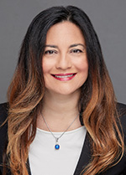
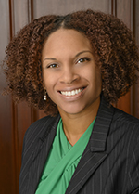
Recruiting and Graduating African American Doctoral/Law
Students and Other Graduate Students of Color
Co-Leads
Workgroup Members
Kara Bowen, Asst Dir of Admission, Law School
Michael Houston, PhD Student, Dept. of Marketing & Supply Chain Management
LaVonda Clay, Student
Chaylin Garrett, Student
Vivian Morgan, Student
Don Rodrigues, Asst. Professor, Dept of English
Lilith Green, Student
Raven Cohen, Student
Kirbi Tucker, Coordinator for Graduate Recruitment
Latetrica Wilson, Student
Daniel Baker, Assoc. Professor, Department of Chemistry
Earnestine Jenkins, Professor, Department of Art
Miah Cobb, Student
Jane Brown, Student
Latrina Stewart, Community Member
Kimberly Bledsoe, Student
Helen Shaw, Student
Tony Pinson, Project Coordinator, Center for information Assurance
Dr. Ebenezer Olúṣẹ́gun George Professor of Mathematics, Department of Mathematical Sciences
Dr. Esra Ozdenerol Professor, Department of Earth Sciences; Director of GIS Certificate program, Director of SAGE (Spatial Analysis and Geographic Education) Laboratory
Demetria Frank, Esq. Associate Professor,
Director of Diversity,
Cecil C. Humphreys
School of Law
Dr. Richard Irwin Professor of Sport Commerce, Kemmons Wilson School of Hospitality & Resort Management; Executive Dean of the College of Professional and Liberal Studies and UofM Global
Goal: Increase application pipeline of URM graduate students by 10% each year for the next three years.
a.) Among the 107 HBCUs, select a subset of 30-50 for focused recruiting and develop a program of early interaction with promising junior and senior students, especially those with STEM majors. Also target AA junior and senior AA students in midsouth colleges and universities for early UM faculty interaction.
b.) Increase marketing of Prior Learning (PLA) for graduate students such as use of credit by exam, transfer credit, Experiential Learning Credit. Also, promote option to utilize certain number of credit hours of master level coursework to doctoral program.

Slide 39
Branding
Co-Leads
Workgroup Members
Nikita Bell
Kimberly Grantham
Katrina Heard
Tony Poteet
Otis Sanford
Katie VanLandingham
Willie Williams
Ted Townsend Chief Economic Development and Government Relations Officer, Office of Economic Development and
Government Relations
Tammy Hedges Executive Vice President for University Relations
Kathy Johnson Director of Space Planning, Utilization and Administration
Goal: Better visibly acknowledge and recognize diversity on campus through naming and branding.

Slide 40
Branding
Goals for Branding workgroup accomplished 2020-2021 Academic Year:
Placed historical marker at Jones Hall where the office of Dr. Miriam DeCosta Sugarmon, the first Black faculty member, was located.
a. President Rudd, administrators, faculty, staff, students, legislators, alumni and family participated in the marker ceremony, December 14, 2021
(per Board of Trustees approval on December 2).
Marker Copy:
A Phi Beta Kappa graduate of Wellesley College, later earning her MA and PhD degrees from Johns Hopkins University, Miriam DeCosta Sugarmon was denied entrance to then Memphis State University in 1957. In 1966, she became the first Black professor at the University where she taught Spanish, was the advisor to the Black Student Association, and helped organize the Faculty Forum.
Rename the Alumni Mall to the Luther C. McClellan Alumni Mall in honor of our first African American graduate.
a. McClellan was one of the Memphis State Eight and was the first African American to graduate from the UofM, earning his Bachelor of Science
degree in mathematics in 1962. A historical marker will be dedicated in his honor. All signage, campus maps and related collateral will be designed.
Named the University Center the Maxine A. Smith University Center.
a. In 1957, Smith was denied admission to pursue graduate studies at the University of Memphis because she was African American. Among her many notable efforts, Smith went on to become involved with the NAACP where she was executive secretary; assisted in desegregating Memphis public schools; served on the Memphis Sanitation Strike committee and was the first African American elected to the Memphis City Board of Education, later being appointed by Governor McWherter to the Tennessee Board of Regents which served as the governing body for many public colleges and universities across Tennessee including the UofM. She was awarded an honorary doctorate from the University of Memphis in 2010.

Slide 41
Health Disparities and Academic Achievement
Co-Leads
Workgroup Members
Dr. Marian Levy (SPH)
Dr. Eric Bailey (LCON)
Dr. Tasma Robertson (LCON)
Dr. Gregory Washington (Social Work)
Dr. Justin Lawhead (Dean of Students)
Asia Monique Cross (Nursing Student)
Danielle Youssef Husseini (Law School Student)
Randolph Potts (Community)
Dr. Jerry Watson (Social Work)
Dr. Lin Zhan Dean and Professor of Loewenberg College of Nursing, Wharton Executive Fellow
Dr. Jebose Okwumabua Professor, College of Health Studies
Goal: Eliminate barriers related to the intersection of health disparities, systemic racism and academic achievement of our students.
a.) Strengthen SNAP (Supplemental Nutrition-Assistance Program) initiative to ensure all eligible students are enrolled in program, and provide support staff, perhaps via federal funding, to implement service activities.
b.) Strengthen mental health services to underserved student populations, and ensure diversity, inclusivity, and equity among providers representative of student diversity.

Slide 42
Assessment Plan
Assessment Strategies
A 3-phase rubric is used for all 14 working groups to standardize assessment activities across teams with disparate goals and strategies, and plan for scheduled measurements of the status of progress towards strategies. Teams have identified strategies, metrics, and benchmarks to monitor progress during the three phases using SMART goals: Specific, Measurable, Achievable, Relevant, Time-Bound.
Successful initiative assessment requires centralized communication, collaboration, and ongoing assessment of progress towards goals throughout the lifecycle of the initiative. This includes collaboration with the Office of Institutional Research, outsourcing qualitative analysis to the Center for Research in Education Policy and adequately staffing key offices that provide DEI programming and conduct assessments.

Slide 43
Example of Assessment with Metrics and Benchmarks
Closing Gaps in Retention and Completion of Students from Historically
Underrepresented, First-Generation and Low-Income Populations
Goal 1: Eliminate Opportunity Gaps - eliminate Opportunity Gaps among future and current UofM students from first-generation, low-income, and underrepresented backgrounds (focus populations).
Strategy 1 | Partner with pk-12 schools, area community colleges, community-based organizations, and the UofM community (e.g., faculty, staff, students, alumni and administrators). | Phase 1 | Phase 2 | Phase 3
Metrics | Number of partnerships with community colleges, community organizations, and external stakeholders. | Baseline | Baseline + 5% | Baseline + 10%
 | Perceptions of partner stakeholders (survey). | Baseline | Baseline + 5% | Baseline + 10%
 | Number of completed applications from focus populations (baseline Fall 2020) | 10181 | Baseline + 5% | Baseline + 10%
 | Number of students from focus populations enrolled in Freshman class (baseline Fall 2020) | 1190 | Baseline + 5% | Baseline + 10%
 | Yield rate for focus populations for Freshman class (baseline Fall 2020) | .20 | Baseline + 5% | Baseline + 10%
Strategy 2 | Establish a Transfer Student Services Office (TSSO) or program to provide support to students who transfer (or plan to transfer) to the UofM from other colleges and universities, with focus on community college partnerships. | Phase 1 | Phase 2 | Phase 3
Metrics | Number of community college transfer students enrolled (baseline F2020) | Baseline346 | Baseline + 5% | Baseline + 10%
 | Percent of progress made towards establishing TSSO office or program | 0% | 50% | 100%

Slide 44
Implementation/ Next Steps
Co-leaders have prioritized goals from High Impact/Low Cost to Low Impact/Low Cost and will present workgroup reports to President Rudd, Daphene McFerren, Linda Hall, Karen Weddle-West and other Co-Leads: March 2021
Remaining faculty, staff, students and alumni who volunteered to serve on the 14 workgroups will be invited to serve as “Implementation Ambassadors” for the Eradicating Systemic Racism and Promoting Social Justice Initiative

Slide 45
Report and Recommendations of the Academic, Research and Student Success Committee
Trustee David Kemme

Slide 46
Report and Recommendations of the Audit Committee
Trustee Susan Springfield

Slide 47
Report and Recommendations of the Governance and Finance Committee
Chairman David North

Slide 48
Election of Board Chair and Vice-Chair
Chairman David North

Slide 49
Additional Business
Chairman David North

Slide 50
Adjournment
Chairman David North

