Slide 1




A NATIONAL CENTER OF ACADEMIC EXCELLENCE in EDUCATION & RESEARCH (CAE-IAE/CAE-R)

Slide 2

Scavenger Hunt

Slide 3
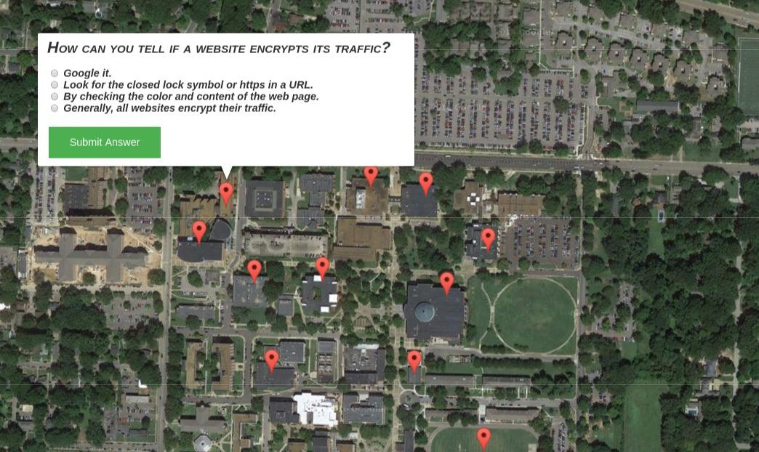
Scavenger Hunt

Slide 4

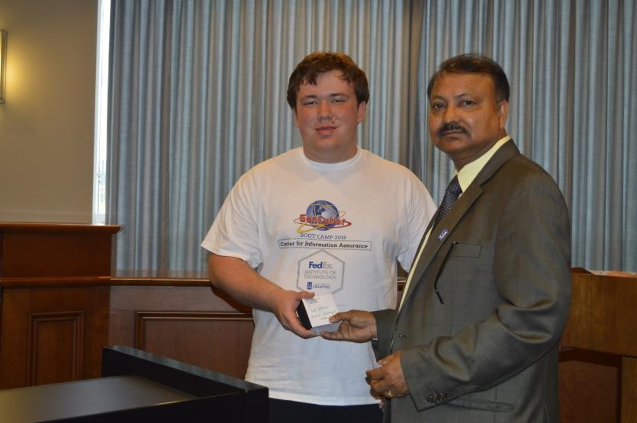

Winner of
Scavenger Hunt Game
Wyatt P. Dolce

Slide 5
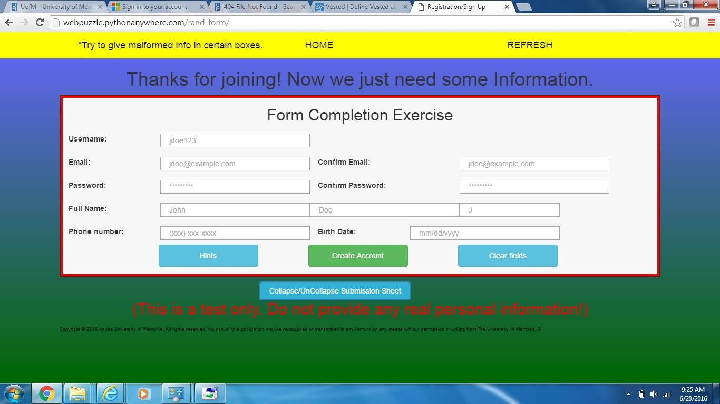
Web Form Testing Exercise

Slide 6
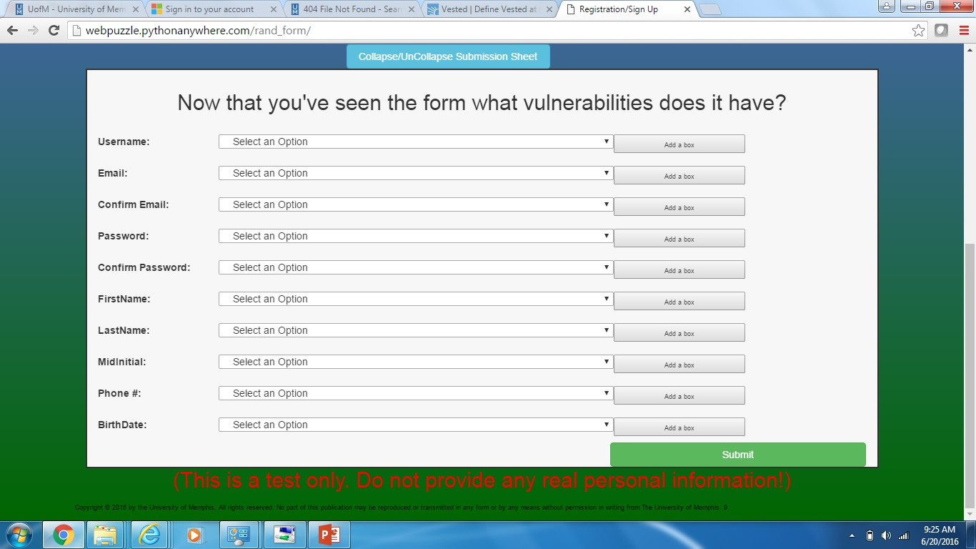
Web Form Testing Exercise

Slide 7
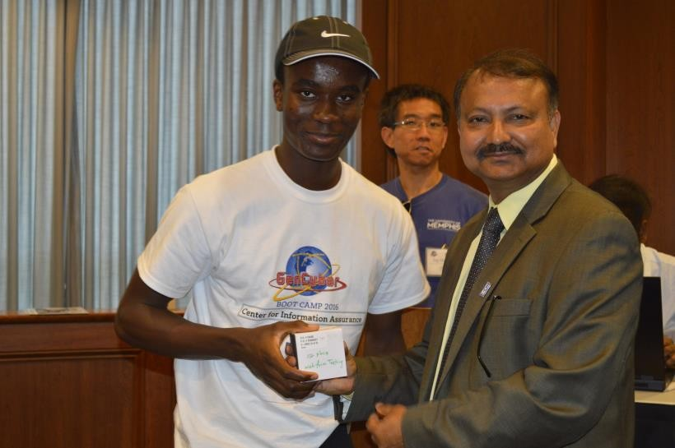
Winner
of
Web Form Testing
Kwaku Opuni-Frimpong

Slide 8
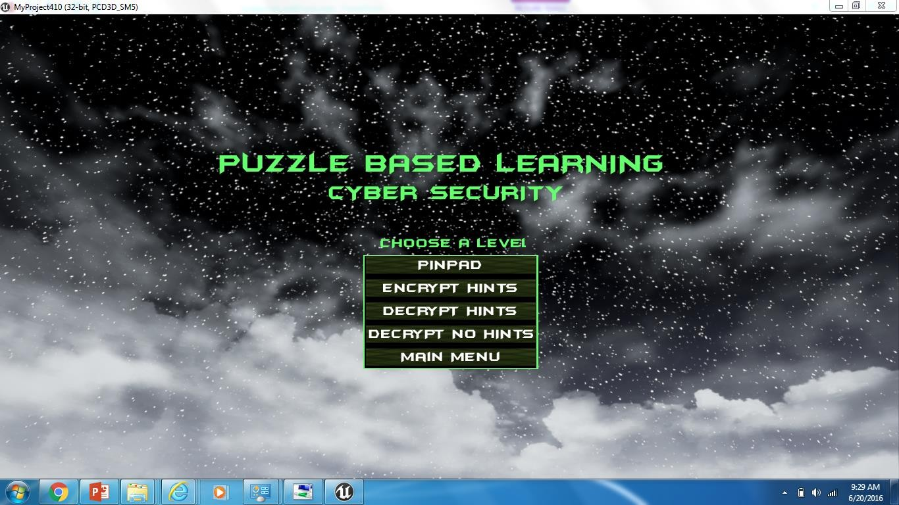
Encryption/Decryption Game

Slide 9
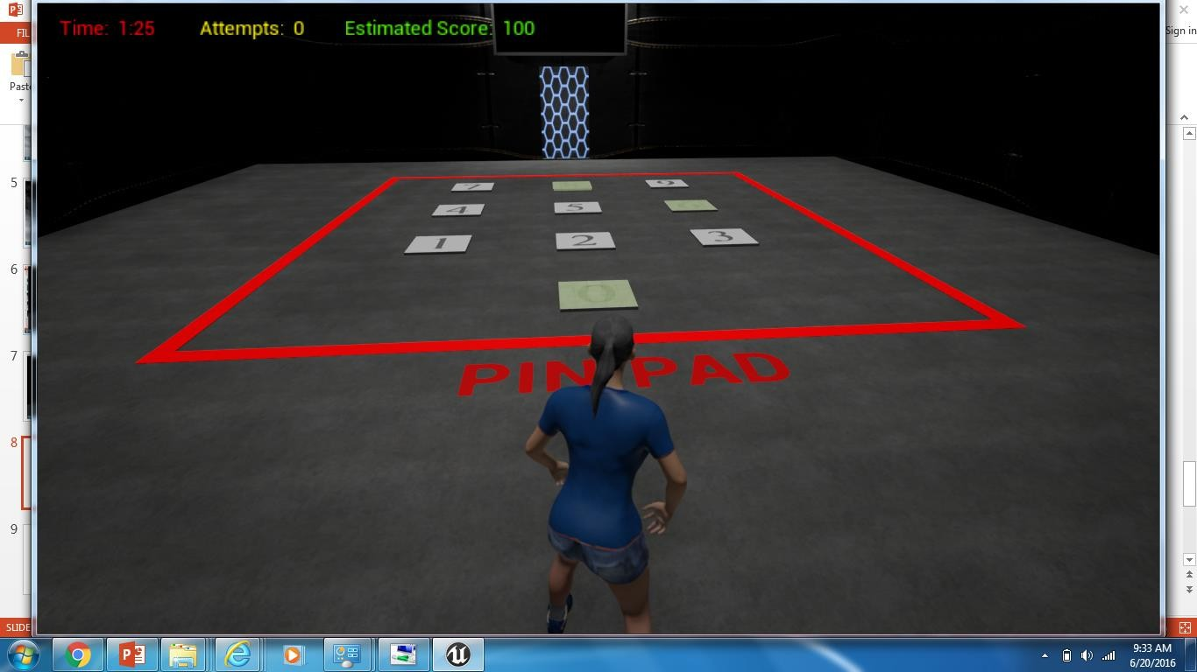
Encryption/Decryption Game

Slide 10
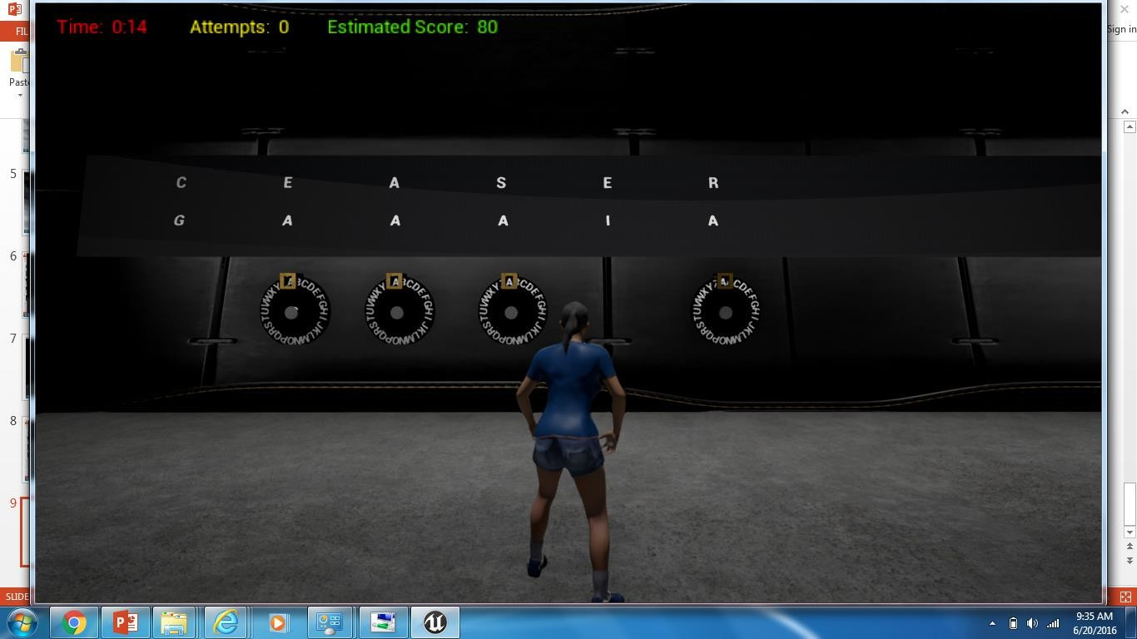
Encryption/Decryption Game

Slide 11
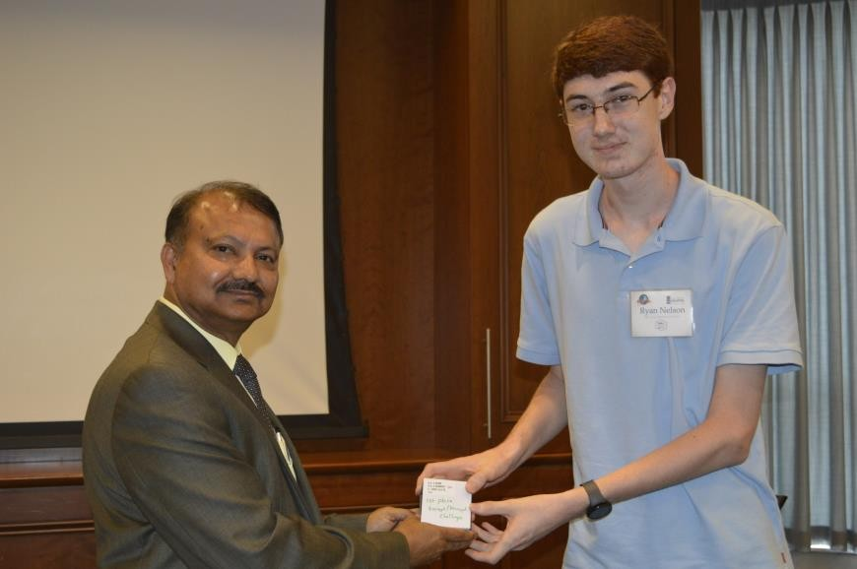
Winner of
Encryption/Decryption Challenge
Ryan M. Nelson

Slide 12


App Development Group Project

Slide 13
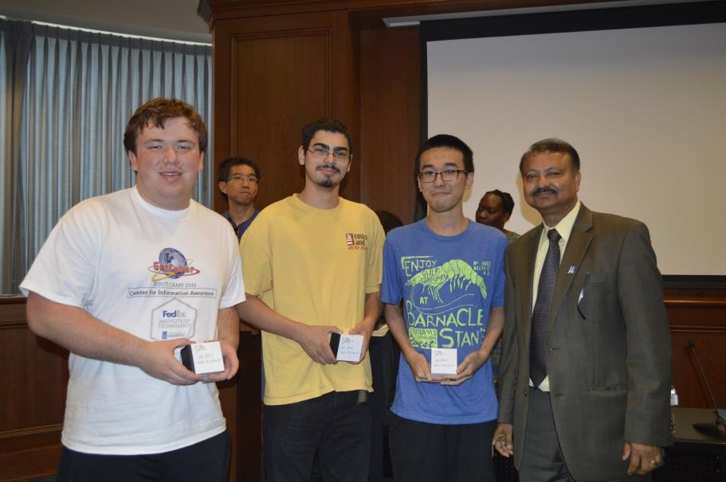
App Development Contest
First Place Team
John Pi (Houston HS), Wyatt Dolce (Houston HS),
Luis Del Mar (Houston HS)

Slide 14
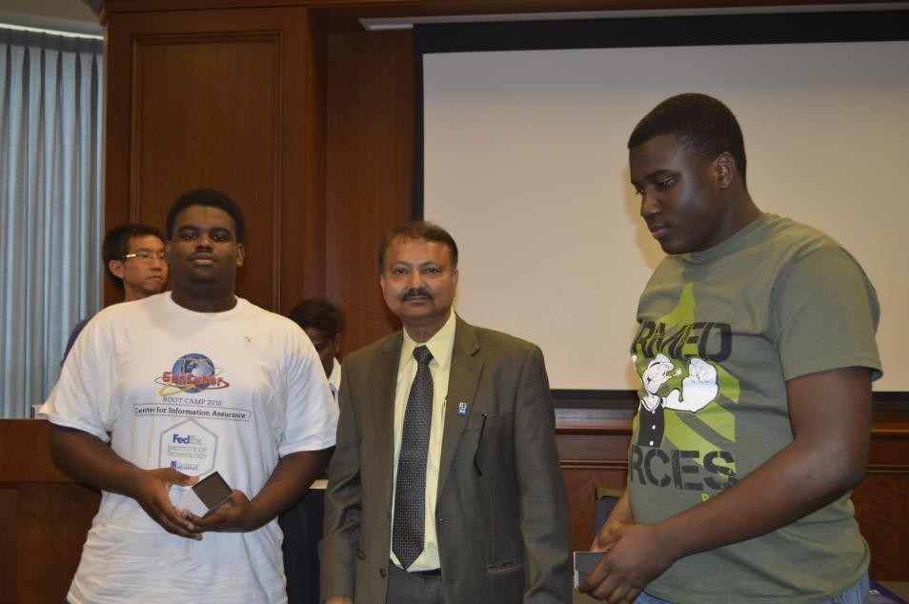
App Development Contest
Second Place Team
Keith Burks (MUS),
Ore Dixon (Cordova HS)

Slide 15
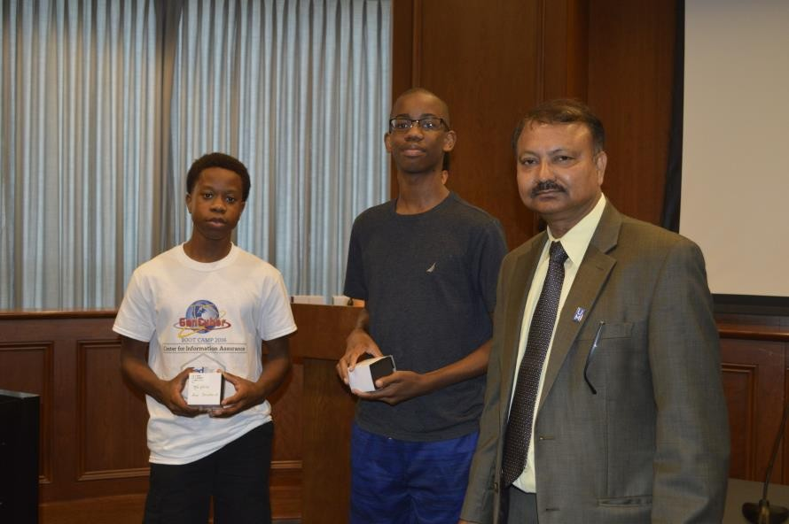
App Development Contest
Third Place Team
Antonio Christopher (Bartlett 9th Grade Academy),
Jordan James(Middle College High School)

