Slide 1

Event Consortium
2-5-19

Slide 2

Event Consortium
Created to assist the campus community with achieving excellent events for the University of Memphis
An opportunity to connect with other campus event planners
Share experiences
Share ideas
Available to answer questions
The Reserve
4,000 sq. ft. warehouse filled with items available for checkout
A resource that adds and improves its inventory

Slide 3
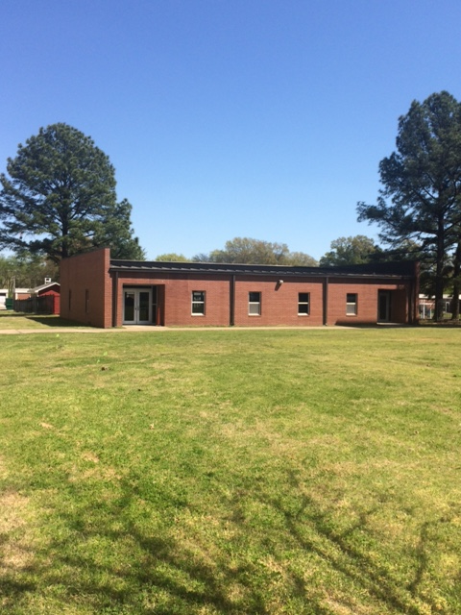
Reserve Location
Reserve
South of Zach Curlin Parking Garage and North of Ball Hall
Annex IV on the campus map
By appointment Only

Slide 4
Event Consortium Check-out Process
Items can be checked out by appointment only Monday – Friday
Monday, Wednesday, and Friday – 9:30 a.m. – 11:00 a.m.
Tuesday and Thursday – 1:30 p.m. – 3:00 p.m.
Call (2793) or e-mail (pcash) for an appointment
Items can be checked-out the day before an event and returned the next day
Check-out form must be completed
Departments are responsible for items broken or not returned
Items to picked-up from and returned to Reserve location only

Slide 5
Event Consortium Web Page
Marketing and Communications Home Page
Events (horizontal gray band)
Event Consortium
http://www.memphis.edu/logo/resources/event_consortium.php

Slide 6
When Planning An Event
Date
Guest List
VIP Guests?
Location
Parking
Invitation
Marketing Manager
Food
Centerpieces
Entertainment
Reserved Seating
Order of Program
Printed program?
Photographer
Check-in Table?
Social Tables

Slide 7

Contact Your Marketing Manager for
Save the Date
Invitations
Program
Email Templates
Yard Signs
Banners
Social Media Graphics
Flyers
Digital & Print
Promotional Items
Directional Signage
Event Brochure
Photography Request
Videography Request

Slide 8
Event Tips
Table linens should go to the floor
Table settings should be consistent throughout the venue
Table Numbers should be from left to right when you enter the room
Chairs should “kiss” the tablecloth
If a program is being used (and not being handed out at the door), it should be centered in each chair so that when they walk up to the chair back they can read it

Slide 9
Event Tips
Check the event space
Prop doors open
Someone should greet guest
Wear Tiger blue
Background music
Reserved seating for speakers and special guests
Sound check and mic check
Event Ready 30 minutes prior to event start time
Start on time

Slide 10
Event Tips
Receptions should be an hour and a half
Try to start lunches at noon
Prop doors open at the end of the event and have someone thank guests for coming

Slide 11
University Event Calendar
http://www.memphis.edu/calendar/
To Request an Event Be Added
Click on Submit Event
Complete Form
Request will be Reviewed
If Approved for the Master Calendar it will be Added

Slide 12
Care of Items
Up-Lights
Turn off before packing
Pack properly in case in divided sections
Make sure all cords are packed in front zipper
Vertical Banners
Do not let them retract quickly
Feed banner into base slowly and evenly to ensure that the caps do not pop off

Slide 13
Care of Items
Tablecloths
Not meant for food tables
Fold neatly and return to hanger
When checking in tell us of any known spots or marks
Acrylic Centerpieces
Do not stack without a layer in between each panel
Pack each section in one pillowcase

Slide 14
Care of Items
Puck Lights
Turn off before packing
Be sure to include remote when packing
Blue and White “M”
Separate sections
Pack each M in one pillowcase

Slide 15
Join the Flower Club
Can contact Pam at pcash@memphis.edu to see if there are any flowers available in the Reserve for a University Event
You can donate flowers from your event to the Reserve to used by other departments

Slide 16
Next Meeting
Fall of 2019

