Slide 1
Experiential
Learning Credit
University of Memphis

Slide 2

Have you gained valuable knowledge and skills throughout your various experiences?
Learn how to Make your experience COUNT

Slide 3
What is the ELC learning portfolio?
The ELC portfolio is a comprehensive collection of reflective essays and evidence that documents and supports a student’s claim of learned skills and knowledge from experiences outside of the traditional classroom that aligns with college credit.

Slide 4
What are the benefits of an ELC prior learning portfolio?
The ELC portfolio can:
Accelerate your time to degree completion.
Save money on tuition.
Provide a comprehensive record of your learned skills and knowledge.
Serve as a more student-centered, self-reflective approach to learning.

Slide 5
Am I a good candidate to develop an ELC portfolio?
  To determine if the ELC portfolio is the right option for you, carefully consider the questions below:
  Can I effectively write about my learning experiences to demonstrate my learned skills and knowledge I have gained?
  Can my learning experiences be validated by a credible outside source?
  Are my prior learning experiences college level, comprising reflective breadth and analytical depth?
  Have my relatively complex learning experiences lasted at least 6 months?
  Is my learning different from coursework credit I have already earned?

Slide 6
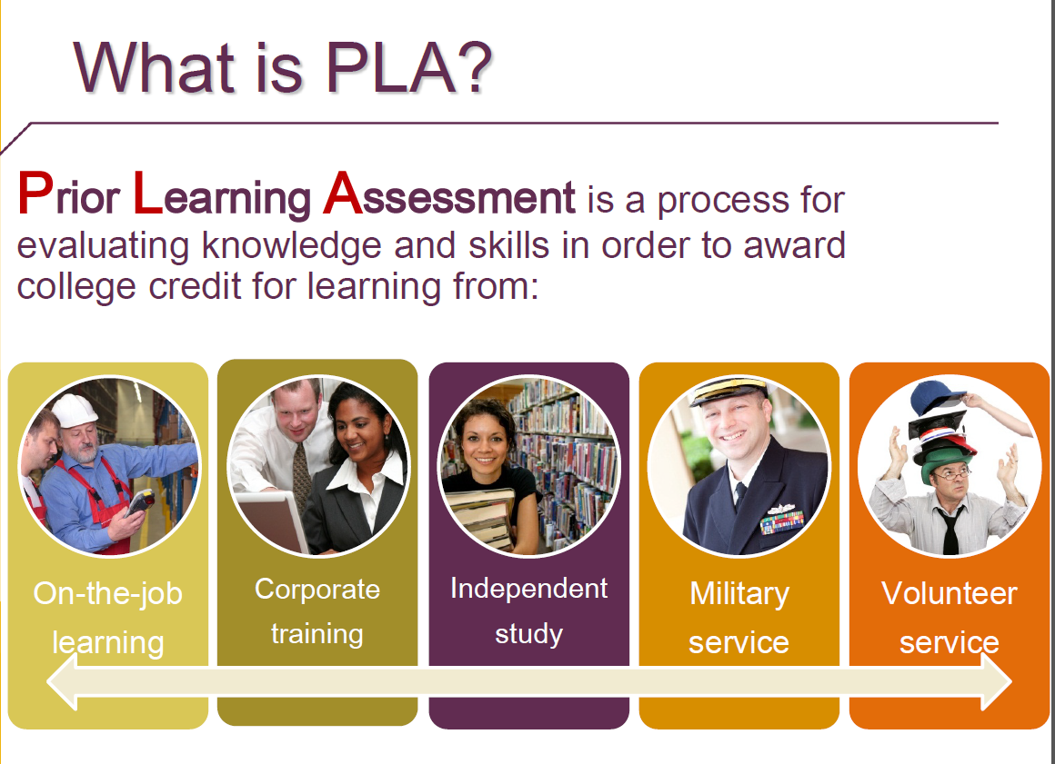
What type of experiences may be worthy of ELC?
Current or Previous Work Experience
Worksite Training/Professional Development
Military Training
Professional Certifications
Entrepreneurship
Volunteerism
Unique Life Experiences
Open Education Resources

Slide 7
What is the online portfolio development course ?
  The ELC portfolio development class (UNIV 3900 / UNIV 7115) is required for current enrolled students who pursue credit for prior learning experiences via the portfolio option. This course is non-tuition and self-paced. The class guides students in creating a learning portfolio that shows what they have learned, how the learning was obtained, and their capability of applying the learning in the future.
  *Please note that the ELC portfolio process is for highly independent students and is very intensive.

Slide 8
What is the online portfolio development course ? Cont.
  This course consists of seven different modules that will help you create your portfolio. Here are the basic components of each module:
Module 1 – Preliminary Prospectus
*Complete Learning Outcomes Worksheet *Develop Preliminary Syllabus *Create Résumé
Module 2 – Target Statement
*Craft the Portfolio Target Statement
Module 3 – Skill and Knowledge Statements
*Understand Bloom’s Taxonomy *Build Skill and Knowledge Learning Outcome Statements *Categorize Skill and Knowledge Statements

Slide 9
What is the online portfolio development course ? Cont.
  This course consists of seven different modules that will help you create your portfolio. Here are the basic components of each module:
Module 4 – Critical Learning Event Narratives
*Understand the Kolb Learning Model *Create Your Learning Timeline
*Identify Critical Learning Events *Reflect on Critical Learning Events
Module 5 – Evidence
*Gather Evidence to Support Learning Outcomes

Slide 10
What is the online portfolio development course ? Cont.
  This course consists of seven different modules that will help you create your portfolio. Here are the basic components of each module:
Module 6 – The Reflective Essay
*Synthesize Critical Learning Events and Learning Outcomes *Develop Reflective Conclusion to Portfolio
Module 7 – Finalize Portfolio
*Create Cover Page and Table of Contents *Assemble the Portfolio Contents *Submit the Portfolio

Slide 11
What are the necessary components of an ELC Portfolio?
Cover Page
Table of Contents
Target Statement
Critical Learning Event Narratives
Reflective Essay
Detailed Resume
Letter of Intent
Timeline of Key Learning Events
Supportive Documentation of your Experiences

Slide 12
How long does it take to develop an ELC Portfolio?
The portfolio requires a significant amount time and effort to write. The process is an investment:
  The course is self-paced, but you are encouraged to develop a timeline with the ELC Coordinator to fit your schedule.
  It is highly recommended that the portfolio be completed within a semester in order to incorporate the ELC award into degree planning. Therefore, you should participate in the portfolio development two semesters before your anticipated graduation.

Slide 13
How is ELC awarded?
Credit is based on the expertise of an anonymous faculty evaluator’s assessment of your learning outcomes demonstrated in the portfolio. ELC is not graded, but rather granted credit hours.
*Please note that credit is not guaranteed for your portfolio.

Slide 14
What is the portfolio evaluation criteria?
The University of Memphis has developed a rubric to direct the ELC award process. The rubric describes the criteria used in the assessment:
Portfolio Presentation – inclusion and organization of all written narratives and supporting documentation.
Survey of Portfolio – demonstration of breadth and depth of content and display of critical thinking, reflective, and problem solving skills.
Learning Essay – thoroughly addressing Kolb’s four stages of Experiential Learning for each learning outcome.

Slide 15
What is the portfolio evaluation criteria?
A portfolio evaluator wants to see:
Strong, college level writing skills;
Specific and concrete learning outcomes that are college level;
Sufficient evidence of learning from valid sources;
Both theoretical and practical understanding of the learning principles and theories;
Transferable skills, competencies, and knowledge that are generally applicable to other contexts.

Slide 16
How long does it take to find out if I have been awarded the credit?
  Faculty evaluation can take 8-12 weeks to properly review and assess the portfolio content for possible college credit.
  The ELC Coordinator will notify you of the anonymous evaluator’s decision via email.

Slide 17
I have experiences that I want to document in an ELC Portfolio. How do I get started?
You will need to complete four steps in order to get started.
Contact your Academic Advisor.
Complete the Letter of Intent (LOI).
Submit the Portfolio Deposit.
Forward your LOI and a copy of your payment receipt to: elc_program@memphis.edu
CONTACT YOUR ACADEMIC ADVISOR
The Letter of Intent allows you to identify the areas of your expertise for which you hope to receive ELC hours and serves as your agreement for participating in the portfolio development process.
SUBMIT YOUR PORTFOLIO DEPOSIT
Undergraduate students are required to submit a $75.00 Portfolio Evaluation Deposit.
Graduate students are required to submit a $100.00 Portfolio Evaluation Deposit.
The deposits are applied to your first hour of awarded ELC should you be granted credit for your portfolio.
Forward your LOI & Deposit
Forward your Letter of Intent and proof of your deposit to elc_program@memphis.edu.
You then will receive access to the online ELC course to begin developing your prior learning portfolio.
COMPLETE THE LETTER OF INTENT
Your Academic Advisor will assist you in determining if ELC might be applicable to your degree. If so, you and your Advisor will discuss the specific areas of study and the number of credit hours you may petition for ELC.

Slide 18
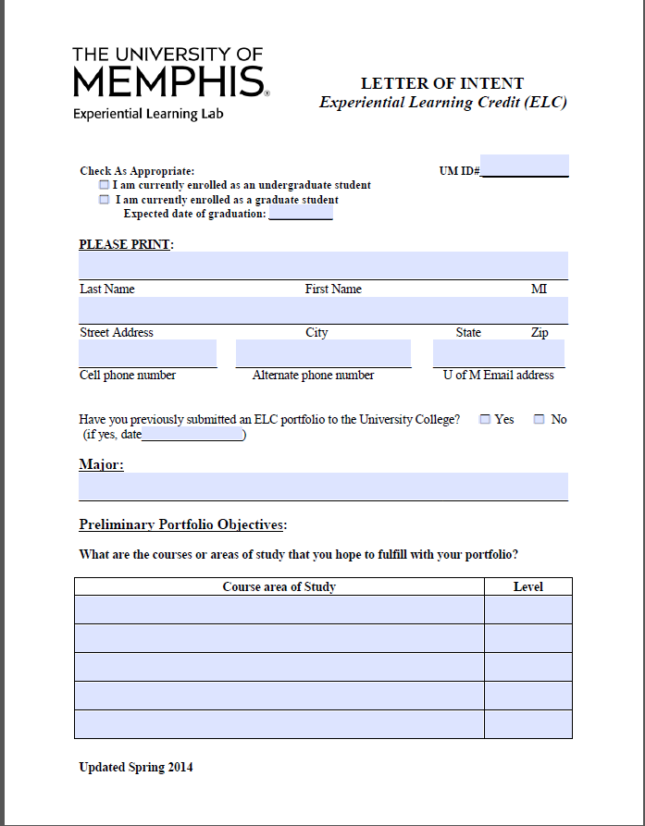
How do I complete the Letter of Intent?
The Letter of Intent is a PDF file.
You will be permitted to type your information into the document.
You are also able to save the document.

Slide 19
How do I complete the Letter of Intent?
The purpose of the Letter of Intent is to identify the areas of your expertise that you plan to include in your petition.
The top section of the first page asks you to provide basic information.
The bottom portion of the first page asks you to identify the areas of your expertise that you hope to be awarded credit.

Slide 20
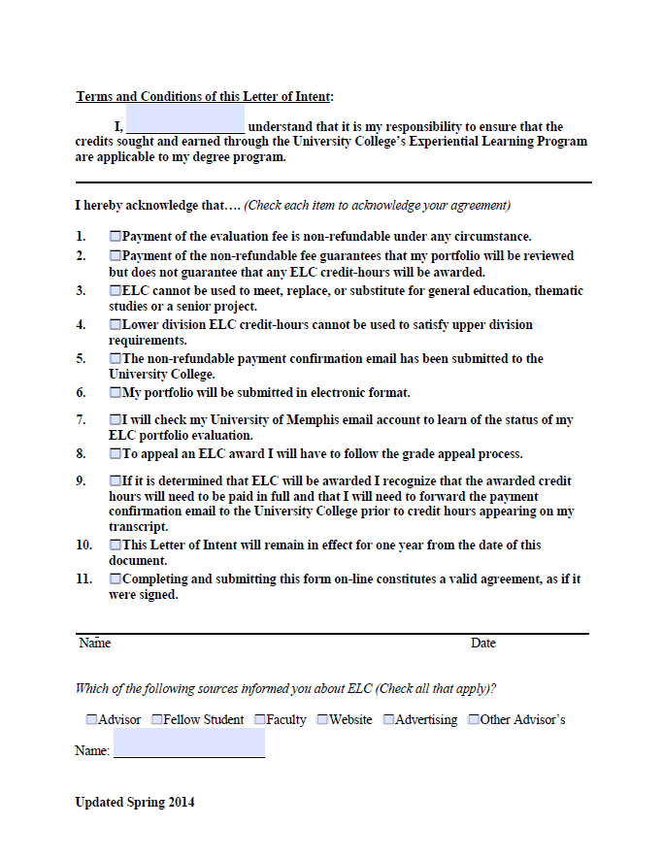
How do I complete the Letter of Intent?
The second page of the document will ask you to acknowledge your understanding of program policies and procedures.
Type your name here
Click in the boxes to acknowledge you understand each individual statement
Type your name here to serve as your electronic signature
Click any applicable boxes to identify how you learned about ELC
Type your Academic Advisor’s Name Here

Slide 21
Do I have to match my experiences to the remaining courses in my degree program?
You are not required to course match, but you may attempt to receive credit for an exact course that is listed in your degree plan.
ELC is intended to display in one electronic project your unique knowledge base and skills set that you have developed throughout your experiences.

Slide 22
May I petition for credit in areas that are not directly related to my degree program?
You may document experiences that are not directly related to your degree program if you are attempting to receive credit that may be used to satisfy General Elective requirements.
*Please contact your Academic Advisor to determine if you have any General Elective requirements remaining.

Slide 23
How do I choose which areas to include in my petition?
Let’s look at an example…
Education
Curriculum Development & Assessment
Unit & Lesson Planning
Behavior Modification
Instructional Methods
Ann has worked as an elementary school teacher for the past four years. She created the following categories to reflect the numerous ranges of expertise in her field.
Ann could identify these four broad categories as the courses/areas of study that she will detail in her ELC Portfolio.

Slide 24
How do I choose which areas to include in my petition?
Here’s another example…
Education
Employment Law
Supervision
Team Development
Program Development
Martin has worked as a Manager at a local distribution company for the past fifteen years. He created the following categories to reflect the numerous ranges of expertise in his field.
Martin could identify these four broad categories as the courses/areas of study that he will detail in his ELC Portfolio.

Slide 25
How do I determine the level of my course/area of study?
If you are seeking credit equivalent to a 1000 or 2000 level course please indicate this by putting "Lower" in the Level column.
If you are seeking credit equivalent to a 3000 or 4000 level course please indicate this by putting "Upper" in the Level column.
If you are seeking credit equivalent to a 7000 or 8000 level course please indicate this by putting "Graduate" in the Level column.

Slide 26
Where do I pay my deposit?
Undergraduate Students
Graduate Students
Follow the link below to access the Bursar’s online payment portal
Pay Undergraduate Portfolio Deposit
You may also contact the ELC Coordinator to find out how to pay your deposit on campus.
Follow the link below to access the Bursar’s online payment portal
Pay Graduate Portfolio Deposit
You may also contact the ELC Coordinator to find out how to pay your deposit on campus.

Slide 27
elc_program@memphis.edu
901-678-2754
University of Memphis

