Slide 1

Department of Computer Science
Industry Advisory Board Meeting
Dr. Lan Wang, Professor and Chair
Friday, Nov. 3, 2017

Slide 2


Agenda
3:00-3:15 Department News (Lan Wang), Round-table Updates (IAB and Faculty) 3:15-3:30 Spring 2017 Capstone course (Scott Fleming) 3:30-3:40 Competitive programming (Thomas Watson) 3:40-3:50 Break 3:50-4:20 Undergraduate program overview and discussion (Vinhthuy Phan)
4:20-4:40 Graduate program overview and discussion (Vasile Rus)
4:40-5:00 Discussion on strategies to increase graduate enrollment (Dipankar Dasgupta, Lan Wang)

Slide 3

New CS Faculty: James Yu, Ph.D.
Instructor
Ph.D. in Electrical and Computer Engineering, McMaster University
Research interests: Software engineering, robotic controls, wafer alignment process and data analysis for surface measurement
Teaching: CS1, CS2, Software Engineering, Computer Org/Architecture

Slide 4
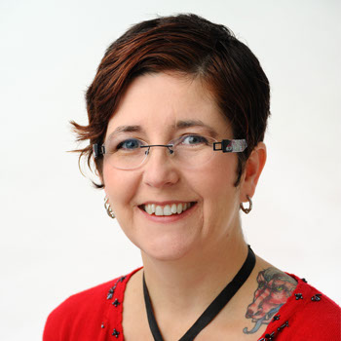
New IAB Member: Shiloh Barnat Goodman
VP, User Experience Strategy
Lokion
Masters, Sociology, University of New Orleans, 1994
BA, Political Science, Philosophy, French & Spanish, Tulane University, 1993

Slide 5

CS Degrees Awarded
 | 2011-12 | 2012-13 | 2013-14 | 2014-15 | 2015-16 | 2016-17
BS | 18 | 15 | 24 | 36 | 29 | 41
MS | 10 | 19 | 14 | 14 | 19 | 21
PhD | 8 | 2 | 4 | 6 | 4 | 7
MS+PhD | 18 | 21 | 18 | 20 | 23 | 28

Slide 6
2012- 2017 MS/PhD Graduates
Academic:
Abhijit Nag (PhD 2016) is an Assistant Professor at Texas A&M-Central Texas University.
Hanwen Yu (MS 2015) is a Post-doc at Univ. of Houston.
Poonam Dharam (PhD 2015) is on the Computer Science faculty at Central Michigan University.
Vivek Shandilya (PhD 2015) is an Assistant Professor at Jacksonville University.
Amin Ali (PhD 2014) is an Assistant Professor at the University of Dhaka in Bangladesh.
Christopher Simmons (PhD 2014) is an Assistant Professor at Lipscomb University.
Serge Salan (PhD 2013) is an Assistant Professor at Christian Brothers University in Memphis.
Yaoqing Liu (PhD 2013, MS 2011) is an Assistant Professor at Clarkson University.
Denise Ferebee (PhD 2012) is a tenure-track faculty member at LeMoyne-Owen College in Memphis.
Local companies:
Soumya Medapati (MS 2017) is a data scientist at Methodist Healthcare.
Sree Lasya Vallabhaneni (MS 2017) is a Software Engineer at SmartBear Software in Germantown.
Ruchi Ruchi (MS 2016) is a Bioinformatics Research Specialist at Methodist Healthcare.
Ramya Dharam (PhD 2014) is an Information Security Research Scientist at FedEx.
Nisrine Ait Khayi-Enyinda (MS 2013) is at International Paper in Memphis.

Slide 7
2012-2017 MS/PhD Graduates
Intel:
Mustafa Hajeer (PhD 2016, MS 2013) is a Software Engineer at Intel.
Md Fahad Polash (MS 2015) is a Software Development Engineer at Intel.
IBM:
Ernest McCracken (MS 2012, BS 2009) does front-end Web development for IBM and is an adjunct instructor at the U of M.
Amazon:
Stephen Ash (PhD 2017, MS 2012) is a Sr. Software Engineer at Amazon.
Rajendra Banjade (PhD 2017, MS 2014) is at Amazon.
AKM Mahmudul Hoque (MS 2014) is at Amazon.
Jin Wang (MS Applied Computer Science, 2013) is at Amazon.
Google:
Minsheng Zhang (MS 2016) is at Google.
Javier Snaider (PhD 2012) is at Google.

Slide 8
2012-2017 MS/PhD Graduates
Research:
Md Mahbubur Rahman (PhD 2016) is a Research Engineer at Samsung Research.
Hillol Sarker (PhD 2016) is at the IBM T. J. Watson Research Center in Cambridge, MA
Nobal Niraula (PhD 2015) is at Boeing Research.
Vivek Datla (PhD 2014) is a Research Scientist at Philips Health Systems.
Harkeerat Bedi (PhD 2013) is a Sr. Research Scientist at Verizon Digital Media Services.
Other:
Marc Badrian (MS 2016) is a Data Analyst at Mosaik Solutions.
Maria Luong (MS 2015, BS 2014) is an Associate at PwC in Houston.
Brandie White (MS Applied Computer Science, 2014) is at Raytheon.
Somnath Mitra (MS 2012) is a Mobile Applications Engineer at Identity Guard

Slide 9
Program Enrollment
Undergrad enrollment increased 28.4% compared to 2012.
Overall graduate enrollment is decreasing, due to decrease in MS program.

Slide 10
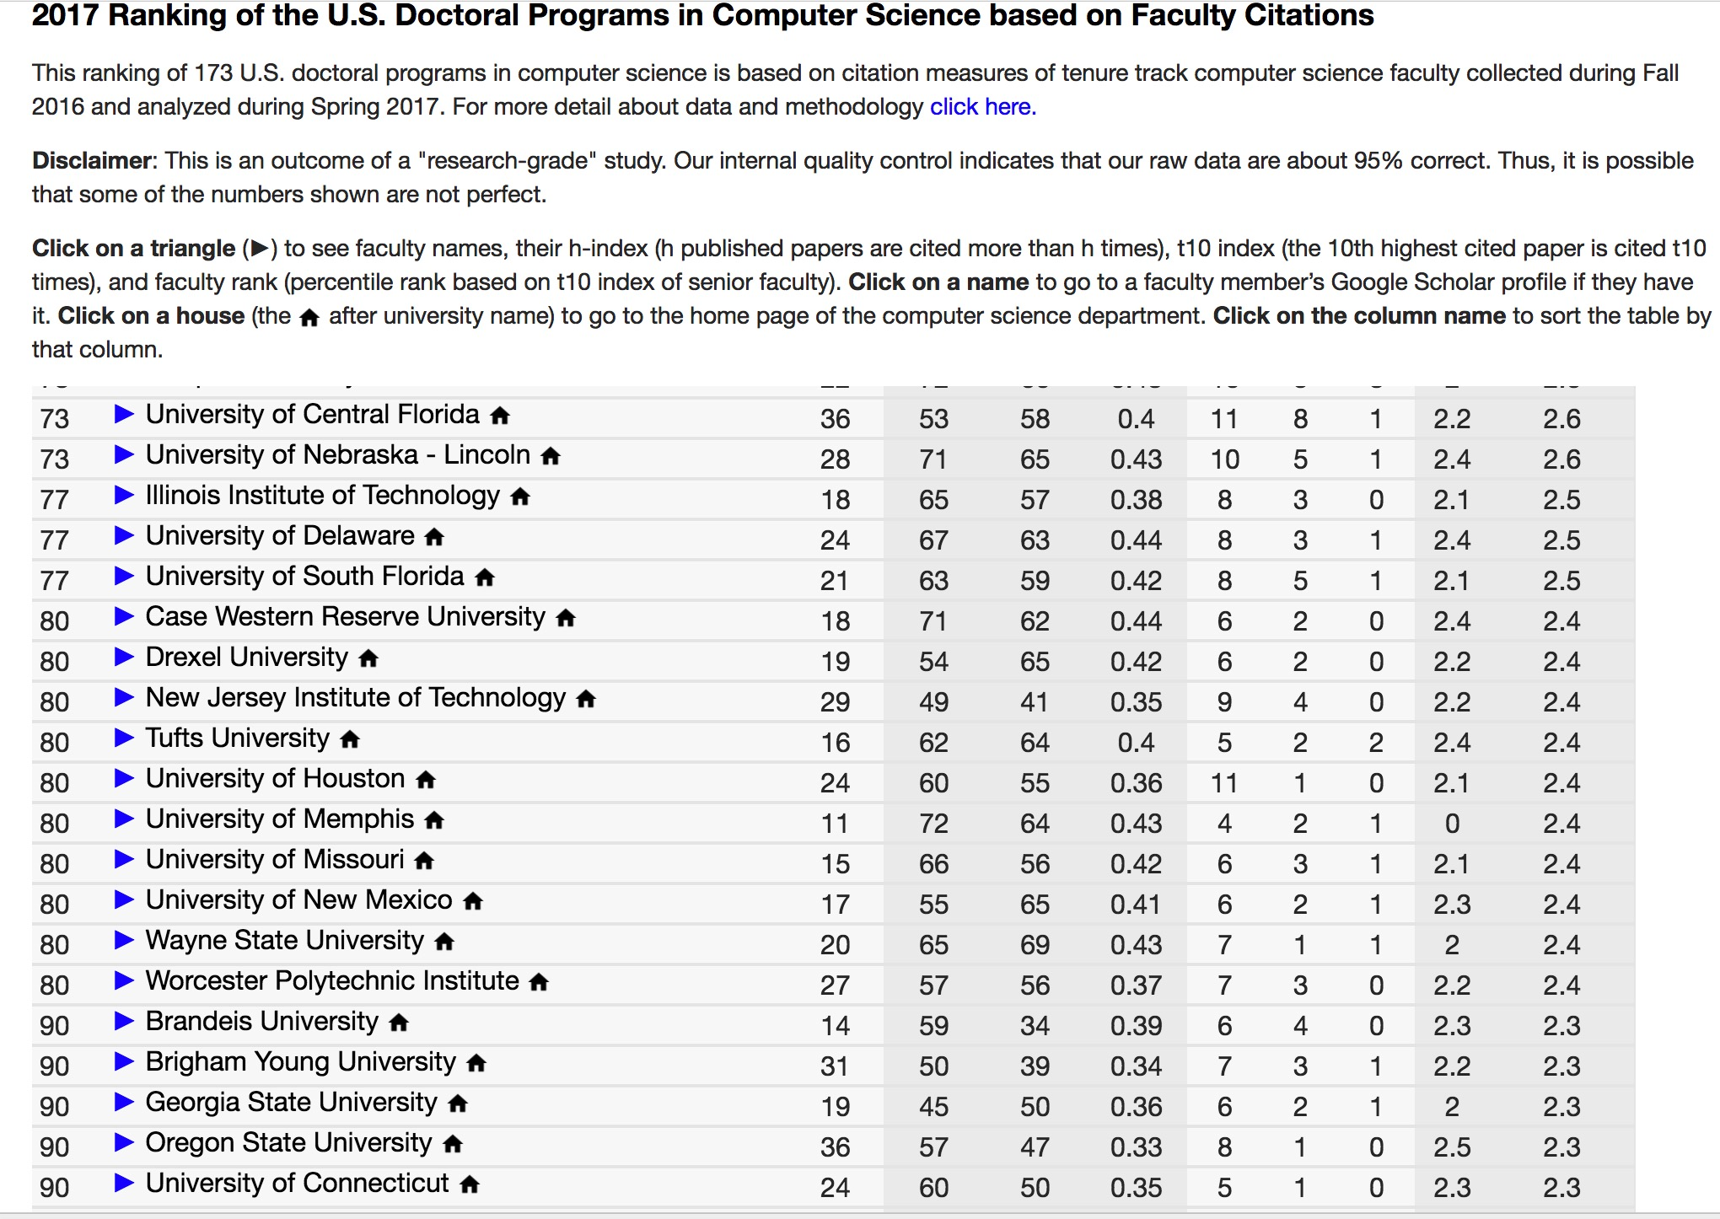
PhD program was ranked 80th in the nation among 173 doctoral CS programs
Goal: top 60 in US News Ranking
Note that our department was established in 2005, much younger than many other CS departments

Slide 11



Publication Highlights
Dasgupta Publishes New Book
Dipankar Dasgupta published a new textbook Advances in User Authentication through Springer-Verlag.
Watson Publishes in FOCS 2017 Thomas Watson published a paper entitled "Query-to-Communication Lifting for BPP” at the 58th Annual IEEE Symposium on Foundations of Computer Science (FOCS 2017). FOCS is one of the two top-tier conferences in Computer Science Theory.
Venugopal Publishes in IJCAI 2017
Deepak Venugopal published a paper "Efficient Inference for Untied MLNs" at the International Joint Conference on Artificial Intelligence (IJCAI 2017).

Slide 12
New Grants
IARPA Grant Santosh Kumar’s MD2K Center of Excellence received a new $13.8M contract from the Intelligence Advanced Research Projects Activity (IARPA). The research in this project will use mobile sensors in monitoring and predicting work performance.
NSA Grant
Dipankar Dasgupta’s Center for Information Assurance has been awarded a $206K CAE Cyber Security Workforce Education Grant to develop interactive, hands-on exercises to integrate into cyber security curricula.
DARPA Grant
Lan Wang received a $1.03M grant to develop networking technology for the Defense Advanced Research Projects Agency (DARPA).
Adobe Research Gift
Deepak Venugopal received a $9,000 unrestricted gift from Adobe Research Labs. He plans to use it to develop joint inference applications with Markov logic.
Notes:
The sensors will be used by 600 employees from major pharmaceutical companies, large consulting firms, high-tech companies, and high-tech startups in five cities in the U.S. and New Zealand.

Slide 13
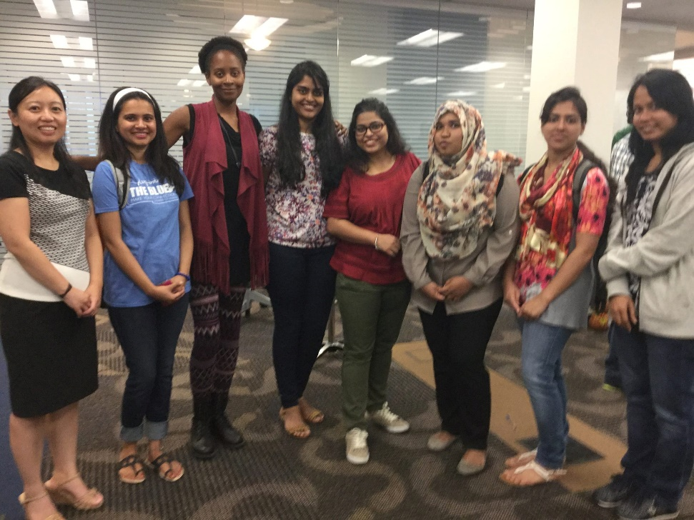
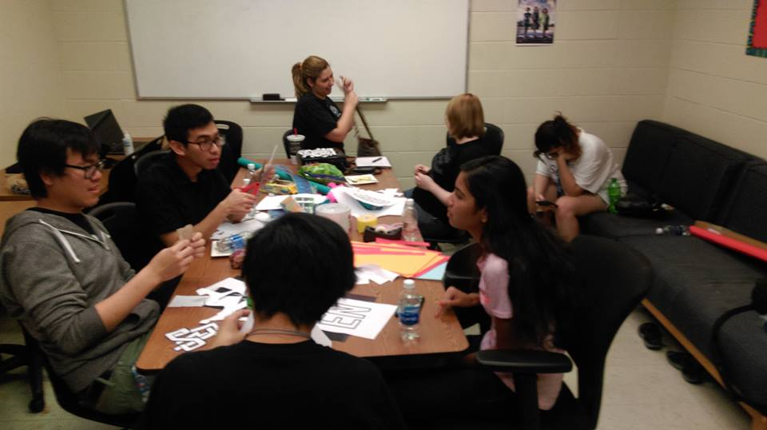
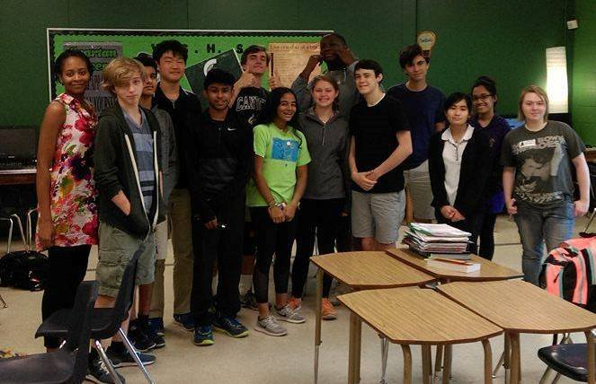
Women in Computing
Leadership:
2017 President: Brianna Frye
2016 President: Heather Duke
Events organized by WiC:
mass meetings, movie nights, sessions on virtual reality, LEGO robotics, and interview/resume preparation
Visits organized by WiC:
Teacher Mark Harris’s AP Computer Science Principles class at White Station High School (bottom picture) to meet the students and provide guidance on their projects.

Slide 14


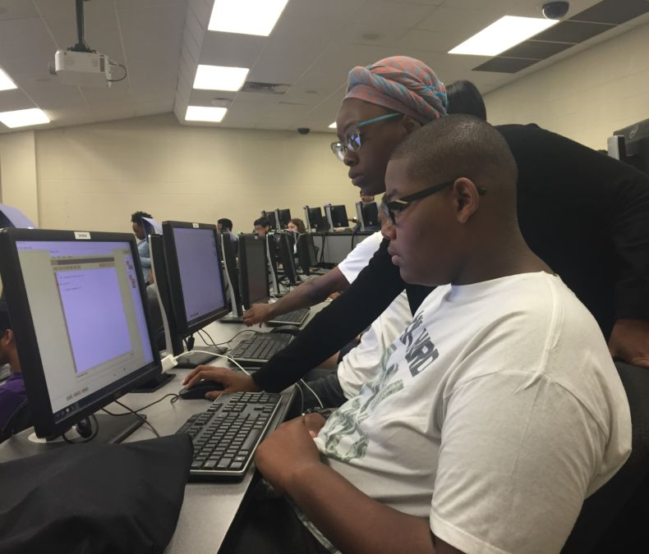
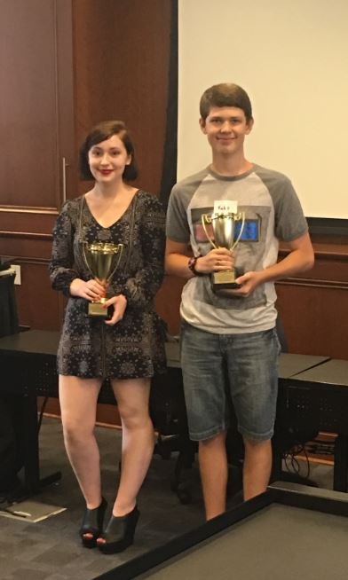
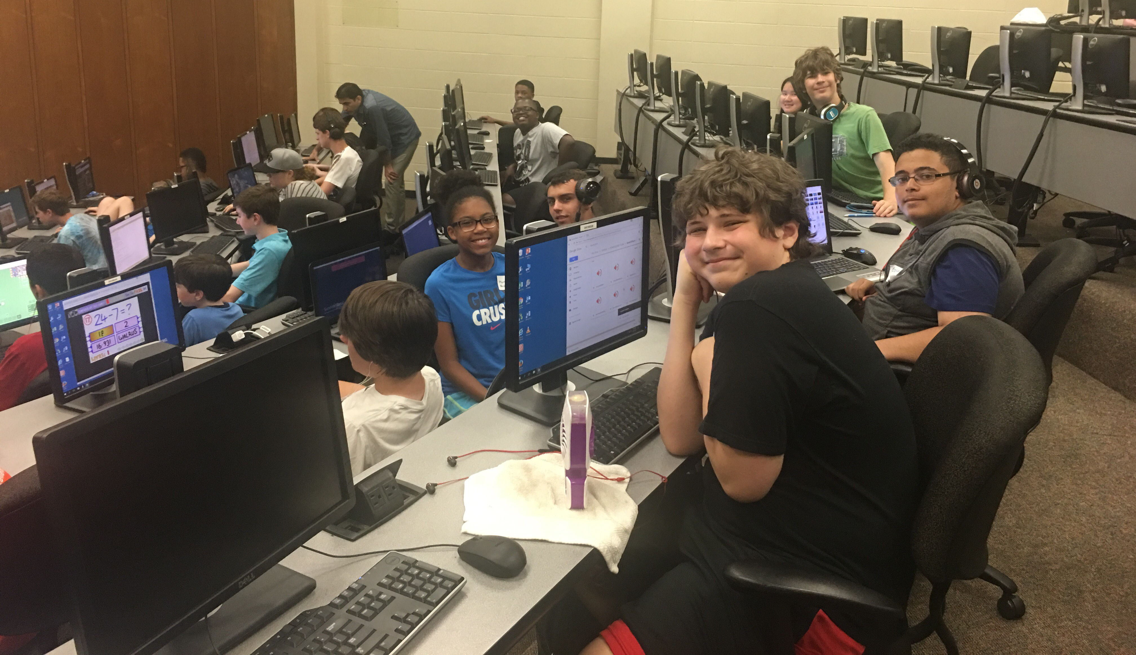
Outreach: Summer Camps
2017 GenCyber Boot Camps
The Center for Information Assurance held two cyber security boot camps for middle- and high-school students June 12 -16 (MS) and June 19 -23 (HS).
The camp attracted over 80 middle and high school students, the majority from the mid-south region.
Students learned about cyber safety, privacy, security, and best practices.
Students were tasked with developing cyber security related stories/games.
Each group presented their projects to a panel of industry professionals on the last day of the camp.
2017 Creative Game Design Camp The Department of Computer Science hosted the third annual Creative Game Design Camp for high school students from July 10 -14.
The camp attracted over 30 students from throughout the Memphis and Mid-South area.
Students learned programming and game design concepts using the RenPy visual novel engine for Python.
Students worked in teams to create their own games
Each team presented their finished products at the end of the camp.

Slide 15
Data Science & Analytics in Python Workshop
Date/Time: December 8 - 10, 2017 / 9 AM - 4 PM
Location: University of Memphis; Dunn Hall 233
Description:
This 3-day hands-on workshop is designed for scientists and working professionals who would like to learn new skills and strengthen existing skills in coding, data science and analytics.
Topics include:
Coding in Python
Data processing with Python Pandas
Data visualization
Machine learning with Scikit-learn
Registration: $600 (Non-UofM) / $200 (UofM) – Online through UofM’s MarketPlace
Participants will bring their own laptops. They should be fluent in using a computer and have basic familiarity with programming. Full refunds will be issued if requested by 12/1.

Slide 16
CS Full-Time Faculty and IAB Members
Mike Anderson, Information Technology Director International Paper - Technical Services
Brett C. Doty, Independent Consultant
Meka Egwuekwe, Executive Director CodeCrew
Naga Gurumoorthy, Sr. Principal Engineer and Sr. Director Data Center Engineering Group, Intel Corp. Shiloh Barnat Goodman, Vice President, User Experience Strategy Lokion
Robert Jackson, Chief Information Officer University of Memphis
Xuan Liu, Managing Director, IT FedEx
John Marsalis, Corporate Director of Software Development CoreLogic
Mark McMath, Sr. Vice President and CIO Information Technology Methodist LeBonheur Healthcare
Mark Moffett, Director, Systems Engineering Sales Cisco U.S. Public Sector
Tim Whitehorn, CEO Asentinel

Slide 17
Agenda
3:00-3:15 Department News (Lan Wang), Round-table Updates (IAB and Faculty) 3:15-3:30 Spring 2017 Capstone course (Scott Fleming) 3:30-3:40 Competitive programming (Thomas Watson) 3:40-3:50 Break 3:50-4:20 Undergraduate program overview and discussion (Vinhthuy Phan)
4:20-4:40 Graduate program overview and discussion (Vasile Rus)
4:40-5:00 Discussion on strategies to increase graduate enrollment (Dipankar Dasgupta, Lan Wang)

Slide 18
CS Capstone 2017

Slide 19
Project/Mentor Recruitment
14 proposals submitted
10 accepted
Teams of 3 to 5 students

Slide 20
Projects
Cerebral Cortex (MD2K Center)
Dynamic Clustering App (U of M faculty)
Google AdWords-Analytics (Local company; former CS grad)
LITE-Memphis (Let's Innovate through Education local non-profit)
Memphis Events Calendar (Local startup)
MFA (Prof. Dasgupta)
Performance History-Chem (U of M faculty)
Student Event Calendar (Local tech community)
VMS (FedEx)
Yearly (University startup)

Slide 21
Project Types
1 Systems
8 Web applications/services
2 Mobile apps

Slide 22
Course Structure
1 planning iteration + 3 development iterations
Demonstrations at the end of each devel. iteration
Public project showcase at the end of the semester

Slide 23
Selection of Project "Commercials"
VMS - https://youtu.be/qDOqH2Nwrhw
Yearly - https://youtu.be/iG5ei4fVr94
LITE-Memphis - https://youtu.be/m5W0M2RIy_g

Slide 24
Demo Day

Slide 25
Demo Day

Slide 26
Demo Day

Slide 27
2018 Project Mentor/Recruitment
Course runs January to May
Will begin soliciting projects soon!
If interested, please share your contact info with me
Thanks!

Slide 28
Agenda
3:00-3:15 Department News (Lan Wang), Round-table Updates (IAB and Faculty) 3:15-3:30 Spring 2017 Capstone course (Scott Fleming) 3:30-3:40 Competitive programming (Thomas Watson) 3:40-3:50 Break 3:50-4:20 Undergraduate program overview and discussion (Vinhthuy Phan)
4:20-4:40 Graduate program overview and discussion (Vasile Rus)
4:40-5:00 Discussion on strategies to increase graduate enrollment (Dipankar Dasgupta, Lan Wang)

Slide 29
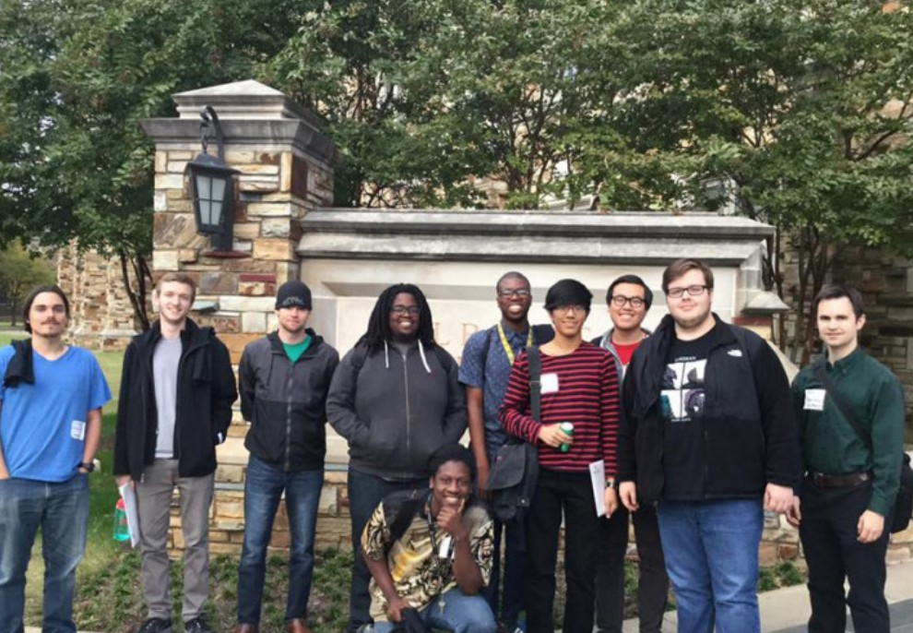
Competitive Programming and Technical Interviews
New 1-credit course
Training for programming competitions such as ACM International Collegiate Programming Contest

Slide 30
Competitive Programming and Technical Interviews
Using standard library data structures
Practicing with online judges
Algorithmic techniques
Implementation tricks
Testing, handling corner cases
Team programming

Slide 31
Competitive Programming and Technical Interviews
Programming contest problems
Whiteboard coding interview questions (at big tech companies)

Slide 32
Competitive Programming and Technical Interviews
Programming contest problems
Whiteboard coding interview questions (at big tech companies)
Bit manipulation
Recursion
Graph traversal
Dynamic programming
Data Structures

Slide 33
Competitive Programming and Technical Interviews
Programming contest problems
Whiteboard coding interview questions (at big tech companies)
Interview skills:
Surviving without syntax highlighting / autocompletion ...
Explaining thought process
Illustrating ideas with diagrams
Designing code structure before writing code
Describing efficiency analysis
Stepping through code on concrete inputs
Mock Interviews

Slide 34
Competitive Programming and Technical Interviews
Course is tailored to general software engineer / developer positions at big tech companies
How should students prepare for interviews with local companies?

Slide 35
Agenda
3:00-3:15 Department News (Lan Wang), Round-table Updates (IAB and Faculty) 3:15-3:30 Spring 2017 Capstone course (Scott Fleming) 3:30-3:40 Competitive programming (Thomas Watson) 3:40-3:50 Break 3:50-4:20 Undergraduate program overview and discussion (Vinhthuy Phan)
4:20-4:40 Graduate program overview and discussion (Vasile Rus)
4:40-5:00 Discussion on strategies to increase graduate enrollment (Dipankar Dasgupta, Lan Wang)

Slide 36
Undergraduate Curriculum Structure
Core (51 hours)
MATHs, CS1&2, Algorithms, Networking, Database, OS, CAPSTONE, ...
Concentrations (12 hours): one of the followings.
General (4 courses)
Cybersecurity (4 courses)
Data Science (4 courses)

Slide 37
Specializations in Computer Science
Specializations within the major will be useful in seeking jobs.
Two different ways to achieve this.
Concentration:
required specific 12 hours;
rigid: no overlap between concentrations;
designated on degree and transcript.
Track:
suggest 12 hours of specialization;
flexible;
not appearing on degree or transcript.

Slide 38
Accelerated B.S./M.S. degree
Can be accomplished in 5 years.
All course-work except MS projects can be done in 4.5 years.
How supportive are employers of their employees taking time to obtain MS degree?
M.S. projects can be directly relevant to their professions.

Slide 39
Agenda
3:00-3:15 Department News (Lan Wang), Round-table Updates (IAB and Faculty) 3:15-3:30 Spring 2017 Capstone course (Scott Fleming) 3:30-3:40 Competitive programming (Thomas Watson) 3:40-3:50 Break 3:50-4:20 Undergraduate program overview and discussion (Vinhthuy Phan)
4:20-4:40 Graduate program overview and discussion (Vasile Rus)
4:40-5:00 Discussion on strategies to increase graduate enrollment (Dipankar Dasgupta, Lan Wang)

Slide 40
Graduate Programs
Dr. Vasile Rus (vrus@memphis.edu)

Slide 41
Graduate Programs
Masters of Science
Computer Science
Bioinformatics
Doctor of Philosophy (PhD)
Two Certificates
CyberSecurity/Information Assurance
Data Science
Workshops
R
Python
Software Testing

Slide 42
Masters Requirements
33 credit hours
Core Requirements:
COMP 7012 - Fndtns/Software Engr
COMP 7212 - Operating/Distrib Sys
COMP 7612 - Foundations of Computing
COMP 7712 - Algorithms/Prob Solv
Project/Thesis:
COMP 7996 - Advanced Topics in Computer Science
COMP 7980 - Master's Project

Slide 43
Certificate In Cyber Security/IA
Major Cyber Security and Information Assurance Courses
COMP 6410 - Computer Security
COMP 7120/8120 (Same as MIS 7670). Cryptography and Data Security
COMP 7327/8327. Network and Internet Security
Cyber Security and Information Assurance Electives
COMP 6272 - System Admin and Unix Prog
COMP 7900 - Cyber Ethics
COMP 7125 - Computer Forensics
LAW 386 - Cyber Law
CJUS 6180 - Corp/White Collar Crime

Slide 44
Graduate Certificate in Data Science
Data Science Core Courses
COMP 7150 - Fundamentals of Data Science
COMP 7745 - Machine Learning
Data Science Electives
COMP 6118 - Introduction to Data Mining, COMP 7115 - Database Systems, COMP 7116 - Adv Database Systems, COMP 7118 - Data Mining, COMP 7130 - Inform Retrieval/Web Search, COMP 7740 - Neural Networks, COMP 7747 - Adv Topics in Machine Learning, COMP 7780 - Natural Lang Processng, MATH 7670 - App Stochastic Models, MATH 7680 - Bayesian Inference, PSYC 7302 - Adv Statistics Psych I

Slide 45
Discussion
Any topic we should include in our programs?
Any specific needs or trends in your organization/industry?
Anything else?

Slide 46
Agenda
3:00-3:15 Department News (Lan Wang), Round-table Updates (IAB and Faculty) 3:15-3:30 Spring 2017 Capstone course (Scott Fleming) 3:30-3:40 Competitive programming (Thomas Watson) 3:40-3:50 Break 3:50-4:20 Undergraduate program overview and discussion (Vinhthuy Phan)
4:20-4:40 Graduate program overview and discussion (Vasile Rus)
4:40-5:00 Discussion on strategies to increase graduate enrollment (Dipankar Dasgupta, Lan Wang)

Slide 47
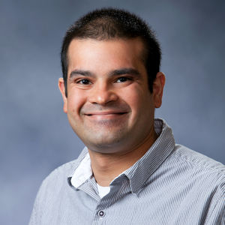
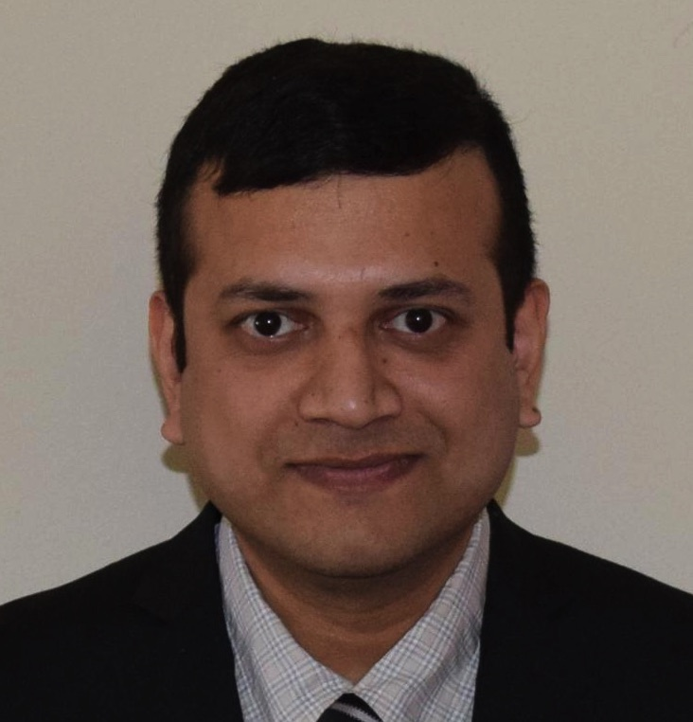
Alumni Highlights: Faculty/Research
Sidney D'Mello is an Associate Professor at the Institute of Cognitive Science and Department of Computer Science at the University of Colorado Boulder. Prior to joining the University of Colorado Bolder, he served as an Assistant and Associate Professor of Psychology and Computer Science at the University of Notre Dame. His research interests include affective computing, attentional computing, intelligent learning environments, speech and language processing, human-computer interaction, and computational models of cognition. He has co-edited five books and has published over 200 journal papers, book chapters, and conference proceedings in these areas. He received his Ph.D. from the University of Memphis in 2009.
Hillol Sarker joined IBM Thomas J. Watson Research Center as Postdoctoral Researcher on the Collaboratory Healthcare Effectiveness Research team. He earned his Ph.D. from the University of Memphis in 2016 while working on mobile sensor research (at MD2K Center of Excellence) under the supervision of Dr. Santosh Kumar. His research focuses on the analysis of physiological data from human subject studies in free-living conditions. In his dissertation work, he developed machine learning models to infer location, stress, smoking, and user's availability from wearable sensor data. His research had revealed the statistically significant association between sensor inferred context (e.g., location) and adverse health outcomes (e.g., stress). His research is enabling the design and delivery of just-in-time mobile health (mHealth) intervention using wearable sensors to help users improve health and well-being. While he was a Ph.D. student at the Computer Science department of the University of Memphis and working on just-in-time intervention, he came across research problems regarding physiology, statistics, behavioral science, electronics, and computer science. The University of Memphis and the MD2K Center gave him opportunities to collaborate with leading researchers in each of these domains and borrow unique knowledge and perspective which significantly enriched his work. This unique training made him a desirable candidate in the job market of mobile sensor big data.

Slide 48
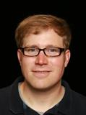
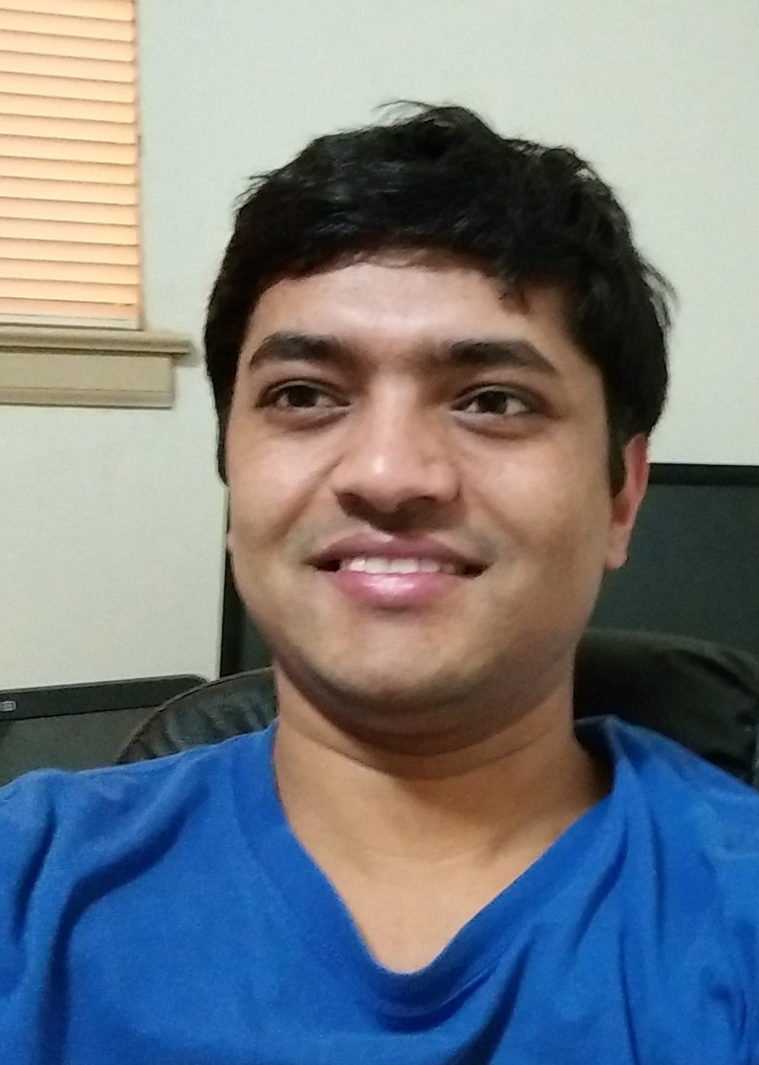
Alumni Highlights: Amazon/Audible
Stephen Ash is Senior Software Engineer in the Amazon AWS Deep Learning group in Seattle, WA. Prior to joining Amazon, he worked for 10+ years in R&D for banking and healthcare software vendors. At Amazon, he works in the Deep Learning group, which builds AWS services such as Lex, a platform for natural language understanding (NLU), and Rekognition, an image detection and analysis service. As a Senior Engineer, Stephen works with scientists, engineers, and business stakeholders to deliver state-of-the-art ML-based services to be consumed by thousands of customers across the globe. Stephen received a B.A. in Computer Science from Rhodes College and a M.S. and Ph.D. in Computer Science from the University of Memphis. As a U of M graduate student, Stephen had the opportunity to work on challenging problems with a number of faculty members in addition to working hard to build a strong foundation in computer science. Stephen uses his University of Memphis education every day at his job, whether it is analyzing the runtime complexity and performance of algorithms or building out sophisticated NLP pipelines to tackle hard real-world problems.
Rajendra Banjade has worked as Manager in the Data Science department at Audible Inc. (an Amazon company) since he obtained his Ph.D. in Computer Science from the University of Memphis, Tennessee in August, 2017. During his Ph.D., he was a member of Language and Information Processing research lab and was involved in Artificial Intelligence (AI) research targeting educational systems. He proposed machine learning models for understanding natural language interactions that can be used in various high-tech applications, such as virtual assistants (e.g. Amazon Echo and Apple Siri) and automatic answer grading. His research work has been published in major NLP conference proceedings. He also played leading roles in participating in international competitions where his team was often ranked among the top performers. As part of Amazon, he has received opportunities to work on very challenging problems in the areas of his interest and where access to vast amounts of data is paramount. He develops content and transaction based prediction models that can impact millions of customers. The courses and research work done during the Ph.D. program at the UofM were decisive for embarking on his current career path.

Slide 49
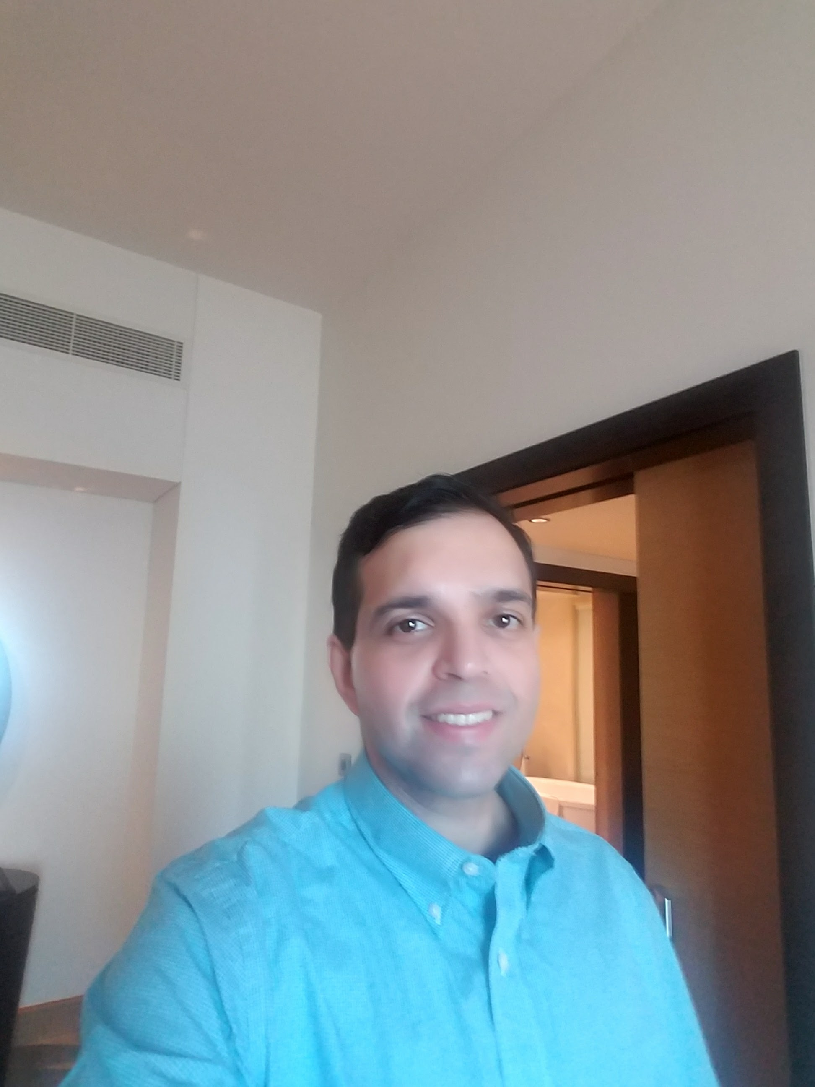
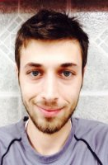
Alumni Highlights: Intel Corp.
Naga Gurumoorthy is Senior Principal Engineer of the Data Center Engineering Group (DCG) at Intel Corp. Naga leads the Platform Architecture Intercepts (PAI) team focusing on the definition and implementation of a variety of Data Center products. He is focused on platform debug and stability, power and performance optimizations and innovations. Naga works closely with a variety of customers to anticipate their needs and translate them into products. His MS degree in Computer Science is fundamental to his way of approaching problems from 1st principles and helps him grounded with the basics in HW-FW-SW and System design. He received his MS degree from the University of Memphis in 1997.
Mustafa Hajeer is a system engineer at Intel Corp. where he develops end-to-end platform solutions for the Data Center. Mustafa has been with Intel Corp. since he first joined in Summer 2015 as an intern. Mustafa is working on various areas, including: research and exploration of scalable power delivery, emulation, RAS, power, performance optimizations for servers; scalable software lifecycle concepts for expediting mass production; and developing methodology and flow for cutting edge storage and networking solutions around the following areas: cyber security/information security; Big data; data center networking; and data visualization, machine learning/data analytics/data mining, cloud computing. Mustafa completed his Master's degree in Computer Science from the University of Memphis, and he received his Bachelor's in Computer Science from Yarmouk University in Jordan in 2009. His research interests focus on big data, data science, and analytics.

Slide 50
Enrollment in CS, EECE and BIT
DEPT | CS |  |  | EECE |  |  | BIT
 | 2017 | 2016 | change | 2017 | 2016 | change | 2017 | 2016 | change
BS | 271 | 258 | 5.0% | 70 | 59 | 18.6% | 260 | 239 | 8.9%
MS | 27 | 35 | -22.9% | 17 | 24 | -29.2% | 3 | 24 | -87.5%
PhD | 43 | 41 | 4.8% | 24 | 26 | -7.6% | 9 | 8 | 12.5%
Undergraduate enrollment has increased in all three departments.
MS enrollment has decreased significant in all three departments.
PhD enrollment is relatively stable.

Slide 51
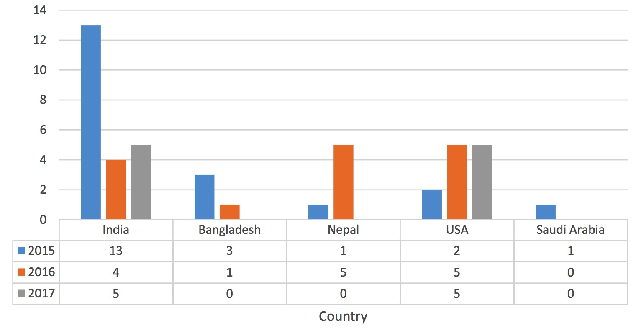
New MS Enrollment by Country

Slide 52
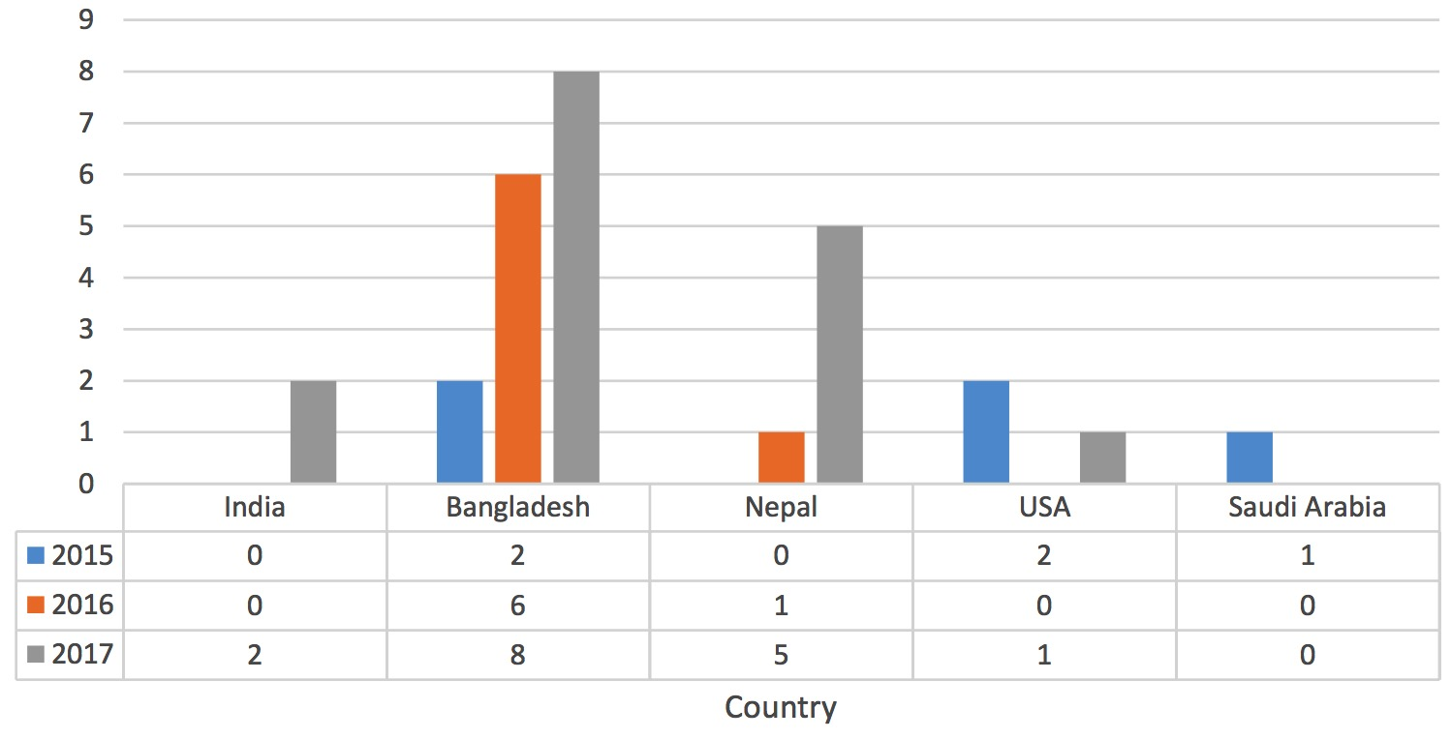
New PhD Enrollment by Country

Slide 53
Challenges
Emerging immigration policies
High-tech industry and the economy/employment is great which usually leads to drops in graduate enrollments
Most of our grad students need funding (TA and RA positions are limited by department budget and research funding)

Slide 54

Boosting Enrollment: Marketing Campaign
Advertised in Daily Helmsman, USA Today special edition, studyinternational.com
What else can we do?
Billboards: $1500 - $3000 per month depending on vinyl or digital and location.
TV: ~$40k for air time, production from $10k to $100K depending on company/quality.
Spotify/Pandora: upwards of $6500 per month.
Radio: $30k-100k for 6 months

Slide 55
Boosting Enrollment: More Ideas
Fundraising? The department has only 1 fellowship program that can offer $3000/year to 2-3 students
M.S. program with new concentrations?
Theory (with Math), data science, artificial intelligence (with IIS), cybersecurity, CS education (with CoE), digital health (with Psych, SPH), etc.
Attract local students
offering courses in the evening and weekends
offer more short courses (such as python, R programming, Blockchain technology, Hadoop, etc)
Offer online courses/certificates/degrees

Slide 56


Thank you.
Your contributions catalyze change in the CS Program to better serve our students and the community.

