Slide 1
CS Graduate Student Association
Tyler Moore, President
Laqin Fan, Vice President
CSGSA organizes social and professional events for graduate students with the CS department and works to build a supportive community for students to collaborate, build skills, and succeed together.
Help us to serve you by contacting Tyler (tgmoore@memphis.edu) or Laqin (lfan1@memphis.edu) with ideas for events, opportunities to support the student community, and specific questions about being a CS graduate student.

Slide 2
ACM Student chapter

Slide 3
Who are we
Association for Computing Machinery
Social Events
Networking
Professional Development

Slide 4
Why should you join
Exposure to growing technologies
Networking with local IT professionals
Gaming tournaments, parties, hackathons, & more!

Slide 5
contact
Tiger Zone
memphis.acm.chapter@gmail.com
Dr. Thomas Watson

Slide 6


WHO WE ARE
BDPA is the premier organization focused on nurturing and developing diverse working professionals and future IT leaders in the Science, Technology, Engineering, and Math (STEM) and all digital technology fields.

Slide 7
WOMEN IN COMPUTING
At UofM
Women in Computing aims to connect female Computer Science students at University of Memphis through events like speaker talks, lab tours, movie nights and mentorship.
To know more, join our RSO and facebook group:
https://memphis.campuslabs.com/engage/organization/wic
https://www.facebook.com/groups/memphiswic/

Slide 8
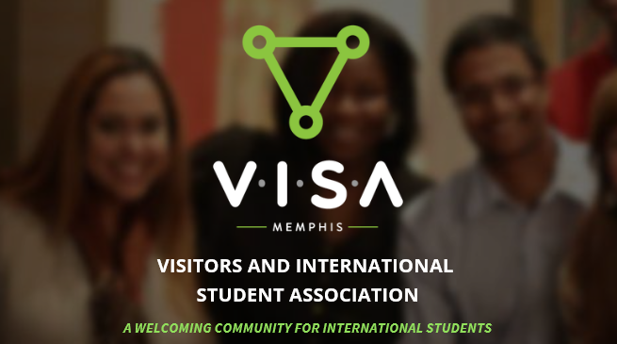
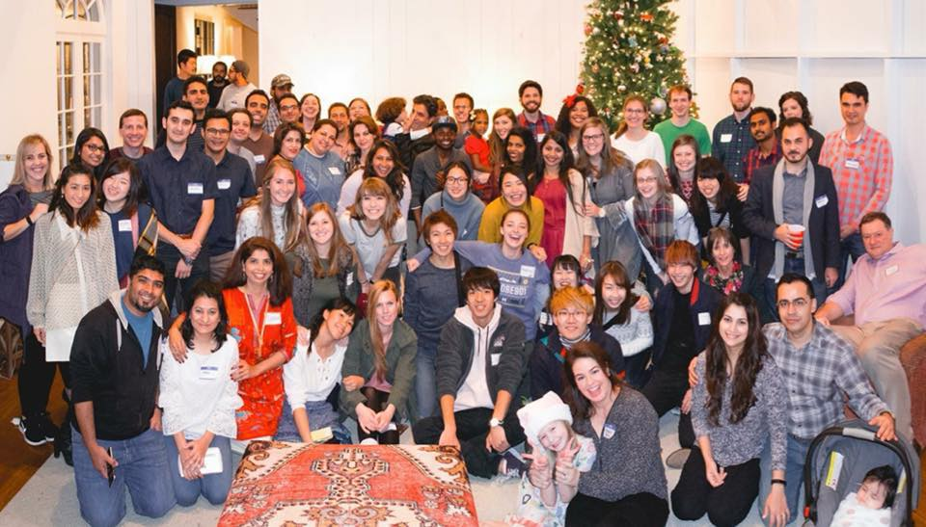
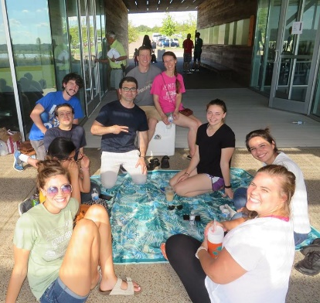
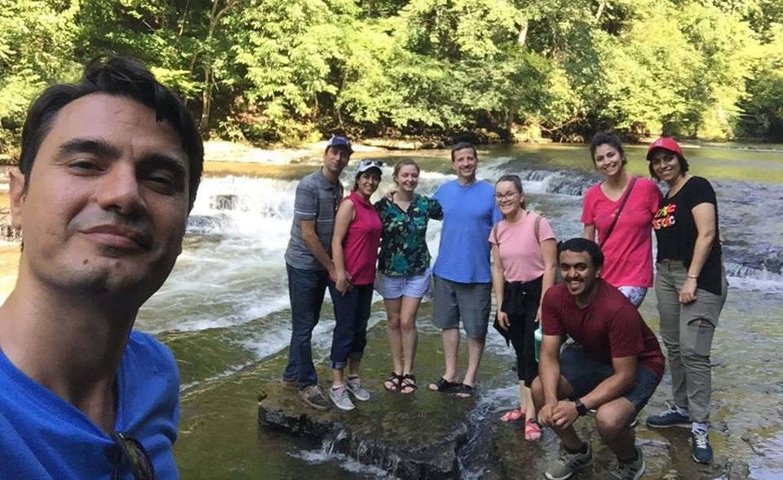
Activities & More
Monthly Parties
Tuesday Lunches
Spring Break & Summer Trips
Conversation Partners, Tours, etc.

Slide 9
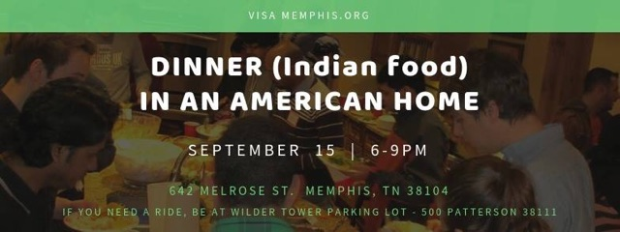


Upcoming Events

Slide 10

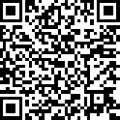
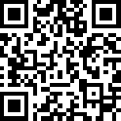
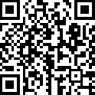
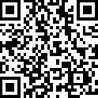
Get Connected
Weekly Email
FB Group
Sign-up for VISA Weekly Email
https://us4.list-manage.com/subscribe?u=5cc3f6b33eef4dff42254a12c&id=afea79f671
Join our VISA Facebook Group
https://www.facebook.com/groups/visamemphis/
Sign-up for Girls’ Night
https://memphis.co1.qualtrics.com/jfe/form/SV_d5sbfwwhD5DKgMR
Sign-up for CS Tour of Memphis
https://memphis.co1.qualtrics.com/jfe/form/SV_0qV1UJzDSYfBmct
Girls’ Night
CS Tour

