Slide 1
Computer Science Graduate Students Orientation
Dr. Scott Fleming
Fall 2019

Slide 2
Agenda
Welcome
Main Presentation
Department overview
Program overviews
Common issues
Student organizations
Open Questions

Slide 3
Department of Computer Science
Office: DH 375
Offering
Computer Science: Bachelor, Masters, Ph.D.
Data Science, Information assurance: Graduate Certificate
Bioinformatics: MS (with other departments)
Cutting-edge research
Areas such as: artificial intelligence, bio-inspired computing, big-data, natural language processing, networking, security, software engineering, etc.
Strong research funding and publication record

Slide 4
The roll-call (our faculty)
William Baggett
Amy Cooke
Dipankar Dasgupta
Scott Fleming
Xing Gao
Max Garzon
Nirman Kumar
Santosh Kumar
Kriangsiri Malasri (Advising Coordinator)
Vinhthuy Phan (Associate Chair)
Vasile Rus
Fatih Sen
Sajjan Shiva
Deepak Venugopal
Lan Wang (Chair)
Thomas Watson
Myounggyu Won
Kan Yang
James Yu
Xiaofei Zhang

Slide 5
Who I should HAVE MET
Department secretary: Rhonda Smothers (DH 375)
Give any forms for me to sign to the secretary
Your academic advisor
If you do not have one yet, talk to Kriangsiri "Top" Malasri and he will assign you one.
Call him/her Dr. Lastname (e.g., Dr. Wang) or firstname if your advisor prefers
Get your advisor’s permission before you do anything related to your courses and research
Set up an appointment before meeting your advisor.
If you have any questions, ask your advisor first.
Your advisor should email me any questions he/she cannot answer.
You can change academic advisor, but let Top know and email both the old and new advisors

Slide 6
Master Program: Requirements
33 credits
Main points
4 core courses: COMP 7012, 7212, 7612, 7712, At least 3 of the 4 have to be B- or better
Maximum 6 credits of non-coursework (project/thesis/independent studies etc.)
At most 6 credits of 6000-level courses
Project/Thesis: COMP 7996 or COMP 7980
GPA : should be at least 3.0
Grades : should not have more than two “C+/C/C-”, No D or F
Programming test requirement

Slide 7
Ph.D. Program – Requirements
Course credits
Qualifying exams: 4 core courses
Comprehensive exam/Dissertation Proposal
Final Dissertation defense
Remember to fill out the PhD curriculum planning form (on department website) the first semester.
Must be approved by advisor, graduate coordinator and department chair

Slide 8
Ph.D. Program – Course credits
72 credits from Bachelor degree
If you do not come with a Master’s
The 4 Master level core courses, must get at least B in all of them, before your first 36 credits
In case of failure, an additional exam will be given
If you come with an approved Master, you need at least 36 credits (but maybe more)
Other requirements
9-15 credits of COMP 9000 (Dissertation) – must be consecutive and can't take until after passing proposal
At least 18 credits of 8000-level or above courses
At most 15 credits of Independent studies

Slide 9
Approved Master’s Degree
Courses and requirements similar to our MS degree
Give your transcript to advisor for evaluation
Advisor makes his/her recommendation to the graduate committee over email along with your transcript
If approved (up to 36 credits), put this info in the PhD curriculum planning form.
Put in degree candidacy form when graduating.

Slide 10
Ph.D. Program – Comprehensive exam/Dissertation proposal
Student should find a dissertation proposal advisor
Settle for an advisor 2 years after BS/1 year after M.S.
No need to be your initial advisor
Prepare a dissertation proposal – what research to do for dissertation?
Select a dissertation committee
4 members minimum
Set a date for comprehensive exam
Include dissertation proposal defense
Questions on areas of study

Slide 11
Ph.D. Program – Dissertation defense
Final defense with dissertation committee
Have the final draft of the dissertation early to the committee
Follow graduate school guidelines “to the letter”

Slide 12
Ph.D. Program – What to do NOW!
If you’re a new Ph.D student
Talk to your initial advisor ASAP
Fill out a Ph.D Planning Form
Available from the department web site: http://www.memphis.edu/cs/current_students/forms.php
Have you advisor approve it and send it to the department
If you are a current Ph.D. student and have not filled in the form, do it ASAP.
Form needs to be updated and approved after passing qualifying exam.

Slide 13
Programming Test
Make sure you can write programs that run
1 week before semester begins
1 hr test on computer
Java, C or C++ (ask if you want to use other language)
You must either
Pass the test within your first 2 attempts
Take a programming course (chosen by the department) and get a B or better (B- do NOT count)
Remember, this course does NOT count towards the degree
Students who have not passed programming test cannot be department GA.

Slide 14
Course Registration
GA: university-supported graduate assistants are expected to carry a 9-credit-hour load every semester (or 6 hours when enrolled only in thesis or dissertation hours). https://web0.memphis.edu/gradcatalog/assistantship.php
Grant-supported GAs may register in fewer than 9 credits but international students still need to follow the rules below.
International Students: Graduate students may take fewer than 9 credit hours only if they have met all coursework requirements and have dissertation-only, thesis-only, or final-project-only remaining.

Slide 15
Not all courses count…
Some classes do not count towards the degree
Any pre-req course
Courses for non-majors: COMP 6001, 6005, 6014, 6011, 6030, 6040, 6270, 6601, etc.
Cognitive Science seminar (COMP7/8514):
only if closely related to computer science or your research
need to get advisor’s approval (based on course syllabus)
Courses from other departments
Rule of thumb: may count 1-2 at most toward a degree, but must have approval of your advisor before taking the course (above 2 need advisor’s statement on why)
Easier version of our courses from other departments do not count (e.g. MIS database)

Slide 16
Academic Fraud
Serious matter! Zero tolerance
Plagiarism/Cheating: doing the following without clearly acknowledging the source
Direct copying the work of another person
Paraphrasing the ideas of another person
Recycling previously submitted work
Potential action
F grade – cannot be removed
Appear at University committee

Slide 17
Academic Probation
GPA < 3.0 → Academic Probation
First semester:
You must talk to your advisor and grad coordinator before registration
You will lose your GA
Two consecutive semesters:
You will appear before a 3-member committee
Make your case
Committee may decide
Terminate your student status
Require you to take extra courses
To avoid getting into trouble
Work hard
Don’t overload yourself

Slide 18
Other Common Issues
Transfer credits
Talk to advisor. Apply for credit transfer in the first semester
Must be CS relevant course that has not been used to fulfill another degree
No UG level course can be transferred
For Masters students: at most 12
For Ph.D. students: at most 36
For PhD students, advisor puts his/her recommendation in the PhD curriculum planning form.
Waiving core courses
Need to be approved by advisor based on transcript, course syllabus, etc.
Advisor: email me for MS students, record in PhD form for PhD students

Slide 19
Misc Information
CS Notice board : Outside the CS dept office
Departmental activities
Fall: Social – have a bit of fun!
Spring: Research day – show off your research
Computer Science Colloquium
Fridays 12:30 – 2pm
All undergraduate and graduate students are welcome and department GAs must attend.

Slide 20
Computer Science Graduate Assistants Orientation
Fall
2019

Slide 21
Computer Science Graduate Students Orientation
Dr. Scott Fleming
Fall 2019

Slide 22
Agenda
Welcome
Main Presentation
Department overview
Program overviews
Common issues
Student organizations
Open Questions

Slide 23
Department of Computer Science
Office: DH 375
Offering
Computer Science: Bachelor, Masters, Ph.D.
Data Science, Information assurance: Graduate Certificate
Bioinformatics: MS (with other departments)
Cutting-edge research
Areas such as: artificial intelligence, bio-inspired computing, big-data, natural language processing, networking, security, software engineering, etc.
Strong research funding and publication record

Slide 24
The roll-call (our faculty)
William Baggett
Amy Cooke
Dipankar Dasgupta
Scott Fleming
Xing Gao
Max Garzon
Nirman Kumar
Santosh Kumar
Kriangsiri Malasri (Advising Coordinator)
Vinhthuy Phan (Associate Chair)
Vasile Rus
Fatih Sen
Sajjan Shiva
Deepak Venugopal
Lan Wang (Chair)
Thomas Watson
Myounggyu Won
Kan Yang
James Yu
Xiaofei Zhang

Slide 25
Who I should HAVE MET
Department secretary: Rhonda Smothers (DH 375)
Give any forms for me to sign to the secretary
Your academic advisor
If you do not have one yet, talk to Kriangsiri "Top" Malasri and he will assign you one.
Call him/her Dr. Lastname (e.g., Dr. Wang) or firstname if your advisor prefers
Get your advisor’s permission before you do anything related to your courses and research
Set up an appointment before meeting your advisor.
If you have any questions, ask your advisor first.
Your advisor should email me any questions he/she cannot answer.
You can change academic advisor, but let Top know and email both the old and new advisors

Slide 26
Master Program: Requirements
33 credits
Main points
4 core courses: COMP 7012, 7212, 7612, 7712, At least 3 of the 4 have to be B- or better
Maximum 6 credits of non-coursework (project/thesis/independent studies etc.)
At most 6 credits of 6000-level courses
Project/Thesis: COMP 7996 or COMP 7980
GPA : should be at least 3.0
Grades : should not have more than two “C+/C/C-”, No D or F
Programming test requirement

Slide 27
Ph.D. Program – Requirements
Course credits
Qualifying exams: 4 core courses
Comprehensive exam/Dissertation Proposal
Final Dissertation defense
Remember to fill out the PhD curriculum planning form (on department website) the first semester.
Must be approved by advisor, graduate coordinator and department chair

Slide 28
Ph.D. Program – Course credits
72 credits from Bachelor degree
If you do not come with a Master’s
The 4 Master level core courses, must get at least B in all of them, before your first 36 credits
In case of failure, an additional exam will be given
If you come with an approved Master, you need at least 36 credits (but maybe more)
Other requirements
9-15 credits of COMP 9000 (Dissertation) – must be consecutive and can't take until after passing proposal
At least 18 credits of 8000-level or above courses
At most 15 credits of Independent studies

Slide 29
Approved Master’s Degree
Courses and requirements similar to our MS degree
Give your transcript to advisor for evaluation
Advisor makes his/her recommendation to the graduate committee over email along with your transcript
If approved (up to 36 credits), put this info in the PhD curriculum planning form.
Put in degree candidacy form when graduating.

Slide 30
Ph.D. Program – Comprehensive exam/Dissertation proposal
Student should find a dissertation proposal advisor
Settle for an advisor 2 years after BS/1 year after M.S.
No need to be your initial advisor
Prepare a dissertation proposal – what research to do for dissertation?
Select a dissertation committee
4 members minimum
Set a date for comprehensive exam
Include dissertation proposal defense
Questions on areas of study

Slide 31
Ph.D. Program – Dissertation defense
Final defense with dissertation committee
Have the final draft of the dissertation early to the committee
Follow graduate school guidelines “to the letter”

Slide 32
Ph.D. Program – What to do NOW!
If you’re a new Ph.D student
Talk to your initial advisor ASAP
Fill out a Ph.D Planning Form
Available from the department web site: http://www.memphis.edu/cs/current_students/forms.php
Have you advisor approve it and send it to the department
If you are a current Ph.D. student and have not filled in the form, do it ASAP.
Form needs to be updated and approved after passing qualifying exam.

Slide 33
Programming Test
Make sure you can write programs that run
1 week before semester begins
1 hr test on computer
Java, C or C++ (ask if you want to use other language)
You must either
Pass the test within your first 2 attempts
Take a programming course (chosen by the department) and get a B or better (B- do NOT count)
Remember, this course does NOT count towards the degree
Students who have not passed programming test cannot be department GA.

Slide 34
Course Registration
GA: university-supported graduate assistants are expected to carry a 9-credit-hour load every semester (or 6 hours when enrolled only in thesis or dissertation hours). https://web0.memphis.edu/gradcatalog/assistantship.php
Grant-supported GAs may register in fewer than 9 credits but international students still need to follow the rules below.
International Students: Graduate students may take fewer than 9 credit hours only if they have met all coursework requirements and have dissertation-only, thesis-only, or final-project-only remaining.

Slide 35
Not all courses count…
Some classes do not count towards the degree
Any pre-req course
Courses for non-majors: COMP 6001, 6005, 6014, 6011, 6030, 6040, 6270, 6601, etc.
Cognitive Science seminar (COMP7/8514):
only if closely related to computer science or your research
need to get advisor’s approval (based on course syllabus)
Courses from other departments
Rule of thumb: may count 1-2 at most toward a degree, but must have approval of your advisor before taking the course (above 2 need advisor’s statement on why)
Easier version of our courses from other departments do not count (e.g. MIS database)

Slide 36
Academic Fraud
Serious matter! Zero tolerance
Plagiarism/Cheating: doing the following without clearly acknowledging the source
Direct copying the work of another person
Paraphrasing the ideas of another person
Recycling previously submitted work
Potential action
F grade – cannot be removed
Appear at University committee

Slide 37
Academic Probation
GPA < 3.0 → Academic Probation
First semester:
You must talk to your advisor and grad coordinator before registration
You will lose your GA
Two consecutive semesters:
You will appear before a 3-member committee
Make your case
Committee may decide
Terminate your student status
Require you to take extra courses
To avoid getting into trouble
Work hard
Don’t overload yourself

Slide 38
Other Common Issues
Transfer credits
Talk to advisor. Apply for credit transfer in the first semester
Must be CS relevant course that has not been used to fulfill another degree
No UG level course can be transferred
For Masters students: at most 12
For Ph.D. students: at most 36
For PhD students, advisor puts his/her recommendation in the PhD curriculum planning form.
Waiving core courses
Need to be approved by advisor based on transcript, course syllabus, etc.
Advisor: email me for MS students, record in PhD form for PhD students

Slide 39
Misc Information
CS Notice board : Outside the CS dept office
Departmental activities
Fall: Social – have a bit of fun!
Spring: Research day – show off your research
Computer Science Colloquium
Fridays 12:30 – 2pm
All undergraduate and graduate students are welcome and department GAs must attend.

Slide 40
GA responsibilities
Two types of GAs
Hired by the department: duties includes, but not limited to
Teaching as an instructor, Grading, Research, Lab hours, Office hours, Teaching support, Technical support
Hired by the faculty under his/her grant: research
Department GAs are required to be on campus one week before the start of semester.
Only under exceptional circumstances will extension be granted
“Attend my brother’s wedding” is NOT an exceptional circumstance.
“Caring for my mother who is in serious illness” can be.
We may require written proof.
Failure to do so can mean the GA may be taken away without notice

Slide 41
GA Responsibilities
You are a representative of the department
You are being paid to do a JOB (20 hours or less as stated in your contract)
You are expected to fulfill the task in a outstanding manner
Excuses:
“I have an exam in 3 hours”
“I have to go shopping”
…
These are NOT acceptable

Slide 42
GA Responsibilities
E-mail your course schedule and work time to your supervisors
Instructors - GA for a course
LSP - system admin or lab assistants
CS Secretary - helping in department office
Be in constant (at least weekly) communication with your supervisor
Attend colloquiums (by students & outside speakers)
Fridays 12:30 – 1:30. Stay tuned for the start date.
Only exception: if you have to be in the lab or teaching at that time

Slide 43
Teaching Assistants
Hold office hours
Guideline: at least 5 hours of office hours per week, at least in 2 days
Grade homework and exams in a timely fashion (within one week)
Attend classes if asked by the instructor.

Slide 44
Resources
Use for job-related purpose only
Computer resources
Photocopiers
Stationary
Do not violate copyright
Usage will be tracked

Slide 45
Rules and regulations
Understand your contract
Maintain a 3.0 GPA (NO exceptions!)
If you are hired by the department
Enroll in at least 9 credits (department pays only 9 hours)
Only exception: If all you have left is thesis/dissertation credits
Foreign students: limits on number of hours you can work
Foreign students: need the SPEAK test if you are assigned to teach a course as an instructor
URL: http://academics.memphis.edu/gradschool/ga.html

Slide 46
Rules and regulations -- extension
Semester-wise evaluation of performance
You will be reviewed by all faculty, on all aspects of your performance
Job-wise, academic-wise, attitude-wise etc.
Unsatisfactory performance leads to termination/non-renewal of contracts
If serious problem arises, can terminate in the middle of semester
For GA hired by department
Generally, 3 semesters limit for MS and 5 years for PhD (no guarantees)
Exception granted if recommend for good performance

Slide 47
CS Graduate Student Association
Tyler Moore, President
Laqin Fan, Vice President
CSGSA organizes social and professional events for graduate students with the CS department and works to build a supportive community for students to collaborate, build skills, and succeed together.
Help us to serve you by contacting Tyler (tgmoore@memphis.edu) or Laqin (lfan1@memphis.edu) with ideas for events, opportunities to support the student community, and specific questions about being a CS graduate student.

Slide 48
ACM Student chapter

Slide 49
Who are we
Association for Computing Machinery
Social Events
Networking
Professional Development

Slide 50
Why should you join
Exposure to growing technologies
Networking with local IT professionals
Gaming tournaments, parties, hackathons, & more!

Slide 51
contact
Tiger Zone
memphis.acm.chapter@gmail.com
Dr. Thomas Watson

Slide 52


WHO WE ARE
BDPA is the premier organization focused on nurturing and developing diverse working professionals and future IT leaders in the Science, Technology, Engineering, and Math (STEM) and all digital technology fields.

Slide 53
WOMEN IN COMPUTING
At UofM
Women in Computing aims to connect female Computer Science students at University of Memphis through events like speaker talks, lab tours, movie nights and mentorship.
To know more, join our RSO and facebook group:
https://memphis.campuslabs.com/engage/organization/wic
https://www.facebook.com/groups/memphiswic/

Slide 54

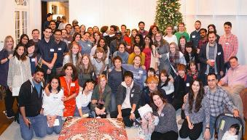
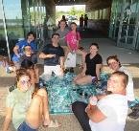
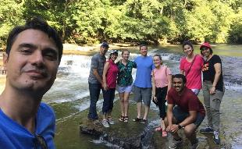
Activities & More
Monthly Parties
Tuesday Lunches
Spring Break & Summer Trips
Conversation Partners, Tours, etc.

Slide 55
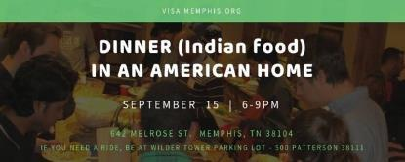


Past Events

Slide 56

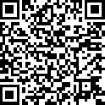
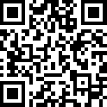
Get Connected
Sign-up for VISA Weekly Email
https://us4.list-manage.com/subscribe?u=5cc3f6b33eef4dff42254a12c&id=afea79f671
Join our VISA Facebook Group
https://www.facebook.com/groups/visamemphis/

Slide 57
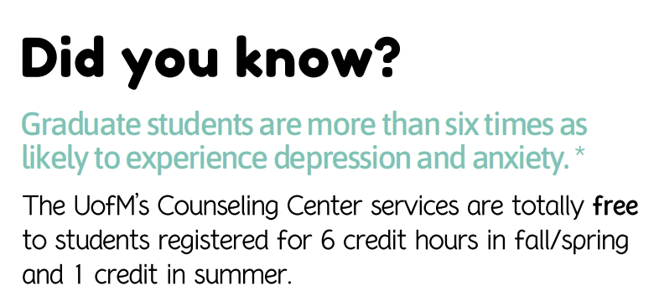
UofM Counseling Services

Slide 58
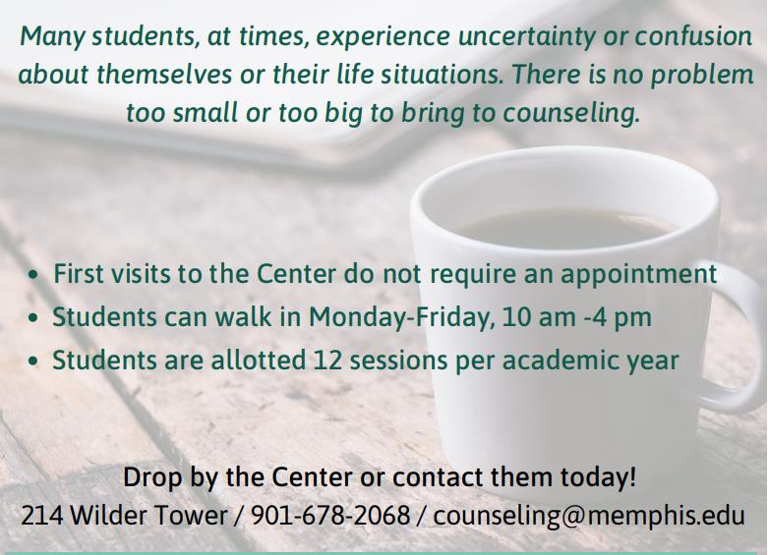

Slide 59

Career services overview
Where Tiger Talent Thrives

Slide 60

Services
Career Advising
Resume and Cover Letter Review
Mock Interviewing
FOCUS 2 Personality Assessment
Job and Internship Searching
Graduate School Planning
Connecting students with Employers (Career Fairs, Workshops, On-Campus Interviews, Information/Recruiting Tables and more)

Slide 61
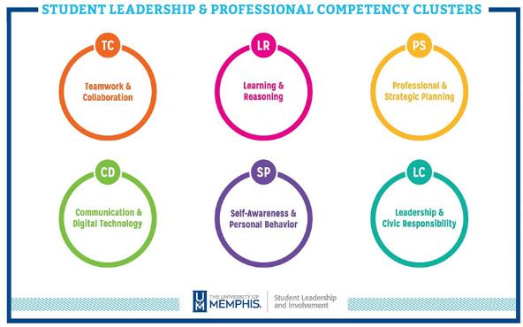
Student Leadership and Professional Competencies

Slide 62
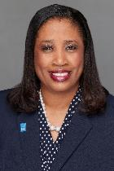
Your STEM Career Specialists
Dr. Jada Meeks
STEM

Slide 63
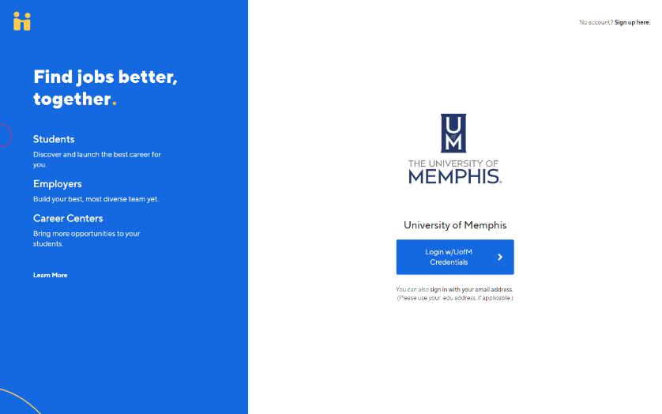
1

Slide 64
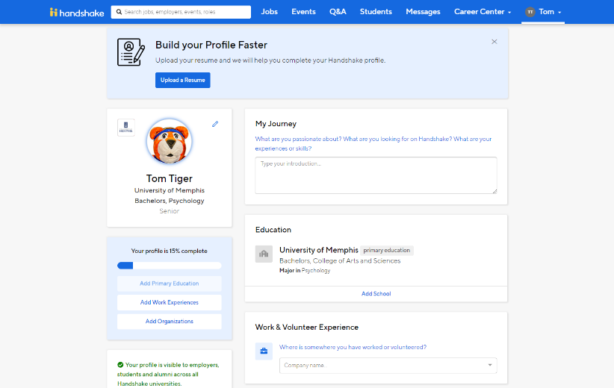
2

Slide 65
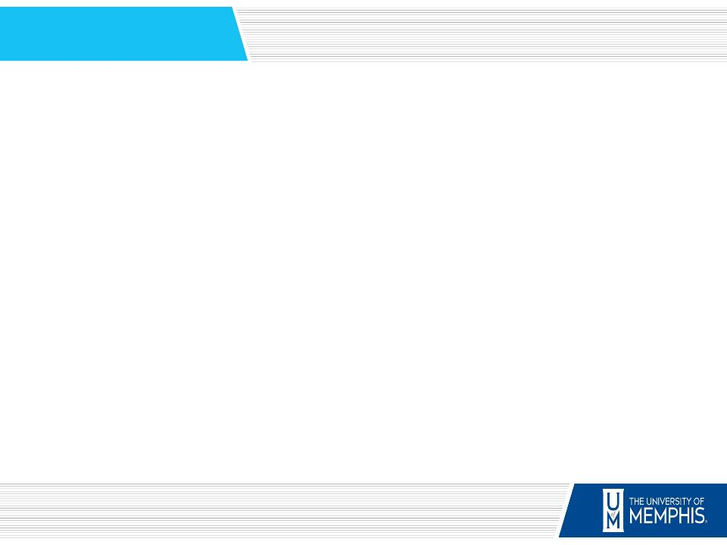
CAREER FAIR CALENDARS
Engineering Career Fair Sep. 20
8:30 am – 11:30 pm
All Majors Career Fair Sep. 25
1pm - 4pm
Science, Technology and Math Career Fair Oct. 9
11am - 3pm

Slide 66


Slide 67
STEM TIGER TALENT
COMMUNITY CALENDAR
CONNECTING WITH EMPLOYERS
Mock Interviews and Networking with Employers
Oct. 24th 1:00 - 4:00 pm
Nov. 1st 1:00 – 4:00 pm
You must register on TigerLink powered by Handshake

Slide 68



STEM CAREER DEVELOPMENT
jmeeks@memphis.edu 901-678-3103
Website: Memphis.edu/stem Make appointments on Tigerlink
UofMSTEMCareers

Slide 69
Your STEM Website
Memphis.edu/STEM
STEM Resume Samples
Job sites
Research opportunities

Slide 70


STEM Social Media
UOFMSTEMCAREERS

