Slide 1

P&T: Preparing Your Electronic Dossier for Mid-Tenure Review
The College of Education, August 27, 2026
Associate Dean Dr. Steve Zanskas
Dean’s Faculty Fellow Dr. Chris Mueller

Slide 2
Today’s Agenda
Process
Importance
Instructions
Responsibilities
How it is done
Address Questions

Slide 3
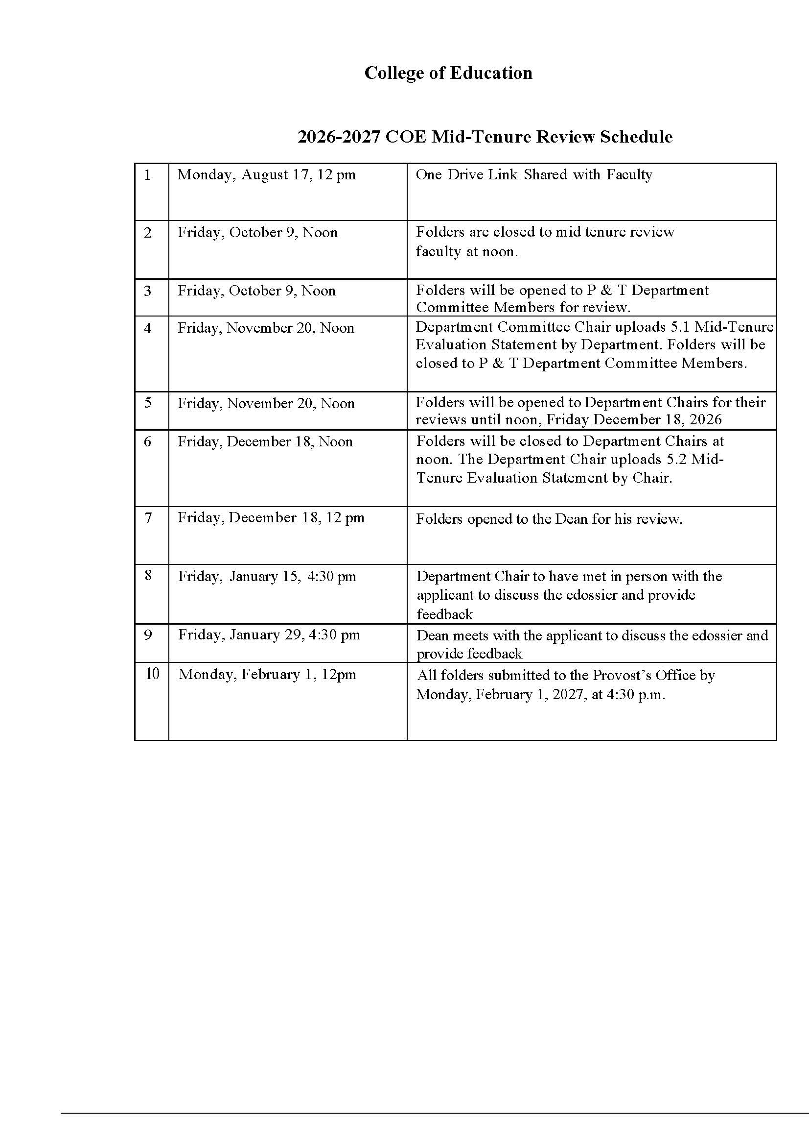

Slide 4
What is The Purpose of Mid-Tenure Review?
To assess the faculty member’s performance record since the beginning of the probationary period.
The Mid-Tenure-Track Review informs the faculty member of her or his progress toward the award of tenure during the third year of the probationary period.
The evaluation criteria for the quality of a faculty member's mid-tenure-track accomplishments should be the same as those used for the award of tenure.
Tenured faculty are responsible for providing the faculty member with a clear, thoughtful, and professional evaluation of:
  The faculty member’s ability to sustain a level of activity that comports with the department’s expectations for faculty members at the rank of the faculty member under review and
  The faculty member’s progress toward promotion and tenure in the context of the Faculty Handbook, his or her appointment, academic unit guidelines, and department guidelines.
  Notice of Non-Renewal
  From section 4.9.5 Mid-Tenure-Track Review in Faculty Handbook

Slide 5
The Instructions
T&P Dossier Guidelines & Instructions
T&P Forms
COE Faculty Mid-Tenure Review Resources
  https://www.memphis.edu/coe/faculty/faculty_resources.php
  COE Mid-Tenure Instructions 2026-2027
Are you looking for information from your past?
  Contact Human Resources
    Email: facultyservices@memphis.edu
    Phone: 901.678.3544
  Instructions for finding your Faculty Evaluations: https://www.memphis.edu/aa/resources/faculty-evaluation.php

Slide 6
Shared Responsibilities
Applicant
Department
Dean’s Office

Slide 7
Applicant
1.2 - P&T Appointment History Form
1.3 - Timeline Adjustment Form
1.4 - Stop the Clock Request Form
4.1 - University CV
4.2 - Initial Appointment Letter
4.3 - Annual Evaluations (ratings and comments)
6.1 - Instruction – Brief Summary of Teaching Responsibility, Philosophy
6.2 - SETE Summary Form (ratings and comments)
6.3 - Peer Evaluations of Teaching
6.4 - Instruction-Related Honors and Awards
6.5 - Internal Instruction-Related Grants
6.6 External Instruction-Related Grants
7.1 – Research, Scholarship, Creative Activity - Brief Summary of Accomplishments & Plans
7.5 - Research-related Honors and Awards
7.6 - Internal Research, Scholarship, or Creative Activity-related Grants
7.7 - External Research, Scholarship, or Creative Activity-related Grants and Contracts
6.1 and 7.1 are narratives and should include the % of faculty effort devoted to each area.

Slide 8
Applicant Responsibilities Continued…
8.1 - Service, Outreach, Advising, Mentoring, Administration - Brief Summary of Responsibilities and Accomplishments
8.2 - Service-related Honors and Awards
8.3 - Internal Service-related Grants
8.4 - External Service-related Grants and Contracts
9.1 - List of Supplemental Materials
9.2 - Supplemental Materials
(list in 9.1 and files in 9.2 must match)
What are supplemental materials?
PDFs of published and in-press manuscripts
PDFs of book chapters
Conference brochures referencing your presentations
8.1 is a narrative and should include the % of faculty effort devoted to service.

Slide 9
Narratives
Teaching
  Describe your teaching philosophy
  Identify courses taught and teaching load
  Discuss SETES, what you learned, and how you adjusted
  Include and new course development, course redesign, or instructional innovation
Research
  Tell the reader what you do & the associated effort
  Identify your lines
  What are the principal questions that drive your research?
  What is your vision for your future research?
  Mention the number of publications and grant awards since joining the faculty at UoM
  Explain co-authored publications
Service
  Summarize your contributions to the department, college, university, and profession (including leadership roles and dates of service).
  Describe how your service contributions support the mission of your department & your institution.

Slide 10
General Comments About Narratives
Begin early.
Know your audience.
Acknowledge and address issues in teaching, research, and service that might be perceived as weaknesses.
  Using negative teaching evaluations as an example:
    What did you do to overcome the challenges?
    How did you adjust your teaching methods to address the needs and/or concerns of the students?
    Were you experimenting with a new course or new teaching method?
    What did you learn from the constructive feedback?
Have mentors review your statements

Slide 11
Department
5.1 Mid-tenure Evaluation Statement from the Department Committee
5.2 Mid-tenure Evaluation Statement from the Department Chair
Meeting with the Department Chair by January 15, 2027

Slide 12
Dean’s Office
Meeting with the Dean by January 29, 2027
Dean’s Office recommendations to the Provost

Slide 13
How it Is Done…
Sample Sharedrive eDossier
Make it easy for your readers!

Slide 14
Questions?
Contact me at:
szanskas@memphis.edu

