Slide 1
Inventory Locator Service
The world’s most dynamic aerospace parts marketplace
Learning Outcome Presentation By:

Slide 2
What is Inventory Locator Service?
E-Commerce Marketplace to enable both private and public customers to sell and buy aircraft maintenance parts.
Founded in 1979 by John Williams in Memphis,
TN
Acquired by CAMP Systems on Sep. 16, 2019
Customers in over 100 countries and more than 1 Billion part listings.
The role of the application development team is to work closely with our customer feedback to ensure that our service provides clear and concise data to our subscribers while still providing an easy-to-use application.

Slide 3
Tools of the trade

Slide 4
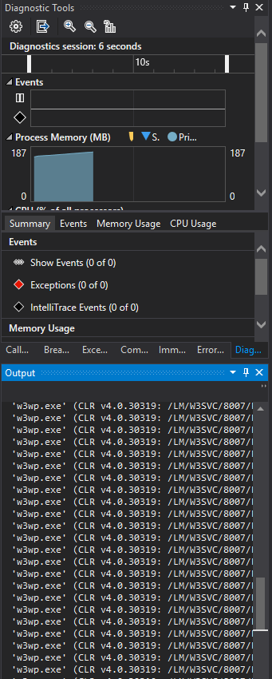
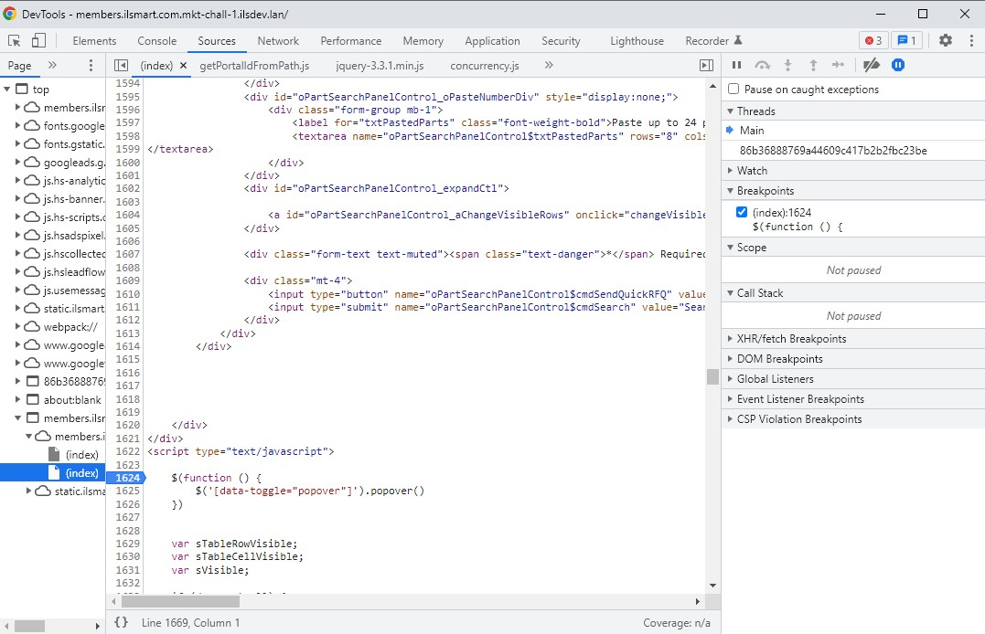
Learning Outcome #1
Using advanced software to analyze complex system systems, such as FEA, CFD, PSPICE, custom software. Responsible for training to repair medical tools and devices down to the component level using service manuals or schematics of the circuit breakdown.
Wrote code using Visual Studio to add various features to our delinquency page as well as customer contact editing page.
Monitor changes to performance using built in Diagnostic tools
Using Chrome’s built in Developer Tools window to inspect elements
Used the newly introduced debugger through breakpoints to follow
implemented code step-by-step.

Slide 5
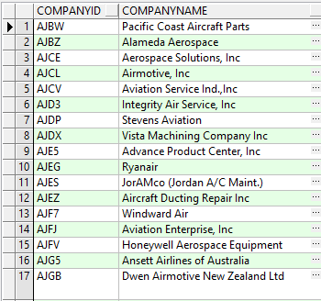
Learning Outcome #2
Using software such as Excel, MatLab, LabView, or custom databases to process data and/or perform calculations
Used PLSQL Developer to view data related to companies, accounts, as well as contact details.
Viewing the schema assists in modelling changes to website features.
Helps you know where the data goes and what type of data to put into the database.

Slide 6
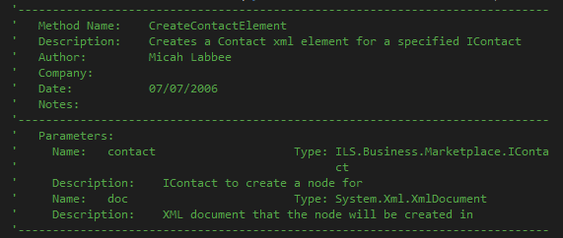
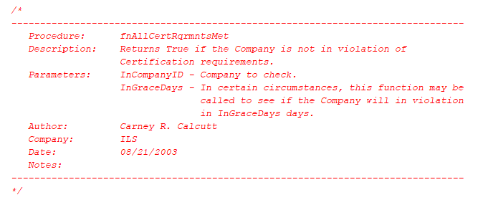
Learning Outcome #3
Researching/Reviewing published literature or technical documents as required to perform assigned duties.
Used previously written comments within the code base to know the function of previously written code
As well as adding comments to inform later developers.
Used publicly available documentation provided by Mozilla (HTML & Javascript) to interpret function usage in those languages.
Used in-line written comments provided by previously developers to determine the usage of SQL functions within the database as well as in the ASP codebase.

