Slide 1

University of Memphis
New Senator Orientation
27 August 2026
Parliamentary Procedure

Slide 2

What We’ll Discuss Today
Rights and Responsibilities of Faculty Senators
Drafting and Submitting Your Motion
Passing Your Motion
Resources and More Information

Slide 3
Rights and Responsibilities
Attend & Participate in:
  Regular meetings. Speak, make motions, vote, ask questions.
  Your assigned committee. In these more informal meetings, you’ll have a chance to dig deeper into issues.
Report & Listen:
  Keep your departmental or unit updated on current business in the Faculty Senate.
  Bring back ideas from your colleagues to the Faculty Senate.

Slide 4
Rights and Responsibilities (from Articles of Authority)
Section 3. MEMBERSHIP
The Faculty Senate shall consist of elected members.
Eligibility
Eligible faculty shall hold an academic appointment, whose sole duties are teaching, research, or library service. Further, the faculty member must have served in that position for at least two years.
Term of Office
The term of office for an elected member of the Senate shall be two years.
Recognition of Service
  The President and the Secretary of the Senate shall receive from the University, not their departments, at least one three hour course equivalent release time each semester in order to perform Senate duties.
  Senators shall be recognized for their participation in the Senate by being relieved of all departmental committee duties unless they voluntarily decide otherwise. Service in the Faculty Senate shall be acknowledged as University service.
Representation
  The Faculty Senate shall consist of members elected by and within the University Libraries, departments and schools within colleges, departments within schools, and schools and colleges without departments. Each entity shall be entitled to one Senator.
  ROTC-Aerospace, ROTC-Army, and ROTC-Navy shall be grouped into one entity and shall be entitled to one representative.
  Any new entity shall attain faculty Senate representation in the first Faculty Senate election following its organization.
Senator Responsibility
It is the responsibility of each Senator to attend meetings of the Senate and, in the event of an absence, to ensure that the Senator's department, independent unit or area is adequately represented.

Slide 5
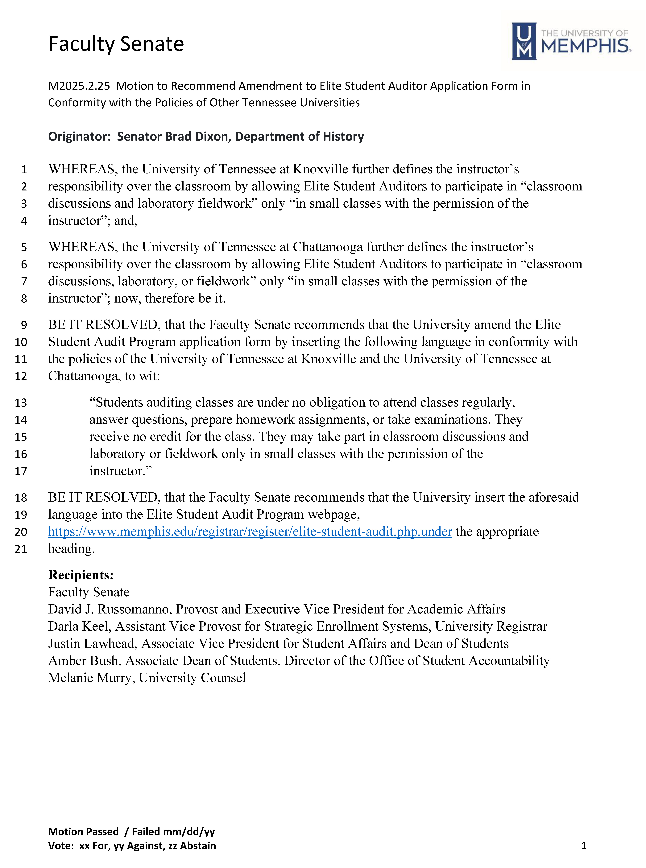
Drafting and Submitting Your Motion
Parts of a Faculty Senate Motion:
Whereas clauses provide the information and background supporting your recommendation.
Resolved clauses state what it is you want the Senate to recommend.
Recipients should include the administrators and others to whom your proposed recommendation would be directed for action.

Slide 6
Drafting and Submitting Your Motion
Rules for Submission of a Main Motion:
“Any member of the Senate may submit to the Executive Committee items, including motions, no later than 10 days in advance of the Faculty Senate meeting at which the item is to be considered.”
  Special Rules of Order, Faculty Senate Articles of Authority

Slide 7
Passing Your Motion
Step 1: Introduction of the Motion
The President states the motion, putting it the hands of the Senate.
You (as the motion’s sponsor) get to speak first in debate to explain the purpose of your motion.
After that, your motion formally belongs to the Faculty Senate to consider, amend, and dispose of.

Slide 8
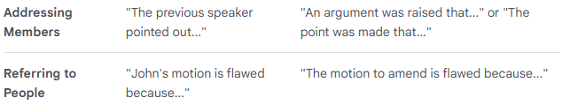
Passing Your Motion
Step 2: Debate on the Motion
To Debate, Be Recognized. Raise your hand to be recognized by the President.
State Your Name and Unit.
  “Brad Dixon, Department of History.”
Address the President. “Madam President, I rise to…”
Keep it Germane and Courteous. Make your remarks relevant to the matter at hand. Be courteous and avoid personalities.

Slide 9
Passing Your Motion
Step 2: Debate on the Motion
Speak No More than Twice on the Same Question. You can speak a second time once all members have had a chance to speak once.
Limit of 10 Minutes per Speech. Unless extended by permission of the Faculty Senate.
Need More (or Less) Debate Time? “I move to Limit / Extend Debate…” Needs a second. Undebatable. 2/3rds majority to pass.

Slide 10
Passing Your Motion
Step 3: Handling the Main Motion
Want to Make a Change? “I move to amend the motion…” Needs a second. Debatable but must focus on the merits of the amendment, not the Main Motion.
Second-Degree Amendment
Simple amendments can be adopted by unanimous consent.
“Without objection… the amendment is adopted.”
Amendments require a majority vote for approval.
First-Degree Amendment
Main Motion

Slide 11
Passing Your Motion
Step 3: Handling the Main Motion
Adjourn to a Fixed Time
Adjourn
Recess
Raise a Question of Privilege
Call for the Orders of the Day
Lay upon the Table
Call the Previous Question (End Debate)
Limit or Extend Debate
Postpone to a Time Certain
Commit or Refer to Committee
Second-degree Amendment
First-Degree Amendment
Postpone Indefinitely
Main Motion
The higher the motion, the further from a decision on the main question.
Motions higher on the ladder must be handled before lower ones.
Higher is in order; lower out of order
Learn the “Ladder of Motions”

Slide 12
Passing Your Motion
Step 3: Handling the Main Motion
You think the Faculty Senate should not take a position.
You want to put the Main Motion off forever.
You say, “I move to Postpone Indefinitely.”
You need a second and it is debatable.
Unamendable.
Requires a simple majority. If successful, the Senate will not consider the Main Motion for the remainder of the session.

Slide 13
Passing Your Motion
Step 3: Handling the Main Motion
You think the Main Motion’s recommendation merits further study.
You want to send the Main Motion to a committee to do so.
You say, “I move to Refer the Main Motion to Committee.”
You need a second and it is debatable.
You can amend which committee will get the assignment.
Requires a simple majority to pass.

Slide 14
Passing Your Motion
Step 3: Handling the Main Motion
You think the Main Motion should be considered at a different time.
You want to put off the Main Motion until a specific time and then consider it. (You’re not trying to defeat the measure.)
You say, “I move to Postpone to a Certain Time…”
You need a second and it is debatable.
You can amend the motion to change the time to which action is postponed.
Requires a simple majority to pass.

Slide 15
Passing Your Motion
Step 3: Handling the Main Motion
You think another matter has come up that needs to be dealt with before the Main Motion.
You want to lay the Main Motion aside for a time and take it up later.
You say, “I move to Lay Upon the Table…”
You need a second is undebatable.
Unamendable.
Requires a simple majority to pass.
Same rules apply for the later motion to take the tabled Main Motion off the table.

Slide 16
Passing Your Motion
Step 3: Handling the Main Motion
You think e.g. that you’re not sure which motion is the right one to accomplish your aim or are wondering what the next steps are.
You want to get advice about parliamentary procedure.
You say, “Parliamentary Inquiry…”
Address the President who will answer the inquiry.
You can rise to a Parliamentary Inquiry even when another member has the floor.

Slide 17
Passing Your Motion
Step 3: Handling the Main Motion
You think that the rules have been violated in some way.
You want to bring the breach of rules to the President’s attention.
You say, “I rise to a Point of Order…”
Address the President with your understanding of the potential infraction.
The President will rule on the Point of Order.

Slide 18
Passing Your Motion
Step 3: Handling the Main Motion
Adjourn to a Fixed Time
Adjourn
Recess
Raise a Question of Privilege
Call for the Orders of the Day
Lay upon the Table
Call the Previous Question (End Debate)
Limit or Extend Debate
Postpone to a Time Certain
Commit or Refer to Committee
Second-degree Amendment
First-Degree Amendment
Postpone Indefinitely
Main Motion
The higher the motion, the further from a decision on the main question.
Motions higher on the ladder must be handled before lower ones.
Higher is in order; lower out of order
Learn the “Ladder of Motions”

Slide 19
Passing Your Motion
Step 4: Deciding on the Main Motion
Ready for the Vote? When there is a lull in the discussion on the Main Motion, and once all amendments and other matters are through, the President will ask “Are you ready for the question?” If no one rises to speak, she will put the Main Motion to a vote.
Putting the Question. The President then says, “Hearing no further discussion or debate the question is on the motion to…”

Slide 20
Passing Your Motion
Step 4: Deciding on the Main Motion
Debate Dragging on Too Long? If it appears that debate is going on too long, you can call the Previous Question to close debate.
You want to Close Debate.
You say, “I call the Previous Question.” You need a second. It is undebatable. Requires a 2/3rds majority. If successful, the Senate proceeds straight to the vote on the question at hand.

Slide 21
Passing Your Motion
Steps 4 and 5: Voting on and Advocating for the Main Motion
Methods of Voting. Robert’s Rules of Order has several methods of voting, starting with voice votes. The Faculty Senate often votes with an electronic voting machine.
“They ayes or noes have it!” Once the vote is complete, the President announces the result to the Faculty Senate.
Advocacy with Administration. If your Main Motion succeeds, you will then take it back to the administrators to advocate for your recommendation.

Slide 22
Passing Your Motion
Step 4: Deciding on the Main Motion
Dubious about a voice vote? If a voice vote seems close or you do not believe the outcome as determined by the chair, you can ask to verify the count
You want to be Sure of the Vote Totals.
You say, “Division!” or “I move that the vote be counted.” Any single member can force the count. It does not need a second. It is undebatable. If called for, a countable method must be used for the vote.

Slide 23
Parliamentary Inquiries?
Ask us!
presfacultysenate@memphis.edu
901-678-2942
w.alexander@memphis.edu

