Slide 1

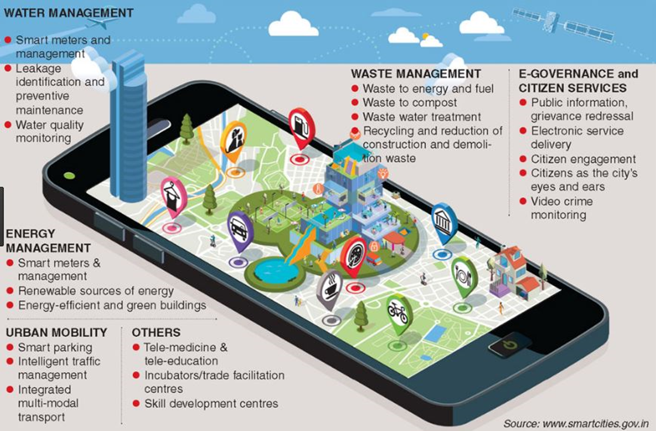
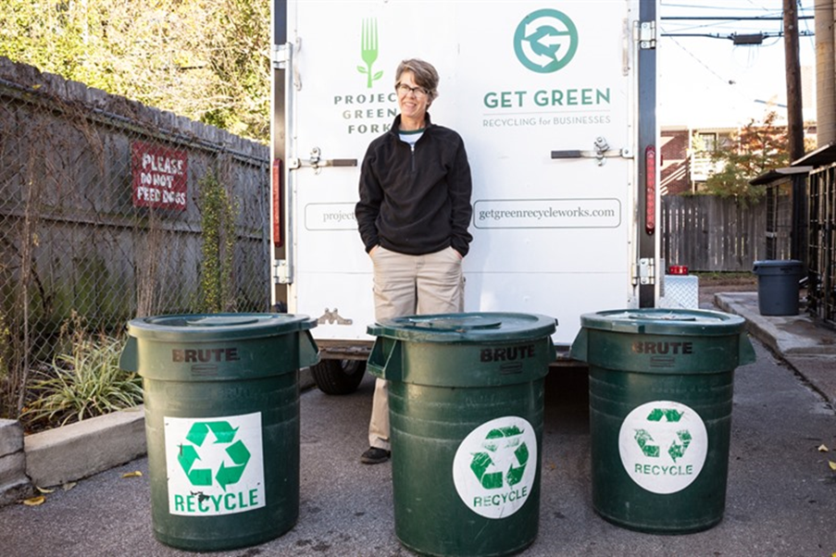
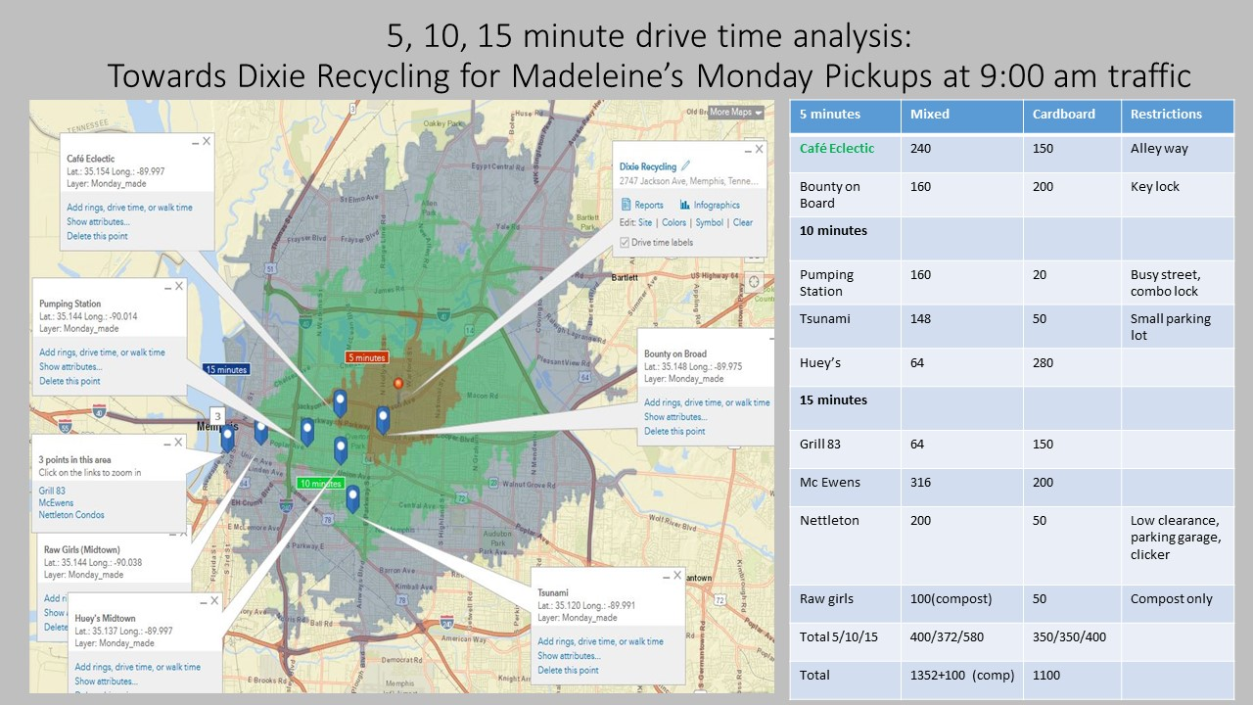
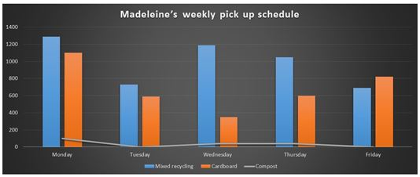
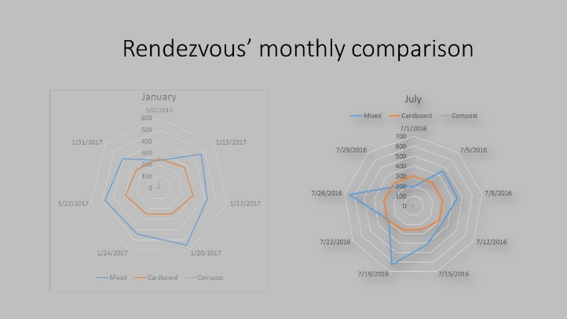
Most pick ups are done in the 10 minute drive time and average traffic volume is 6,000 -15,000 vehicles per day Composting is not common among restaurants. Mixed recycling materials are consistently picked up more in winter months than summer months, Cardboard is consistently picked up around 300 gallons with no seasonal change. Rendezvous, Whole Foods and Café Eclectic lead Memphis in recycling. More data collection and establishing baseline metrics are needed to create blueprint for all sectors –private, public and non-profit in the recycling domain in Memphis Smart devise solutions should be used so GIS maps and apps could monitor and reveal assets in real time Initiatives should be taken towards a smarter, healthier, and more sustainable city by focusing on business and consumer education efforts, raising local business and community awareness of the economic development opportunities associated with recycling and recycling-related manufacturing.
A New Chapter for Recycling: Using GIS and mixed methods approach to improve
the market development and transportation of recycled materials.
From a Private Collector’s Perspective Esra Ozdenerol, PhD, The University of Memphis
PRIVATE COLLECTOR IIN CIRCULAR ECONOMY
Reduce regular waste disposal costs
Make recycling affordable
Support the local and circular economy
Train and educate on recycling
Daily, weekly, as needed basis collection
SMART CITIES WASTE MANAGEMENT
Zero waste goal and high diversion rate
Mandate waste, recycling and organic collections
Collect data, track and analyze
Establish baseline metrics
Use web-based smart device solutions and monitor their assets in real time
Leverage non-profits so cities can help them become more successful with what they are doing instead of the city taking control of the programs

