Slide 1
New Student Orientation Student Financial Aid & Scholarships

Slide 2
The Financial Aid Process
2.Submit documents (myMemphis)
3.Aid processed for two semesters
4.Accept award via myMemphis
5.FA sends money to Bursar
1.FAFSA
6.Either pay balance by August 24th or receive eRefund

Slide 3
Free Application for Federal Student Aid https://fafsa.ed.gov
Create username/password via
https://fsaid.ed.gov
Academic Year | Submit the FAFSA | Using Tax Information
2018-2019 | October 1, 2017 | 2016
2019-2020 | October 1, 2018 | 2017

Slide 4
Financial Aid Available through the FAFSA
Federal Grants
Federal Pell Grant
Federal Supplemental Educational Opportunity Grant (SEOG)
State Government Money
HOPE Lottery Scholarship
Tennessee Student Assistance Award (TSAA)
Other TSAC Programs
Federal Loans
Subsidized
Unsubsidized
Parent Loan for Undergraduate Students (PLUS)
Federal Work Study

Slide 5
What You Should Know About Student Loans: They Must Be Paid Back!
Type of Loan | Interest Rate | Interest Accrual | Grace Period
Subsidized Loan | 5.045% | Interest free while in school | 6 months
Unsubsidized Loan | 5.045% | Not interest free while in school | 6 months
Parent Loan for Undergraduate Students (PLUS) *Apply via studentloans.gov | 7.595% | Not interest free while in school | NA The parent can apply for in-school deferment
Student
is the borrower
Parent
is the borrower

Slide 6
Keep the HOPE Lottery Scholarship
File FAFSA every year
Must maintain continuous enrollment
Must stay enrolled at the status you were paid each semester
Must meet the required cumulative GPA at the benchmarks below
Benchmarks | GPA Requirement
24 hours attempted | 2.75
48 hours attempted | 2.75
72 hours attempted and beyond | 3.0 Or 2.75 – 2.99 cumulative GPA AND a semester GPA of at least a 3.0

Slide 7
Academic Scholarship Requirements
Maintain eligibility
2.75 cumulative GPA after first year, 3.0 cumulative for each additional year
Must complete a minimum of 24 credit hours per academic year
Must complete any required service hours by June 1st of each year

Slide 8
Academic Scholarship Requirements
Dean’s
75 service hours per academic year (June to June)
or
One honors class per academic year (make a B or better)
Provost’s and Cecil C. Humphreys Presidential
150 service hours per academic year (June to June)
or
Two honors class per academic year (make a B or better)

Slide 9
Tiger Scholarship Manager
Departmental/Private Scholarships
Log into myMemphis
Click Account$ tab
Bottom right hand side, click “Tiger Scholarship Manager”
Opens every mid-November through early February

Slide 10
Look for Outside Scholarships
Include name and UID number on the Memo OR in the attached information with the check
Make a copy for your record
Be sure to use the correct address
The University of Memphis P.O. Box 1000, Dept. 313 Memphis, TN 38148-0313

Slide 11
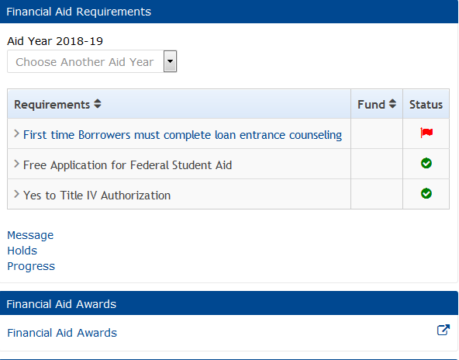
Accessing Your Financial Aid Information
Financial Aid Requirements
Red Flag –outstanding/incomplete item
Green check mark – item received/
completed
Financial Aid Awards
Click Financial Aid Awards Link

Slide 12
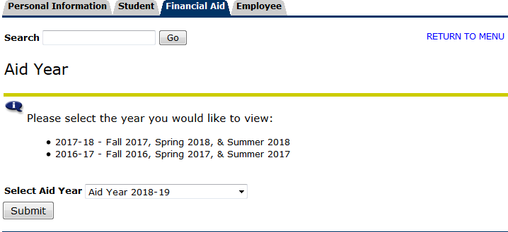
Accessing Your Financial Aid Information

Slide 13
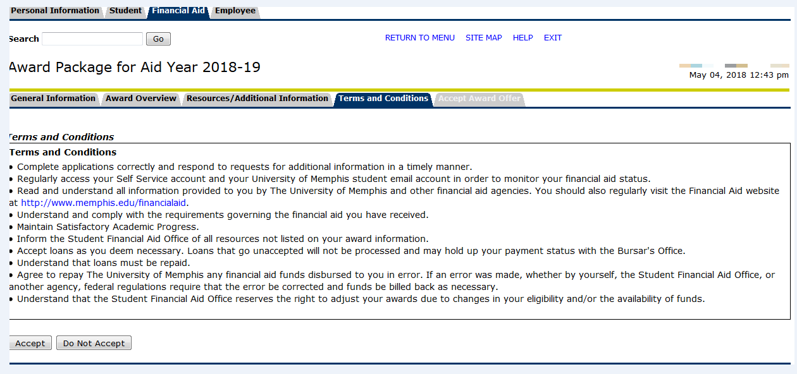
Accessing Your Financial Aid Information
Select the Terms and Conditions tab

Slide 14
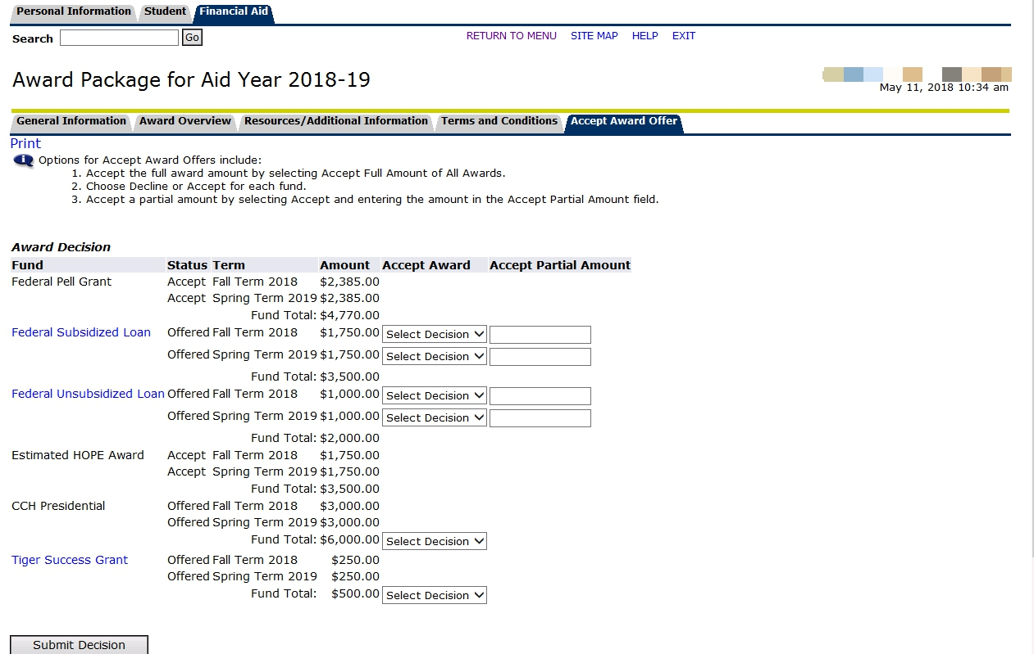
Reviewing the Financial Aid

Slide 15
Accessing Status and Award Information
Click on Account$ and check for any missing documents under Financial Aid Requirements (red flags).
Submit any missing documents to the Student Financial Aid Office.
For awards, scroll down and click on the Financial Aid Awards link.
Select the Aid Year 2018—2019, then Submit.
Click on the Terms & Conditions tab.
Scroll down to ‘Accept’ the Terms & Conditions.
Click on the Accept Award Offer tab and review your awards on-line.
Accept/accept partial/decline using the drop down box, then Submit Decision.
Continuously check myMemphis for additional requirements and/or updates.

Slide 16
Budget Example #1 Semester Estimate (based on 15 credit hours)
Expenses
In-State Tuition | $4,850
Dining Dollars | $ 300
Total | $5,150
Awards
Provost Schlp | $2,000
Outside Schlp | $1,000
HOPE | $1,750
Total | $4,750
Balance Owed: ($400)

Slide 17
Budget Example #2 Semester Estimate (based on 15 credit hours)
Expenses
In-State Tuition | $4,850
Dining Dollars | $ 300
LLC/Wkly 7 | $3,990
Total | $9,140
Awards
Dean’s Schlp | $1,500
PELL Grant | $3,048
HOPE w/Aspire | $2,500
TSAC Grant | $1,000
Total | $8,048
Balance Owed: ($1,092)

Slide 18
Budget Example #3 Semester Estimate (based on 15 credit hours)
Expenses
250R Tuition | $7,850
Dining Dollars | $ 300
Centennial Place/Wkly 7 | $4,070
Total | $12,220
Awards
Provost Schlp | $2,000
Department Schlp | $ 500
PELL Grant | $3,048
Loans (maximum) | $2,750
Total | $8,298
Balance Owed: ($3,922)

Slide 19
Budget Example #4 Semester Estimate (based on 15 credit hours)
Expenses
Out-of-State Tuition | $10,706
Dining Dollars | $ 300
Centennial Place/Wkly 7 | $ 4,070
Total | $15,076
Awards
Presidential Schlp | $3,000
Valedictorian Schlp | $1,000
PELL Grant | $3,048
Loans (maximum) | $2,750
Total | $9,798
Balance Owed: ($5,278)

Slide 20
What if we don’t have enough?
Installment Payment Plan (IPP) through the Bursar’s Office
www.memphis.edu/bursar
Commute versus dorm?
Where else can you cut? Re-assess your expenses/work on a budget
What other monies are coming in?
Tuition discounts (State of TN employee, TN teacher, Veterans benefits, etc.)
Parent’s employer
Community
House of Worship

Slide 21
Other Tidbits
First time borrowers of loans must visit https://studentloans.gov and complete:
Entrance Counseling
Master Promissory Note
Parent applying for PLUS must complete their own MPN
Summer is an optional semester; Not all programs are summer eligible; Financial Aid Office will communicate with you in spring semester regarding your options
Program of Study
Student must maintain Satisfactory Academic Progress
2.0 cumulative GPA
Complete 67% of attempted hours
Federal Work Study award is earned by a student as they work an on campus job
Complete withdrawal has serious repercussions

Slide 22
Contact Information
Matthew Rhodes
Financial Aid & Scholarships Outreach Coordinator
Wilder Tower 201
Email: mdrhodes@memphis.edu
Scholarship Office
201 Wilder Tower
Ph: (901) 678-3213
Fax: (901) 678-5621
Email: scholarships@memphis.edu
Web: memphis.edu/scholarships
Financial Aid Office
103 Wilder Tower
Ph:(901) 678-4825
Fax:(901) 678-3590
Email: financialaid@memphis.edu
Web: memphis.edu/financialaid

