Slide 1

New Student Orientation
Federal Student Loan Workshop
2018

Slide 2


The Financial
Aid Process
2.Submit documents (myMemphis)
3.Aid processed for two semesters
4. Accept award via myMemphis
5. FA sends money to Bursar
1.FAFSA
6. Either pay balance by August 24th or receive eRefund

Slide 3

Free Application for Federal Student Aid https://fafsa.ed.gov
Create username/password via
https://fsaid.ed.gov
Academic Year | Submit the FAFSA | Using Tax Information
2018-2019 | October 1, 2017 | 2016
2019-2020 | October 1, 2018 | 2017

Slide 4
Who Qualifies for Federal Student Loans?
Student who completes the FAFSA
U.S. citizen or an eligible non-citizen (permanent resident)
Degree-seeking student
Enrolled in at least half time (6 hours)
Making Satisfactory Academic Progress

Slide 5
What You Should Know About Student Loans: They Must Be Paid Back!
Type of Loan | Interest Rate | Interest Accrual | Grace Period
Subsidized Loan | 5.045% | Interest free while in school | 6 months
Unsubsidized Loan | 5.045% | Not interest free while in school | 6 months
Parent Loan for Undergraduate Students (PLUS) *Apply via studentloans.gov | 7.595% | Not interest free while in school | NA The parent can apply for in-school deferment
Student
is the borrower
Parent
is the borrower

Slide 6
How Much Can Students Borrow?
Dependent Loan Amount
Grade level | Subsidized or Unsubsidized | Additional Unsubsidized | Yearly Totals
Freshman 1-29 hrs | 3,500 | 2,000 | 5,500
Sophomore 30-59 hrs | 4,500 | 2,000 | 6,500
Junior 60-89 hrs | 5,500 | 2,000 | 7,500
Senior 90+ hrs | 5,500 | 2,000 | 7,500
TOTAL | 19,000 | 8,000 | 27,000
Lifetime limit:
Dependent Student = $31,000
You are responsible for monitoring how much you’ve borrowed. Keep up with your federal loans at the National Student Loan Data System at https://nslds.ed.gov

Slide 7
Parent Loan for Undergraduate Students (PLUS)
Parent is the borrower
Apply on-line at https://studentloans.gov
A credit history check is required
If approved, parent must complete a Master Promissory Note (MPN) at same website
Parent can request in-school deferment
If denied, parent can:
  Appeal credit decision; OR
  Obtain an endorser/co-signer; OR
  Turn loan over to student for additional unsubsidized loan (by filling out PLUS Change Form)

Slide 8
Dependent Loan Amount w/ Denied PLUS
Grade level | Subsidized or Unsubsidized | Additional Unsubsidized | If PLUS is turned over to student | Yearly Totals
Freshman 1-29 hrs | 3,500 | 2,000 | 4,000 | 9,500
Sophomore 30-59 hrs | 4,500 | 2,000 | 4,000 | 10,500
Junior 60-89 hrs | 5,500 | 2,000 | 5,000 | 12,500
Senior 90+ hrs | 5,500 | 2,000 | 5,000 | 12,500
TOTAL | 19,000 | 8,000 | 18,000 | 45,000
Lifetime limit:
Dependent Student = $31,000
Independent Student = $57,500
You are responsible for monitoring how much you’ve borrowed. Keep up with your federal loans at the National Student Loan Data System at https://nslds.ed.gov

Slide 9
Loan Repayment Examples
Total Borrowed | $15,000 | $45,000
Monthly Payment | $155 | $466
Total Owed/Paid | $18,655 | $55,965
This example is based on a standard repayment plan for undergraduate borrowers of Federal Unsubsidized loans at a 4.5% interest rate with 120 monthly payments. (Source: studentaid.ed.gov)
You are NOT required to take out the maximum amount of loans
Visit nslds.ed.gov to monitor your loans
Stafford loans interest rates vary from year to year, but they are capped at 8.25% (changes July 1 of every year)
A dependent student can only borrow 31,000 in their lifetime and an independent student 57,500

Slide 10
Accessing Status and Award Information
Click on Account$ and check for any missing documents under Financial Aid Requirements (red flags).
Submit any missing documents to the Student Financial Aid Office.
For awards, scroll down and click on the Financial Aid Awards link.
Select the Aid Year 2018—2019, then Submit.
Click on the Terms & Conditions tab.
Scroll down to ‘Accept’ the Terms & Conditions.
Click on the Accept Award Offer tab and review your awards on-line.
Accept/accept partial/decline using the drop down box, then Submit Decision.
Continuously check myMemphis for additional requirements and/or updates.

Slide 11
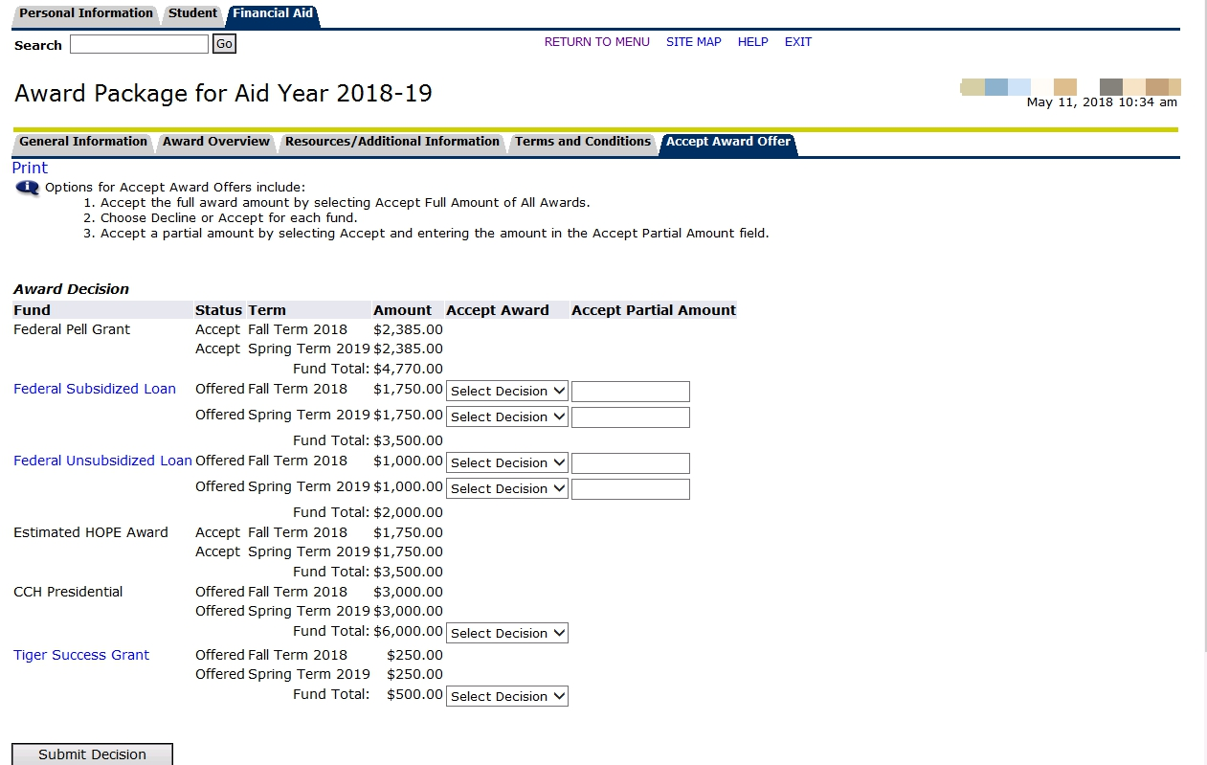
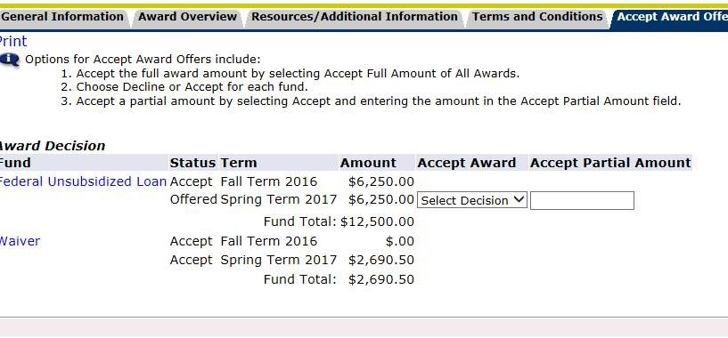
Accepting an Award

Slide 12
What if we don’t have enough?
Installment Payment Plan (IPP) through the Bursar’s Office
  www.memphis.edu/bursar
Commute versus dorm?
Where else can you cut? Re-assess your expenses/work on a budget
What other monies are coming in?
  Tuition discounts (State of TN employee, TN teacher, Veterans benefits, etc.)
  Parent’s employer
  Community
  House of Worship

Slide 13
Other Tidbits
First time borrowers of loans must visit https://studentloans.gov and complete:
  Entrance Counseling
  Master Promissory Note
Parent applying for PLUS must complete their own MPN
Summer is an optional semester; Not all programs are summer eligible; Financial Aid Office will communicate with you in spring semester regarding your options
Program of Study
Student must maintain Satisfactory Academic Progress
  2.0 cumulative GPA
  Complete 67% of attempted hours
Federal Work Study award is earned by a student as they work an on campus job
Complete withdrawal has serious repercussions

Slide 14
What Is My Role?
Student
Parent
Get paperwork done AND submitted as soon as possible
Be aware of deadlines
Check myMemphis often for possible updates to your account
READ YOUR EMAIL from key offices, as it will contain important information
Keep parent(s) informed of status
Ensure your student is getting their paperwork done as soon as possible
Be aware of deadlines
Have your child get to know certain people in key offices
Maintain open communication with your student
Remember, under the Family Educational Rights and Privacy Act (FERPA), we cannot release specific information to parent

Slide 15
Contact Information
Financial Aid Office
103 Wilder Tower
Phone: (901) 678-4825
Fax: (901) 678-3590
Email: financialaid@memphis.edu
Web: memphis.edu/financialaid

