Slide 1

Student Financial Aid & Scholarships
Parent Session

Slide 2
Enrollment Services Center (ESC)
One office can answer all your questions
Financial Aid
Scholarships
Registrar
Admissions
103 Wilder Tower

Slide 3
Financial Aid Available through the FAFSA
Grants
Federal Pell Grant
Federal Supplemental Educational Opportunity Grant (SEOG)
Tennessee Student Assistance Award (TSAA)
Federal Work Study
Federal Student Loans
Subsidized
Unsubsidized
Parent Loan for Undergraduate Students (PLUS)
Scholarships
HOPE Lottery
Check myMemphis Often!!!

Slide 4
Need Based Aid
Grants - Free $$
Federal Pell Grant
Federal Supplemental Educational Opportunity Grant (SEOG)
Tennessee Student Assistance Award (TSAA)
Federal Work Study
Job on campus
Does not pay tuition/fees
Subsidized loan

Slide 5
What You Should Know About Student Loans: They Must Be Paid Back!
Type of Loan | Need Based | Required Enrollment | Interest Rate | Interest Accrual | Grace Period
Subsidized Loan | Yes | At least six hours | 4.29%* | Interest free while in school | 6 months
Unsubsidized Loan | No | At least six hours | 4.29%* | Not Interest free while in school | 6 months
Parent Plus for UG Students *Apply via studentloans.gov and undergo a credit check | No | At least six hours | 6.84%* | Not Interest free while in school | NA *The parent can apply for in-school deferment
Student
is the borrower
Parent
is the borrower

Slide 6
Loan Repayment Examples
Total Borrowed | $15,000 | $40,000
Monthly Payment | $173 | $460
Total Owed/Paid | $20,714 | $55,239
This example is based on a standard repayment plan for undergraduate or graduate borrowers at a 6.8% interest rate with 120 monthly payments. (Source: studentaid.ed.gov)
You are NOT required to take out the maximum amount of loans
Visit www.nslds.ed.gov to monitor your loans
Stafford loans have variable interest rates, but they are capped at 8.25% (changes July 1 of every year)
A dependent student can borrow 31,000 in their lifetime

Slide 7
Keep the HOPE Scholarship
File FAFSA every year
Maintain continuous enrollment
Must meet the required cumulative GPA at the benchmarks
Benchmarks | GPA Requirement
24 hours attempted | 2.75
48 hours attempted | 2.75
72 hours attempted and beyond | 3.0 Or 2.75 – 2.99 cumulative GPA AND a semester GPA of at least a 3.0
Check myMemphis Often!!!

Slide 8
Tiger Scholarship Manager
Departmental/Private Scholarships
Student will log into myMemphis
Click Account$ tab
Bottom right hand side, click “Tiger Scholarship Manager”
Opens November to January for 2016 - 2017

Slide 9
Outside Awards
Include name and U number on the Memo OR in the attached information with the check
Make a copy for your record
Be sure to use the correct address
The University of Memphis P.O. Box 1000, Dept. 313 Memphis, TN 38148-0313
Tuition discounts (State of TN employee, TN teacher, Veterans benefits, etc.)

Slide 10

Stack Money
Per Year Award Example
Pell Grant $5,775
Provost Sch. $4,000
Band Sch. $1,000
Outside Sch $500
Hope Sch. $3,500
Total $14,775

Slide 11
Budget Example #1 (Off-Campus Student)
Fall Semester Estimate
Costs Awards
Tuition $4,482 HOPE $1,750
Dining Dollars $ 300 Pell Grant $2,887
Total $4,782 Total $4,637
Balance Owed: $145

Slide 12
Budget Example #2 (On-Campus Student)
Fall Semester Estimate
Costs Awards
Tuition $4,482 HOPE $1,750
Dining Dollars $ 300 Pell Grant $2,887
Room/Board $4,000 Total: $4,637
Total: $8,782
Balance Owed: $4,145

Slide 13
Financial Aid Process
FAFSA must be completed online
www.fafsa.gov
Priority deadline
March 1
Aid is processed for 2 semesters – Fall and Spring
Submit any requested documents/requirements listed with red flags on my.memphis.edu

Slide 14
Financial Aid Process
Log on to your my.memphis.edu account to review and accept your award offers
Financial Aid Office forwards aid to the Bursar’s Office to pay for fees
Check Tiger Xpress
Excess aid will be refunded by the Bursar’s Office via eRefunds or paper check. Otherwise, pay the balance.
Fee Deadline August 21

Slide 15
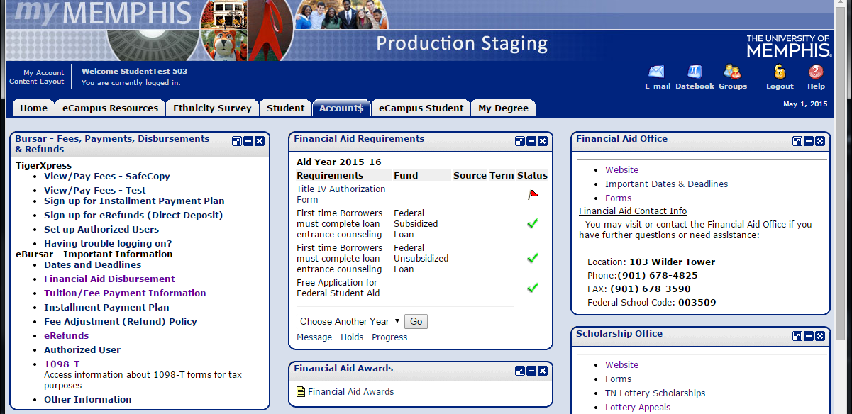
Checking for Red Flags on myMemphis
Financial Aid Requirements
Red flag – incomplete
Green check mark – item received/
completed
Financial Aid Awards
Click Financial Aid Awards Link

Slide 16
Proxy Access
Students can log in to myMemphis to give parent/guardian authorization to see selected Financial Aid information
Proxy will be emailed to set up access
Student will confirm what they want Proxy to be able to view

Slide 17
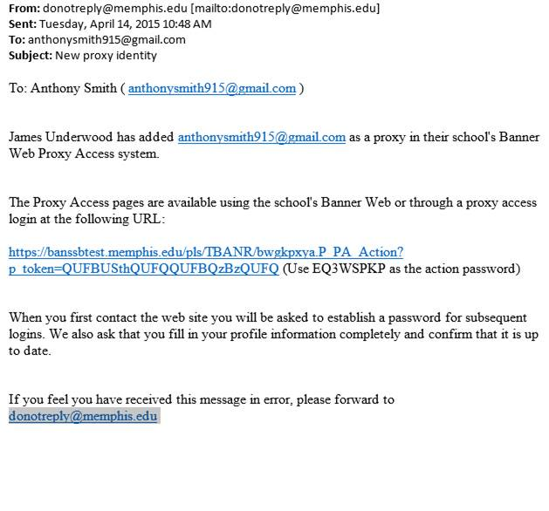
Proxy email

Slide 18
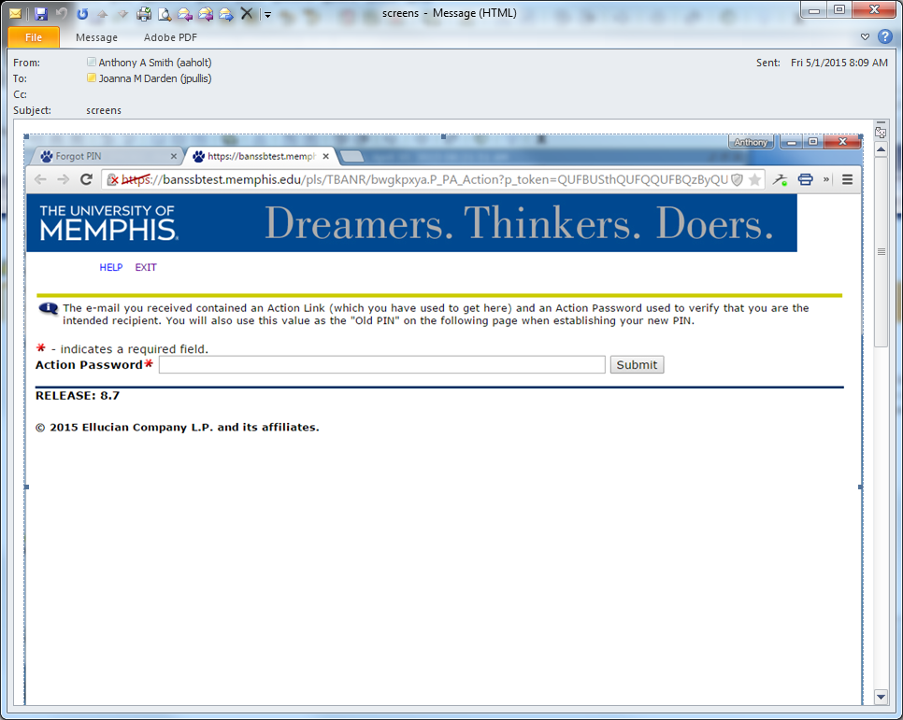
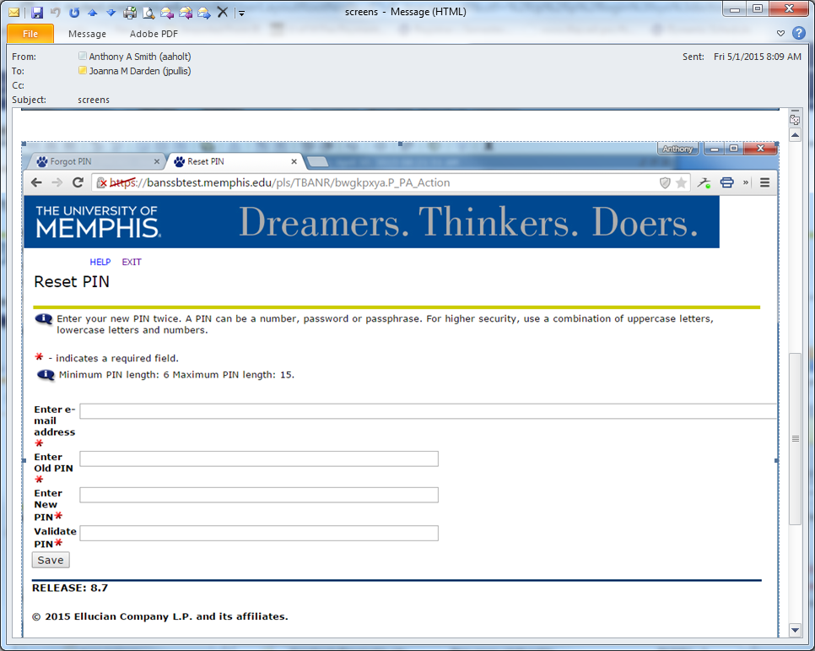
Proxy login

Slide 19
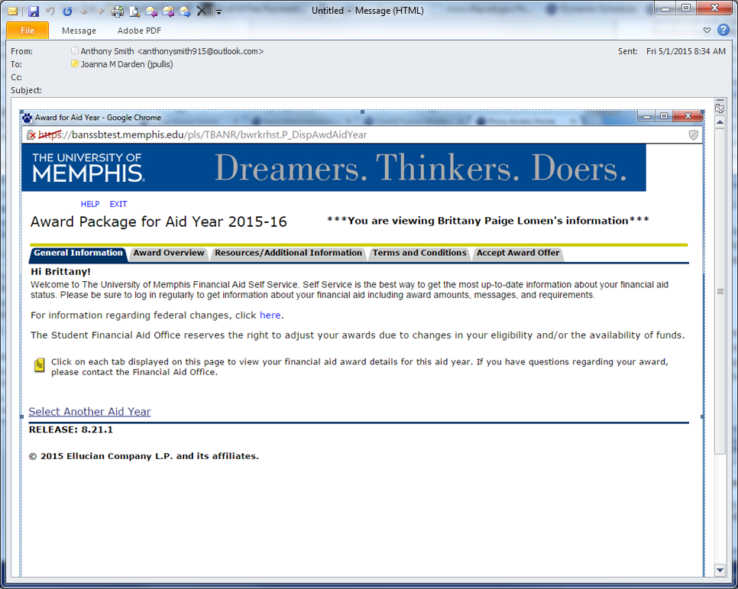
Proxy Access

Slide 20
Questions?
More sessions:
Loan Session at 8:30am
FA/Bursar Satellite Location at 12pm
Enrollment Services Student Support Center
103 Wilder Tower Memphis, TN 38152
Main: 901.678.4825
Fax: 901.678.3590
Web: www.memphis.edu/financialaid
Email: financialaid@memphis.edu

