Slide 1
HPC Current Report
Fall Semester 2019

Slide 2
Changes made since April
May:
Decreased default --mem-per-cpu from 4 GB to 1 GB
Implemented limit enforcement
Fairshare started at weight 16625
June:
CPU affinity enforcement
Increased fairshare weight from 16625 to 100000
August:
Decreased fairshare weight from 100000 to 50000

Slide 3
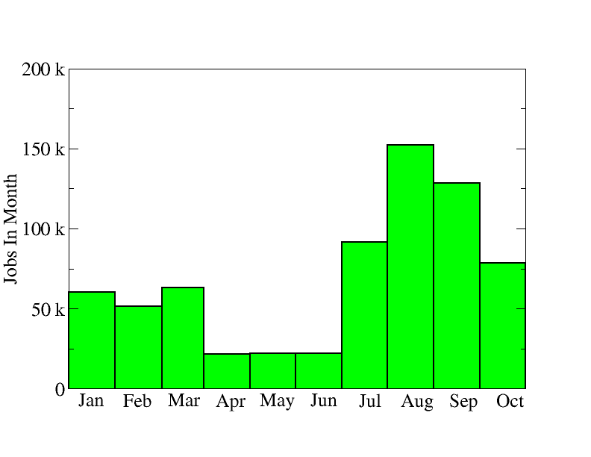
Jobs per Month

Slide 4
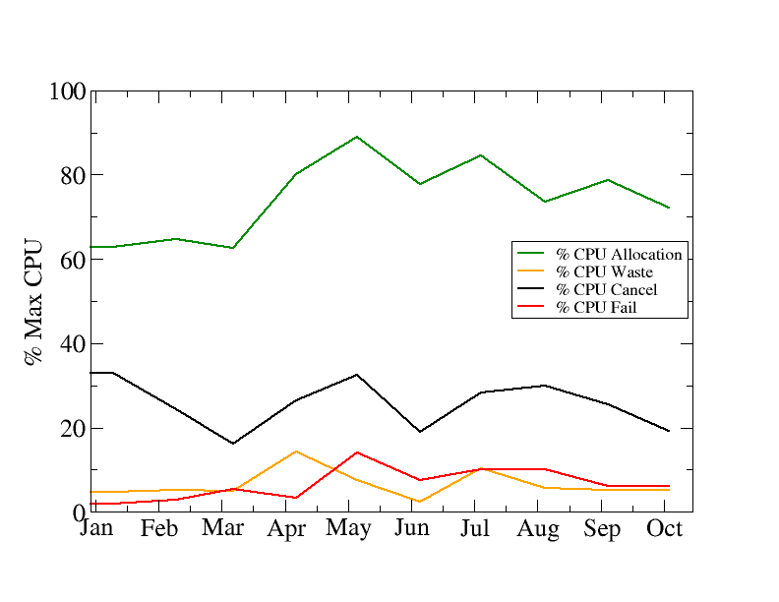
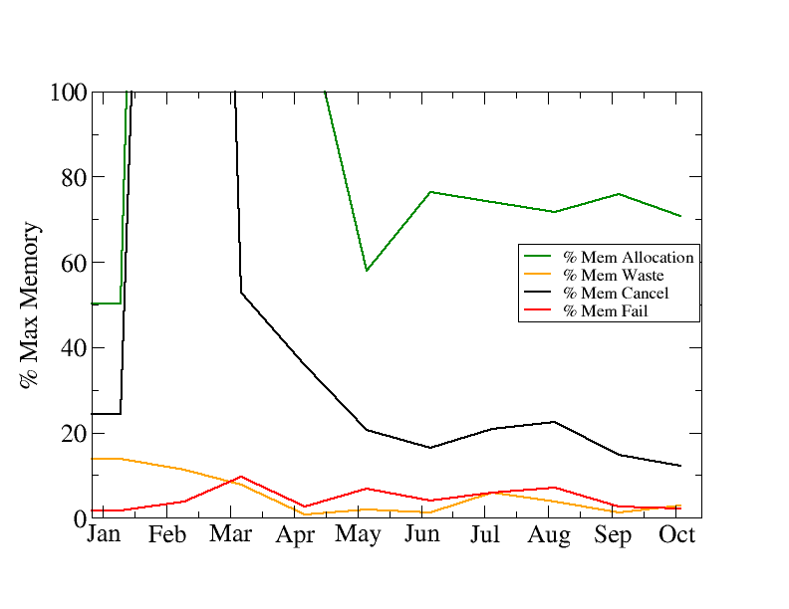
Utilization
Allocation=job ran
Waste=job scheduled but was cancelled
Cancel=job scheduled and ran but was cancelled
Fail=job failed, very likely ran

Slide 5
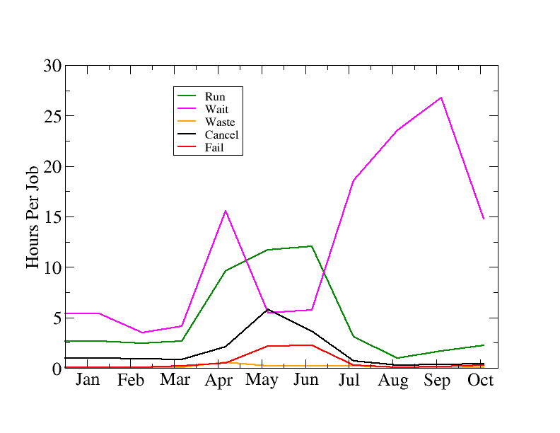
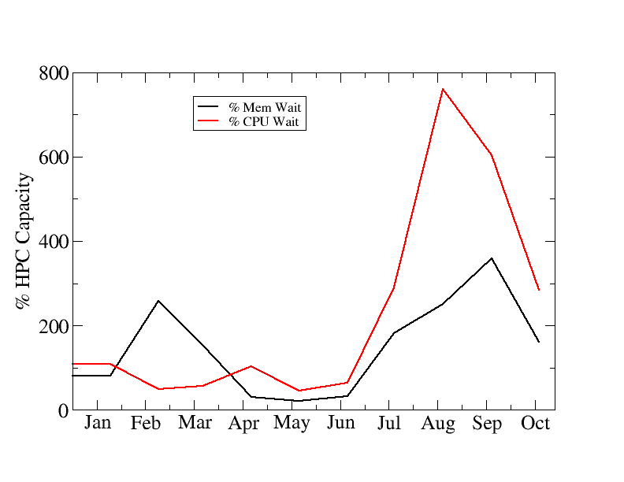
Why are jobs waiting so long?
Run=Allocation=job ran
Wait=how long a job was in queue
Waste=job scheduled but was cancelled
Cancel=job scheduled and ran but was cancelled
Fail=job failed, very likely ran

Slide 6
Job Queue (FIFO)
Job 1 requires 40 CPUs and 1 hours, Job 2 requires 20 CPUs and 1 hour,
Job 3 requires 30 CPUs and 1 hours, Job 4 requires 7 CPUs and 1 hour
1:00
1
2
2:00
1
3:00
1
3
4
2
3
4
2
3
4
4:00
1
2
3
4
Time > JobId
Job 1 queued, others wait
Job 1 starts, job 2 queued, others wait
Job 1 finishes, job 2 starts, job 3 queued, others wait
Job 2 finishes, job 3 starts, job 4 queued

Slide 7
Job Queue (Priority)
Job 1 requires 40 CPUs and 1 hour, Job 2 requires 30 CPUs and 1 hour,
Job 3 requires 30 CPUs and 1 hour, Job 4 requires 7 CPUs and 1 hour
1:00
1(10)
2(20)
2:00
1(10)
3:00
1(10)
3(12)
4(15)
2(20)
3(12)
4(15)
2(20)
3(12)
4(15)
4:00
1(10)
2(20)
3(12)
4(15)
Time > JobId(priority)
Job 2 queued, others wait
Job 2 starts, job 4 queued, others wait
Job 2 finishes, job 4 starts, job 3 queued, others wait
Job 3 finishes, job 4 starts, job 1 queued

Slide 8
What factors into priority?
Priority=Age+Size+Nice+Partition+QOS+TRES+FS
Age
Size (aka CPU+Time)
Nice (aka administrative adjustment)
Partition
QOS (Quality of Service)
TRES (Trackable resources, CPU+Memory+GPU)
FS (Fairshare)

Slide 9
Priority Values
Age Weights
Maximum 16625 at 7 days
Increments priority linearly from 0 as job waits
Size Weights
Maximum 16625 with 3250 CPUs and 1 second of requested time
More Requested CPUs=Higher Size Priority Factor
More Requested Time=Lower Size Priority Factor
Nice Weights (±2147483645)
If Nice>0 then lower priority, if Nice<0 then higher priority

Slide 10
Priority Values (cont.)
Partition Weights
Currently zero, but can be set per partition
QOS Weights (just 1, but this enforces other limits)
“bigmemqqos” attached to bigmemq partition with limits of 40 cpus and 1.5 TB memory per user
“normal” qos for all jobs with maximum wall time of 28 days
TRES Weights
CPU=3000, Mem=3000, GRES/gpu=16625
Set to favor jobs requesting GPUs in gpuq
Favors CPU jobs

Slide 11
Fairshare Priority
Based on account shares and recent user utilization
Primary weight 50000
User weights 100
Account weights depend on the number of users (this balances weights fairly among labs, departments, and colleges)
Imposes a penalty that decays by ½ every 2 hours (effectively zero by 1 to 2 days if you don’t submit or have running any jobs)

Slide 12
Backfill (Lower your timelimit!)
Job 1 requires 40 CPUs and 4 hours, Job 2 requires 20 CPUs and 1 hour,
Job 3 requires 20 CPUs and 2 hours, Job 4 requires 7 CPUs and 1 hour
1:00
1(10)
2(20)
2:00
1(10)
3:00
1(10)
3(12)
2(20)
3(12)
4(5)
2(20)
3(12)
4(5)
4:00
1(10)
2(20)
3(12)
4(5)
Time > JobId(priority)
Job 2 and 3 queued, job 1 will start at 4:00
Job 2 and 3 starts, job 4 will “backfill” at 3:00
Job 2 finishes, job 4 starts, job 3 continues
Job 3 finishes, job 4 starts, job 1 queued

Slide 13
Task vs CPU
Job Script (--cpus-per-task=4)
Task0
CPU0
CPU1
CPU2
CPU3
Job Script (--ntasks=4)
Task0
CPU0
Task1
Task2
Task3
CPU1
CPU2
CPU3
Use --cpus-per-task for shared memory
multithreaded applications!
Using --ntasks for shared memory
multithreaded applications forces
the affinity for all threads on 1 cpu!

Slide 14
Task vs CPU
Job Script (--cpus-per-task=4)
Task0
CPU0
CPU1
CPU2
CPU3
Job Script (--ntasks=4)
Task0
CPU0
Task1
Task2
Task3
CPU1
CPU2
CPU3
Srun or mpirun
Use --cpus-per-task for shared memory
multithreaded applications!
Using --ntasks for distributed memory
multithreaded applications allows
the affinity for all threads on all cpus!

Slide 15
Time Slicing (gang scheduling)
Job 1 requires 40 CPUs and 2 hour, Job 2 requires 30 CPUs and 2 hours,
Job 3 requires 30 CPUs and 2 hours, Job 4 requires 7 CPUs and 3 hour
1:00
1(10)
2(20)
2:00
1(10)
3:00
1(10)
3(12)
4(15)
2(20)
3(12)
4(15)
2(20)
3(12)
4(15)
4:00
1(10)
2(20)
3(12)
4(15)
Time > JobId(priority)
Everyone starts
Job 1 and 3 pause, 2 and 3 continue
Job 2 finishes, job 3 and 4 continue, job 1 paused
Job 3 and 4 finish, job 1 starts

Slide 16
Time Slicing (caveats)
If we implement this, we have to take the cluster down for maintenance
This queues jobs faster, but can slow many jobs down if their priority isn’t high enough

Slide 17
Storage
We have 348 TB
We are currently using 212 TB of it in the first year!
If we go to 100%, /home/scratch will be cleared first
We have archive storage (ask us about it)

Slide 18
DMTCP module
DMTCP: Distributed MultiThread Check Pointing
Just add to your script (--interval is seconds!):
module load dmtcp
dmtcp_launch --no-coordinator --interval 20 program
If your job fails, keep the checkpoint file, load the rest of your job modules like normal, and restart with dmtcp_restart:
module load dmtcp
dmtcp_restart --interval 20 ckpt_program_1877bec222c5a-40000-108508048ad56e.dmtcp

Slide 19
DMTCP caveats
These checkpoints require a lot of storage!
Only 1 checkpoint file is saved at a time
A temporary file is created during intervals with roughly the same size as the checkpoint file
It may slow down some applications
Frequent checkpointing (low --interval) will increase the effect
If something in your program failed, dmtcp_restart will simply repeat it
DMTCP is more useful for node failures and debugging
Don’t use sleep command, it just loops forever waiting for a broken timer

