Slide 1



Southeast Transportation Workforce Center
IFTI State of Freight
December 10, 2015

Slide 2
Agenda
Brief background on federal initiative and NNTW
SETWC mission and tasks
First year progress
What’s next? Opportunities for engagement!
Notes:
Open discussion, what works, what doesn’t etc.

Slide 3

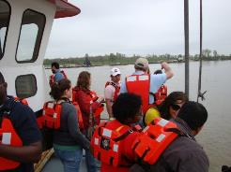

Background: Workforce Challenges
Competition from other industries
New technologies require new skill sets
Challenge to reach underrepresented groups
Lack of awareness/understanding of career opportunities
Notes:
Gender and diversity issues

Slide 4
Background: Impetus for National Network
Need to increase awareness of existing programs
Need to coordinate successful practices at all levels
Grades 6-12, Community Colleges, Technical Schools, University, Post Graduate, Professional Development
Need to coordinate efforts and resources across transportation, education, workforce, labor communities
Need for strategic approach to transportation workforce development

Slide 5
Background: Establishing a National Network
5 Regional Centers of Excellence with funding for 4 years
Combination of SAFETEA-LU and MAP-21 funding – matching REQUIRED in years 3 & 4
Administered through FHWA Technology Partnership Program
Notes:
Administered through FHWA’s Technology Partnership Programs
University and Grants Program inc. Eisenhower and Garrett Morgan programs
LTAP/TTAP
TEDPP

Slide 6
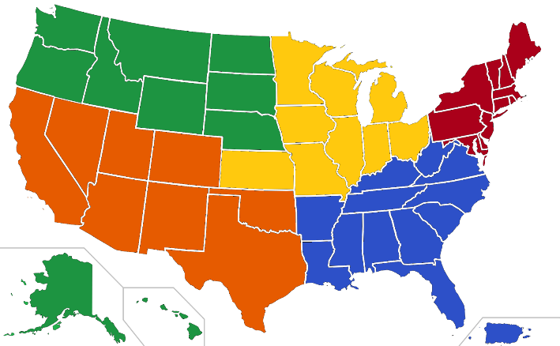
National Network for the Transportation Workforce
 | Midwest – University of Wisconsin
 | Northeast – University of Vermont
 | Southeast – University of Memphis
 | Southwest – California State Univ., Long Beach
 | West – Montana State University

Slide 7

National Network for the Transportation Workforce
Common approach for all region centers
Unique areas of national focus

Slide 8
Common Tasks for All Regional Centers
Identify stakeholders
Identify existing training and education programs
Identify best practices
Develop job needs and priorities profile
Identify training and workforce needs
Serve as a resource (‘one stop shop’) for transportation workforce
Notes:
While tasks conducted at a regional level, the centers will work collectively to develop a cohesive national picture

Slide 9
Southeast Regional Center
Serving 12 southeastern states and Puerto Rico
Areas of national focus:
Women in transportation
SFTP
Freight (trucking, rail, logistics)
IFTI
Military/veteran transition
to workforce
U of M Veterans Resource Center
Notes:
Important- we are center of excellence for these NATIONAL focus areas; Mention the importance of SFTP and IFTI involvement and how this led to us being selected for this work. Leveraged previous experience to make the case for why we should be selected for this.

Slide 10
SETWC
The vision of SETWC is that the work of the center in concert with regional partners will lead to a right-sized, career-ready transportation workforce being produced in the southeast region.
The mission of SETWC is to coordinate existing regionally based programs, plans, and processes and to strategically create partnerships to ensure that students and persons seeking workforce reentry, career transition, or career advancement are aware of opportunities, required education, skills, training, and ladders to success within the regional transportation workforce.
Notes:
Focus on vision- ultimately lead to sustained workforce center with regional and national impact – success beyond grant period and true value to partners

Slide 11
SETWC
The goals of SETWC include:
Identify regional transportation job needs and priorities;
Catalog existing training programs from K-12 through professional development;
Evaluate existing programs for scale and replication;
Identify education and training gaps;
Develop resources to bridge identified gaps; and
Fully engage in the national network to showcase successful programs and practices and to increase impact in the southeast region
Notes:
Aligned to FHWA requirements, but focused on regional impact

Slide 12
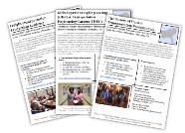
SETWC – First Year
Web Resource
Stakeholder Meetings
Focus area initiatives
Compendium of education/certification programs
Regional job needs and priorities draft
Notes:
-Show website – particularly resources and focus area (women’s page – video, conference summary, WIT Index)
-Stakeholder meetings- we go to them
-Scope for focus areas and key activities – will talk specifically about CT in a minute
-Show search functionality if available
-RJNP- BLS data review, identification of top occupations for region, skillsets, education, forecasts. Will need input from public and private sector to vet findings from lit review and BLS – is this what they also are seeing/expecting; what are priorities for our region?

Slide 13
Web Resource
Notes:
-Show website – particularly resources and focus area (women’s page – video, conference summary, WIT Index)
-Stakeholder meetings- we go to them
-Scope for focus areas and key activities – will talk specifically about CT in a minute
-Show search functionality if available
-RJNP- BLS data review, identification of top occupations for region, skillsets, education, forecasts. Will need input from public and private sector to vet findings from lit review and BLS – is this what they also are seeing/expecting; what are priorities for our region?

Slide 14
SETWC – Stakeholder Meetings
Professional Organizations
Sector roundtables
Focus area initiatives
Notes:
-Show website – particularly resources and focus area (women’s page – video, conference summary, WIT Index)
-Stakeholder meetings- we go to them
-Scope for focus areas and key activities – will talk specifically about CT in a minute
-Show search functionality if available
-RJNP- BLS data review, identification of top occupations for region, skillsets, education, forecasts. Will need input from public and private sector to vet findings from lit review and BLS – is this what they also are seeing/expecting; what are priorities for our region?

Slide 15


Focus Area Initiatives
Save Your Seat!!!
Notes:
Women; military; freight

Slide 16
Compendium of Programs
Database submitted to FHWA
Finalized framework
Working to embed within university system
Expected portal launch December 2015
Virginia DOT first best practice spotlight
Notes:
Open discussion, what works, what doesn’t etc.

Slide 17
Draft Job Needs and Priorities Report
Open for comment/review through January 31

Slide 18
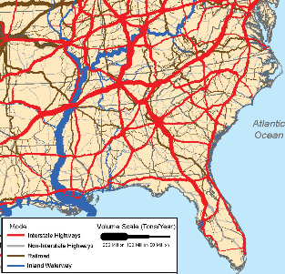
Draft Job Needs and Priorities Report
Regional description
Infrastructure
Mode by mode description
Key industry sectors by state
Regional workforce data
Bureau of Labor Statistics
Screening methodology
Priority occupations

Slide 19
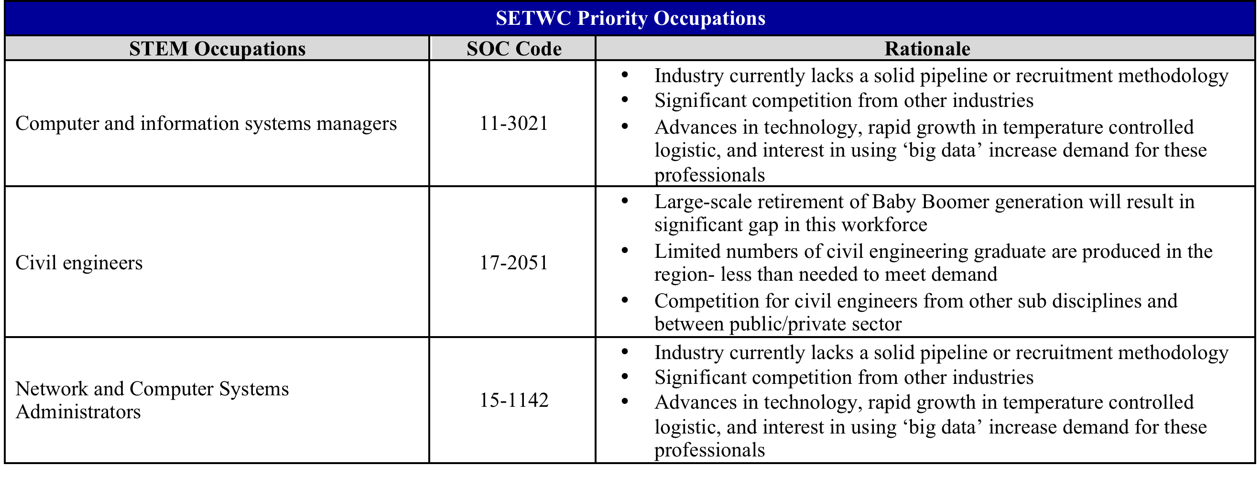
SE Priority Occupations

Slide 20
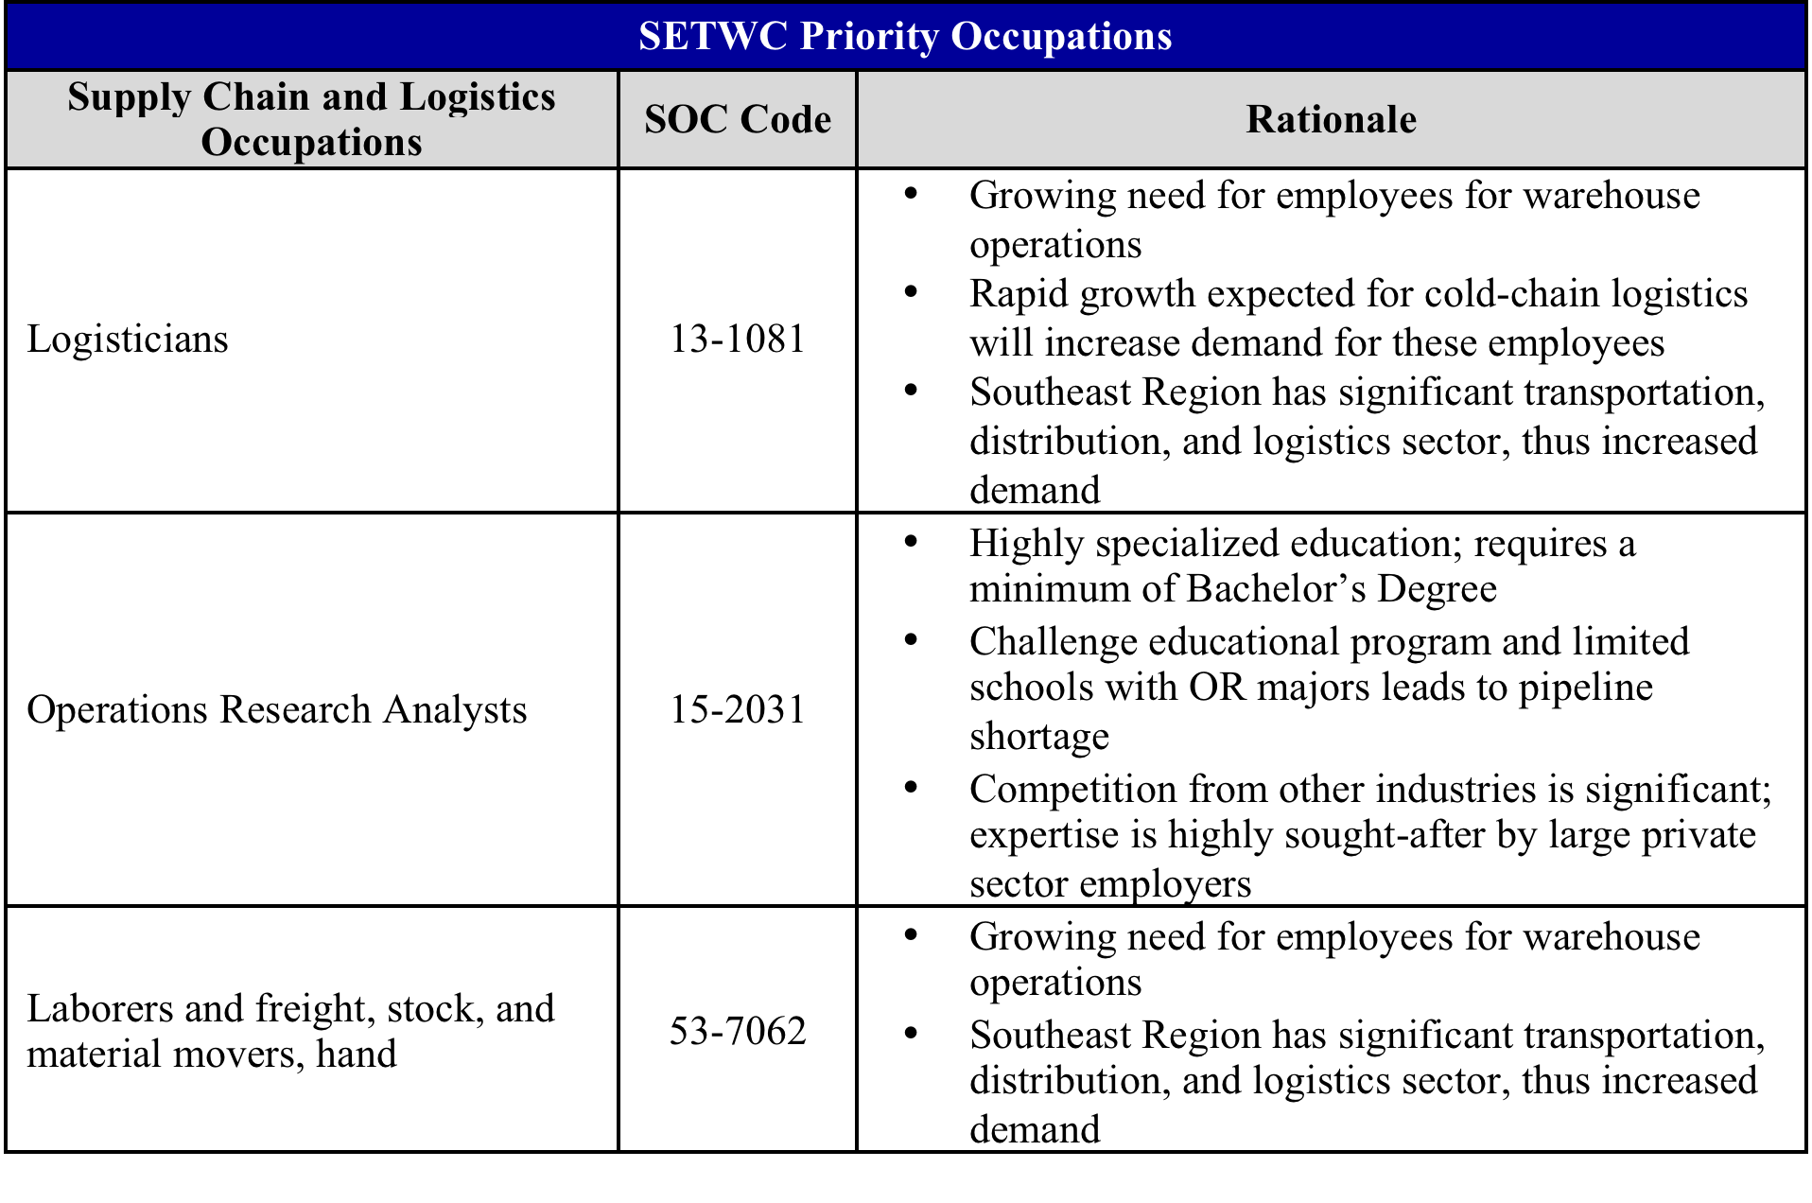
SE Priority Occupations

Slide 21
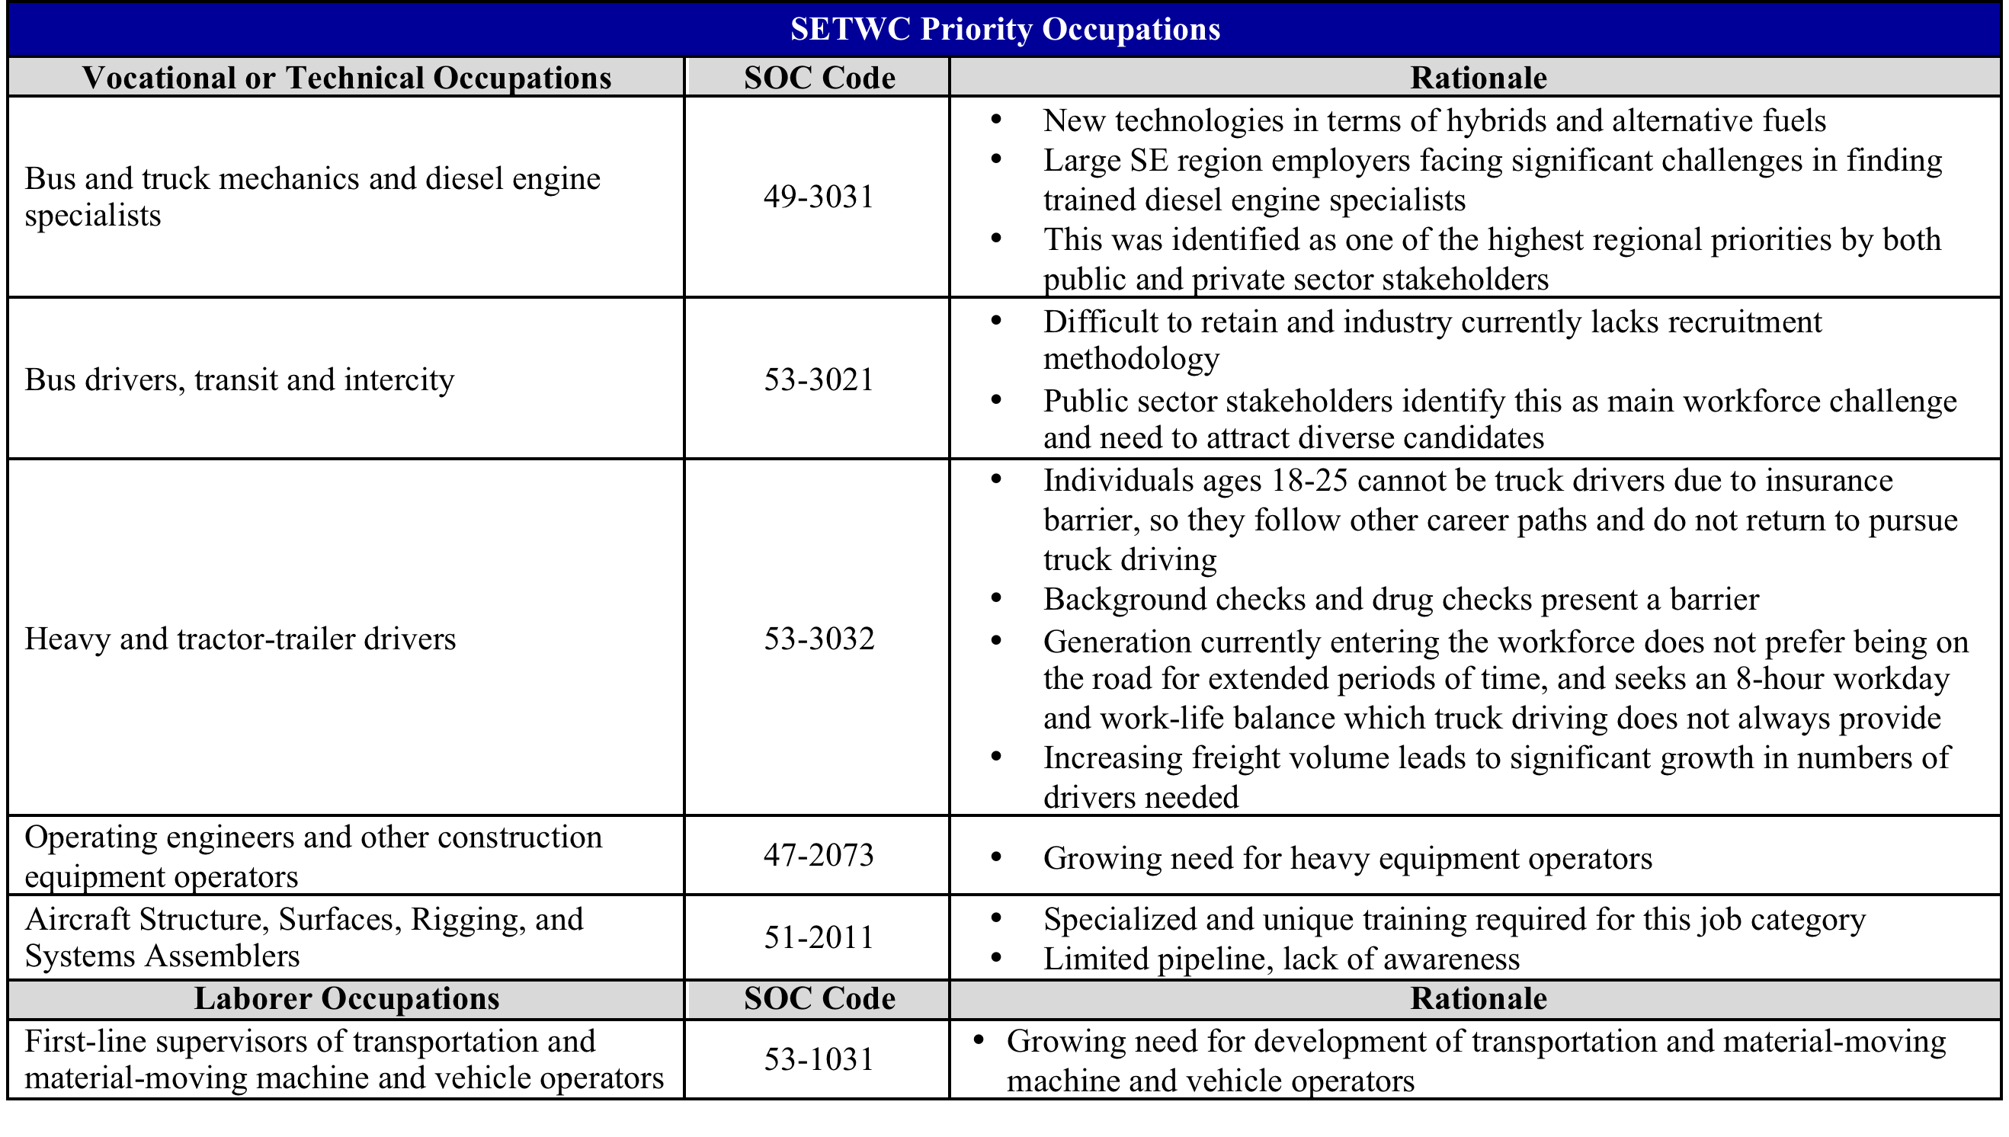
SE Priority Occupations

Slide 22
What’s Next? Get involved!
Contribute to Compendium
Serve on Steering Committee
Contribute to regional Job Needs and Priorities Report
Engage in Choosing Transportation 2016!
Support SETWC Initiatives – 100 Key Partners
Notes:
Mention compendium will include CTE for all our states

Slide 23
More Information?
www.memphis.edu/setwc
Notes:
Mention compendium will include CTE for all our states

