Slide 1
UTC Best Practices
Reporting Requirements
Mountain Plains Consortium
North Dakota State University
Region 8
University Transportation Center
June 2013

Slide 2
Mountain Plains Consortium
Consists of 8 Universities
Colorado State University
North Dakota State University
South Dakota State University
University of Colorado Denver
University of Denver
University of Utah
University of Wyoming
Utah State University

Slide 3
Mountain Plains Consortium
2011 -2012
Universities | Number of Projects | Number of PI’s
Colorado State University | 18 | 36
North Dakota State University | 14 | 17
South Dakota State University | 10 | 22
University of Colorado Denver | 4 | 8
University of Denver | 1 | 1
University of Utah | 12 | 36
University of Wyoming | 13 | 26
Utah State University | 5 | 8
MPC Totals | 77 | 154

Slide 4

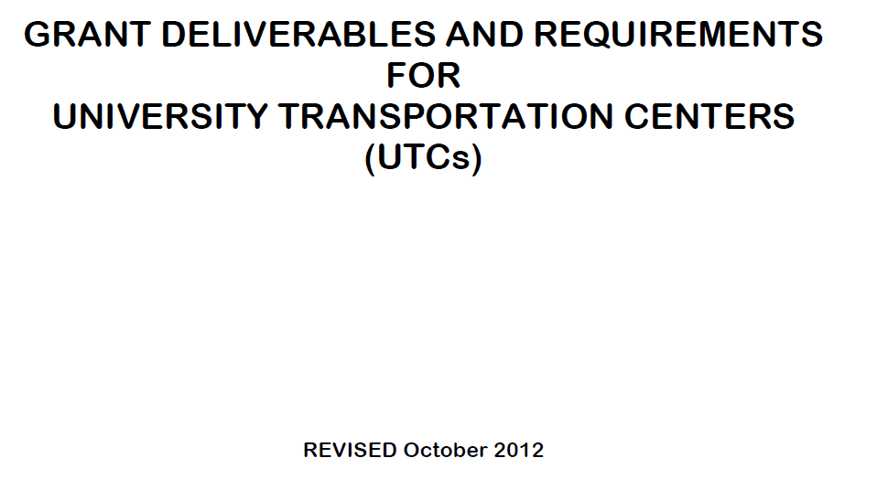
http://www.rita.dot.gov/utc/sites/rita.dot.gov.utc/files/about_utc/pdf/grant_deliverables_october_2012.pdf

Slide 5
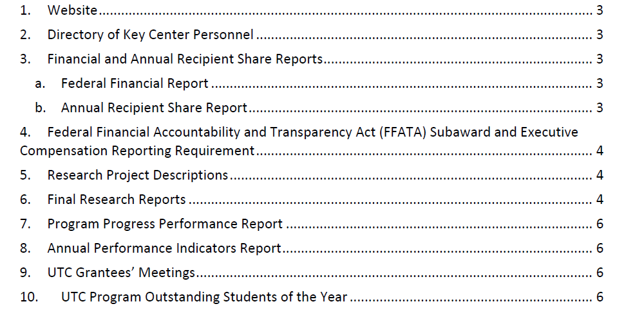
Grant Deliverables and Requirements for UTC Grants

Slide 6
Two Biggest Reporting Challenges
Program Progress Performance Report
Annual Performance Indicator Report

Slide 7
Program Progress Performance Report
EXHIBIT B: Program Progress Performance Report for University Transportation Centers
PI: http://reporting.mountain-plains.org/?code=354yeEXjk9
Univ Director: http://reporting.mountain-plains.org/?code=wrE64Jkrwe
MPC Director: http://reporting.mountain-plains.org/?code=453urtERj7

Slide 8
Program Progress Performance Report
PI’s are given access codes to their Universities entry site.
PI: http://reporting.mountain-plains.org/?code=354yeEXjk9

Slide 9
Program Progress Performance Report
University Directors are given access codes that allow viewing and editing of their university data.
Univ Director: http://reporting.mountain-plains.org/?code=wrE64Jkrwe

Slide 10
Program Progress Performance Report
MPC director access code allows him/her to view all levels of entry consolidated by University.
MPC Director: http://reporting.mountain-plains.org/?code=453urtERj7
Completion and submission of PPPR for current reporting period from MPC -
http://www.mountain-plains.org/resources/progress/

Slide 11
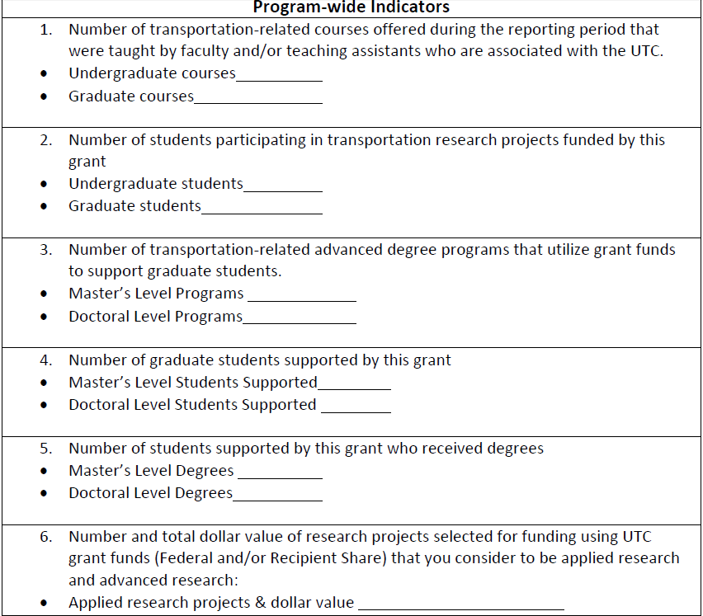
Annual Performance Indicator Report

Slide 12
Grant Deliverables and Requirements for UTC Grants
QUESTIONS???
Jody Bohn
North Dakota State University
jody.bohn@ndsu.edu
701-231-7938

