Slide 1

Social Media & UTC Outreach
CUTC Summer Meeting
Memphis, TN
June 11, 2013

Slide 2
Why?

Slide 3

Connect
Engage
Inform

Slide 4


Slide 5

MAP-21:
UTC Program $72,500,000 Year

Slide 6
How?

Slide 7

Have a Plan

Slide 8

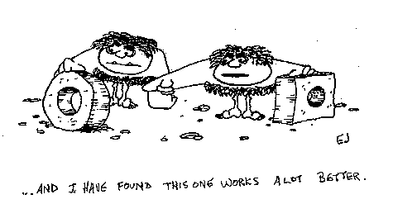
No Need to Reinvent the Wheel

Slide 9

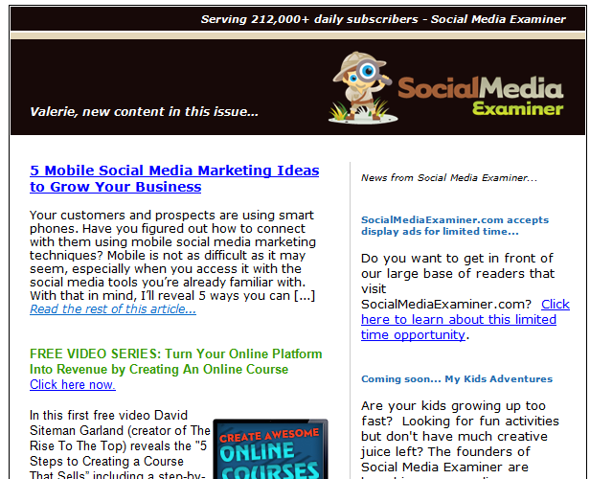

Slide 10
Understand Your Audience
Know your target audience(s)
  Get Specific... Create Personas…
You’re busy – so are they!
  Don’t waste your time or theirs…
It’s not all about you.
  Show interest in needs of others, not just yours.
Do unto others…
  Others like mentions and RT’s as much as you~
Be responsive
  Respond to comments or questions within 24 hours or less.

Slide 11
Plan your Content
How much time do you have?
  Be realistic…
Monthly: Have a content strategy.
  Use themes or campaigns for consistency.
Use an editorial calendar to maximize impact.
Schedule posts in advance!
Check feeds at least 2 times per day.
Determine how you will measure success!

Slide 12


Slide 13



Examples

Slide 14
Facebook
Who has a Facebook account?
Who has a Facebook Page for their UTC?
Who has over 100 likes?
Who has over 500 likes?
More?

Slide 15
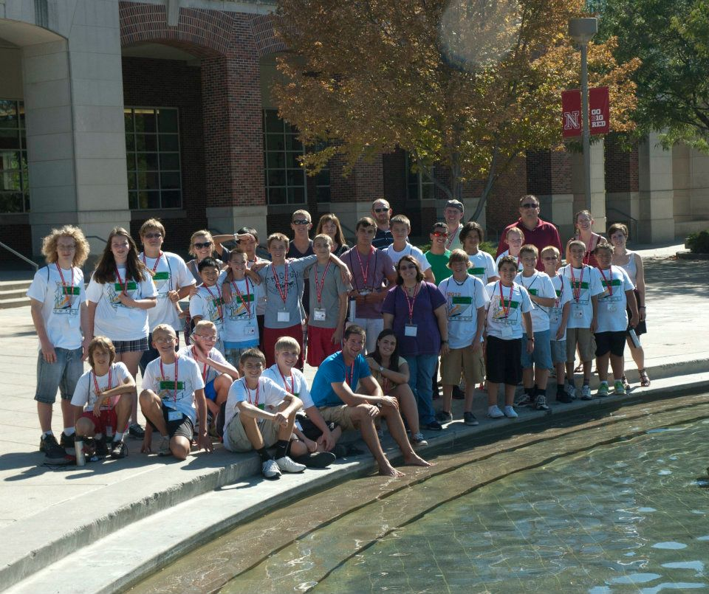
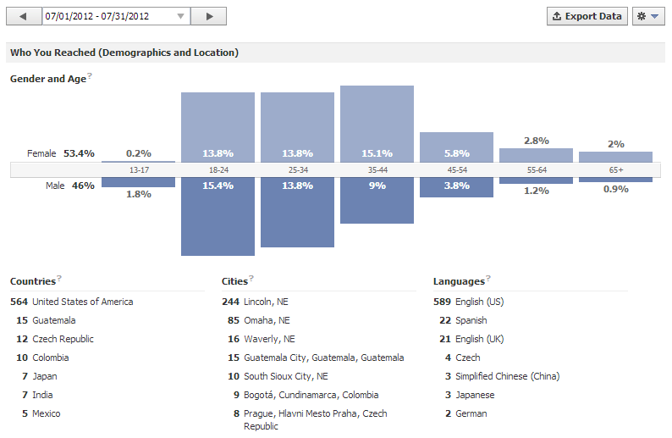
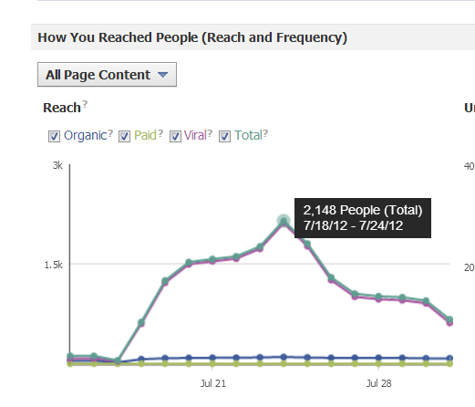


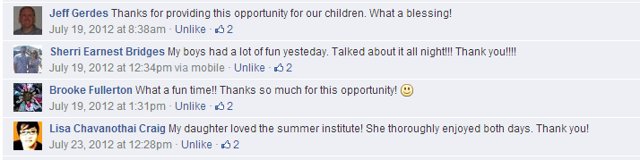
What to use Facebook For?
Research?
  Eh?
Tech Transfer?
  Maybe?
Workforce Development/Education?
  JACKPOT!
    Example:
      MATC Student Engineering Excellence Institute
Documentable
Global Impact!

Slide 16

SlideShare
Who has a SlideShare Account for your UTC?

Slide 17
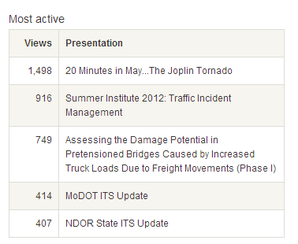
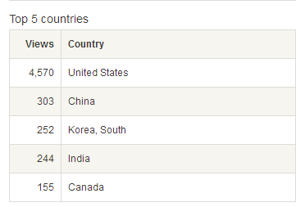
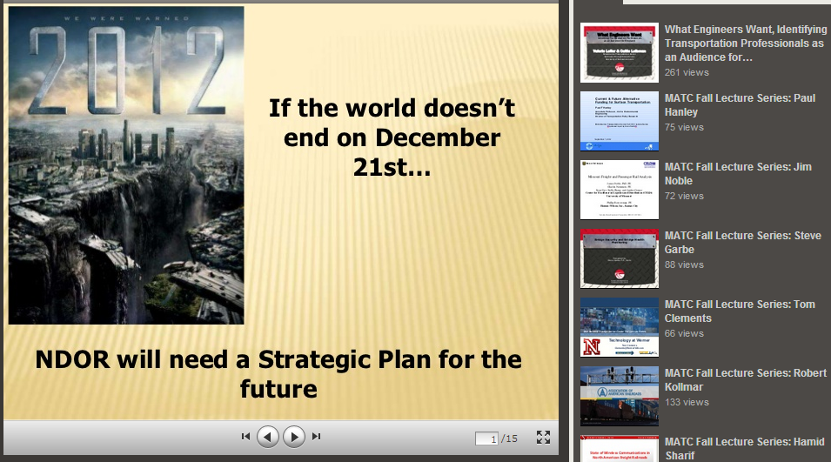
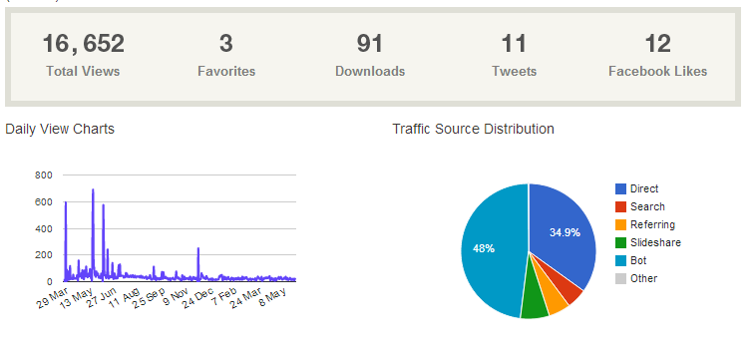
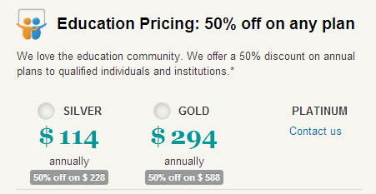
What do you put on SlideShare?
All PowerPoint Presentations!
  Conference Presentations
  TAC Committee Presentations
  Anything really…
Documentable
Global Impact!
Reach 16,652 folks in over 5 countries for $300?

Slide 18



YouTube/Vimeo/Teacher Tube
Who watches videos on YouTube?
Who has YouTube Channel for your UTC?
Who has Vimeo Channel for your UTC?
Who has Teacher Tube Channel for your UTC?
What is the difference?

Slide 19
Why is YouTube Important?
Viewership Statistics
More than 1 billion unique users visit YouTube each month
Over 4 billion hours of video are watched each month on YouTube
72 hours of video are uploaded to YouTube every minute
70% of YouTube traffic comes from outside the US
YouTube is localized in 53 countries and across 61 languages

Slide 20
What do you put on YouTube/Vimeo?
Research Video Footage
Montages of Student/Workforce Development Activities
Picture Slideshows to Music
Narrated Power Point Presentations
Webinar Recordings
Tours of Research Labs
Television Coverage of your Programs
Interviews with Students/Faculty/Research Staff
Anything!

Slide 21
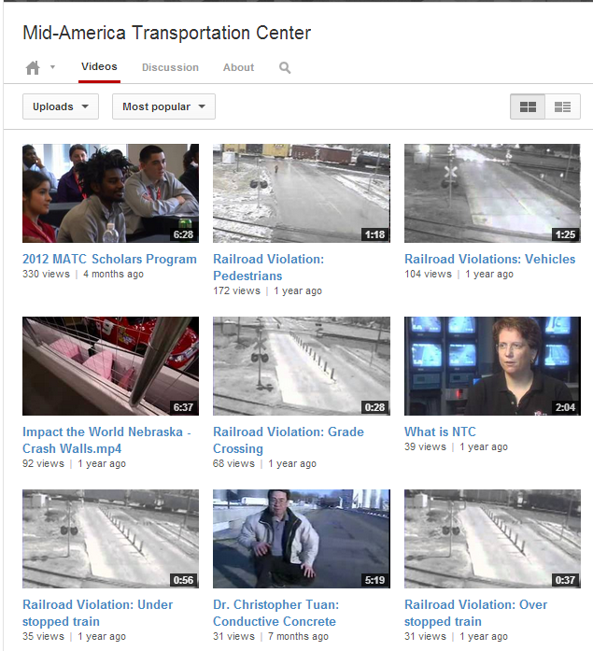
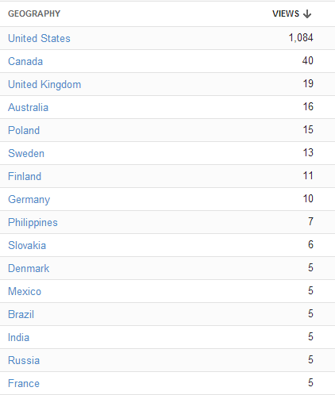
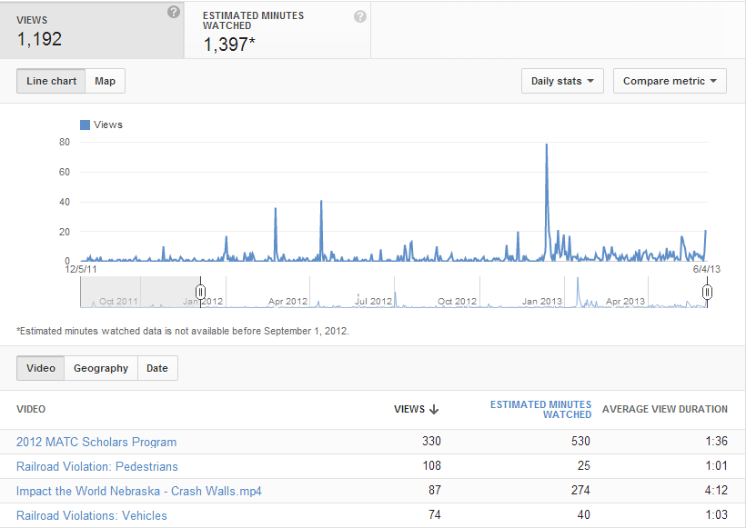
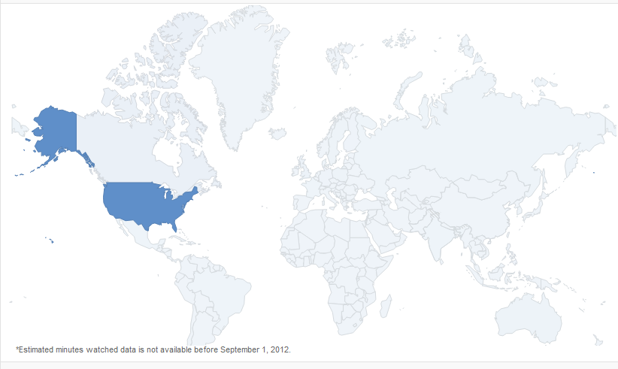
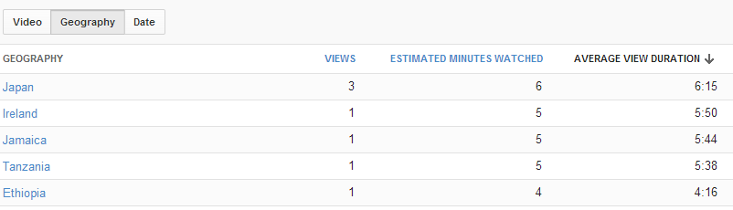
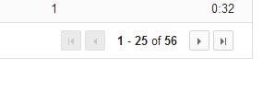
Documentable
Global Impact!

Slide 22


Decide, Plan, Implement, & Measure!

Slide 23

Act Locally,
Think Globally

Slide 24

Questions?
Valerie Lefler
Cell: 402-806-0315
Email: vlefler2@unl.edu

