Slide 1


Slide 2
The Earned Income Tax Credit: Leaving Money on the Table
Elena Delavega, PhD, MSW
University of Memphis
iIMPACT Summit
April 7, 2022

Slide 3
Learning Objectives:
Participants will understand the Earned Income Tax Credit’s role in reducing poverty.
Participants will recognize and assess the barriers for participation in the Earned Income Tax Credit.
Participants will define the role of social work in assisting families access EITC benefits and the importance in teaching about taxes in the social work curriculum.

Slide 4
Earned Income Tax Credit
Widely considered one of the most effective anti-poverty programs (Alstott, 2010).
Refundable tax credit that transfers cash into the hands of low-income American citizens.

Slide 5
Earned Income Tax Credit
Purpose
Alleviate poverty
Allow working people with low earnings to accumulate assets
Encourage work and self-reliance rather than welfare
(Athreya, Reilly, & Simpson, 2010)

Slide 6
What is the EITC and Who Qualifies for FY 2021
Refundable tax credit American citizens or permanent residents can receive if they have earned any income in a fiscal year.
Filer must have a maximum investment income of $10,000 or less for the year.
Filer must be either a head of household or married filing jointly, and not having been claimed as a dependent on another return.

Slide 7
What is the EITC and Who Qualifies for FY 2021
If the filer does not have dependent children, he or she must be between the ages of 25 and 65.
Legal Same-Sex Marriages Will Be Recognized For Federal Tax Purposes.

Slide 8
Minimum Requirements to Claim the EITC:
Must be a citizen of the United States, and must live in the U.S. for more than half of the year.
Must have earned income for the tax year and a valid Social Security number (SSN).
Can't be a qualifying child on another return.
Can't use the married filing separate (MFS) filing status.
Must meet eligibility requirements as described above.

Slide 9
Income Thresholds to Receive the EITC for FY 2021:
• $51,464 ($57,414 married filing jointly) with three or more qualifying children
• $47,915 ($53,865 married filing jointly) with two qualifying children
• $42,158 ($48,108 married filing jointly) with one qualifying child
• $21,430 ($27,380 married filing jointly) with no qualifying children

Slide 10
Tax Year 2021 Maximum Credit:
• $6,728 with three or more qualifying children
• $5,980 with two qualifying children
• $3,618 with one qualifying child
• $1,502 with no qualifying children
Seems like a perverse incentive to have children out of wedlock!

Slide 11
Nonclaims!
Many people fail to claim the EITC
The exclusions are important because they are by design
  Many low-income people don’t qualify
Those who qualify often fail to claim
  Lack of knowledge
  Lack of access
  Unscrupulous/incompetent tax preparers fail to claim the EITC

Slide 12
Estimation Methods
A variety of methods were utilized to estimate number of eligible participants
All people who might not be eligible were excluded
  Over 65
  Under 25
  Half of married people
  People withouth children
  Non citizens (% speaks English less than very well)
  Percent did not work last year

Slide 13
To Note:
Households may comprise several families who file taxes separately
There should always be more EITC claims than households
My estimates are likely very conservative
The IRS is more interested in excluding and punishing than in reaching eligible participants

Slide 15
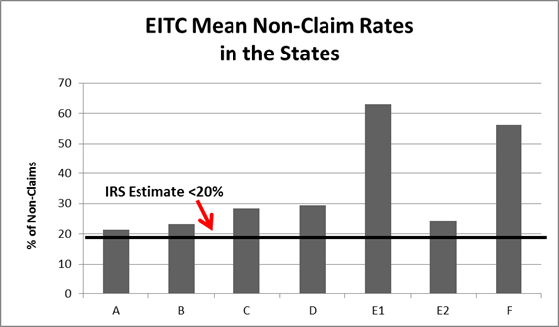

Slide 16
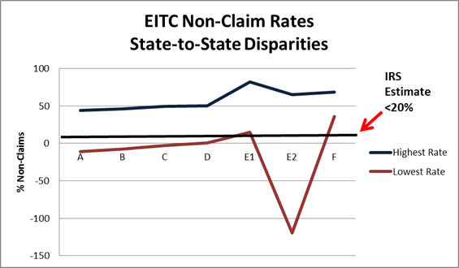

Slide 17
In most cases, the percentage of people failing to claim the EITC is at least 50% higher than what the IRS reports.

Slide 18

Solutions
More outreach
Increased volunteer body
Social Work Students
We must include the missing piece of “PIE”

Slide 19
Challenges
Social workers are reluctant to engage in economics and finances
Students complain bitterly in teacher evaluations of having to do taxes
Partners can have difficulty in integrating volunteers for one semester
Policy courses do not match with tax-training and tax-preparing season perfectly

Slide 20
Taxes in the Social Work Curriculum
Taxes
  Types of taxes
  Tax rates (including marginal)
  Tax credits
  The role of taxes in social welfare

Slide 21
Taxes in the Social Work Curriculum
The EITC is of interest to social workers because this credit is associated with better outcomes in health, education, and mental health among low-income families (Athreya et al.; Boyd-Swan, 2013; Dahl & Lochner, 2010).

Slide 22
Taxes in the Social Work Curriculum
EITC is a sufficient transfer to lift families with dependent children out of poverty in many cases (Schmeiser, 2007).

Slide 23
Earned Income Tax Credit Project
Tax training, preparation, and research
Helping low-income people get the Earned Income Tax Credit
Understanding barriers to tax credits

Slide 24
The Project
Students are trained in late fall or mid-winter
Students become certified as basic (or higher) tax preparers under the VITA program
Students volunteer at a tax site during the spring semester

Slide 25
SaveFirst ImpactTennessee
Binghampton Development Corp. – Memphis, TN
Church Health Center – Memphis, TN
Orange Mound Community Center – Memphis, TN

Slide 26
Since 2013
200 MSW Students from University of Memphis have participated with ImpactAmerica and the United Way of the Midsouth in VITA program

Slide 27
Each Year, Student Volunteers help:
2,000 Memphis families in poverty and with low and moderate incomes save $750,000 in tax preparation fees
Claim more than $2,000,000 in EITC

Slide 28
#SharedRiskforSharedProsperity

