Slide 1
The SMART Center: Tele-health Best Practices for Working with Children and Adolescents
Dr. Susan Elswick LCSW, RPT-S, IMH-E
University of Memphis
School of Social Work

Slide 2

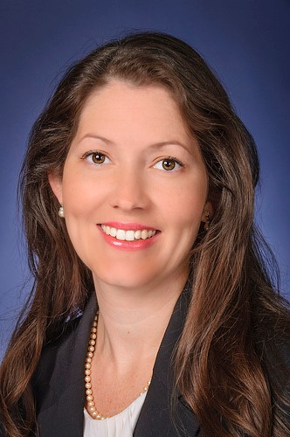
Susan Elswick EdD LCSW
Dr. Elswick is an Associate Professor at the University of Memphis in the School of Social Work. She is the School Social Work Certificate Coordinator for the University of Memphis.
Dr. Susan Elswick has over 16 years of clinical mental health experience that includes community mental health, case management, residential programming, school-based programming, integrated behavioral health, infant mental health, and home-based services. She is a Licensed Clinical Social Worker in TN, AR, and MS; she is also a Registered Play Therapist and Supervisor (RPT-S).
One of her areas of research focuses on the use of informatics and technology in the field of social work. Dr. Elswick serves as the Co-chair for the Council on Social Work Education (CSWE) Annual Program Review Technology Track that focuses on harnessing technology for social good in behavioral health practice, and she is a current Faculty Affiliate on campus at University of Memphis with the Institute for Intelligent Systems (IIS). She is a Co-PI on the U of M’s $2.58 million National Science Foundation (NSF)-funded project, which will lay the foundation for a future Learner Data Institute (LDI) at the university. Most recently, she was awarded funding from Urban Child Institute to develop the School Mental Health Access to Resources through Telehealth (SMART) Research, Training, and Treatment Center.
She is also the owner of a tech start-up Engage Data Systems LLC.

Slide 3
Learning Objectives
1. Participants will learn how the SMART Center at the University of Memphis is working to support the community through tele-behavioral health programming.
2. Participants will be exposed to research outcomes regarding tele-behavioral health in the region
3. Participants will learn about the community-university partnerships that are increasing the access to behavioral health services in our region through tele-health programming
4. Participants will learn what tele-behavioral health services include, how they can be delivered, and the impact on the community

Slide 4

The Need

Slide 5
Statistics- Pre-COVID
ADHD, behavior problems, anxiety, and depression are the most commonly diagnosed mental disorders in children
  9.4% of children aged 2-17 years (approximately 6.1 million) have received an ADHD diagnosis.²
  7.4% of children aged 3-17 years (approximately 4.5 million) have a diagnosed behavior problem.³
  7.1% of children aged 3-17 years (approximately 4.4 million) have diagnosed anxiety.³
  3.2% of children aged 3-17 years (approximately 1.9 million) have diagnosed depression. ³
    https://www.cdc.gov/childrensmentalhealth/data.html

Slide 6
Statistics- Pre-COVID
Treatment rates vary among different mental disorders
  Nearly 8 in 10 children (78.1%) aged 3-17 years with depression received treatment.³
  6 in 10 children (59.3%) aged 3-17 years with anxiety received treatment.³
  More than 5 in 10 children (53.5%) aged 3-17 years with behavior disorders received treatment.³
One in five teens (13-18 years) and more than one in 10 children (8-15 years) experience severe mental illness, but almost half of those aged 8-15 years with a mental illness receive no treatment.
Mental, behavioral, and developmental disorders begin in early childhood
  1 in 6 U.S. children aged 2–8 years (17.4%) had a diagnosed mental, behavioral, or developmental disorder.⁵
    https://www.cdc.gov/childrensmentalhealth/data.html

Slide 7
Statistics and Need
Prior to COVID-19, Centers for Disease Control and Prevention (CDC) data found 1 in 5 children had a mental disorder, but only about 20% of those children received care from a mental health provider.
In a 2020 survey of 1,000 parents around the country, 71% of parents said the pandemic had taken a toll on their child’s mental health, and 69% said the pandemic was the worst thing to happen to their child.
A national survey of 3,300 high schoolers conducted in spring 2020 found close to a third of students felt unhappy and depressed much more than usual.
Mental health crises are also on the rise. From March 2020 to October 2020, mental health–related emergency department visits increased 24% for children ages 5 to 11 and 31% for those ages 12 to 17 compared with 2019 emergency department visits, according to CDC data
Common barriers to treatment include stigma, transportation, funding issues, time commitments, lack of insurance, and limited availability of providers.

Slide 8
Data from Screening Tool
5,221 screens from 2017-2021 in Shelby County
  73% (3797) adults, 28% (1345) youth, others unknown
2,756 in 2020 and 2021
  Main things contributing to their mental health problems:
    24% of adults and 21% of youth listed Coronavirus as one the three
    52% of adults and 70% of youth listed Loneliness or isolation as one the three
        Mental Health America of the Mid-South Data
Notes:
Many did not list a zip code in the larger dataset
79 unknown age

Slide 9
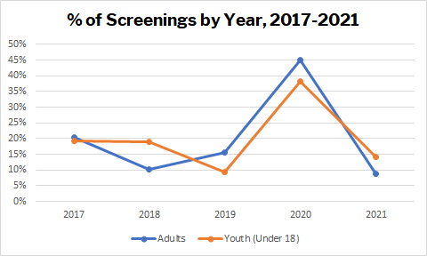
Screenings by Year
Year | Adults | Youth (Under 18)
2017 | 774 | 261
2018 | 386 | 255
2019 | 597 | 126
2020 | 1708 | 513
2021 (through March) | 332 | 190

Slide 10
Tennessee Needs
2020-2021 Statistics Across Tennessee
39% of school districts have no school social workers or access to behavioral health in schools

Slide 11
SMART Center Background
In June 2020, Dr. Susan Elswick received funding from the Urban Child Institute and The University of Memphis Institute for Interdisciplinary Memphis Partnerships to Advance Community Transformation (iIMPACT) to develop a tele-behavioral health training and treatment program for the region due to the impact of COVID-19 pandemic on the mental health service delivery in the region.
With this seed funding, Dr. Elswick launched the School Mental Health Access Through Teletherapy (SMART) Research, Training, and Treatment Center.

Slide 12

The Solution

Slide 13
SMART Center
The University of Memphis School of Social Work SMART Research, Training and Treatment Center aims to:
  provide evidence-based interventions for school-based mental health programming,
  increase access for school-based behavioral health programming in underserved areas,
  provide training on best practices in tele-behavioral health,
  develop opportunities to research the use of technology in practice,
  and provide direct services to the states most vulnerable populations.

Slide 14
University-Community Partnerships
Transformative relationships that are reciprocal
  Direct service delivery
Support workforce development for student populations
  School Social Work Licensure in TN requires school placements/ service (we host 5-8 student interns a year)
  Skill development in EBI adapted to telehealth
Support service needs of the larger community in underserved and mental health shortage regions
  Training community partners in tele-behavioral health best practices
  Supporting community practitioners (we host 5 LMSW volunteers a year)
  Preparing the next generation of practitioners

Slide 15
SMART Center Telehealth
Is a virtual, outpatient behavioral and mental health clinic that uses videoconferencing technology
Therapy provided to those with mild to moderate psychosocial problems
Up to 12 sessions are held weekly

Slide 16
SMART Center: Telehealth and Warm Line Services
We provide 100% telehealth services to children PreK-12th in the West TN region. These services are offered both during school hours and after school hours based on the school and student needs.
Warm Line for community needs and families- Our “warm line” is a telephone service (aka a call line) for people who are looking for someone to discuss their daily struggles or needs. Warmlines are staffed with peers who have been trained in supporting others in need.

Slide 17
Two types of Telehealth Programming in Schools
Students served in their home environment –COVID-19
Students served at the school in a telehealth suite

Slide 18
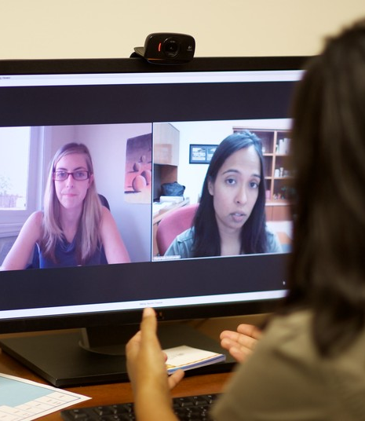
SMART Center Telesuites
Partnerships with schools and community agencies
Partners provide a private, secure space with computer, webcam and high-speed internet so that their clients can access our services
MOU completed between organizations

Slide 19
SMART Center EBI Services
We will provide 100% telehealth interventions to clients grades Prek-12th
Clients are referred to us and served for 8-12 weeks (based on their progress and needs).
We track client symptoms and progress in each session using Rapid Assessment Interventions (RAIs). Assessments to measure symptom severity or psychological, social, and occupational functioning to determine DSM diagnosis for referred youth.
Guidance, training, and technical consultation to schools on the use of telehealth in practice, adapt interventions to telehealth, and how to establish whole system mental health- telehealth programs.
We use the following EBI:
  Cognitive Behavioral Therapy (CBT),
  Motivational Interviewing (MI),
  Cognitive Behavioral Interventions for Trauma in Schools (CBITS),
  Play Therapy,
  Trauma Focused Cognitive Behavioral Therapy (TFCBT),
  Teacher Child Interaction Therapy (TCIT),
  Psychoeducation, and
  Solution Focused Brief Therapy.

Slide 20
SMART Center 2020-2021 Outcomes
Since launching the SMART Center in June 2020,the following data have been collected:
  Warm line has provided direct and indirect referral services to over 52 agencies and 580 families within the city for intervention linkage, education, and technical consultation. The Warm Line was recently established in September 2021.
  We also support training and professional development to the community, and to date have trained over 3000 community partners in tele-behavioral health best practices.
  Workforce development trained 6 student interns (BA, MSW, DSW) and 2 community LMSWs.
  Additionally provided direct therapeutic intervention services virtually for 250 children and families in 2021-2022 (equates to 2500 session contacts), and outcomes resulted in over 50% reduction in symptomology via self report for 90% of the participants across diagnosis/ need.

Slide 21
Comparison: Tele-health and Face to Face Trauma Groups

Slide 22
Funding and Sustainability
Currently we are 100% grant funded (Oct 2021-July 2022) through the Urban Child Institute (UCI)- possible funding extension
These services (individual therapy for students) offered are free of charge with no cost to you or the families you serve.
In anticipation of moving to grant funding ending, we will use a braided model of funding to continue services, which will include:
  Contract services through a fee-based model
  Additional grant funding options
  Billing Insurance for services that are billable (to offset cost to schools and agencies)
  We can provide possible cost coverage options (for future needs)

Slide 23
What we learned about using tele-health with Children and Adolescents

Slide 24
Setting Up Your Playroom and Therapy Space

Slide 25
Not Everything Has to Be Virtual…
Actual PLAY can be grounding for children in a virtual world.
Set up your screen so the child can see your playroom
Let the child tour the playroom and pick a toy/ game
Send/ prep for activities in advance and talk to caregiver
Use your own sandtray and miniatures and work with the child through prompts
Be creative and do arts activities together and share your work
Pull out specific toys and engage the child

Slide 26
Setting Up a Virtual Playroom
Dr. Rachel Altvater has developed a wonderful FREE training on YouTube that walks you through this process
https://www.youtube.com/watch?v=L_B2oUk9Jok
See her Virtual Playroom Activities
https://www.youtube.com/watch?v=ceK0rYnPNxc

Slide 27
Play Therapy and Virtual Sandtray
Virtual Sandtray: https://www.sandtrayplay.com/
Virtual Sandtray makes the use of Sandtray in Play more accessible online
  Portable
  Interactive
  Interactive
  Remote Access for Client
  Youtube Video: https://www.youtube.com/watch?v=LfVHSSgnIxU

Slide 28
Digital Play Therapy

Slide 29
What is Digital Play Therapy?
Digital play therapy refers to a set of therapeutic tools that use video games, the Internet, and other digital technologies to assist in the psychotherapeutic process with children.
Digital play therapists utilize technologies to assist in three components of counseling with children and their families. These include:
  skill development
  insight-oriented therapy
  Psychoeducation
  https://southcountychildandfamily.com/services/digital-play-therapy/

Slide 30
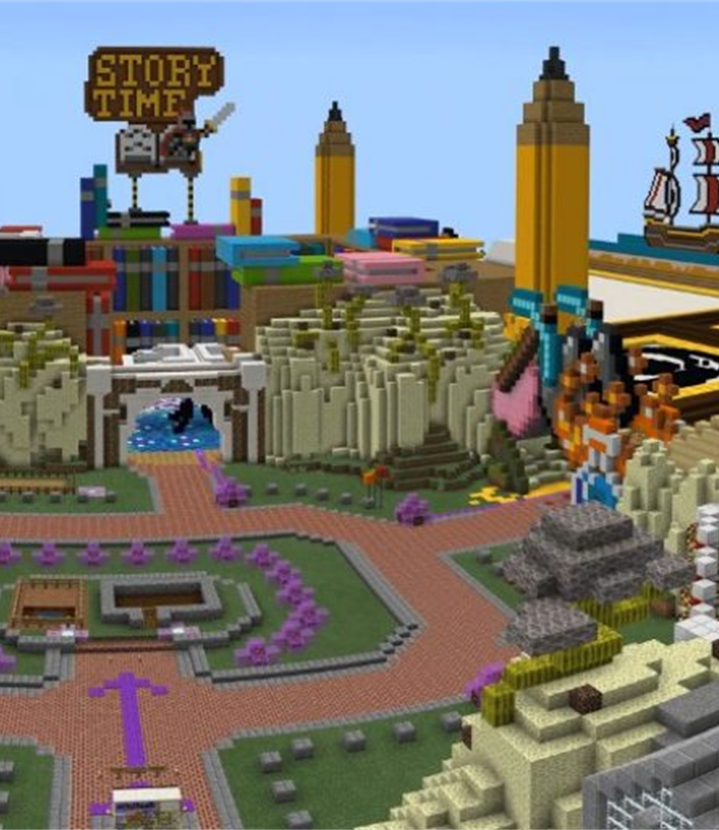
Digital Play Therapy- Skill Development
Skill development refers to the use of digital technologies to help children develop critical-thinking, problem-solving, and self-management skills.
An example of this in digital play therapy would be to utilize a child’s video game play as an opportunity to practice and then generalize planning or organizational skills from the game to the real world.
MineCraft for teaching mindfulness and social skills: https://education.minecraft.net/lessons/the-mindful-knight
Skill development is guided by a set of teaching curricula that connects the use of digital technologies to real-world thinking and psychological skills.

Slide 31
The Use of Video Games in Play Therapy
Fortnite
Roblox
MineCraft***
Virtual Escape Rooms***
Animal Crossing
And much, much more
Trainings on how to use these in practice: Lets Play Therapy has some free trainings: https://letsplaytherapy.org/

Slide 32
Engaging Kids in Virtual Therapy

Slide 33
“Zoom Exhaustion”
Since attending school virtually requires both time online as well as time offline to successfully complete required lessons, some children will find the amount of time required to be in front of a computer daunting and overwhelming.
Many reports on cases of “zoom exhaustion” and virtual overload have been reported since the beginning of the pandemic. Zoom exhaustion will be real for many of children and adults across the nation.
Students who are experiencing technology exhaustion may report the following symptoms:
  easily distracted,
  easily off task by environmental stimuli,
  difficulty staying focused and attending to needed information,
  extreme fatigue,
  eye dryness,
  decreased interaction,
  difficulty sleeping at night,
  and class participation.
Mindfulness techniques and incremental virtual breaks will be necessary to support the needs of clients.
Clients will need to learn techniques to manage their health and well-being in the remote education environment.

Slide 34
Break Activities- Grounding Practices
Decreasing Zoom Exhaustion with Break Activities-
  Embedding effective kinesthetic activities and movement tips will benefit the students and break up the monotony of the academic virtual day.
  Movement activities can be as simple as stretching together, doing simple yoga stretches, or more advanced game-like movement activities.
  For some simple examples of movement-based break activities check out this website: https://blog.reallygoodstuff.com/getting-the-wiggles-out-3-movement-activities-you-cant-live-without/

Slide 35
Supporting Children and Youth in a telehealth model
Your session length will need to be adjusted for younger students
Utilize Play-based activities to sustain engagement (Scavenger Hunt, Wiggle Games, expressive art directives, use of shared screen in session, bibliotherapy, use the virtual Active Student Responding “reactions,” breakout groups, etc.)
Utilize EBP skills during session
Continue to teach, embed, and practice mindfulness and regulating activities in sessions
Make sure you are tracking progress
  * Use Rapid Assessment Instruments
Engage Parents in the programming as a check in
Keep in contact with teachers to prepare them for the school transition and continued support of the student

Slide 36
Supporting Children and Youth Continued
Set rules and expectations and make things predictable for children- structure helps to ground the dysregulated
Create predictability for the clients
Guided Imagery Exercises
Children and Practitioners CANNOT stay on a computer for an hour or more (zoom exhaustion)
Role Play Activities
Games and Social Time for kids/ Social Skills activities
SEL check-ins during the session
Video and reflection (Ted Talks for kids)
Whiteboard Activities/ Share screen
Breaks card procedures
Using Active Student Responding in session
Breakout sessions
  Adapting EBP interventions for tele-behavioral health programming
  Used to support teachers and students with classroom disruptions

Slide 37

Using Breakout Sessions Groups
To engage children in group-based programming utilize Small group Activities
Use Break out rooms in the following ways:
  Calm down time
  Movement Activities
  Think-Pair-Share
  Problem Solving Activities
  “Getting to Know You” Activities

Slide 38
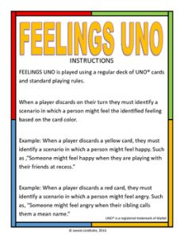
Activities to Engage in Virtual Space
Use your Screen Share and Virtual White Board options.
Use Online Games like Jeopardy- https://jeopardylabs.com/play/friendship-jeopardy-review-game-9
Or UNO https://play.unofreak.com/?fbclid=IwAR3kYuBVX21AnHggPnAqfzgBabyPo3zB6-dO4wnUUdV7brqC8d8Ps4prA5k
Feelings Spinning Wheels https://wordwall.net/resource/349343/emotions-feelings-wheel
Mancala https://www.mathplayground.com/mancala.html
Jenga https://chandlerprall.github.io/Physijs/examples/jenga.html

Slide 39
Ways to Cultivate Attunement, Co-Regulation, and Trust in Virtual Space

Slide 40

Attunement
A definition of attunement ‘is a kinesthetic and emotional sensing of others knowing their rhythm, affect and experience by metaphorically being in their skin, and going beyond empathy to create a two-person experience of unbroken feeling connectedness by providing a reciprocal affect and/or resonating response’. (Erksine 1998).
One could say it is our ability to be present to, and with, another’s expression of their experience.
Attunement relates to client's level of safety within the therapeutic relationship AND environment.

Slide 41
How to Create Safety in Virtual Programming
Assess family and child’s digital literacy skills (start this in intake)
Do a “Check IN” and “Check Out” Procedures
Make things predictable each time (have a routine for therapy)
Allow the Child to Take a Tour of Your Space Virtually (See if they are comfortable giving you a tour of their space)**Making videos in advance and Social Stories
Begin with a “Here and Now” Activity
Invite them to Locate the Floor in their Room- Grounding activities
Invite them to create their own sensory box- Therapy Box
Use the screen share feature whenever possible- Play interactive games (Jamboard/ Google Slides)
Use sensory/ movement activities that are grounding
Ask the child what would make them feel safer? (turn off camera? Tilt the camera?)
https://www.threebirdscounseling.com/post/2020/03/23/tips-for-helping-clients-ground-during-telehealth

Slide 42
Monitoring the Child’s Behavioral Cues
How to determine if a child is dissociating- assess and monitor
Watch for activity level- If they are slow pick-up pace, if they are hyper slow it down for them
Seems uninterested in therapy- play a game or do a movement activity
Use grounding activities to re-engage
Remember some children need session lengths to be adapted and intersperse activities in between “therapy” techniques.

Slide 43

Creatively Including Caregivers

Slide 44

Prepping Caregivers for Virtual Programming
Discuss Expectations Early
Help Caregiver with setting up a confidential space for their child
Inform them you will meet with them (before or after) each session for a “check-in”
Establish a system for communicating with caregivers about needs and accomplishments
You may need caregivers help with accessing needed play materials (also assessing families needs around access to developmentally appropriate play items)**Grant Funded projects
And include them in the play…

Slide 45
Family Play Activities
Video therapy has sometimes allowed for an increased ability to include families in sessions.
These family sessions have proved to be especially fruitful and rich, as family members navigate both new stressors and an increased amount of time around one another.
Helping families develop teamwork mindsets and supportive relationships within the system is often a goal of therapy, and one of my favorite activities using video therapy to do so has been family scavenger hunts.
By asking families to find items such as “something that makes you feel safe” or “something you like to do with your family”, this activity promotes both movement throughout the house, a window into family interactions, as well as an opportunity for meaningful discussions between members.
https://samaritan-center.org/5-play-therapy-activities-using-telehealth/

Slide 46
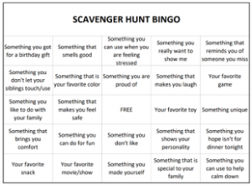
Family Scavenger Hunt BINGO Board

Slide 47
Parent Play (Homework Activities)
Encourage 5 Minutes of “Special Play” time between caregiver and child a day (Child Parent Relational Therapy (CPRT) and Parent Child Interaction Therapy (PCIT)- See sample handout
Filial Play Therapy Techniques-training the parent to be the play therapist and use aspects of play with the child
Prescriptive Parent Play- This is similar to CPRT and Filial in that the caregiver is participating and trained to conduct components of play therapy- BUT this is a little more directive in nature and leads parents with prompts.

Slide 48
How to Connect with SMART Center

Slide 49
Resources
More Filial Play Therapy Techniques: https://myplaytherapypage.com/category/filial-therapy/#sthash.BBrfMMwz.dpbs
More Information on Building a Virtual Playroom:
More Information about Online Games:
More information and activities for Attunement: https://www.threebirdscounseling.com/post/2020/03/23/tips-for-helping-clients-ground-during-telehealth
More interactive activities for telehealth: https://www.guidancett.com/blog/interventions-for-online-therapy-with-children-and-youth-2020?fbclid=IwAR3cU5tylcpNHBK8JzAo4Q8rYNIcCcpCWXQo5jrNgPHoZ-IE1gJynWBj1cw
More training and webinars of use of Digital Play Therapy-https://www.youtube.com/watch?v=L_B2oUk9Jok
Virtual Sandtray: https://www.sandtrayplay.com/
For More information and Curriculum on MineCraft Packs/ Escape Room Activities for Clinicians: https://www.engagedatasystems.com/

Slide 50
References
LeBlanc, M., & Ritchie, M. (1999). Predictors of play therapy outcomes. International Journal of Play Therapy, 8, 19-34.
Winek, J., Lambert-Shute, J., Johnson, L., Shaw, L., Krepps, J., & Wiley, K. (2003). Discovering the moments on movement in filial therapy: A single case qualitative study. International Journal of Play Therapy, 12, 89-104.
From Child Parent Relationship Therapy (CPRT) Treatment Manual: A 10-Session Filial Therapy Model for Training Parents, by Bratton, S., Landreth, G., Kellam, T., & Blackard, S.R. (2006). New York: Routledge. Permission to reproduce is granted purchaser only.
R. G. Erksine, (1998) Attunement and involvement: therapeutic responses to relational needs. International Journal of Psychotherapy, Vol. 3 No. 3
Elswick, Susan E.; Hirschi, Melissa; Delavega, Maria Elena; and Casey, Laura B. (2020) "The Therapy Box in the Classroom: A Function-based Multi-Component Directive Play Therapy Treatment Package Intervention," International Journal of School Social Work: Vol. 5: Iss. 2. https://doi.org/10.4148/2161-4148.1063

Slide 51

Questions and Answers

Slide 52

Contact Information
Dr. Susan Elswick – (901)484-3546, selswick@memphis.edu

