Slide 1
ESCORT FROM CAR TO LAW SCHOOL:
678-4357 (678-HELP - Main campus dispatch (24/7)
678-4075: Front Desk
Escorts are available Mon. – Fri. 24/7
to any garage or parking lot.
Other numbers to know:
Aggressive panhandling: 901-281-9146
Suspicious behavior – non-emergency - 636-4099
MPD Downtown Desk officer
.

Slide 2
ID Badges
All students must wear their ID badges while in the building.

Slide 3

Parking
Students
may not park in the University-designated faculty/staff parking areas on Court Avenue or behind or next to the Law School building.

Slide 4
Student Mailboxes
Student mailboxes have been updated. Please check the list in the basement for your new mailbox number.

Slide 5

BLSA SCHOOL SUPPLY DRIVE
AUGUST 18 – 29, 2014
Please place donations in designated bins in the lobby.

Slide 6
Monday

Slide 7
Free Tacos! PALS Meeting
What: Public Action Law Society (PALS) member interest meeting
When: Monday, August 25, 12 p.m.-12:50 p.m.
Where: room 244
Why: Free tacos! Oh, and prospective members will find out more about the organization and public service in general.

Slide 8
Tuesday

Slide 9
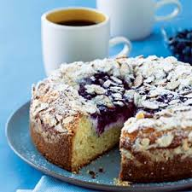
Coffee Tuesday in the CSO
9:00 - 11:00 a.m.
Have you voted
for your favorite coffee cake?

Slide 10
Navy JAG
Information Session
Presented by: LCDR Boyd A. Ellis, JAGC,USN
Tuesday, August 26, 2014
12:00 – 12:50, Room 230
Sign-up in Symplicity to reserve your spot.

Slide 11
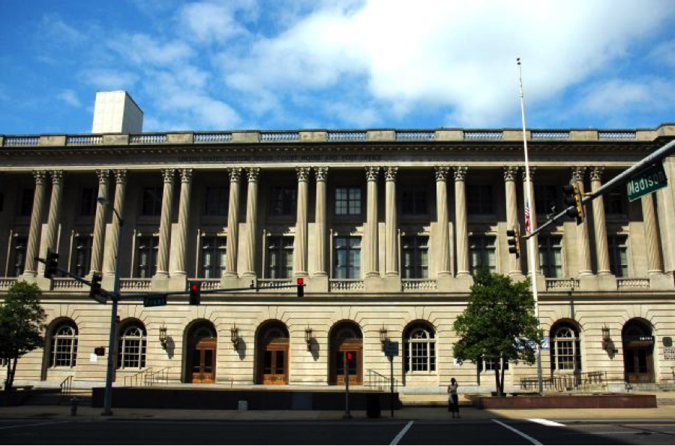
MOOT COURT BOARD
FALL TRAVEL TEAM INFORMATIONAL MEETING
TUESDAY, AUGUST 26 AT NOON
IN THE SMALL COURTROOM
LUNCH WILL BE PROVIDED
COME BE A PART OF OUR WINNING TRADITION

Slide 12
Wednesday

Slide 13
Thursday

Slide 14
Want to Be a Student Ambassador?
The Law Admissions Office has opened the Law Student Ambassadors Application. Student Ambassadors help the Law Admissions Office with tours and assist with other administrative functions throughout the school year. This is a volunteer opportunity with minimal commitment but huge rewards. Tours are given daily at Noon. At most, ambassadors give one or two tours a month.
Application deadline: Thursday, August 28, 2014
Former ambassadors need to complete a new application.

Slide 15
Friday

Slide 16
1L Academic Success Open House
The Academic Success Program Graduate Assistants John Floyd and Josh Headrick will be hosting an open house for 1Ls on Friday, August 29 from 8:30 to 10:00 a.m. in the Academic Success Suite in the 4th Floor Computer Lab.
All 1Ls are encouraged to stop by and have a
light breakfast and meet Josh and John.

Slide 17
1L Academic Success Open House
The Academic Success Program Graduate Assistants John Floyd and Josh Headrick will be hosting an open house for 1Ls on Friday, August 29 from 8:30 to 10:00 a.m. in the Academic Success Suite in the 4th Floor Computer Lab.
All 1Ls are encouraged to stop by and have a
light breakfast and meet Josh and John.

