Slide 1
The University of Memphis
Cecil C. Humphreys School of Law
2020-2021 Scholarship
Overview Process

Slide 2
Four scholarship types and three separate applications.
Service Scholarships & Fellowships-Herff, Faculty Emeritus, Humphreys, and Health
Memphis Access & Diversity
Law school specific scholarships
ASP and Writing Center Fellows

Slide 3
How to apply online
Law School Service Scholarships
Humphreys Fellows, Herff, Health, and Faculty Emeritus Scholarships
a. Interested students must complete the online application.
b. All current recipients must complete the online process.
c. Deadline is Friday, February 28, 2020.
d. Notification early April 2020.
d. Upload resume on a desktop and use last name, first in the file name. e. Be sure to consent to have grades and rank released.
Humphreys Fellows Details
a. Assigned to faculty member and responsible for working 280 hours a year. Some faculty will be interested in having some of the hours completed in the summer.
b. $5,000 stipend

Slide 4
c. Humphreys Fellows cannot engage in outside employment.
d. Complete the employment hours certification each semester with the university
Herff, Humphreys, Health, & Faculty Emeritus Selection Process (Service Scholarships)
1. Faculty Committee and Assistant Dean of Admissions
2. Notifications via email early April from Ms. Rogers.
3. Online application
4. Answer all questions, including dropping off your resume to Professor Black.

Slide 5

Tiger Scholarship Manager – Access & Diversity and Law School Specific Scholarships, Deadline is March 16, 2020.
MyMemphis
Click on “Account$” Tab
Sign in to your profile using Memphis credentials
First page is “Your General Application”
When completed click on blue “Finish & Continue” button.
Your “Recommended Opportunities” will be available for you based on your answers to the General Application.
Detailed information on the scholarship is available by clicking the “apply” button.

Slide 6
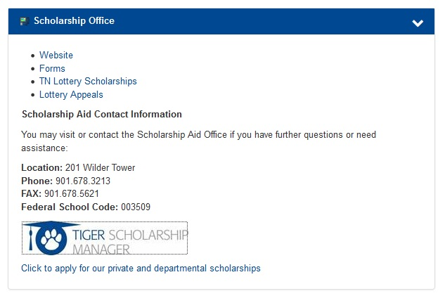

Slide 7
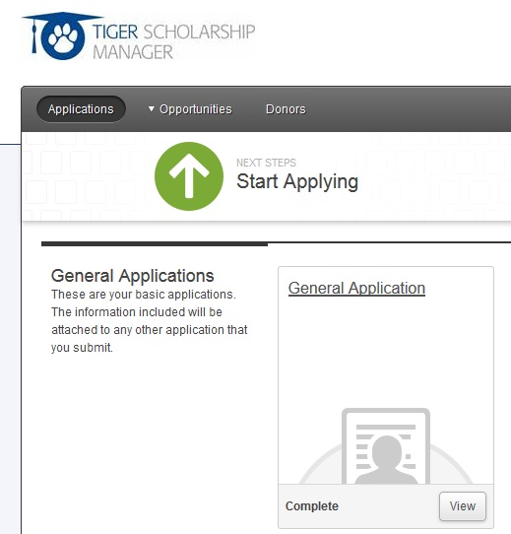

Slide 8
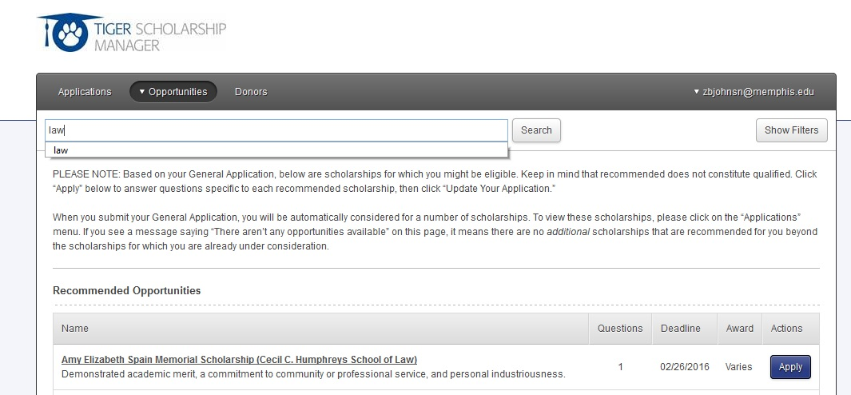

Slide 9
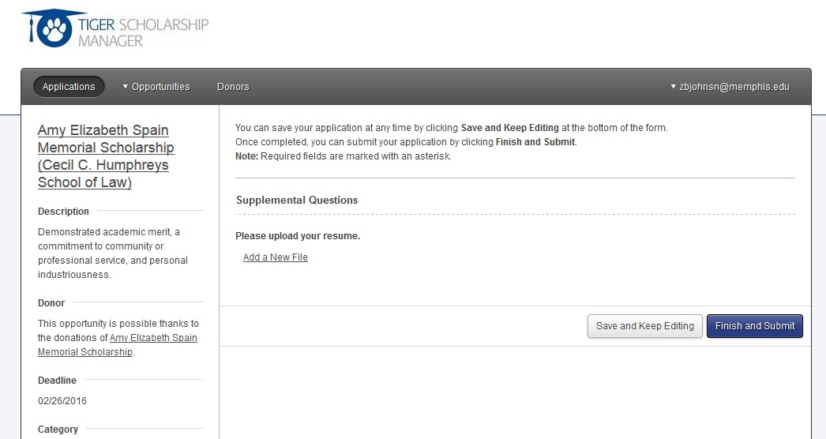

Slide 10
Memphis Access & Diversity Application
Tiger Scholarship Manager
2. March 16, 2020 Deadline
3. 250 word essay on how you contribute to Diversity at Memphis Law.
4. Current MADLS recipients must complete the online application.
5. Award notifications in June after spring grades and class ranks are released.
6. Resume not required.
7. These funds are limited.

Slide 11
Please describe in 250 words or less how you contribute to diversity at Memphis Law and why you should receive the Access & Diversity Scholarship.
Note: We define diversity broadly to include several aspects of human differences that contribute to the intellectual discourse and inclusive environment at the University of Memphis School of Law. Diversity eligibility may be based on, but is not limited to, socioeconomic disadvantage, race, ethnicity, disability, or whether the applicant is a first generation U.S. citizen, whether the applicant is a first generation college graduate, or whether the applicant attended an HBCU, HSI, or Tribal College.
Application Acknowledgment *
By submission of this form, I hereby apply for the Memphis Access & Diversity Scholarship. Please initial below.

Slide 12
Deadline for all law scholarships 3.16.20
Service & law school specific scholarships require resumes.
Memphis Access & Diversity do not require resumes.
Humphreys Fellows cannot engage in outside employment.
Humphreys Fellows, Herff, Health, & Faculty Emeritus scholars will be asked to complete the service application.
Many law scholarships require outside donor involvement.
Read questions and provide appropriate answers for specific scholarships.
Honors & Awards Committee will consider all scholarship applicants as received. Practice is to spread limited resources among as many as possible.

Slide 13
Contact Information
Assistant Dean of Admissions
Dr. Sue Ann McClellan
smcclell@memphis.edu
Assistant Director of Admissions
Kara Bowen
kphllp10@memphis.edu
Administrative Assistant
Penny Rogers
rpenny@memphis.edu
901.678.5403

