Slide 1
The University of Memphis
Cecil C. Humphreys School of Law
2021-2022 Scholarship
Process Overview

Slide 2
Four scholarship types and three separate applications.
Service Scholarships/Fellowships:
Herff, Faculty Emeritus, & Humphreys.
2. ASP and Dean’s Writing Fellows
3. Memphis Access & Diversity
4. Law school specific scholarships

Slide 3
How to apply online
Law School Service Scholarships
Humphreys Fellows, Herff, and Faculty Emeritus Scholarships
a. Interested students must complete the online application.
b. All current recipients must complete the online application.
c. Deadline is Monday, February 15, 2021.
e. Award notification to applicants late-March 2021.
Humphreys Fellows Details
a. Assigned to faculty member and responsible for working 260 hours a year. Some faculty will be interested in having some of the hours completed in the summer.
b. $5,000 stipend

Slide 4
c. Humphreys Fellows cannot engage in outside employment.
d. Complete the employment hours certification each semester with the university
Herff, Humphreys, & Faculty Emeritus Selection Process (Research Assistant/Graduate Assistant)
1. Faculty Committee and Dean of Admissions
2. Notifications via email late-March from Ms. Penny Rogers.
3. Online application
4. Answer all questions and be sure to upload your resume.

Slide 5
Academic Success and Dean’s Writing Fellows
All interest candidates must complete the Research Assistant/Graduate Assistant application. Please note, these Fellows opportunities have an additional & separate application you will need to complete as well. The selection process and deadlines will be the same as the Research Assistant/Graduate Assistant application.
Academic Success Fellows work with Dean Meredith Aden to assist entering law students with first-year courses. Finalists will be interviewed by Dean Aden and current ASP Fellows. Interested students should direct inquiries to Dean Aden at maden@memphis.edu.
Dean’s Writing Fellows work under the supervision of Dr. Marilyn Dunham Smith and Professor Regina Hillman to assist first-year law students with writing assignments for Legal Methods. Finalists will be interviewed by Dr. Marilyn Dunham Smith, Professor Hillman, and current Writing Fellows. Interested students should contact Dr. Marilyn Dunham Smith at mdsmith2@memphis.edu.

Slide 6

Tiger Scholarship Manager – Access & Diversity and Law School Specific Scholarships, Deadline is March 15, 2021.
MyMemphis
Click on “Account$” Tab
Sign in to your profile using Memphis credentials
First page is “Your General Application”
When completed click on blue “Finish & Continue” button.
Your “Recommended Opportunities” will be available for you based on your answers to the General Application.
Detailed information on the scholarship is available by clicking the “apply” button.

Slide 7
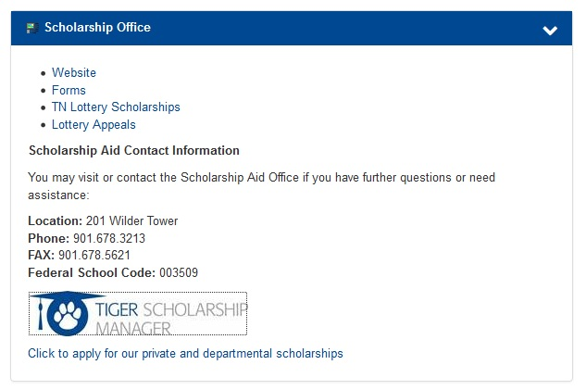

Slide 8
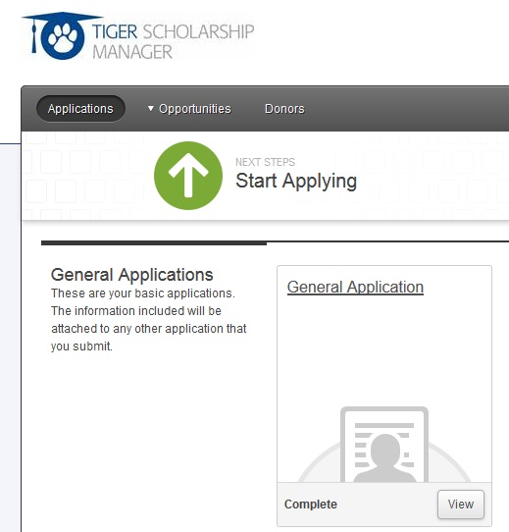

Slide 9
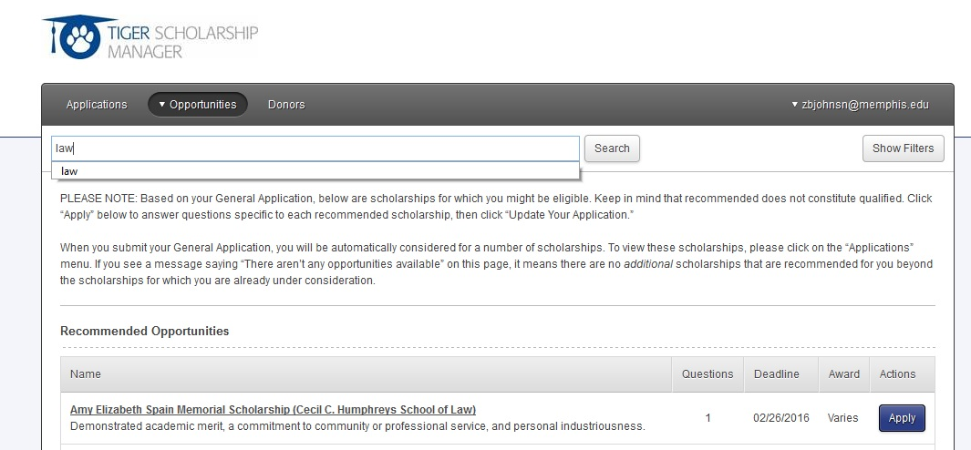

Slide 10
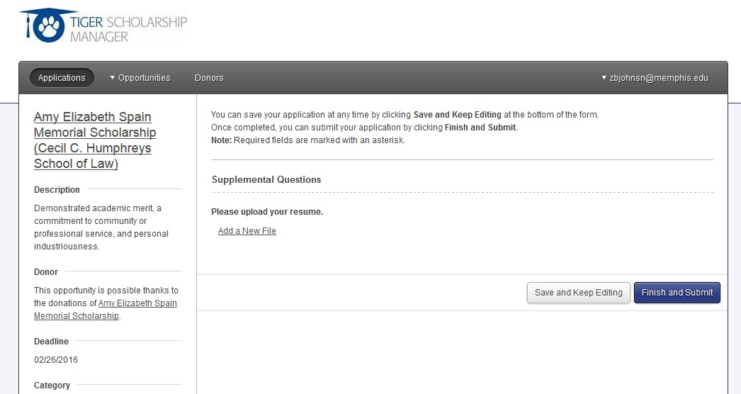

Slide 11
Memphis Access & Diversity Application
Tiger Scholarship Manager
2. March 15, 2021 Deadline
3. 250 word essay on how you contribute to diversity at Memphis Law.
4. Current MADLS recipients must complete the online application.
5. Award notifications in June after spring grades & class ranks are released.
6. Resume not required.

Slide 12
Please describe in 250 words or less how you contribute to diversity at Memphis Law and why you should receive the Access & Diversity Scholarship.
Note: We define diversity broadly to include several aspects of human differences that contribute to the intellectual discourse and inclusive environment at the University of Memphis School of Law. Diversity eligibility may be based on, but is not limited to, socioeconomic disadvantage, race, ethnicity, disability, or whether the applicant is a first generation U.S. citizen, whether the applicant is a first generation college graduate, or whether the applicant attended an HBCU, HSI, or Tribal College.
Application Acknowledgment *
By submission of this form, I hereby apply for the Memphis Access & Diversity Scholarship. Please initial below.

Slide 13
Deadline for Research Assistant/Graduate Assistant: 2.15.21
Deadline for other all law scholarships 3.15.21
Service & law school specific scholarships require resumes.
Memphis Access & Diversity does not require a resume.
Humphreys Fellows cannot engage in outside employment.
Humphreys Fellows, Herff, & Faculty Emeritus scholars must complete Research Assistant/Graduate Assistant application.
Candidates only applying for ASP and Writing Center Fellows must complete Research Assistant/Graduate Assistant application.
Many law scholarships require outside donor involvement.
Read questions and provide appropriate answers for specific scholarships.
Honors & Awards Committee will consider all scholarship applicants.

Slide 14
Contact Information
Dean of Admissions
Dr. Sue Ann McClellan
smcclell@memphis.edu
Director of Admissions
Kara Bowen
kphllp10@memphis.edu
Administrative Assistant
Penny Rogers
rpenny@memphis.edu

