Slide 1
ACADEMIC ADVISING Rising 3Ls
Associate Dean Jodi Wilson
jlwlson2@memphis.edu

Slide 2
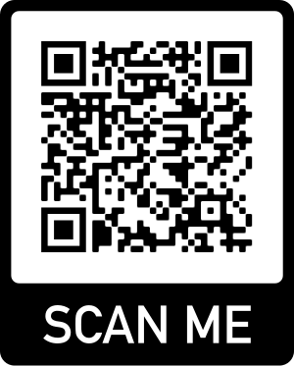
STUDENT ADVISING
http://bit.ly/StudentAdvising

Slide 3
Details, Details
Academic Advising Worksheet
Academic Regulations
(Esp. AR 5, 6, 10 & 16)
Registration Memo
Course Catalog
Fall 2024
Course List, Course Grid & Exam Schedule
Summer 2024 Schedule & Spring 2025 Tentative Course List

Slide 4
Graduation Requirements
40 Hours of Pro Bono Service
2.0 GPA or Better
90 or More Credit Hours
Required courses
Advanced writing requirement course
Experiential learning requirement courses
Electives

Slide 5
Required & Bar-Tested Courses*
Course | Fall 2024 | Spring 2025
Bar Preparation |  | ✓
Business Organizations | ✓
Commercial Law | ✓
Criminal Procedure I |  | ✓
Decedents’ Estates | ✓
Professional Responsibility | ✓
Conflict of Laws |  | ✓
Family Law |  | ✓
Fund. of Bar Exam Writing | ✓
Remedies | ✓
Sales |  | ✓
Secured Transactions | ✓
*Given the audience, this list does not include required 1L & 2L courses.

Slide 6
General Limitations
MAX Ungraded (Pass/Fail) Hours
MAX Hours Per Semester
PT: 11 hours
FT: 18 hours
FT with GPA below 2.50: 16 hours
12 hours
FT with externship: 16 hours
MIN Hours Per Semester
PT: 8 hours
FT: 12 hours
Clinics are graded.

Slide 7
Registration
Timeline
Veterans: April 10, 8 a.m.
43+ Attempted Credit Hours (“ACH”): April 15, Noon
42-15 ACH: April 17, Noon
0-14 ACH: April 19, Noon
ACH do not include the hours currently in-progress.
Additional Notes
Get advance approval for exam conflicts.
New Registration Process – Info Session on 4/8 at Noon in Wade
Check for holds/Alternate PIN requirements.
Do NOT register early.
Use the waitlist – and monitor your email.
Be mindful of drop/add deadlines.

Slide 8
More Questions?
Individualized Advising Appointments
Faculty Advisor
Dean Aden
Other Resources . . .
Registrar Cheryl Edwards
Certificate Advisors
Other Faculty
Professor Harris, Director of Bar Preparation
Your Assigned Faculty Advisor from 1L Year
Dean Wilson

