Slide 1



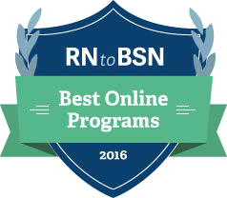

RN to BSN Program
________________________
Entirely Online!

Slide 2


Overview
We offer a flexible, accessible, and affordable online (24/7) RN to BSN Program. Nursing faculty are committed to providing high quality, individualized, and student-centered education for registered nurses.
Program Highlights
Affordable
Accessible
Achievable
Flexible
High Quality
Individualized
Partnerships
Dyersburg State Community College
Jackson State Community College
Southwest Tennessee Community College
Application Deadlines
RN applications are processed on a continual basis; however, priority will be given to those applicants who meet the following dates:
Fall Semester – July 1
Spring Semester – October 1
Summer Semester – April 15
Accelerated Bachelors to Master’s (ABM) Program Available For additional information, go to http://www.memphis.edu/nursing/programs/

Slide 3

Admission Requirements
Be admitted to the UofM as a degree seeking undergraduate student.
Have an active, unencumbered RN license, or be eligible for licensure.
Complete and submit an application for admission to the Loewenberg College of Nursing RN to BSN Program.
Have a minimum college cumulative GPA of 2.5.
Complete Anatomy and Physiology I and II with labs and Microbiology with lab with a grade of “C” or better within seven (7) years of LCON admission, or submit a letter from your current supervisor verifying use of the sciences.
Have completed the additional prerequisite courses with a grade of “C” or better (English Comp I and II, Intro to Sociology or General Psychology, Math, and Nutrition).
If transferring from another accredited nursing program, applicants must submit a letter of good standing from the dean/director of the previous nursing program, along with a transcript, and meet LCON admission and progression standards as stated in the Undergraduate Catalog.
General Education Requirements
In order to earn a BSN, students must complete an upper division elective (3000-4000 level course) and the regular general education requirements for the University of Memphis. (Many students transfer in most of these after completing their Associates Degree. However, students may complete these within the four-year period.)
For specific listings of General Education requirements visit: http://www.memphis.edu/ugcatalog/graduation/gened.php

Slide 4

COST SAVING FEATURES
Credit by Examination (CBE)
Credit By Examination (CBE) can be earned for three (3) RN-BSN courses:
  NURS 3101 - Health Assessment (3 credits)
  NURS 3103 - Health Assessment Lab (1 credit)
  NURS 3400 - Pathophysiology (3 credits)
  NURS 3000 - Pharmacology - (3 credits)
Students will be awarded college level credit after admission to LCON by successfully passing a professionally recognized national exam at the national proficiency benchmark. CBE can be earned by achieving proficiency on a standardized achievement exam taken in the associate degree nursing (ADN) program or taking a national standardized exam at LCON.

Slide 5
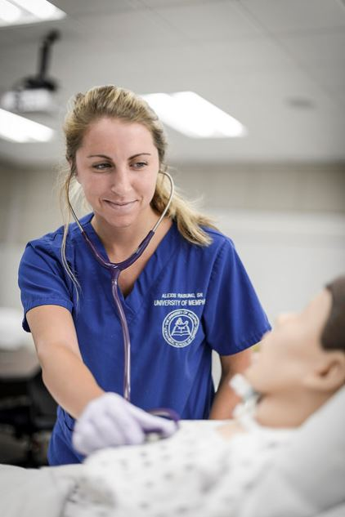
COST SAVING FEATURES
Credit for Prior Learning
Credit through a prior learning assessment portfolio may be earned for a maximum of four (4) credits in the Professional Nursing Practice Practicum (NURS 4206).
Professional experiences with validation may include:
New graduate residency
National nursing certification
Professionally recognized continuing education credits (American Nurses Credentialing Center)
Preceptor experience for students and new graduates
Scholarly presentations and publications
Clinical project leadership
Leadership in professional nursing or healthcare organizations.
Adaptive Learning
Adaptive learning is used to individualize the student learning experience. Through continuous assessment and feedback, course lesson plans may accelerate based on the student’s level of mastery. This provides students the opportunity to progress through the course at a faster rate.

Slide 6


Tuition & Scholarship
UofM Global – Online Degrees
Flat Tuition Rate for Qualified Applicants
$350/credit hour plus applicable fees *
For the most current information regarding
UofM Global and UofM tuition, visit
www.memphis.edu/uofmglobal/about/fees.php
and
http://www.memphis.edu/bursar/fees/
Limited time offer
Not available to students receiving the WTHC scholarship
Jackson-Madison County General Hospital
Nursing Scholarship
$80,000 per year is provided as a gift from West Tennessee Healthcare (WTHC) for RN to BSN students in Madison County and contiguous counties (Gibson, Henderson, Carroll, Chester, Hardeman, Haywood, and Crockett)

Slide 7
CORE VALUES
Caring
Diversity
Integrity
Leadership

Slide 8

CONTACT US
Norma Neal
RN to BSN Coordinator
nneal1@memphis.edu
901.678.3514
Dr. Jill Dapremont
Director, RN to BSN program
jdaprmnt@memphis.edu
901.678.3502
Loewenberg College of Nursing
901.678.2003
nursing.memphis.edu
RN@memphis.edu

