Slide 1
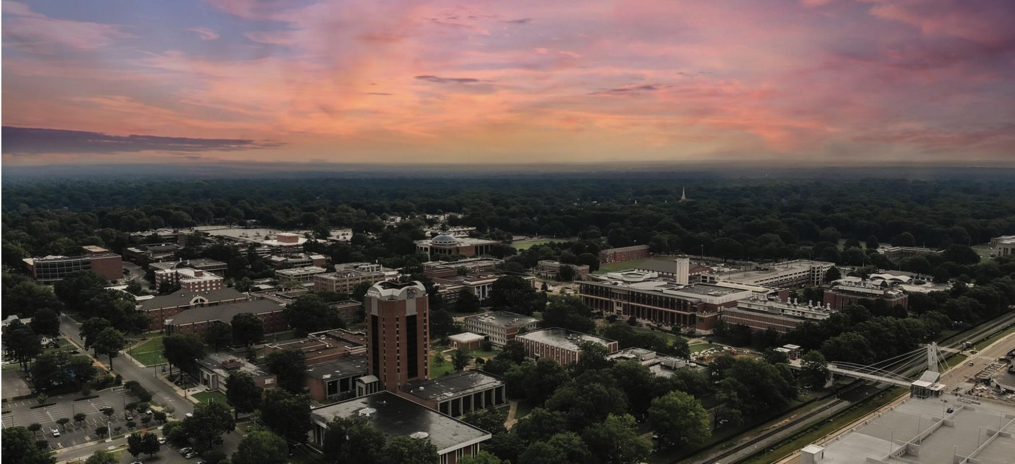
University of Memphis Department of Public and Nonprofit Administration

Slide 2
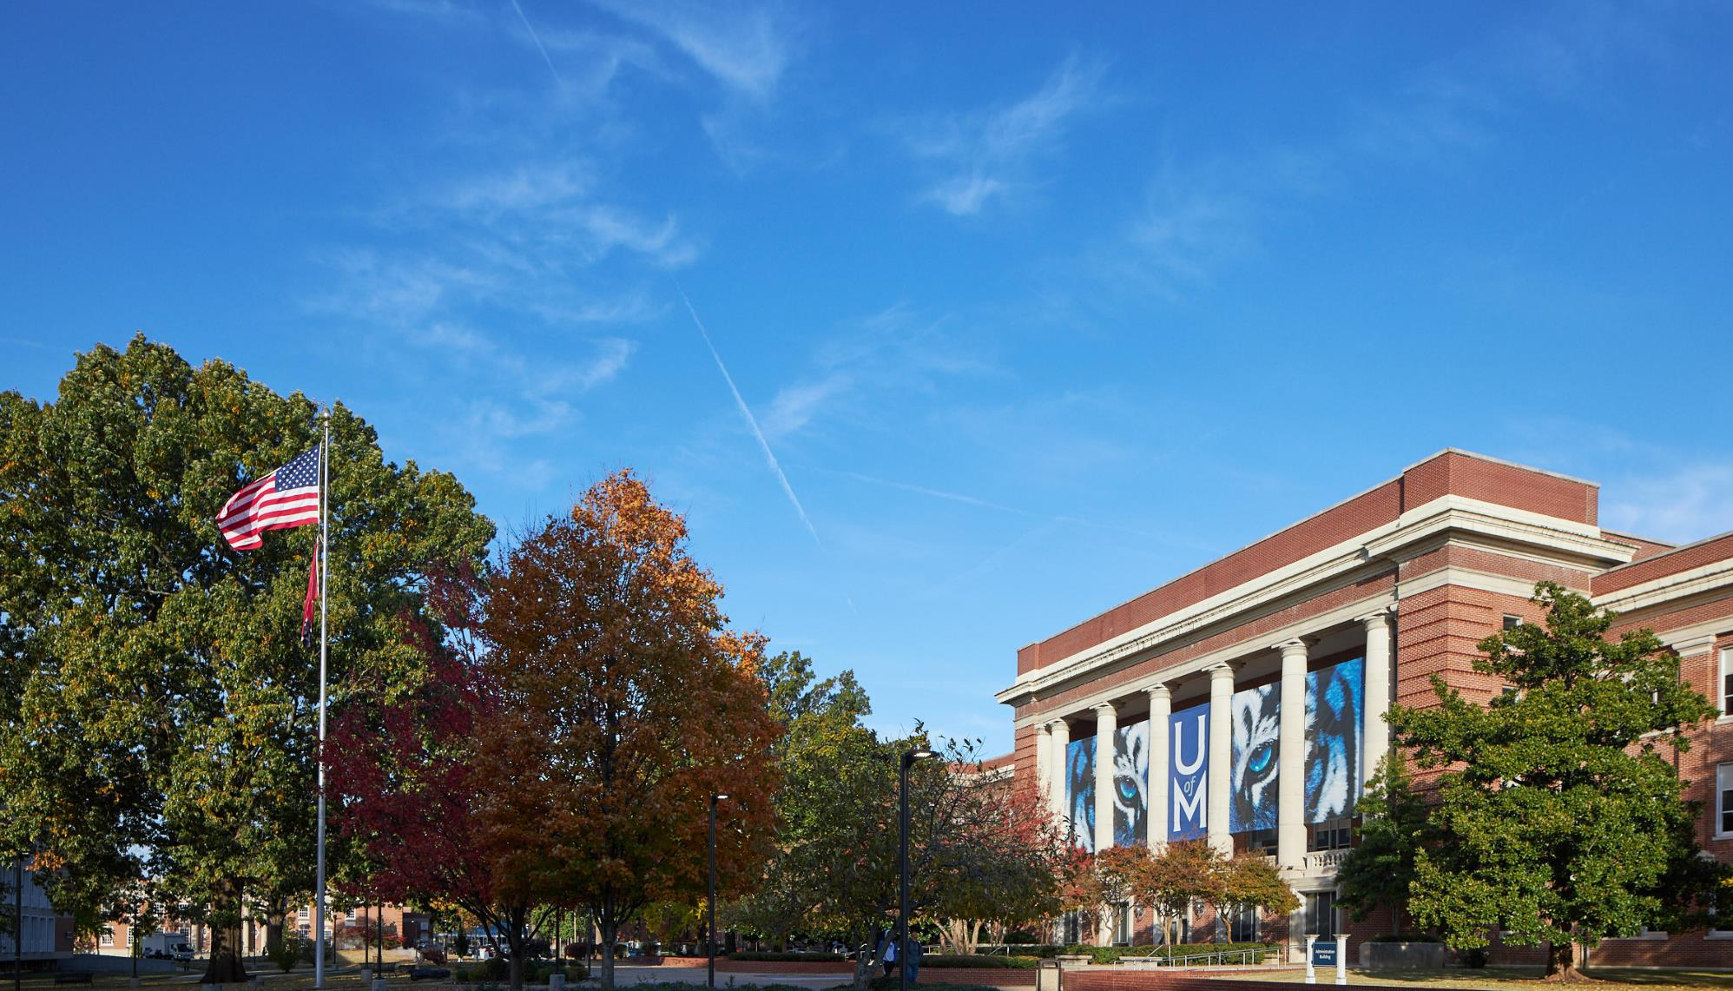
DRIVEN BY DOING
2 Masters Programs
2 Graduate Certificate Programs
7:1 Student to Faculty Ratio
90% employed in-field within one year after graduation
Our Mission
Promoting responsive, responsible and professional public service through teaching, research and community engagement using a practice-based curriculum centered on nonprofit and urban management.

Slide 3
A Note From Our Chair
On behalf of the faculty and staff, I would like to welcome you to the Department of Public and Nonprofit Administration! We are proud to have been part of the University of Memphis for over 50 years, and we are continuing to adapt and grow to meet the changing needs of our community and the public and nonprofit professions.
The department is home to a number of programs at all academic levels, and all with the purpose of preparing public services leaders wherever they are in their careers. We offer undergraduate minors in Public Administration and Nonprofit, for students who wish to enhance their current program of study. We offer a nationally ranked, NASPAA accredited Master of Public Administration degree, and a newly established, fully online Master of Nonprofit Management degrees. For students who wish to enhance their current master’s coursework, or who wish to continue their graduate education without the commitment to a full master’s degree, we offer graduate certificates in Philanthropy and Nonprofit Leadership and Local Government Management. Finally, we are one of seven academic programs who are part of the School of Urban Affairs and Public Policy’s Ph.D. in Urban Affairs program. Our courses, offered in-person or online, are taught by our excellent and dedicated faculty. Our full-time faculty are active in a wide variety of regional, national, and international research areas, and our part-time faculty have distinguished themselves as leading professionals in their fields.
Our student and alumni are our first priority and our greatest source of pride. Even before completing their academic programs, our students are making meaningful contributions through internships, fellowships, service-learning projects and community service. Graduates of the program go on to work in federal, state, and local government, as well as nonprofits locally and across the globe.
Whether you are a student looking to further your education and enhance your career, or a community organization looking to partner with our students and faculty, we look forward to assisting you realize your goals.
Dr. Sharon Wrobel Associate Professor and Chair

Slide 4
Nationally Ranked
U.S. News & World Report Ranking Best Graduate Public Affairs Programs University of Memphis is proudly ranked at #114

Slide 5
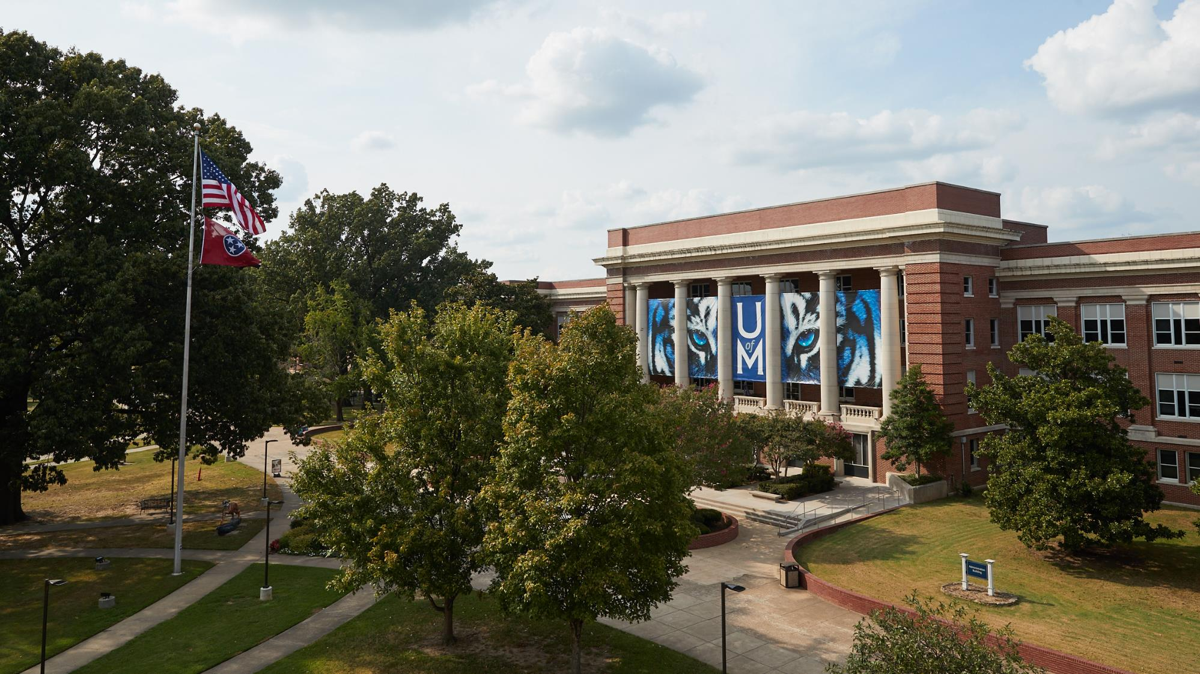
Join the Next Generation of Public and Nonprofit Leaders

Slide 6
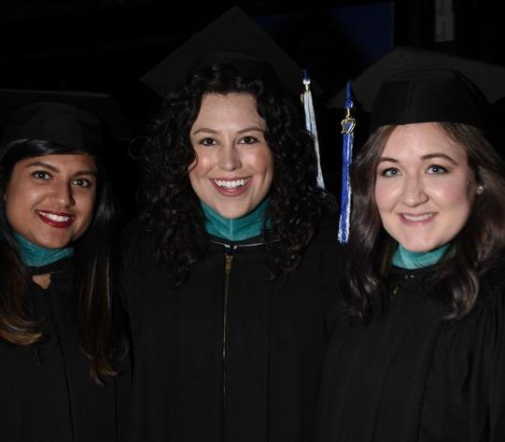
Master of Public Administration
Program Features
In-person and online courses
Complete in as little as four semesters
Concentrations
Nonprofit Administration
Urban Management
Fully Accredited by NASPAA
Develop critical thinking and analytical skills necessary for effective management and leadership in today’s public and nonprofit sectors

Slide 7
Master of Nonprofit Management
Program Features
Fully online program
Complete in as little as four semesters
Three Tracks
Nonprofit Management
Fundraising and Philanthropy
Social Justice
Preparing and empowering nonprofit leaders with the theoretical and practical knowledge to transform organizations and address complex social problems.

Slide 8
Graduate Certificate in
Local Government Management
Program Features
15 credit hour program
Complete in 12-18 months
In-person and online classes
knowledge and management skills for mayors, managers, department heads, supervisors, and other local government professionals

Slide 9
Graduate Certificate in Philanthropy &
Nonprofit Leadership
Program Features
15 credit hour program
Complete in 12-18 months
In-person and online classes
Ideal for nonprofit professionals, community volunteer leaders and philanthropist.

Slide 10
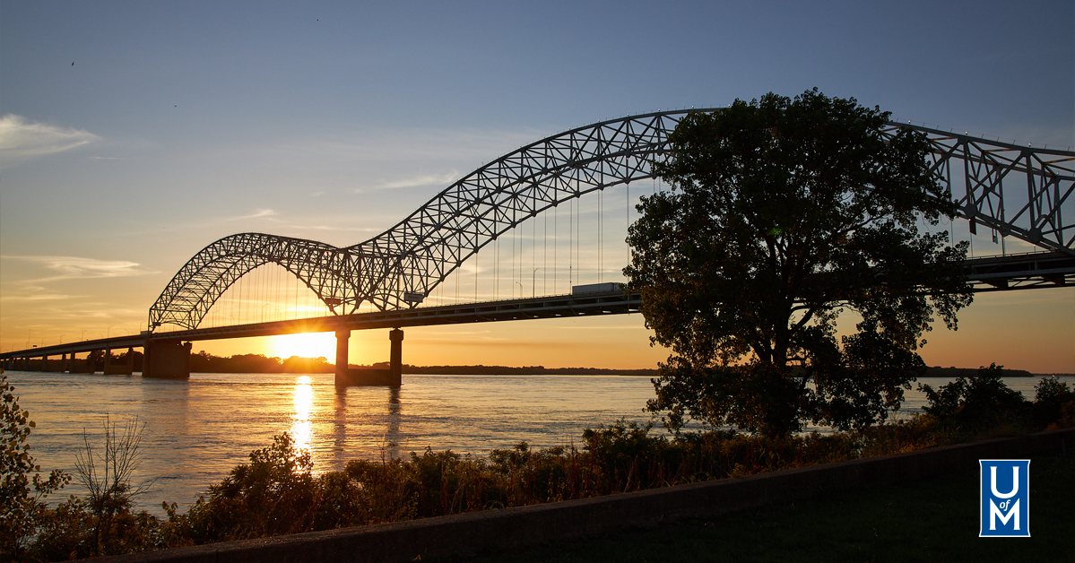
WE KNOW MEMPHIS
Our programs are tightly linked in the Memphis community. Memphis is our laboratory for learning and doing. We connect our students to a large network of government and nonprofit partners through classes, internships, and special projects.

Slide 11
Select A Degree That Can REALLY MAKE A DIFFERENCE
Our programs have a great track record of placing our graduates in nonprofit and government organizations here in Memphis and beyond. In addition, the University provides career development resources and services to all students. Here is a sample of where some of our alums are working today:
Overton Park Conservancy
United Way
University of Nebraska – Lincoln
Town of Collierville
University of Memphis
State of Tennessee
Career & Leadership Development Institute, Kenya
American Heart Association
U.S. Department of Homeland Security
Shelby County Schools
Seeding Success
San Diego Zoo Wildlife Alliance
Cornell University
Methodist LeBonheur Community Outreach
Neighborhood Preservation, Inc.
ALSAC/St. Jude Children’s Research Hospital

Slide 12
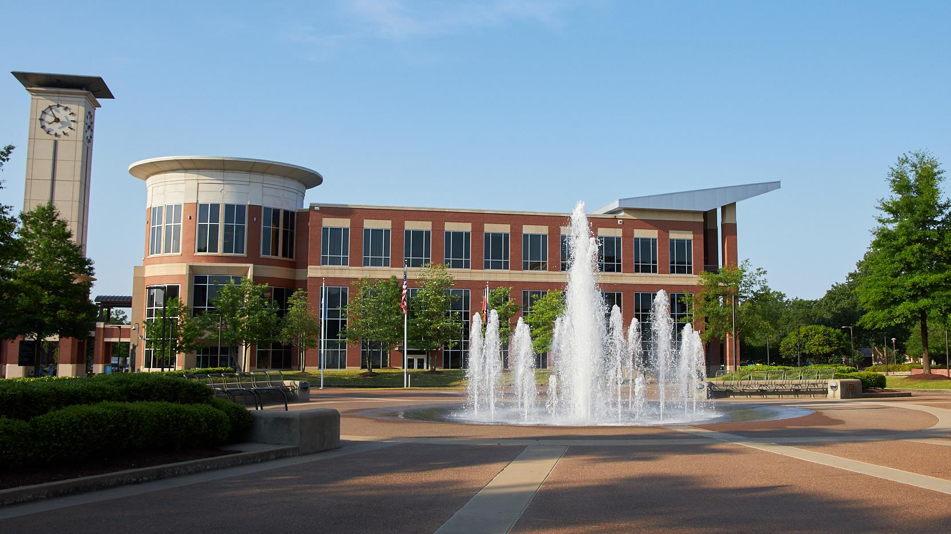
Financial Assistance
We offer a limited number of graduate assistantships each year
20 hours of work per week is required
Assistantships cover nine credit hours per semester (fall and spring)
Monthly stipend for fall and spring semesters
Federal workstudy funds may also be available to you (not available to international students under an F-1 visa)

Slide 13
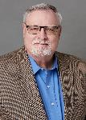
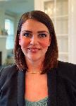
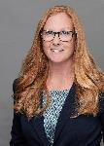
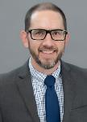
Faculty Coordinators
Dr. John Topinka Clinical Assistant Professor MPA Coordinator jptpinka@memphis.edu | 901.678.3365 Dr. Erin Nelson Associate Professor MNM Coordinator e.nelson@memphis.edu | 901.678.5527
Dr. Beth Gillespie Assistant Professor PNLD Certificate Coordinator mgllspe3@memphis.edu | 901.678.3873 Dr. Joe Hafer Assistant Professor LG Certificate Coordinator jahafer@memphis.edu | 901.678.3349

Slide 14
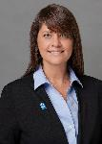
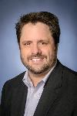
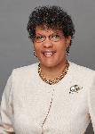
Faculty
Dr. Sharon Wrobel Associate Professor Chair swrobel@memphis.edu 901.678.4720
Dr. Michael Howell-Moroney Professor michael.hm@memphis.edu 901.678.2640
Ms. Candace Walsh Assistant Professor of Teaching cmwalsh1@memphis.edu 901.678.4395

Slide 15
Department of Public and Nonprofit Administration
3820 Desoto Avenue
213 Browning Hall, Memphis, TN 38152
901.378.3360
memphis.edu/padm

