Slide 1
Public Health By Design: Ideation and Storyboarding
Innovating Solutions for Healthier Communities
Workshop by: Michelle Jeu, MPH
Notes:
Speaker Notes:
Welcome to our session on Public Health By Design
Today, we will explore how design principles can be applied to public health to develop, implement, and sustain innovative solutions.
We will cover key concepts such as problem identification, empathy and research, ideation, prototyping, testing and feedback, and implementation.
Let me take you through a structured approach to creating innovative and sustainable solutions for these challenges.

Slide 2
Introduction to Public Health By Design
Public health problems require innovative solutions that are both sustainable and effective. By applying a structured design process, we can create impactful interventions that address the root causes and consider the needs of diverse populations.
The goal of this workshop is to introduce student learners to the design thinking process, guiding them from identifying a problem to creating an initial prototype.
Notes:
Speaker Notes:
We will introduce students to the design thinking process and guide them from problem identification to ideation and cover concepts related to prototyping a solution.
Throughout this presentation, we will look at various examples and case studies to see how these concepts work in real-world scenarios.
In public health, the complexity of problems demands a thoughtful approach to design.
This presentation will outline a step-by-step process that integrates empathy, research, and iteration to develop solutions that are both innovative and practical.
Reference:
World Health Organization. (2019). Designing solutions for complex public health issues. Geneva: WHO Press.

Slide 3
Learning Objectives:
Understand how design can effectively address public health challenges.
Recognize the main stages in the design process for public health solutions for ideation and storyboarding.
Learn to apply design thinking principles to create innovative public health interventions.
Grasp the importance of engaging stakeholders to ensure relevant and effective solutions.
Develop strategies to overcome common challenges in public health design.
What you will learn
Notes:
Speaker Notes:
Our learning objectives for today are to:
Understand how design can effectively address public health challenges.
Recognize the main stages in the design process for public health solutions.
Learn to apply design thinking principles to create innovative public health interventions.
Grasp the importance of engaging stakeholders to ensure relevant and effective solutions.
Develop strategies to overcome common challenges in public health design.

Slide 4
Design Principles
Notice
Conduct secondary research to determine industry trends
Identify other relevant demographic, political, social, economic, or technological trends
Identify your key stakeholders
Identify your positionality
Empathize
Develop empathy for a particular group of people through interviews and rapport building
Define
Synthesize your research and develop a visualization of what is going on
Identify a few key needs/insights/issues that a future scenario will have to address
Define an opportunity for innovation
Ideate
Generate a wide range of ideas of what is possible
Explore different parts of the experience that could be improved
Create a number of provocative ideas
Select the most promising ideas
Prototype
Understanding our assumptions
Prototype different types of ideas
Get feedback on your ideas
Implement
Tell a compelling story about your idea and the impact it will have on people
Articulate your value proposition
Reflect
Identify next steps for implementing your ideas
Anticipate impact
Observe how people experience daily life or currently address problems
Notes:
Speaker Notes:
Design is all about identifying opportunities and creating value.
It involves taking risks and being innovative to bring new ideas to life.
In the context of public health, this means developing new solutions to improve health outcomes and address health disparities.
More on Design:
Design is a creative and systematic process of envisioning, planning, and producing a solution, product, or experience with a specific purpose or set of goals in mind. It involves identifying problems, understanding user needs, generating ideas, and iterating on prototypes to develop a functional and aesthetically pleasing outcome. In broader terms, design can refer to the plan or blueprint that guides the creation of something new, whether it’s a physical object, a digital interface, a process, or a service.
Key aspects of design include:
Problem-Solving: Design aims to address a specific problem or need, finding effective and innovative ways to meet those requirements.
Creativity: Design relies heavily on creative thinking to generate new ideas and explore multiple possibilities.
User-Centeredness: Good design is often user-centered, meaning it considers the needs, behaviors, and experiences of the people who will use the product or service.
Functionality: While aesthetics are important, the primary goal of design is to ensure that the final product works well and fulfills its intended purpose.
Iteration: Design is an iterative process, where ideas are tested, refined, and improved based on feedback and testing.
In summary, design is both a process and a mindset focused on creating solutions that are functional, efficient, and aligned with user needs.
Reference:
Norman, D. A. (2013). The design of everyday things (Revised and expanded edition). Basic Books.

Slide 5
Design For:
Desirability
Feasibility
Viability

Slide 6
Conducting Research and Gathering Data
Use qualitative and quantitative research methods.
Collect data from reliable sources.
Analyze data to understand the problem and potential solutions.
Notes:
Speaker Notes:
Conducting research and gathering data is crucial for understanding the problem and developing effective solutions.
Use a combination of qualitative methods, like interviews and focus groups, and quantitative methods, like surveys and statistical analysis.
Collect data from reliable sources, such as academic journals, government reports, and community organizations.
Analyze the data to gain a deep understanding of the problem and identify potential solutions.
References:
Johnson, A., Smith, B., & Brown, C. (2017). Research methods in public health. Journal of Public Health, 34(2), 123-134.Smith, D. (2019).
Analyzing public health data. Health Data Journal, 29(3), 145-156.
Patton, M. Q. (2015). Qualitative research & evaluation methods. Thousand Oaks, CA: SAGE.

Slide 7
Research and Analysis
Conduct qualitative and quantitative research
Understand root causes and contributing factors
Review existing interventions and best practices
Notes:
Speaker’s Notes:
Research and analysis are essential to understand the problem deeply.
This includes both qualitative methods, like interviews and focus groups, and quantitative data analysis.
Reviewing existing interventions helps identify what works and where there are gaps.
Equip students with basic research skills and insights to inform their solutions.
Activities:
Research Techniques Overview: Introduce basic research methods such as surveys, interviews, and observations. Provide examples and templates for each.
Group Research Activity: Assign each group a research method to gather information about their problem. Encourage them to use online resources or interviews with peers.
Sharing Insights: Have each group present their findings and discuss how these insights influence their understanding of the problem.
Reference:
Sanders, E. B.-N., & Stappers, P. J. (2014). Probes, toolkits and prototypes: Three approaches to making in codesigning. CoDesign, 10(1), 5-14.

Slide 8
Research and Analysis – Ethnographic Interviews and Empathy Mapping
ASK
OBSERVE
INTERPRET
Notes:
Speaker’s Notes:
Research and analysis are essential to understand the problem deeply.
This includes both qualitative methods, like interviews and focus groups, and quantitative data analysis.
Reviewing existing interventions helps identify what works and where there are gaps.
Pay attention to Activities, Environments, Interventions, Objects, and Users – A, E, I, O, U’s
Reference:
Sanders, E. B.-N., & Stappers, P. J. (2014). Probes, toolkits and prototypes: Three approaches to making in codesigning. CoDesign, 10(1), 5-14.
Empathy and Research (15 minutes) - case based provide examples and a walk through
Activity: Empathy mapping
Students create empathy maps to understand the needs, thoughts, and feelings of people affected by the chosen problem.
Discussion: Share insights and refine the problem statement.

Slide 9
Transforming Interviews into Insights: Post-it Note Analysis Process
The purpose of this process:
Turn qualitative data into actionable insights through clustering and thematic analysis
Step-by-Step Process:
Extract Key Thoughts:
Take the ethnographic interviews and turn them into individual post-it note thoughts
Cluster for Themes:
Cluster Post-it notes to identify patterns and themes
Title and Capture:
Title clusters and take pictures as they evolve
Identify Actionable Insights:
Look for stories that reveal actionable insights or pain points
Notes:
Speaker Notes:
Introduction:
In this slide, we'll walk through the process of transforming qualitative data from ethnographic interviews into structured insights using Post-it notes. This method is a staple in design thinking and service design, allowing us to visualize and analyze large amounts of qualitative data effectively.
Step 1: Extract Key Thoughts:
The first step is to review the ethnographic interviews and extract key thoughts or quotes. Each of these thoughts is then written on a separate Post-it note. This helps us break down complex interview data into manageable pieces, making it easier to identify recurring themes or ideas.
Step 2: Cluster for Themes:
Next, we take these individual Post-it notes and start clustering them based on similarities or common themes. This might involve grouping notes that address similar user needs, behaviors, or pain points. Clustering helps to surface patterns in the data, which are crucial for understanding the larger picture.
Step 3: Title and Capture:
Once clusters start to form, we give each cluster a title that summarizes its main theme. It’s also important to document the process by taking pictures of the clusters as they evolve. This not only preserves the work for later reference but also tracks how our understanding of the data develops over time.
Step 4: Identify Actionable Insights:
Finally, we look closely at the clusters to identify stories or themes that reveal actionable insights or significant pain points. These insights will guide the next steps in our design process, ensuring that we're addressing real user needs and challenges.
Conclusion:
By the end of this process, we’ve effectively turned raw qualitative data into organized, actionable insights that can drive design decisions. This method is powerful because it grounds our design work in real user experiences and needs.
Reference:
Brown, T. (2009). Change by design: How design thinking creates new alternatives for business and society. HarperBusiness.
Christensen, C. M., Hall, T., Dillon, K., & Duncan, D. S. (2016). Competing against luck: The story of innovation and customer choice. Harper Business.
Stickdorn, M., Hormess, M. E., Lawrence, A., & Schneider, J. (2018). This is service design doing: Applying service design thinking in the real world. O'Reilly Media, Inc.

Slide 10
Analysis Techniques for Insights
Analyzing the clusters allow us to derive meaningful insights that help inform our design process.
Here are some helpful techniques to aid in analysis:
Jobs to Be Done (JTBD):
Identify the underlying problems or needs the users are trying to solve
Focus on what users are "hiring" a product or service to do. Analyze Post-it clusters to uncover these core jobs, helping you address the right problems.
Journey Mapping:
Visualize the user’s experience from start to finish
Use journey maps to track the user’s interaction with a product or service over time. Identify pain points and moments of delight by analyzing the sequence of actions and experiences captured in the Post-it notes
Pick-a-Story Analysis:
Select and analyze stories that highlight key themes or insights
Focus on specific user stories that stand out in the Post-it clusters. Analyze these stories to extract actionable insights and deeper understanding of user needs or pain points
Notes:
Speaker’s Notes:
Several tools and techniques are particularly useful in designing for public health.
Design thinking and human-centered design are foundational approaches.
Tools like empathy maps, journey maps, and service blueprints help us understand the user experience and design more effectively for public health needs.
Reference:
Brown, T. (2009). Change by design: How design thinking creates new alternatives for business and society. HarperBusiness.
Christensen, C. M., Hall, T., Dillon, K., & Duncan, D. S. (2016). Competing against luck: The story of innovation and customer choice. Harper Business.
Stickdorn, M., Hormess, M. E., Lawrence, A., & Schneider, J. (2018). This is service design doing: Applying service design thinking in the real world. O'Reilly Media, Inc.
IDEO.org. (2015). The field guide to human-centered design. IDEO.org.
Design Council. (2014). Tackling childhood obesity through design: A case study. Retrieved from https://www.designcouncil.org.uk

Slide 11
Ideation
Generate a wide range of ideas
Encourage creativity and diverse perspectives
Use techniques like brainstorming and mind mapping
Notes:
Speaker’s Notes:
During ideation, we generate a wide range of ideas without judgment.
Techniques like brainstorming and mind mapping are useful here.
The goal is to explore diverse perspectives and consider all possible solutions, no matter how unconventional they may seem at first.
Encourage students to generate and explore multiple solutions.
Activities:
Brainstorming Session: Teach brainstorming techniques like "Crazy 8s" (sketching eight ideas in eight minutes) and "Mind Mapping." Emphasize quantity over quality initially.
Idea Selection: Guide groups in evaluating their ideas using criteria such as feasibility, impact, and innovation. Use tools like "Dot Voting" to prioritize ideas.
Activity: Brainstorming solutions
Encourage wild ideas and build on each other’s suggestions.
Use sticky notes to jot down ideas and place them on a board.
Discussion: Narrow down to the most feasible and impactful solutions.
Wrap up by going through prototyping, feedback, implementation, reflect as theories
Reference:
Kolko, J. (2015). Exposing the magic of design: A practitioner's guide to the methods and theory of synthesis. Oxford University Press.

Slide 12
Ideation Techniques: Generating and Visualizing Ideas
Brainstorming:
Gather with your team to generate as many ideas as possible. Quantity over quality—no idea is too wild
Mindmapping:
Start with a central idea and branch out with related concepts. This technique helps explore all possible angles of a problem.
How Might We:
Frame challenges as 'How might we' questions. This opens up possibilities and encourages creative thinking.
Crazy 8s:
Fold a sheet of paper into eight sections and sketch one idea in each within 8 minutes (1 minute per section). Push yourself to think fast and varied
Notes:
Speaker Notes:
Introduction:
In the ideation phase, it’s important to prioritize quantity over quality initially. The goal is to generate a wide range of ideas—at least 30—so that we can explore diverse possibilities before refining them. Each idea should be sketched out on half sheets of paper to visualize your thoughts. More ideas increase the chances of finding innovative solutions.
Brainstorming:
Brainstorming is about getting together with others to generate as many ideas as possible in a collaborative environment. The key here is to suspend judgment—no idea is too wild at this stage
Mindmapping:
Mindmapping helps you visually explore all aspects of a central idea by branching out into related concepts. This technique is great for organizing your thoughts and uncovering connections between ideas that you might not have noticed.
How Might We:
'How Might We' questions are a cornerstone of design thinking. By framing challenges as open-ended questions, you encourage creative exploration. For example, 'How might we make healthy eating fun for kids?'
Crazy 8s:
Crazy 8s is a rapid ideation technique where you fold a sheet of paper into eight sections and fill each section with a different idea in 8 minutes. The time constraint pushes you to think fast and broad, which can lead to unexpected and innovative ideas.
References by topic:
Social Innovation Pathways & Design Thinking:
Stickdorn, M., Hormess, M. E., Lawrence, A., & Schneider, J. (2018). This is service design doing: Applying service design thinking in the real world. O'Reilly Media.
Jobs to Be Done (JTBD) & Innovation:
Christensen, C. M., Hall, T., Dillon, K., & Duncan, D. S. (2016). Competing against luck: The story of innovation and customer choice. Harper Business.
Inspiration by Analogy & Design Thinking:
Brown, T. (2009). Change by design: How design thinking creates new alternatives for business and society. Harper Business.
Mindmapping & Creativity Techniques:
Buzan, T., & Buzan, B. (2010). The Mind Map Book: Unlock your creativity, boost your memory, change your life. BBC Active.
Brainstorming & Ideation:
Osborn, A. F. (1963). Applied imagination: Principles and procedures of creative problem-solving (3rd ed.). Scribner.
Rapid Ideation Techniques (Crazy 8s):
Knapp, J., Zeratsky, J., & Kowitz, B. (2016). Sprint: How to solve big problems and test new ideas in just five days. Simon & Schuster.

Slide 13
More Ideation Techniques:
Social Innovation Pathways:
Explore different avenues for creating social impact. Think about how your ideas can address social issues and contribute to positive change
Design for People (Gifting):
Design as if you're creating a gift for someone. Focus on empathy and personalizing solutions to meet specific user needs
Inspiration by Analogy (What Would _ Do?):
Think about how someone or something unrelated to your problem might solve it. For example, 'What would Google do?' or 'How would nature solve this?’
Get Inspired by New Technology:
Look at emerging technologies and imagine how they can be applied to solve your problem. Consider AI, VR, IoT, etc.
Bad Ideas Generation:
Intentionally come up with bad or absurd ideas. This helps break mental blocks and can lead to surprisingly good concepts
Sketch out at least 30 ideas using these techniques on half sheets of paper. Don't hold back—let your creativity flow!
Notes:
Speakers Notes:
References by topic:
Social Innovation Pathways & Design Thinking:
Stickdorn, M., Hormess, M. E., Lawrence, A., & Schneider, J. (2018). This is service design doing: Applying service design thinking in the real world. O'Reilly Media.
Jobs to Be Done (JTBD) & Innovation:
Christensen, C. M., Hall, T., Dillon, K., & Duncan, D. S. (2016). Competing against luck: The story of innovation and customer choice. Harper Business.
Inspiration by Analogy & Design Thinking:
Brown, T. (2009). Change by design: How design thinking creates new alternatives for business and society. Harper Business.
Mindmapping & Creativity Techniques:
Buzan, T., & Buzan, B. (2010). The Mind Map Book: Unlock your creativity, boost your memory, change your life. BBC Active.
Brainstorming & Ideation:
Osborn, A. F. (1963). Applied imagination: Principles and procedures of creative problem-solving (3rd ed.). Scribner.
Rapid Ideation Techniques (Crazy 8s):
Knapp, J., Zeratsky, J., & Kowitz, B. (2016). Sprint: How to solve big problems and test new ideas in just five days. Simon & Schuster.

Slide 14
Connecting the Dots
Once you’ve generated a variety of ideas, the next step is to evaluate them. Dot voting helps prioritize ideas based on specific criteria: meeting needs and desirability, innovation, feasibility, and viability.
Dot Voting Process:
Dot voting is a simple, democratic way to determine which ideas have the most support. Each participant is given a set number of dots (e.g., stickers or marks) to place on the ideas they believe are the strongest. Use a different color for each criteria
Evaluation Criteria:
Meeting Needs
Does the idea effectively meet the user’s needs?
Consider how well the idea solves the problem or enhances the user experience
Desirability:
Does the idea effectively meet the user’s desires?
Consider if this is something the user will want.
Innovation & Novelty:
How innovative or novel is the idea?
Assess whether the idea introduces something new or offers a fresh approach.
Feasibility:
Is the idea feasible within a reasonable time frame?
Evaluate whether the idea can be realistically implemented given available resources.
Viability:
Is the idea viable in the long term?
Consider if the idea is sustainable and if it makes sense economically and operationally.
Notes:
Speaker Notes:
Introduction:
After generating a wide range of ideas, it's crucial to evaluate them to identify the most promising ones. Dot voting is an effective technique for this purpose, allowing everyone in the team to participate in the decision-making process.
Dot Voting Process:
Dot voting is straightforward. Each team member gets a set number of dots, which they place next to the ideas they believe best meet our criteria. This method quickly highlights which ideas have the most support.
Evaluation Criteria:
When placing your dots, consider the following criteria:
Meeting Needs & Desirability:
First, ask yourself if the idea effectively meets the user’s needs and desires. Does it solve a key problem or significantly enhance the user experience? This criterion ensures that we're focusing on ideas that will resonate with users.
Innovation & Novelty:
Next, consider how innovative or novel the idea is. Innovation drives differentiation, so it’s important to assess whether the idea brings something new to the table or offers a creative solution.
Feasibility:
Then, think about feasibility. Can the idea be implemented within a reasonable time frame? We need to be realistic about our resources and constraints to ensure that the idea can be brought to life.
Viability:
Finally, evaluate the idea's viability. Is it sustainable in the long term? This includes economic viability as well as operational feasibility, ensuring that the idea can thrive over time.
Action Item:
After the dot voting session, we'll focus on refining the top ideas—those that score well across all criteria. These are the ideas that have the best chance of success, balancing desirability, innovation, feasibility, and viability.
Reference:
Knapp, J., Zeratsky, J., & Kowitz, B. (2016). Sprint: How to solve big problems and test new ideas in just five days. Simon & Schuster.

Slide 15
Storyboarding
Take your top 3 ideas
Create a storyboard for each one:
Identify what your product, service, or experience is
The needs it addresses
3-5 critical attributes
Think about:
What are people doing before, during, and after interacting with your product, service, or experience?
Where do they encounter it?
Where do they use it?
How do they feel before?
How are they changed after the interaction?

Slide 16
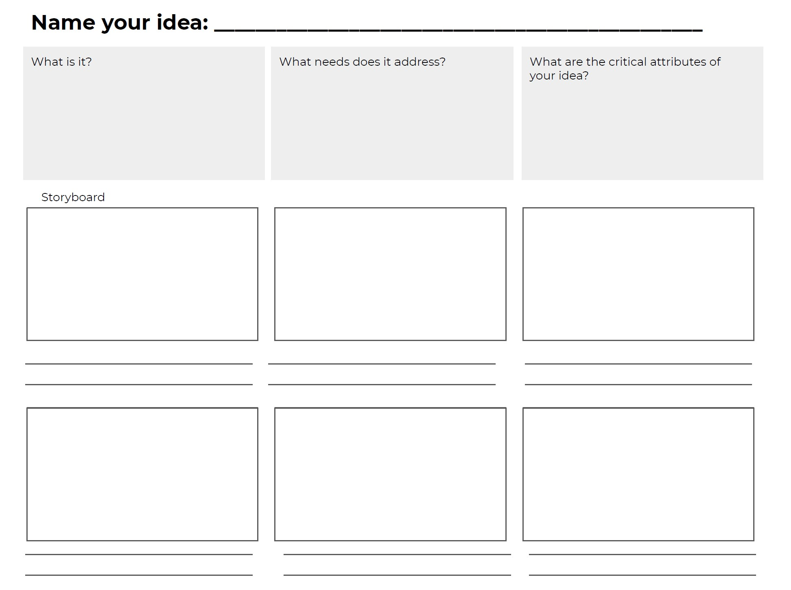
Adapted from Rottenberg, 2023.
Notes:
Reference:
Rottenberg, S. (2023, October 30). Design Thinking for Social Innovation Week 5 Ideation: Generating a wide range of diverse ideas. Module 5.3 Selecting and Refining Your Most Promising Ideas [Lecture]. upenn-catalog.instructure.com/courses/1169/pages/5-dot-3-selecting-and-refining-your-most-promising-ideas-9-10?module_item_id=73612

Slide 17
Finally, We Translate Ideas into Actions
I will cover Prototyping and Implementation in the next workshop.
Please take time practicing ideation and evaluation of your ideas!

