Slide 1
Public Health By Design: Prototyping and Implementation
Innovating Solutions for Healthier Communities
Workshop by: Michelle Jeu, MPH
Notes:
Speaker Notes:
Welcome to our session on Public Health By Design
Today, we will explore how design principles can be applied to public health to develop, implement, and sustain innovative solutions.
We will cover key concepts such as problem identification, empathy and research, ideation, prototyping, testing and feedback, and implementation.
Let me take you through a structured approach to creating innovative and sustainable solutions for these challenges.

Slide 2
Introduction to Public Health By Design
Public health problems require innovative solutions that are both sustainable and effective. By applying a structured design process, we can create impactful interventions that address the root causes and consider the needs of diverse populations.
The goal of this workshop is to introduce student learners to the design thinking process, guiding them from identifying a problem to creating an initial prototype.
Notes:
Speaker Notes:
We will introduce students to the design thinking process and guide them from problem identification to ideation and cover concepts related to prototyping a solution.
Throughout this presentation, we will look at various examples and case studies to see how these concepts work in real-world scenarios.
In public health, the complexity of problems demands a thoughtful approach to design.
This presentation will outline a step-by-step process that integrates empathy, research, and iteration to develop solutions that are both innovative and practical.
Reference:
World Health Organization. (2019). Designing solutions for complex public health issues. Geneva: WHO Press.

Slide 3
Learning Objectives:
Understand how design can effectively address public health challenges.
Recognize the main stages in the design process for public health solutions for prototyping, testing, feedback, and implementation
Learn to apply design thinking principles to create innovative public health interventions.
Grasp the importance of engaging stakeholders to ensure relevant and effective solutions.
Develop strategies to overcome common challenges in public health design.
What you will learn
Notes:
Speaker Notes:
Our learning objectives for today are to:
Understand how design can effectively address public health challenges.
Recognize the main stages in the design process for public health solutions.
Learn to apply design thinking principles to create innovative public health interventions.
Grasp the importance of engaging stakeholders to ensure relevant and effective solutions.
Develop strategies to overcome common challenges in public health design.

Slide 4
Design Principles
Notice
Conduct secondary research to determine industry trends
Identify other relevant demographic, political, social, economic, or technological trends
Identify your key stakeholders
Identify your positionality
Empathize
Develop empathy for a particular group of people through interviews and rapport building
Define
Synthesize your research and develop a visualization of what is going on
Identify a few key needs/insights/issues that a future scenario will have to address
Define an opportunity for innovation
Ideate
Generate a wide range of ideas of what is possible
Explore different parts of the experience that could be improved
Create a number of provocative ideas
Select the most promising ideas
Prototype
Understanding our assumptions
Prototype different types of ideas
Get feedback on your ideas
Implement
Tell a compelling story about your idea and the impact it will have on people
Articulate your value proposition
Reflect
Identify next steps for implementing your ideas
Anticipate impact
Observe how people experience daily life or currently address problems
Notes:
Speaker Notes:
Design is all about identifying opportunities and creating value.
It involves taking risks and being innovative to bring new ideas to life.
In the context of public health, this means developing new solutions to improve health outcomes and address health disparities.
More on Design:
Design is a creative and systematic process of envisioning, planning, and producing a solution, product, or experience with a specific purpose or set of goals in mind. It involves identifying problems, understanding user needs, generating ideas, and iterating on prototypes to develop a functional and aesthetically pleasing outcome. In broader terms, design can refer to the plan or blueprint that guides the creation of something new, whether it’s a physical object, a digital interface, a process, or a service.
Key aspects of design include:
Problem-Solving: Design aims to address a specific problem or need, finding effective and innovative ways to meet those requirements.
Creativity: Design relies heavily on creative thinking to generate new ideas and explore multiple possibilities.
User-Centeredness: Good design is often user-centered, meaning it considers the needs, behaviors, and experiences of the people who will use the product or service.
Functionality: While aesthetics are important, the primary goal of design is to ensure that the final product works well and fulfills its intended purpose.
Iteration: Design is an iterative process, where ideas are tested, refined, and improved based on feedback and testing.
In summary, design is both a process and a mindset focused on creating solutions that are functional, efficient, and aligned with user needs.
Reference:
Norman, D. A. (2013). The design of everyday things (Revised and expanded edition). Basic Books.

Slide 5
What is Prototyping?
Prototyping is the process of creating a preliminary model of a product, service, or experience to test and refine ideas.
Allows designers to explore concepts, solve problems, and gather feedback before final production
Identifies potential issues early
Ensures the final solution meets user needs
Notes:
Speaker Notes:
Prototyping is a key step in the design process, providing a tangible representation of ideas.
It enables us to experiment, iterate, and improve our designs through direct user feedback.
Whether we're working on a product, service, or experience, prototyping helps us visualize and refine our concepts in a cost-effective manner.
Reference:
Dam, R. F., & Siang, T. Y. (2020). What is prototyping?. Interaction Design Foundation. Retrieved from https://www.interaction-design.org/literature/article/what-is-prototyping

Slide 6
Why Prototyping is Important?
Reduces Risk:
Identify and address potential issues early.
01
Cost-Effective:
Saves time and money by refining ideas before full-scale development.
02
User-Centered:
Involves users in the design process, ensuring the final product meets their needs.
03
Encourages Iteration:
Allows for multiple revisions, improving the final outcome.
04
Notes:
Speaker Notes:
Prototyping is essential because it helps us mitigate risks by catching errors early in the design process.
It's cheaper and quicker to make changes to a prototype than to a finished product.
Prototyping also keeps us user-focused, ensuring that our designs align with user needs and expectations.
The iterative nature of prototyping means we can continually improve our designs.
Reference:
Brown, T. (2009). Change by design: How design thinking creates new alternatives for business and society. Harper Business.

Slide 7
Types of Prototyping
Role Prototyping: Focuses on how different users interact with the product or service in various scenarios.
Look and Feel Prototyping: Explores the visual design and user experience, focusing on aesthetics and emotional impact.
Implementation Prototyping: Tests the technical feasibility and functionality of the product, focusing on how it works.
Notes:
Speaker Notes:
Prototyping can be categorized into three main types: role, look and feel, and implementation.
Each serves a distinct purpose in the design process.
Role prototyping helps us understand how different users will interact with the product or service in various contexts.
Look and feel prototyping is about the aesthetics and user experience, ensuring that the design resonates emotionally with users.
Implementation prototyping focuses on the technical aspects, testing whether the design functions as intended and can be built effectively.
Reference:
Houde, S., & Hill, C. (1997). What do prototypes prototype? Handbook of Human-Computer Interaction, 2, 367-381.

Slide 8
Role, Look and Feel, and Implementation Prototyping
Role Prototyping: Simulates user interactions to understand different roles and scenarios.
Look and Feel Prototyping: Focuses on visual design, user experience, and emotional impact.
Implementation Prototyping: Tests the technical feasibility, focusing on functionality and how the product or service works.
Notes:
Speaker’s Notes:
Each type of prototyping serves a specific role in refining the design.
Role prototyping is crucial for testing how different users will interact with the system or service, ensuring that the design accommodates various user needs.
Look and feel prototyping helps us fine-tune the visual and experiential aspects, making sure that the design is not only functional but also appealing and engaging.
Implementation prototyping, on the other hand, focuses on the practicalities—whether the design is technically feasible and functions as expected.
Reference
Houde, S., & Hill, C. (1997). What do prototypes prototype? Handbook of Human-Computer Interaction, 2, 367-381.

Slide 9
Ways to Role Prototype
Low-Fidelity Prototyping: Uses simple materials like paper to quickly visualize ideas.
Wireframing: Creates a basic layout of digital interfaces, focusing on structure and navigation.
Service Prototyping: Models service delivery processes to improve user experiences.
Product Prototyping: Builds physical models to test form, function, and usability.
Experience Prototyping: Combines various elements to simulate the overall user experience.
Notes:
Speaker Notes:
Different types of role prototyping serve different purposes.
Low-fidelity prototypes are quick and cheap ways to visualize ideas.
Wireframing helps map out the structure of digital products, focusing on user navigation.
Service and product prototyping allow us to test physical and process aspects
Experience prototyping offers a holistic view of how users engage with our designs.
Reference:
Houde, S., & Hill, C. (1997). What do prototypes prototype? Handbook of Human-Computer Interaction, 2, 367-381.

Slide 10
Low-Fidelity and Paper Prototyping
Low-Fidelity Prototyping: Quick, simple prototypes made from inexpensive materials like paper to visualize ideas and test basic functionality.
Paper Prototyping Process: Involves sketching interfaces or processes, testing interactions, and iterating based on user feedback.
Notes:
Speaker Notes:
Low-fidelity prototyping is a great way to start refining ideas without investing too much time or resources. It involves using simple materials, like paper, to create a basic version of your design.
Paper prototyping is particularly useful for testing and iterating on user interfaces, allowing us to quickly make changes based on feedback.
Reference:
Snyder, C. (2003). Paper prototyping: The fast and easy way to design and refine user interfaces. Morgan Kaufmann.

Slide 11
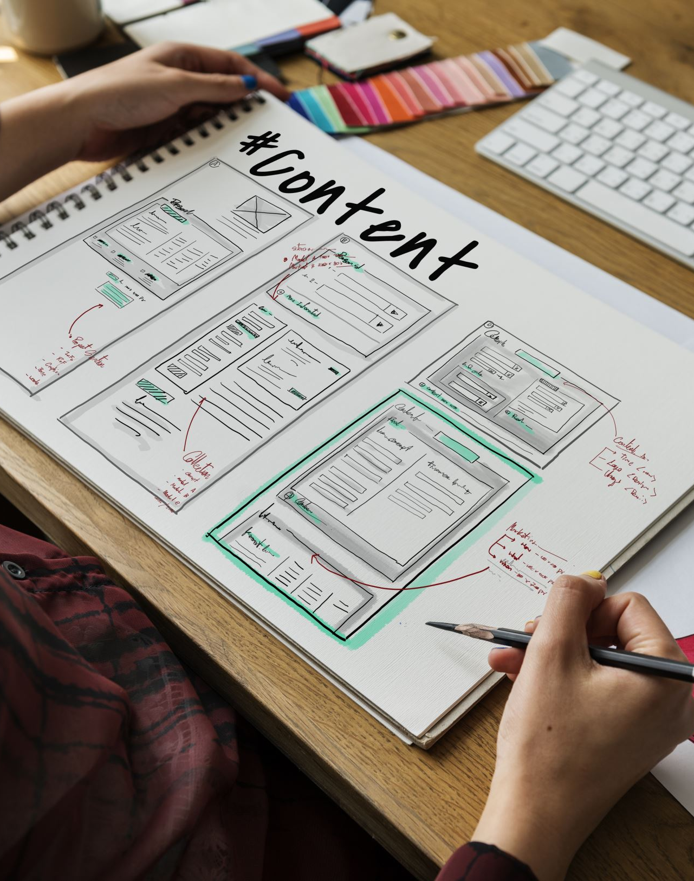
Wireframing
What is Wireframing? A low-fidelity sketch of a digital interface, focusing on layout and functionality.
Purpose: Helps in visualizing the structure and flow of a website or app before adding details.
Tools: Can be done on paper or using software like Sketch, Figma, Canva, or Balsamiq.
Notes:
Speaker Notes:
Wireframing is an essential step in the design of digital products.
It allows us to focus on the layout and structure without getting distracted by colors or fonts.
Wireframes act as a blueprint for the user interface, helping us ensure that the flow of information and navigation meets user needs before we dive into more detailed design work.
Reference:
Garrett, J. J. (2011). The elements of user experience: User-centered design for the web and beyond (2nd ed.). New Riders.

Slide 12
Prototyping for Services, Products, and Experiences
Service
Service Prototyping: Simulates service delivery, testing interactions and processes.
Product
Product Prototyping: Focuses on creating physical models to test usability and functionality.
Experience
Experience Prototyping: Combines elements to test the overall user journey.
Notes:
Speaker Notes:
Prototyping isn't just for physical products—it's equally important for services and experiences.
Service prototyping helps us understand and improve the delivery of a service by simulating the interactions between users and the service.
Product prototyping allows us to test the physical aspects of a design, ensuring it's functional and user-friendly.
Experience prototyping integrates various elements to simulate the entire user journey, helping us refine the overall experience.
Reference:
Blomkvist, J., Holmlid, S., & Segelström, F. (2010). Service prototyping according to service design practitioners. In Proceedings of the 2nd Service Design and Service Innovation Conference (pp. 1-11).

Slide 13
Activity Time - Prototyping
Develop low-fidelity prototypes
Test ideas quickly and gather feedback
Focus on key features and functionalities
Notes:
Speaker’s Notes:
Prototyping allows us to bring ideas to life quickly and test them in a tangible way.
These prototypes don’t have to be perfect—they should be simple representations that allow us to test key features and gather early feedback from stakeholders.
Reference:
Martin, R. L. (2009). The design of business: Why design thinking is the next competitive advantage. Harvard Business Press.

Slide 14
Storytelling in Prototyping
Why Storytelling Matters: Helps communicate the purpose and value of your prototype.
Techniques: Use narratives, personas, and scenarios to make the prototype relatable and understandable.
Impact: Engages stakeholders and users, making the prototype more memorable and impactful.
Notes:
Speaker Notes:
Storytelling is a powerful tool in prototyping. u
It helps communicate the purpose and potential impact of your design, making it more relatable to stakeholders and users.
By using narratives, personas, and scenarios, we can craft a story around our prototype that highlights its value and addresses user needs.
This approach not only makes our prototypes more engaging but also ensures they are understood and appreciated by everyone involved.
Reference:
Gothelf, J., & Seiden, J. (2013). Lean UX: Applying lean principles to improve user experience. O'Reilly Media.

Slide 15
Testing and Iteration
Test
Test prototypes in real-world settings
Collect
Collect data and feedback
Iterate and refine
Iterate and refine based on findings
Notes:
Speaker’s Notes:
Testing in real-world settings is crucial.
It’s about putting the prototype into the environment where it will actually be used, collecting data, and refining the solution based on what we learn.
Iteration is a continuous process of improvement.
Reference:
Ries, E. (2011). The lean startup: How today's entrepreneurs use continuous innovation to create radically successful businesses. Crown Business.

Slide 16
Gathering Feedback and Iterating
Importance of Feedback: Essential for refining prototypes and ensuring they meet user needs.
Methods: User testing, surveys, interviews, and observation.
Iterative Process: Use feedback to make improvements, test again, and repeat until the design is optimal.
Notes:
Speaker Notes:
Feedback is a crucial part of the prototyping process.
It allows us to understand how users interact with our prototypes and what needs to be improved.
Through methods like user testing, surveys, and interviews, we gather insights that guide our iterations.
Prototyping is inherently an iterative process—each round of feedback brings us closer to a final design that truly meets user needs.
Reference:
Nielsen, J. (1993). Usability engineering. Morgan Kaufmann.

Slide 17
From Prototype to Implementation
Final Refinements: Use insights from the final prototype to make necessary adjustments.
Planning: Develop a detailed plan for production or launch.
Execution: Move from the prototype stage to full implementation, ensuring quality and consistency.
Notes:
Speaker Notes:
Once we've iterated on our prototypes and gathered sufficient feedback, it's time to move towards implementation.
The final prototype should inform any last adjustments before we enter the production or launch phase.
At this stage, detailed planning is crucial to ensure that the transition from prototype to final product or service is smooth and successful.
Reference:
Curedale, R. (2016). Design thinking: Process and methods manual. Design Community College Inc.

Slide 18
Planning, Implementation, and Scale
Develop a detailed plan for scaling
Consider resources, partnerships, and sustainability
Plan for long-term maintenance and adaptation
Notes:
Speaker’s Notes:
Once a solution has been refined, it’s time to plan for implementation.
This involves thinking about how to scale the solution, what resources and partnerships will be needed, and how to ensure the solution is sustainable over the long term.
Reference:
Osterwalder, A., & Pigneur, Y. (2010). Business model generation: A handbook for visionaries, game changers, and challengers. Wiley.

Slide 19
Challenges in Designing for Public Health
Common Challenges:
Resource limitations
Cultural barriers
Strategies for Overcoming:
Collaboration
Adaptability
Leveraging technology
Notes:
Speaker’s Notes:
Designing for public health presents unique challenges, such as limited resources and cultural barriers.
To overcome these, we can focus on collaboration, adaptability, and the strategic use of technology.
These strategies help ensure that solutions are both effective and equitable.
Reference:
Bazzano, A. N., Martin, J., Hicks, E., Faughnan, M., & Murphy, L. (2017). The role of design thinking in health care innovation: The first step in human-centered design. JMIR Human Factors, 4(1), e12.

Slide 20
Notes:
Speaker’s Notes:
I hope this presentation has given you a comprehensive understanding of the prototyping process, from initial concepts to final implementation.
To conclude, we’ve walked through a structured design process that emphasizes empathy, inclusivity, and iteration.
These principles are critical in developing public health solutions that are innovative, effective, and sustainable.
I encourage you to apply these approaches in your work.

