Slide 1
Taking the Next Step:
Carnegie R1 Tier for Highest Research Activity
Jasbir Dhaliwal, PhD., EVP for Research & Innovation
Deborah Hernandez, Director – Research Development
December 5, 2018
Wilder Student Union
UofM Lambuth

Slide 2
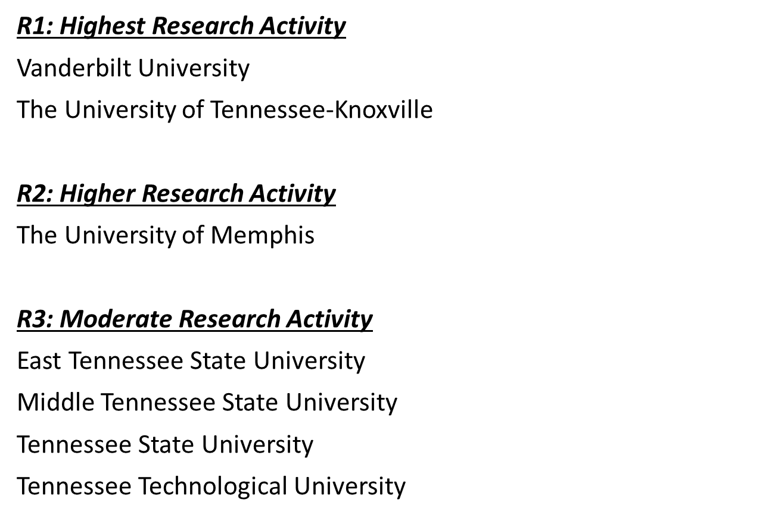
The Importance of Achieving Carnegie (R1) Highest Research Activity
Increase National and International Visibility
Attract Top Students/Faculty
Drive Innovation and Technology
Contribute to Economic Development
Strengthen Institutional Value and Pride
http://carnegieclassifications.iu.edu
Notes:
Notes:

Slide 3
Urgency of Achieving Carnegie (R1) Highest Research Activity
AAC: R1 Schools
University of Central Florida
University of Cincinnati
University of Connecticut
University of Houston
University of South Florida
Temple University
Tulane University
AAC: R2 Schools
East Carolina University
University of Memphis
Southern Methodist University
University of Tulsa
Wichita State University
SEC: R1 Schools
University of Florida
University of Georgia
University of Kentucky
University of Missouri
University of South Carolina
University of Tennessee
Vanderbilt University
University of Alabama
University of Arkansas
Auburn University
Louisiana State University
University of Mississippi
Mississippi State University
Texas A&M University
http://carnegieclassifications.iu.edu
Notes:
Notes:

Slide 4
Carnegie Classifications 2015 Update – Basic Classification: CRITERIA
PCA loadings based on rank-order data
Aggregate analysis (first principal component explained 70% of the total variance)
Doctorates: STEM | 0.914
Research Staff | 0.902
S&E R&D Expenditures | 0.900
Doctorates: Social Sciences | 0.873
Doctorates: Humanities | 0.819
Non-S&E R&D Expenditures | 0.791
Doctorates: Other Fields | 0.616
Per-capita analysis (first principal component explained 71% of the total variance)
Per-capita S&E R&D Expenditures | 0.931
Per-capita Research Staff | 0.928
Per-capita Non-S&E R&D Expenditures | 0.614
https://www.nsf.gov/statistics/srvyherd/surveys/srvyherd_2017.pdf
Notes:
Notes:

Slide 5
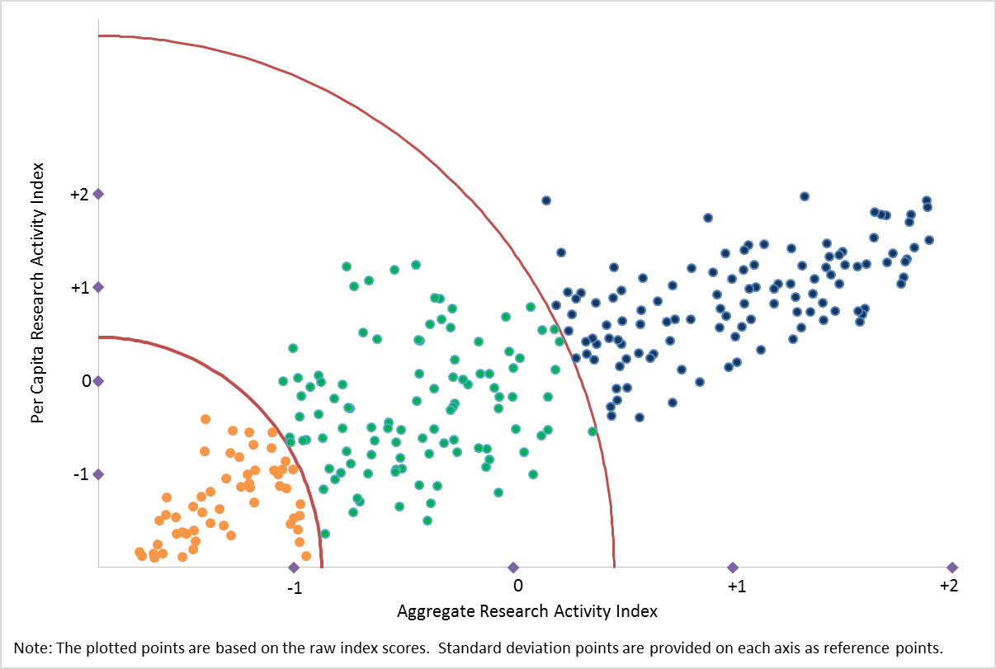
Carnegie Classifications 2015 Update – Basic Classification: Scatterplot
Research Activity Index Results Based on Rank-order Data
From Kosar & Scott, 2017 https://www.tandfonline.com/doi/full/10.1080/2330443X.2018.1442271.
http://carnegieclassifications.iu.edu
Legend:
Blue: R1: Doctoral Universities - Highest research activity
Green: R2: Doctoral Universities - Higher reserach activity
Orange: R3: Doctoral Universities - Moderate research activity
Notes:
-Points represent institutions.
-Units represent standard scores.
-X-axis represents aggregate research index; Y-axis represents the per capita research index.
-Doctoral Universities that are not included in the NSF data collections are not represented and all placed in the Moderate research activity group.
-To reduce the influence of outliers, they converted the raw data to rank scores. This had the effect of compressing differences at the high end of the distributions while increasing differences at the low end, where a large number of institutions were clustered.
Notes:
Notes:

Slide 6
Carnegie Classifications 2015 Update – Basic Classification: Median Values
44,351 (UofM)
11,215 (UofM)
25 (UofM)
http://carnegieclassifications.iu.edu
Notes:
Notes:

Slide 7
Carnegie Classifications 2015 Update – Basic Classification: Median Values
28 (UofM)
22 (UofM)
http://carnegieclassifications.iu.edu
Notes:
Notes:

Slide 8
Carnegie Classifications 2015 Update – Basic Classification: Median Values
32 (UofM)
47 (UofM)
http://carnegieclassifications.iu.edu
Notes:
Notes:

Slide 9
Carnegie Classifications 2015 Update – Basic Classification: Median Values
68.02 (UofM)
17.25 (UofM)
0.038 (UofM)
http://carnegieclassifications.iu.edu
Notes:
Notes:

Slide 10
Comparison to Peer: 2014
2014 | S&E R&D Expenditures | Non-S&E R&D Expenditures | S&E Research Staff | Doctorates: Humanities | Doctorates: Social Sciences | Doctorates: STEM | Doctorates: Other Fields
U of Memphis | 44,351 | 11,215 | 25 | 23 | 28 | 28 | 45
U North Texas | 39,453 | 12,792 | 47 | 13 | 42 | 77 | 72
Notes:
Notes:

Slide 11
Becoming a TOP TIER RESEARCH SCHOOL
Strategic Goals
Expand annual external research funding from $36M to $55M
Increase annual doctoral degree production from 136 to 200
Develop a Tier 1 research culture and profile for sustainability
Notes:
Notes:

Slide 12
Strategic Initiatives 2019-2024
Invest and hire in strategic growth clusters most suited to our research expertise/needs
Increase the amount of research expenditure per faculty member
Increase the number of research-active faculty members
Increase the number of research principal investigators
Increase the efficiency of research space utilization (expenditure per square foot), the quality of existing research space, and the total amount of research space available
Hire more research staff with doctoral degrees – (UofM Post-Doc Program)
Increase STEM doctoral programs and students – increase STEM PhD conferrals by helping them succeed
Improve grants and contracts business practices to provide improved “customer service” to better support faculty members in grant preparation and submission
Encourage greater graduate student funding in grant submissions
Notes:
Notes:

Slide 13
Strategic Initiatives 2019-2024
Energize the U of M Research Foundation to build up a research investment fund
Increase philanthropic funding for endowed professorships, graduate student fellowships, research equipment, and scholarly activities
Boost foundation and industrial relationships as a diversification source of research funding – larger scale requiring co-investigator and multi-disciplinary teams
Increase patent production, technology commercialization, and economic development
Support Honors College to boost undergraduate research and pathways to graduate studies
Develop new Ph.D. programs, refocus and rebrand existing ones, and create concentrations within existing ones to be more nimble in addressing market needs
Form a UofM Research Council for mass mobilization to change research culture
Update research policies to reflect latest best practices
Notes:
Notes:

Slide 14
Carnegie Classifications ® 2018 Update
Basic Classification
In the 2018 update, the Doctoral Universities have been reshaped to better accommodate “Doctor's degree – professional practice”
Doctoral Universities include institutions that awarded at least 20 research/scholarship doctoral degrees during the update year and also institutions with below 20 research/scholarship doctoral degrees that awarded at least 30 professional practice doctoral degrees in at least 2 programs. Excludes Special Focus Institutions and Tribal Colleges.
The first two categories listed below include only institutions that awarded at least 20 research/scholarship doctoral degrees and had at least $5 million in total research expenditures (as reported through the National Science Foundation’s Higher Education Research & Development Survey (HERD)).
R1: Doctoral Universities – Very high research activity
R2: Doctoral Universities – High research activity
D/PU: Doctoral/Professional Universities
Notes:
Notes:

Slide 15
Pertinent Links
https://www.insidehighered.com/news/2018/12/19/professional-practice-doctoral-category-expands-carnegie-system?fbclid=IwAR31ysgSPmW0DEd_o9Qr3khV8PWYzqxIIf1l6-7Wws3ryMUQ_vqJfpKlf7c#.XBpUnbDt2Nk.facebook
http://ocm.auburn.edu/newsroom/news_articles/2018/12/171722-r1-carnegie-classification.php
https://thenevadaindependent.com/article/unlv-achieves-its-goal-of-tier-1-research-university-status-several-years-ahead-of-schedule
http://www.montana.edu/news/18318/msu-receives-very-high-research-activity-designation-in-carnegie-classification
https://www.ua.edu/news/2018/12/carnegie-lists-ua-among-elite-research-institutions/
https://www.unr.edu/Documents/president/econ-impact/unr-economic-impact.pdf

