Slide 1


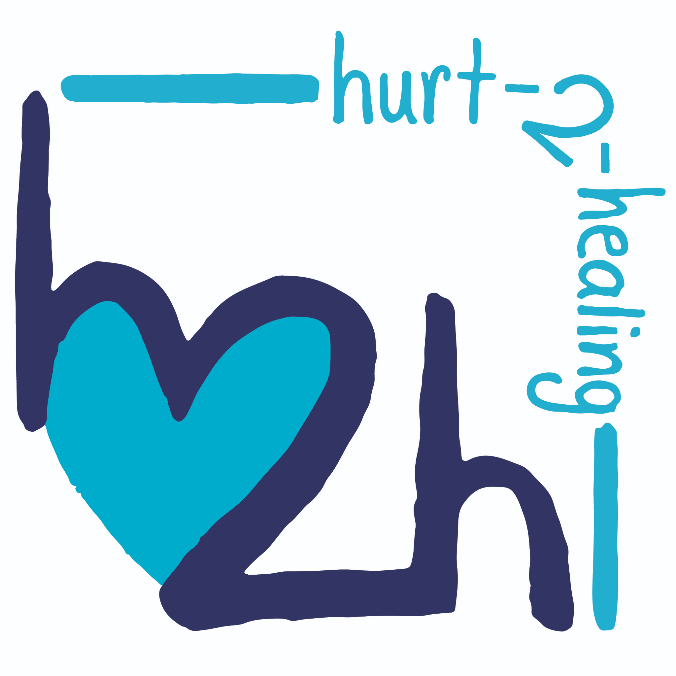
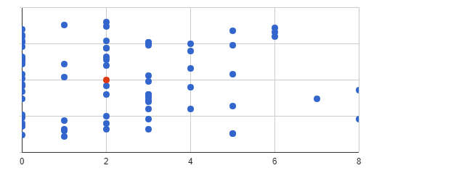











Examining the Incidence of Acute Stress Disorder of Non-Fatal Firearm
Injuries in Pediatric Populations
Sydnie Allen, MS; Eraina Schauss, PhD.
The BRAIN Center, Department of Counseling, Educational Psychology, and Research, The University of Memphis
Introduction
Purpose:
Examine the incidence of Acute Stress Disorder amongst pediatric patients with non-fatal firearm injuries at the sole level-1 trauma center in the midsouth immediately following the incident
Method:
Hurt-2-Healing Program
Universal screening of all trauma patients utilizing the Child Stress Disorder Checklist-Short Form (CSDC-SF)
Ages 2-18
4 items:
-Somatic Symptoms
-Hypervigilance
-Avoidance
-Feelings of the event
Scores of <1 are positive for ASD and have the potential to develop post traumatic stress disorder
Psychoeducation:
Every patient will receive interpretation and information on their CSDC-SF scores
Psychoeducation handout
Interventions:
-Play Therapy
-Grief and Loss
-IPSRT
-Mindfulness Based Stress Reduction
-Unlimited free counseling sessions for the patient and their family
  Procedure and Materials
  Results
•Since 1963 almost 200,000 children have lost their lives due to gun violence.
•On average 1300 deaths and 5790 non-fatal injuries
•Boys comprise 82% of fatal gunshot wounds; 4.5x higher than girls.
•African American boys are seventeen times more likely to die or be injured than their white counterparts
Indirect exposure and direct exposure can lead to:
-Anger
-Becoming Withdrawn
-Desentization to Violence
-Develop PTSD
-Decreased Physical Wellness
Poly- Victimization
Immediate behavioral health interventions reduce post traumatic stress reactions and depressive symptoms yet there is a massive deficit in mental health services available immediately following the firearm injury
68% scored a <1 on the CSDC-SF
Mean Score: 2.21
Standard Deviation: 2.12
51 out of the 75 participants qualify for ASD and have the potential to develop PTSD.
Conclusions and Implications
  Participants
Pediatric patients are experiencing emotional distress immediately following their firearm injury.
African American boys are disproportionally impacted by gun violence and are more likely to not receive mental health assistance- meaning this may be an extremely vital access point for underserved minority children.
Integrated care is essential to providing accessible mental health services to underserved populations and minimizing the negative long-term impacts of trauma.
Participants
75 patients at the Sole Level 1 Trauma Center in the Midsouth
Age: 2-17 (M = 12.15)
90% of patients on Medicaid
  References
¹ Bosquet Enlow, M., Kassam-Adams, N., & Saxe, G. (2010). The child stress disorders checklist-short form: A four-item scale of traumatic stress symptoms in children. General Hospital Psychiatry, 32(3), 321–327. https://doi.org/10.1016/j.genhosppsych.2010.01.009
Children's Defense Fund. (2021, March 26). Since 1963, nearly 193,000 children and teens have been killed with guns on American soil. Children's Defense Fund. Retrieved October 18, 2021, from https://www.childrensdefense.org/glossary/since-1963-nearly-193000-children-and-teens-have-been-killed-with-guns-on-american-soil/.
DHHS,MentalHealth:AReportoftheSurgeonGeneral(Rockville,Md.:DHHS,1999);andDHHS,MentalHealth: Culture, Race, and Ethnicity.
Finkelhor, D., Ormrod, R., Turner, H., & Hamby, S. L. (2005). The victimization of children and youth: A comprehensive, national survey. Child Maltreatment, 10(1), 5–25. https://doi.org/10.1177/1077559504271287
Fowler, K. A., Dahlberg, L. L., Haileyesus, T., Gutierrez, C., & Bacon, S. (2017). Childhood firearm injuries in the United States. Pediatrics, 140(1). https://doi.org/10.1542/peds.2016-3486
Garbarino, J., Bradshaw, C. P., & Vorrasi, J. A. (2002). Mitigating the effects of gun violence on children and Youth. The Future of Children, 12(2), 72. https://doi.org/10.2307/1602739
Mitchell, K. J., Jones, L. M., Turner, H. A., Beseler, C. L., Hamby, S., & Wade, R. (2019). Understanding the impact of seeing gun violence and hearing gunshots in public places: Findings from the Youth Firearm Risk and safety study. Journal of Interpersonal Violence, 36(17-18), 8835–8851. https://doi.org/10.1177/0886260519853393
R.C. Kessler et al., “Comorbidity of DSM-III-R Major Depressive Disorder in the General Population: Re- sults from the U.S. National Comorbidity Survey,” British Journal of Psychiatry Supplement 30 (1996): 17–30; L.K. Sussman, L.N. Robins, and F. Earls, “Treatment-Seeking for Depression by Black and White Ameri- cans,” Social Science and Medicine 24, no. 3 (1987): 187–196; and A.Y. Zhang, L.R. Snowden, and S. Sue, “Differ- ences between Asian and White Americans’ Help Seeking and Utilization Patterns in the Los Angeles Area,” Journal of Community Psychology 26, no. 4 (1998): 317–326.
R.C. Kessler et al., “Prevalence and Treatment of Mental Disorders, 1990 to 2003,” New England Journal of Medicine 352, no. 24 (2005): 2515–2523.
Rothbaum, B. O., Kearns, M. C., Price, M., Malcoun, E., Davis, M., Ressler, K. J., Lang, D., & Houry, D. (2012). Early intervention may prevent the development of posttraumatic stress disorder: A randomized pilot civilian study with modified prolonged exposure. Biological Psychiatry, 72(11), 957–963. https://doi.org/10.1016/j.biopsych.2012.06.002
Turner, H. A., Mitchell, K. J., Jones, L. M., Hamby, S., Wade, R., & Beseler, C. L. (2019). Gun violence exposure and posttraumatic symptoms among children and Youth. Journal of Traumatic Stress, 32(6), 881–889. https://doi.org/10.1002/jts.22466
Correspondence: Sydnie Allen, Srrberts@memphis.edu
Notes:
Correlates negatively with right-wing authoritarianism and social dominance orientation and positively with global identity.
Correlates weakly to the personality traits agreeableness, intellect, extraversion, and conscientiousness.

