Slide 1
Brent Morgan
Research Scientist
Institute for Intelligent Systems
brent.morgan.phd@gmail.com

Slide 2
ElectronixTutor
Multiple resources, so how to track learning?
Learning Record Store
  Knowledge component scores on various items
  What items/topics a user has completed
  Topic ordering
  Links visited
  Reading times, etc.
How to present learning resources?
  Recommender System

Slide 3
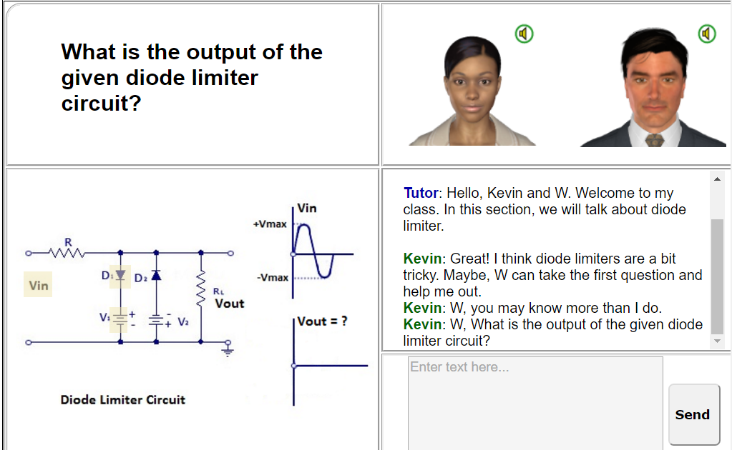
StatisticsTutor
Three components:
  Virtual classroom
  Mobile Fact and Concept Training System
  AutoTutor

Slide 4
Emotions
Math Anxiety
Affect, Cognition, & Exercise (ACE)
  Bike desks
Affect, Cognition, & Athletic Performance (ACAP)
Affect & Decision-Making
  NeuroEconomics

Slide 5
Thank You!
brent.morgan.phd@gmail.com

