Slide 1
Show Interest and They Will Interview Themselves For You
Can Spam Be Useful?
User-Defined Spam as Electronic Discourse
Dr. Ambartsoumian’s Presentation at
Research and Networking Breakfast with a conversation topic on “Data Storage”
Apr 24, 2019 FedEx Institute of Technology

Slide 2
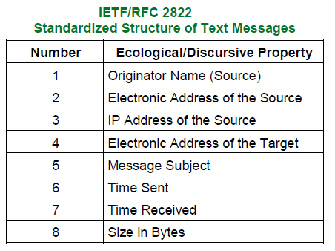
E-Mail as the Most Prevalent Database Type and a Perfect Data Collection and Management Tool
High validity of data in collected messages - verifiable sources and destinations, which are also time-stamped and automatically and manually tagged with meta-data according to IETF standards
All my data include the appropriate addresses and more than half of the messages (over 50,000 by now) mention senders’ names
Textual data are linguistic data and can be analyzed according to the existing linguistic theories
Benefits: leads to clean lexicons, curated taxonomies, perfect for Design Science Research and NLP
Issues:
  Conversion to the .csv format KILLED ALL THE TIMESTAMPS!
  NLP as a field is extremely disorganized
  Too many people do silly things with text these days

Slide 3
Microsoft’s Extensible Storage Engine
Extensible Storage Engine (ESE), also known as JET Blue, is an ISAM (indexed sequential access method) data storage technology from Microsoft.
ESE is the core of Microsoft Exchange Server, Active Directory, and Windows Search.
It's also used by a number of Windows components including Windows Update client and Help and Support Center.
Its purpose is to allow applications to store and retrieve data via indexed and sequential access.
An ESE database looks like a single file to Windows
Internally the database is a collection of 2, 4, 8, 16, or 32 KB pages, arranged in a balanced B-tree structure.

Slide 4
Oracle’s InnoDB Storage Engine
InnoDB is a storage engine for the database management system MySQL.
MySQL 5.5, December 2010, and later use it by default replacing MyISAM.
It provides the standard ACID-compliant transaction features, along with foreign key support (Declarative Referential Integrity).
Full text search indexes, since MySQL 5.6 (February 2013)
and MariaDB 10.0
Spatial operations, following the OpenGIS standard
Virtual columns, only in MariaDB

Slide 5
Show Interest and They Will Interview Themselves For You
Professional advertisement as an agenda-setting (Baran, 2014) communication – a self-forming stream of operants aimed at professional discourse communities (Porter, 1991)
Theoretically defined by three main influencers:
  Skinner’s Operant Conditioning (1957) – professional shaming as punishments and a chance to condescend as a reward
  Foucault’s (1991) episteme (every type of knowledge has its own discourse), plus power relationships – advertisers are too big to ignore
  Glaser (1978), Glaser and Strauss’ (1967) “voices begging to be heard” (or demanding to be collected in my case)
Definitely structured by multiple electronic communication protocols for decades (e.g. RFC 822, "Standard for the Format of ARPA Internet Text Messages“ dating from the mid-1970s) but mistakenly labeled “unstructured” by the SQL programmers
Minimizes researcher’s bias

Slide 6
Result: a Reliable Data Supply Chain with a Theoretically Defined Research Boundary and Protocol Defined Data Structure and Storage
Addressable outbound electronic discourse seeks recipients, minimizes researcher’s bias in data collection, is designed for standardized data storage
Minimizes Garbage-In:
  Stored in packets while in transit in the channel (Shannon, 1948)
  Assembled at destination with TCP-assured reliability (acknowledgment and retransmission)
  With email fetching protocols like POP3 and IMAP, messages are identified, and referenced by a unique ID (UID)
E-mail is not structured for building relational tables, but is structured and densely tagged for linguistic analysis (e.g. application of lexical codes)
Structured metadata provides sender-defined categories (makes category induction less biased) and allows for automatic market analysis by showing the sender name and domain

Slide 7
References
Baran, S. (2014) "Introduction to Mass Communication: Media Literacy and Culture" McGraw-Hill Education; 8th edition.
Bennett, S. “31 Days Before Your CCENT Certification”. Pearson Education (USA). Kindle Edition.
Glaser, B. G. and Strauss, A. L. (1967). “The discovery of grounded theory: Strategies for qualitative research”.
Porter, J.E. (1991). “Audience and Rhetoric: An Archaeological Composition of the Discourse Community”. Pearson.
Rabinow, P. (ed) (1991) “The Foulcault Reader: An introduction to Foulcault’s thought”, London, Penguin.
Shannon, C. (1948). "A Mathematical Theory of Communication". Bell System Technical Journal. 27 (July and October)
Skinner, B. F. (1957). "Verbal Behavior." Acton, MA: Copley Publishing Group.
Wood, D. (2009). “Programming Internet Email: Mastering Internet Messaging Systems”. Kindle Edition. O'Reilly Media; 1st edition (August 1, 1999)

