Slide 1
Big data for Global Change Ecology (Biogeography)
Digital Environmental Map from remote sensing (active / passive) DataOne.org
Continental-scale: Satellite maps (NASA MODIS) 500m to 1 km pixel resolution
Regional-scale: Landsat OLI (30m)
Local-scale: LiDAR (3 feet)
Species occurrence data
The Global Biodiversity Information Facility (GBIF): https://www.gbif.org/
- the largest and most widely known source of species records (Costello et al., 2013)
Plant community data
VegBank/ EVA (European Vegetation Archive)
Forest Inventory and Analysis (FIA database)
- Oracle DB

Slide 2
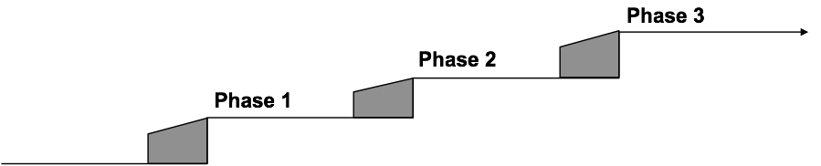



Forest Inventory and Analysis (FIA)
Sampling procedures:
Forest health
One plot per 96,000 acres (Every 16th phase 2 plot)
Ground plot
One plot per 6,000 acres
Remote sensing
Stratification
Plot design:

Slide 3
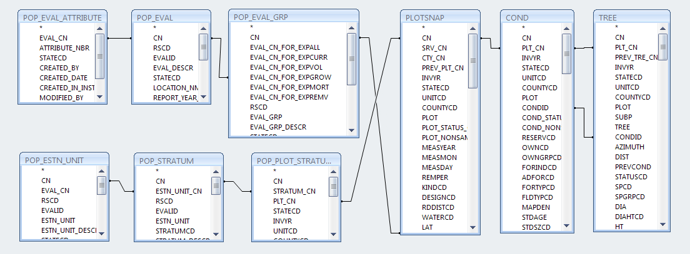

Slide 4
Species Richness from FIA
1. Tally trees are from the four sub-plots:
(i.e. all live trees with stems ≥12.7 cm in diameter measured at 1.4 m above ground).
2. All grids (50 km by 50 km) containing greater than 10 FIA plots were included to estimate species richness
3. For each grid, logarithmic functions developed between total number of species and number of plots
4. Then the estimates of species richness were standardized for one hectare (area equivalent to 17 FIA plots) based on the cell-specific slope and intercept of the logarithmic function.

