Slide 3
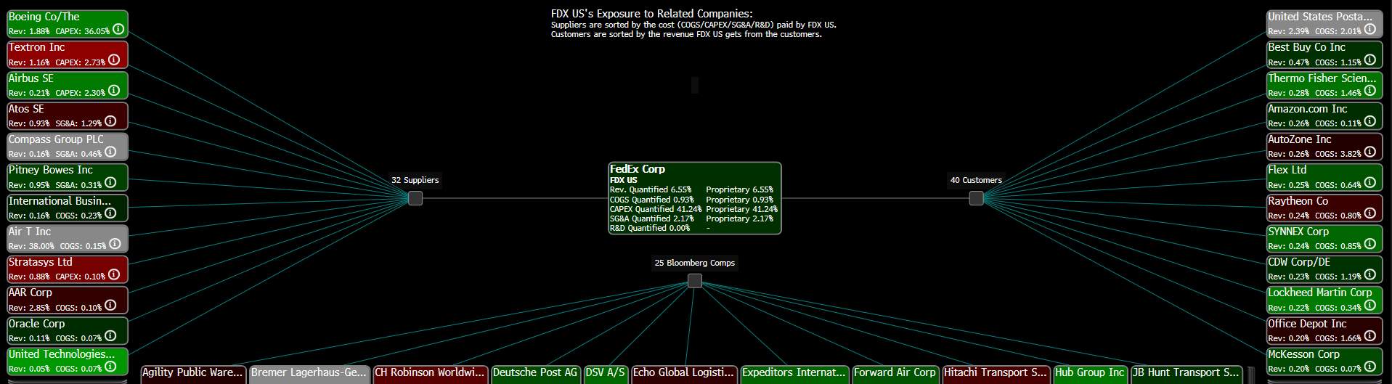
FEDEX Supply Chain Analysis using Bloomberg:

Slide 4
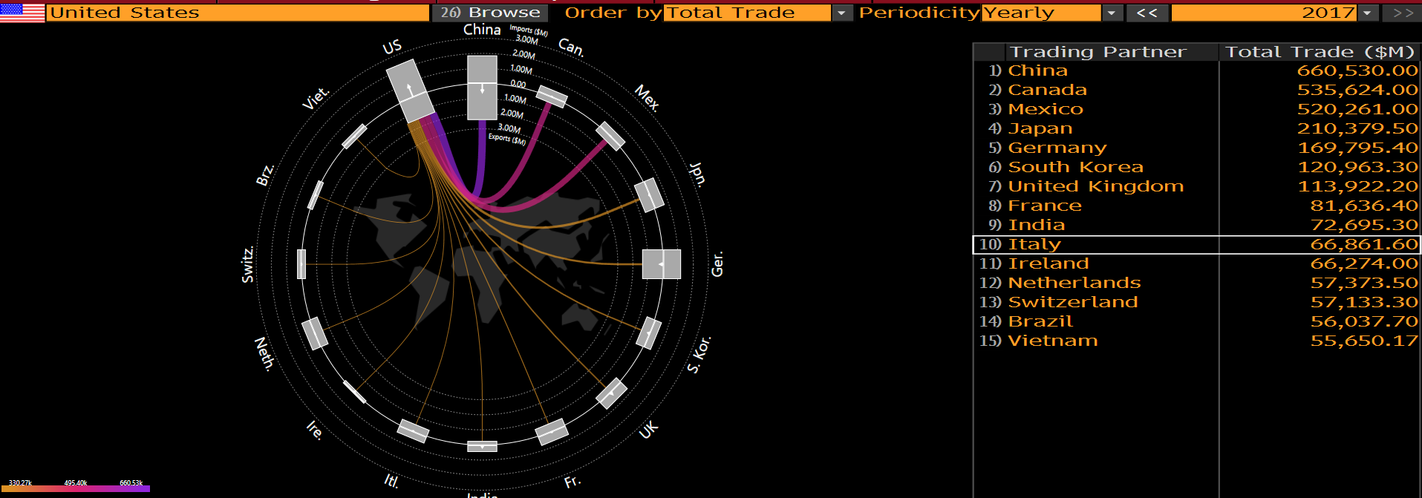
US Trade Flow using Bloomberg:

