Slide 1






sharing, analysis and collaboration across a wide variety of educational data

Slide 2
LearnSphere
NSF Database Infrastructure Building Blocks program
$5.3 million over 5 years, NSF funded
Provide tools for storage, sharing, and collaboration (integrated with DataShop)
Develop a GUI based analysis tool (Tigris) for workflow design, analysis, and sharing
Flexible tool to share analysis methods across projects
Improve replicability and speed development

Slide 3
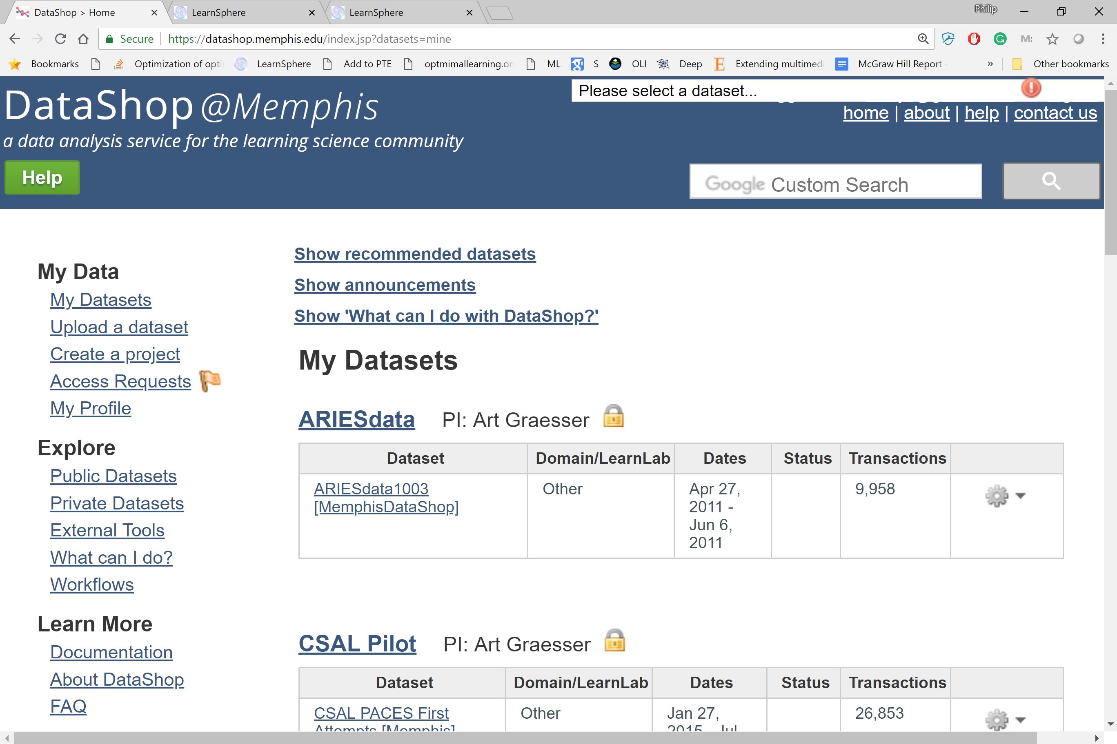
https://datashop.memphis.edu

