Slide 1
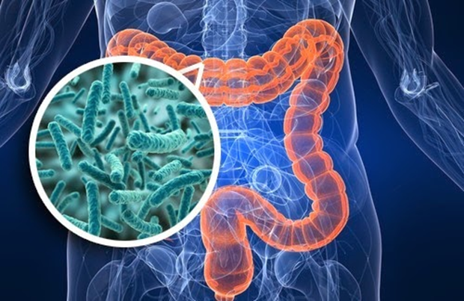
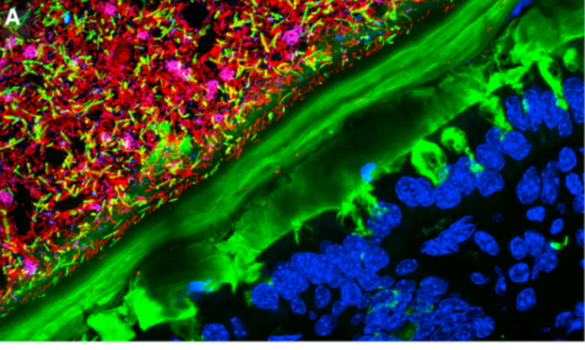
Gut Microbiome
Sequencing technology
10 trillion human cells vs 100 trillion microbial cells
20 000 human genes vs 2-20 million microbial genes
Each person has a unique microbiome
Responds rapidly to changes in environment (diet) vs stable host genetic make up
Diet is a main determinant of gut microbial composition.
Studies
Effect of nutraceuticals on gut health and microbiome composition.
Dietary intervention using preclinical models to determine effect on gut microbiome.
Tropini C et al. Cell Host Microbe, 2017

Slide 2
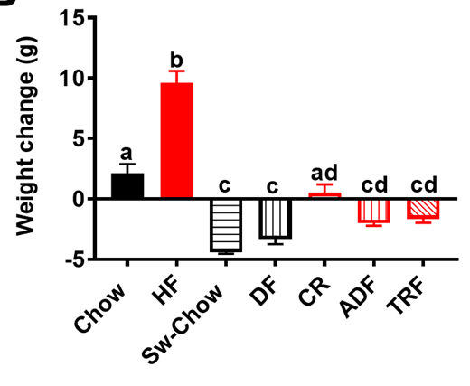
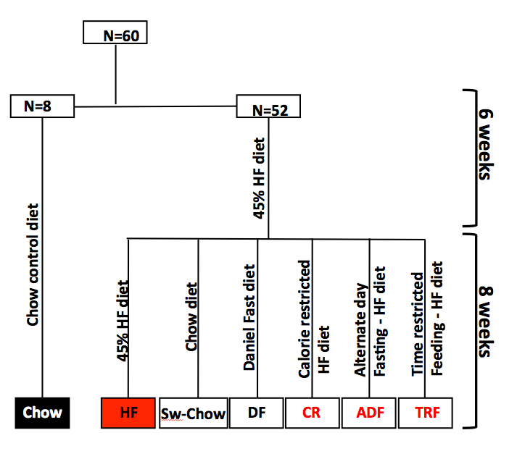
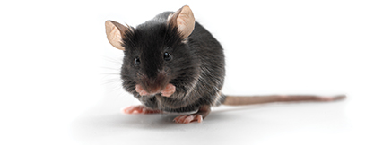
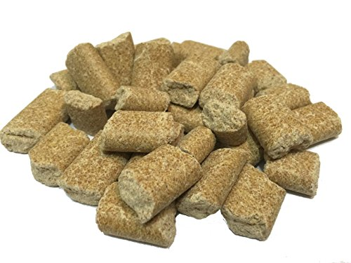
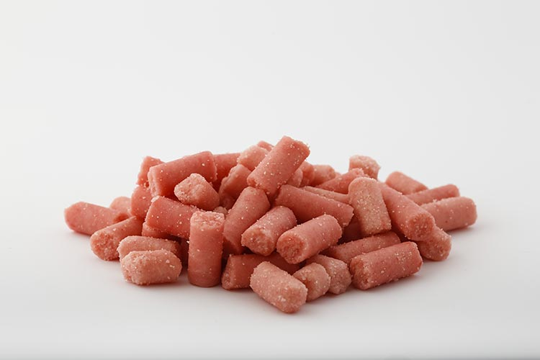
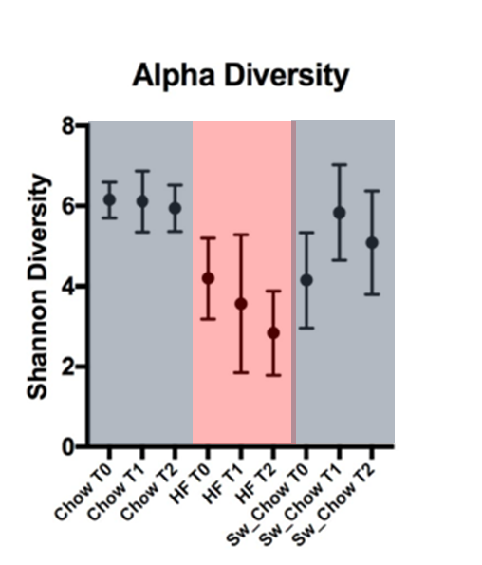
Diet Composition vs Timed Feeding on a High Fat Diet

Slide 3
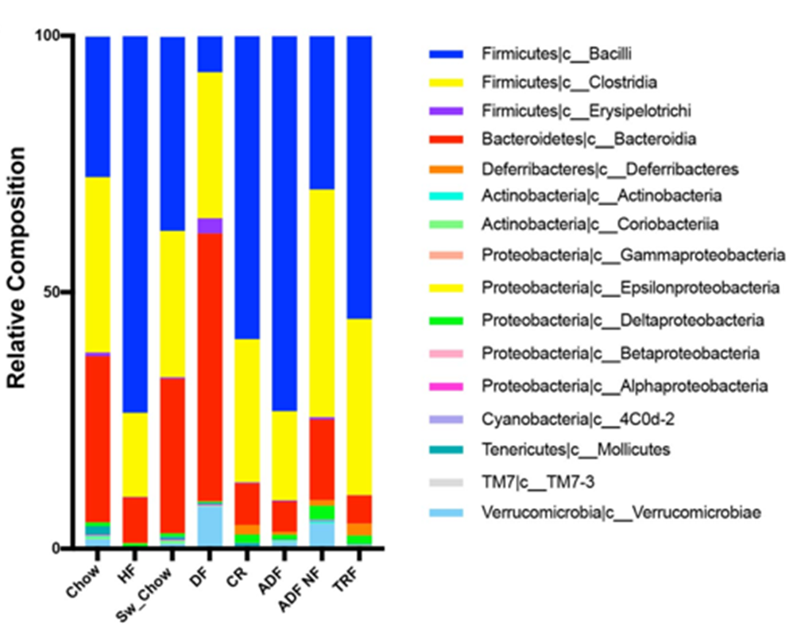
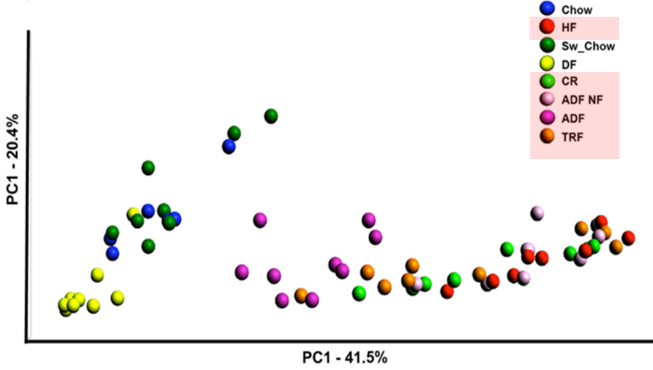
Changes in microbial populations induced by diet or timed feeding protocols.

