Slide 1
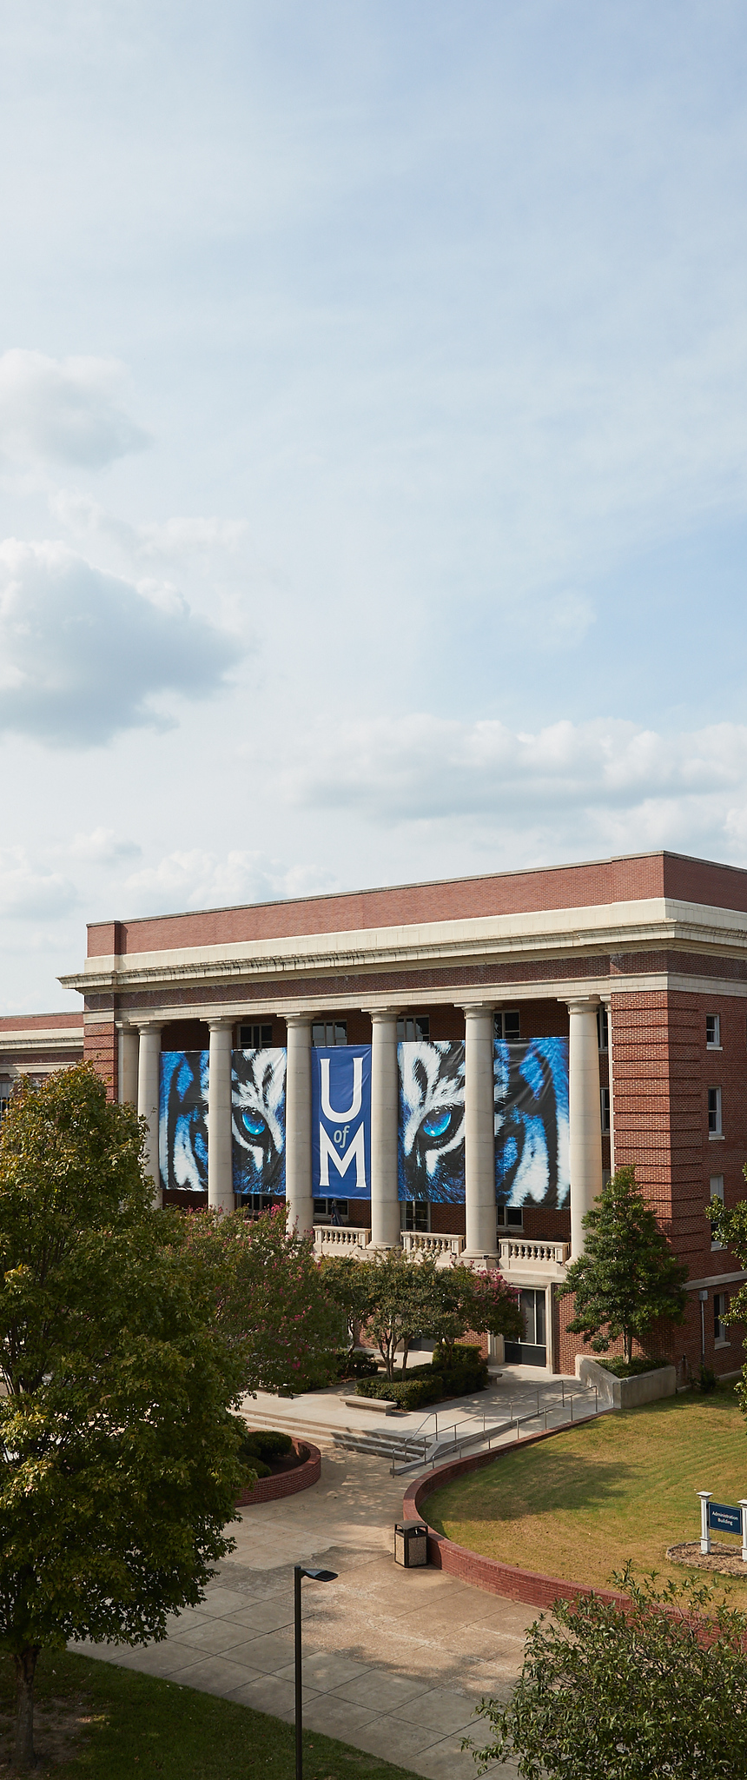
PostDoc Acceleration and Career Escalation
PACE Workshop #1
1/15/20
*Based on “Grantsmanship for Research Professional” by Dr. Faulk-Krzesinksi, 2019 (Creative Commons BY-NC-ND 4.0)

Slide 2
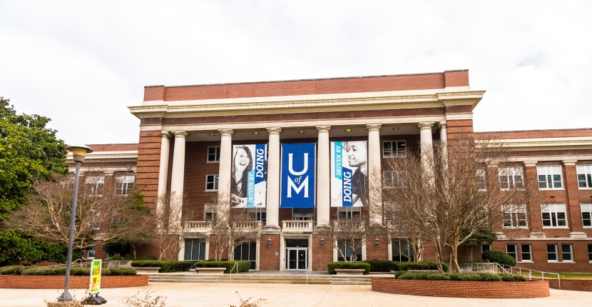

Overview and Introductions
Cody Behles
901-734-0008 (c)
901-678-2648 (o)
cbehles@Memphis.edu
Teresa Franklin
(901) 678-4911
teresa.franklin@memphis.edu
Office of Sponsored Programs
osp@memphis.edu
Admin building 3rd floor
Room 315

Slide 3
The Nightmare Before Funding
Grantsmanship is not a
process by which bad
ideas get transformed
into good ones; rather,
it is more often the case
of a good idea disguised
as a bad one

Slide 4
Demystify the Process
…the skills associated with the grant
application and award
processes…these skills are learned,
sometimes through trial and error
experiences, but can be taught to
those who are open to the advice of
their experienced colleagues.

Slide 5
What To Expect
By the end of the PACE Program you will:
Have submitted at least one external funding application
Know how to find funding opportunities
Be able to read solicitations and write to their requirements
Understand the review process and how to write for reviewers
Understand the compliance process and your role in it
Know how budgets work, and how to fill one out
Manage an award once you receive it

Slide 6
PACE Workshop Series
Finding Funding: Crash Course January 21st @ 3:00
Finding Funding: Workshop January 24th @ 3:00 (1 hour)
Proposal Building: Proposal Arch. January 27th @ 3:00
Understanding the Review Process January 31st @12:00
Biosketch Peer Review & SciENcv February 3rd @ 3:00
Compliance Overview February 6th @ 12:00
Narrative Writing Workshop February 10th @ 3:00 (1 hour)
Statistics Technique Review February 12th @ 12:00 (90 minutes)
Budget & Finance Overview + Cayuse February 14th @ 2:00
Formatting and Citation February 19th @ 2:00 (90 minutes)
Navigating SBIR and STTR February 21st @ 3:30
Workshop: Peer Review Session February 27th @ 3:00
Post Award Management March 16th @ 3:00
Lightning Talks & Networking/Graduation March 19th @ 12:00

Slide 7
Writing Differences

Slide 8
Reasons to Write a Proposal
$$$
Independent
Self‐supporting
Innovative
Leadership
Tenure/Job advancement
Establish formal collaboration/partnership

Slide 9
Getting Started
Print Resources:
How to Write and Publish a Scientific Paper, 7th ed (inexpensive)
The Grant Application Writer’s Workbook (reasonable)
NIH R01/NSF Grant Application Mentor: An Educational How‐to Manual (expensive)
Grant Forward Account Setup (grantforward.com)
Cayuse Account Setup (link to page with info)
Quick Website Overview

Slide 10

Questions?
PERSON TITLE
Email Phone

