Slide 1

\
Getting Started with Sponsored Activity
Loewenberg College of Nursing Faculty
September 2018

Slide 2
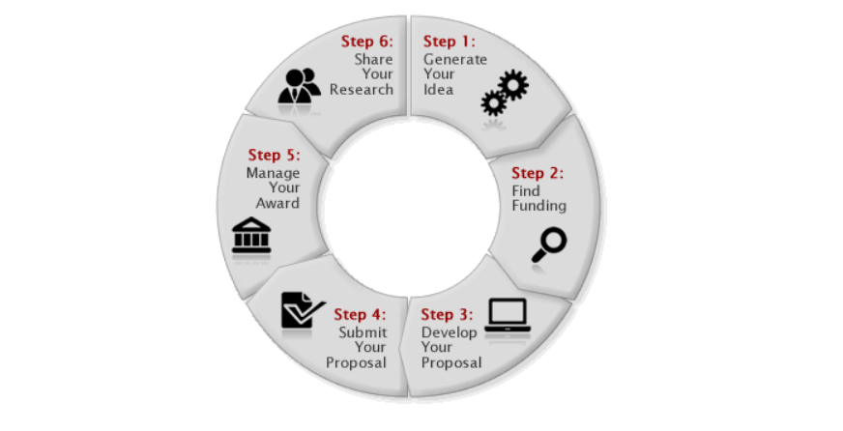
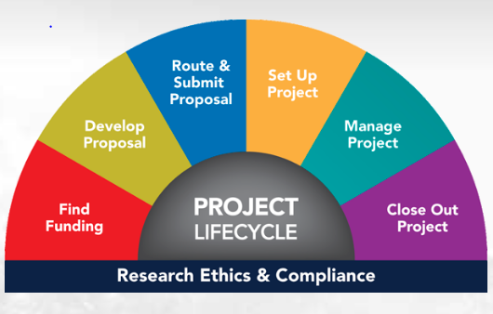
Life Cycle of a Sponsored Project
Notes:
University of Utah:
Generate your idea:
Develop a preliminary idea
Assess your idea’s potential for success
Seek input and feedback
Find Funding:
Find Sources
Search Solicitations/Funding Announcements
Develop Your Proposal:
Review the Solicitation
Understand PI Eligibility
Communicate Early
Find Development Tools
Learn Standard Proposal components
Build your budget
Obtain Sub documentation
Coordinate Compliance Components
Submit Your Proposal:
Obtain approvals
Understand submission process
Check for completeness, accuracy and formatting
Electronic submission and registration
Resubmit your proposal
Manage Your Award:
Read and Understand Sponsor guidelines
Manage
Manage your budget
Report
Closeout
Share Your Research:
Collecting and Analyzing data
Authoring and Journal selection
Publishing and Peer review
Archiving and Preservation
Citation and Metrics
University of Michigan:
Find Funding
Databases
Inperson Consultations
Develop Proposal
Work with your department administrator to get started.
Thoroughly read the guidelines and funding announcements.
Defer discussions of indirect costs to OSP. Utilize OSP for negotiation and review of agreements.
Leverage our signing authority ability on behalf of the University
Route and Submit Proposal
Create a Proposal Record in Cayuse.
When complete and correct, route to OSP well in advance of the sponsor deadline for the most thorough review
Set Up Project
After your proposal is awarded (or in preparation for an anticipated award) you may request an advance account, set up in advance to allow funds to be expended prior to having an award in hand), complete all compliance requirements, or request a budget reallocation.
Manage a Project
Managing a Project successfully means adhering to your reporting milestones, steadily spending your budget, monitoring subcontractors, hiring students, or managing the absence of a project team member.
Close Out Project
finalize technical reports and financial status reports (FSRs); document discoveries, patents, inventions; carefully manage purchase at end of budget; transfer equipment.
Ethics and Compliance
IRB
FCOI
IACUC

Slide 3
Drafting a Pre-Abstract
Purpose of Pre-Abstract: practice writing in the style of a grant application rather than for academic papers.
What are you passionate about?
What is the need, problem, or issue you want to address, and why is it important?
If present knowledge is inadequate, why do we need to know more and do better?
Notes:
One to three paragraphs (one to two pages)

Slide 4
Drafting a Pre-Abstract
In what sense is your idea innovative, i.e. how does it differ from what has already been done?
What makes you think your idea or approach will have better outcomes?
What will your research contribute and who will benefit from it?

Slide 5
Putting your Pre-Abstract to Use
Obtain feedback
Share your Pre-Abstract with colleagues, asking for critique
Revise and repeat as necessary
Use the Pre-Abstract to guide discussions with program officers
“How does this research idea fit what the grant program wants to fund?”
Launch your proposal.

Slide 6
Future Workshops in this Series
Basics of Compliance and IRB
Beverly Jacobik, Sr Assoc Director, Research Compliance
October 17, 2018, 12:30-1:30 pm (CHB 2501)
Proposal Basics
Mary Earheart-Brown
November 14, 2018, 12:30-1:30 pm (CHB 4006)

Slide 7
References
Grant Life Cycle, University of Utah. https://osp.utah.edu/grant-life-cycle/
Project Life Cycle, University of Michigan. https://orsp.umich.edu/sites/default/files/resource-download/1-orsp-research-project-lifecycle-flyer.pdf
Porter, Robert, Six Critical Questions to Launch a Successful Grant Proposal. The NCURA Magazine, May/June 2015. pp 49-51.

Slide 8

Questions?

