Slide 1

STEP BY STEP GUIDE
How to close out your funding award
SOF Purchase and Funding Request in TigerZone
You have 14 calendar days after your event. Late documentation is denied.
2026-2027 | University of Memphis | Student Government Association

Slide 2
KNOW WHICH ONE YOU ARE IN
Two processes, one system
Every award runs through two separate requests in TigerZone. You have already done the first. This guide covers the second.
BEFORE YOUR EVENT
AFTER YOUR EVENT
SOF Programming Request
SOF Purchase and Funding Request
You ask for funding
You estimate expenses
The Finance Committee decides
Deadline is 14 or 30 days before the event, by tier
You report what actually happened
You enter actual expenses and attach receipts
Staff verify against what was approved
Deadline is 14 calendar days after the event, and it is firm
Both requests start at the same place in TigerZone. The process you select at step 4 is what makes them different.
TigerZone Reconcile Guide | SOF Purchase and Funding Request | 2026-2027
2

Slide 3
HAVE THESE READY
Before you start
Your Approved Budget Request Number
Your receipts
Your event documentation
The request number from your approved SOF Programming Request. It is the first field you will be asked for.
An itemized receipt or invoice for every expense. A direct vendor payment needs an itemized invoice, not a receipt. Each line accepts one file up to 10 MB.
Your event advertisement or meeting agenda, and the food forms if food was purchased.
Everything uploads inside the request. Do not email your documentation. A receipt that is not itemized will be returned.
Questions at any point: sgafundingrequest@memphis.edu
TigerZone Reconcile Guide | SOF Purchase and Funding Request | 2026-2027
3

Slide 4
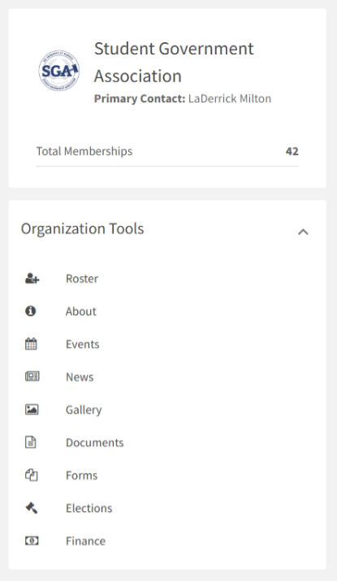
1
Start in your organization
Getting to Finance
From your organization's page, open the tools menu and select Finance under Organization Tools.
This is the same starting point you used to request the funding.
If you do not see Finance, you may not have officer level access. Ask your president to add you.
Steps 1 through 3 are identical to the request you already submitted. Only the process you pick at step 4 changes.
TigerZone Reconcile Guide | SOF Purchase and Funding Request | 2026-2027
4

Slide 5
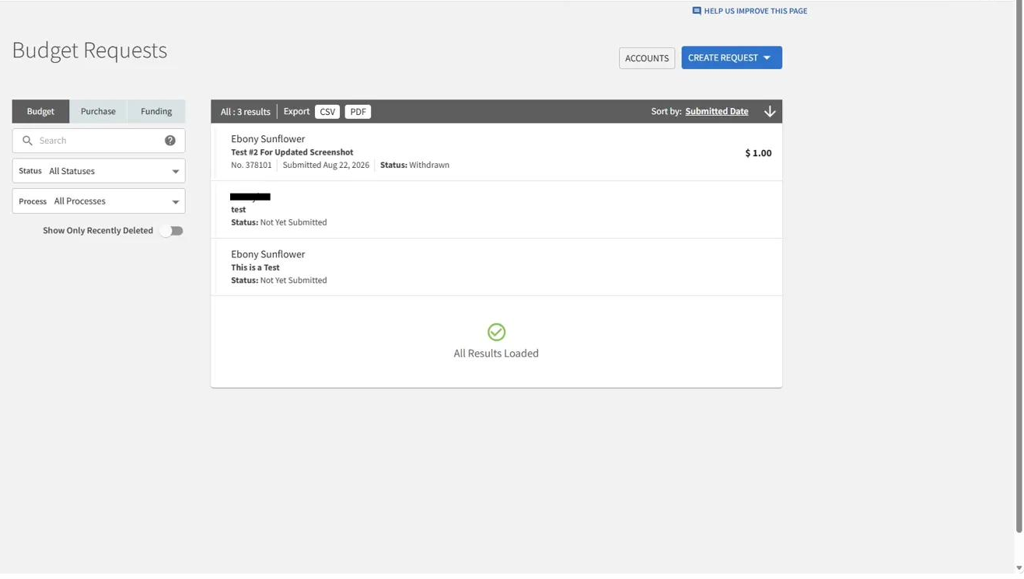
2
The requests page
Where requests live
Selecting Finance takes you here automatically. This page is your organization's request history.
The tabs at the left, Budget, Purchase, and Funding, filter what you are looking at.
Your approved SOF Programming Request is in this list. Open it if you need the request number or the approved amount.
To start your reconciliation, select the blue CREATE REQUEST button in the upper right.
Saving is not submitting. Anything reading Not Yet Submitted has not reached a reviewer.
TigerZone Reconcile Guide | SOF Purchase and Funding Request | 2026-2027
5

Slide 6
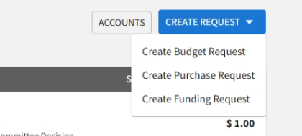
3
Choose your request type
Three options appear
Create Budget Request is what you want, even though this is the Purchase and Funding process. All SGA funding processes live there.
Create Purchase Request and Create Funding Request open older forms that are retired. They will not reach a reviewer.
The names are confusing. Trust the step, not the wording.
Always select Create Budget Request. This is the single most common mistake at this step.
TigerZone Reconcile Guide | SOF Purchase and Funding Request | 2026-2027
6

Slide 7
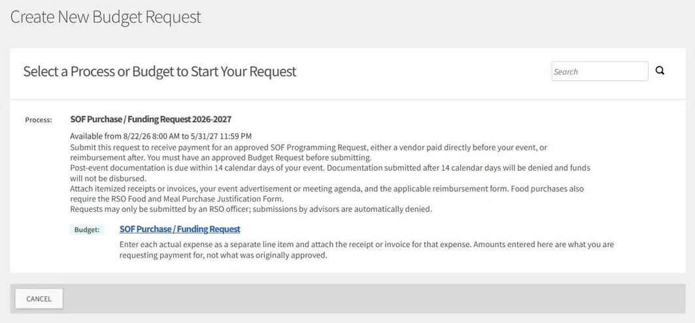
4
Select the process
SOF Purchase and Funding Request 2026-2027
This is the step that separates reconciliation from the original request. Read the process name before you select it.
Choose SOF Purchase and Funding Request 2026-2027. Do not choose SOF Programming Request; that is the process you already completed.
Note the Available from dates. If the window is closed, the process does not appear at all.
Below the process, select the budget to begin.
If you find yourself entering estimated costs again, you are in the wrong process. Cancel and start over.
TigerZone Reconcile Guide | SOF Purchase and Funding Request | 2026-2027
7

Slide 8
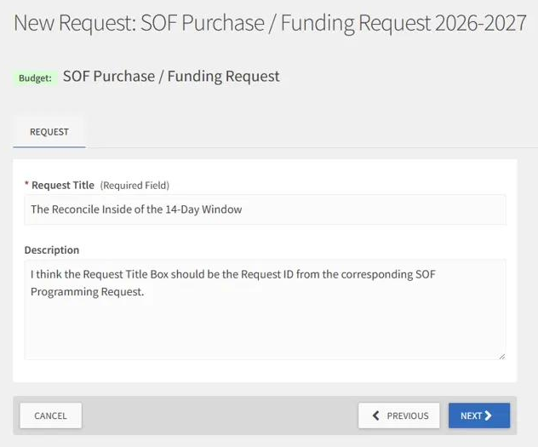
5
Name your request
Request Title and Description
Use the same event name you used on the approved request, so the two are easy to match.
Adding the word reconciliation or the event date makes it unmistakable in the list.
Select NEXT to continue.
Your title appears in your organization's request list and in the reviewer's queue. Make it something you will recognize in three months.
TigerZone Reconcile Guide | SOF Purchase and Funding Request | 2026-2027
8

Slide 9
WHAT TO EXPECT
The pages ahead
This process is shorter than the request you already submitted. There are fewer questions, because most of what matters is in your receipts.
1
Request and Contact
Your Approved Budget Request Number, who is submitting, and how to reach you.
2
Event and Payment Type
What the event was, what kind of payment you are asking for, and whether anything changed.
3
Certification and Submission
Your certification, then instructions on how to submit your documentation.
4
Budget
Actual expenses, entered as line items with a receipt attached to each one.
SAVE AND NEXT moves you forward. FINISH LATER saves your progress so you can return.
TigerZone Reconcile Guide | SOF Purchase and Funding Request | 2026-2027
9

Slide 10
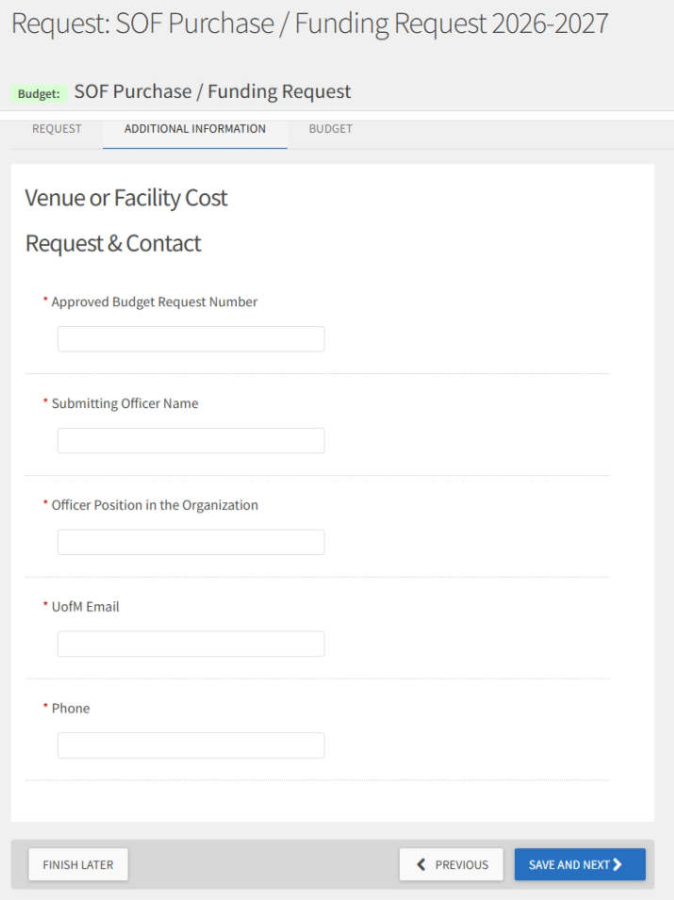
6
Page 1: Request and Contact
Tie this to your approved award
The first field is the Approved Budget Request Number from your SOF Programming Request. Have it in front of you.
Submitting Officer Name and Officer Position must be an officer of the organization. Advisors may not submit.
UofM Email and Phone are how you will be contacted about this reconciliation. Use an address you actually check.
The request number is how a reviewer finds your approved amount. Put it in the subject line of any email about this request too.
TigerZone Reconcile Guide | SOF Purchase and Funding Request | 2026-2027
10

Slide 11
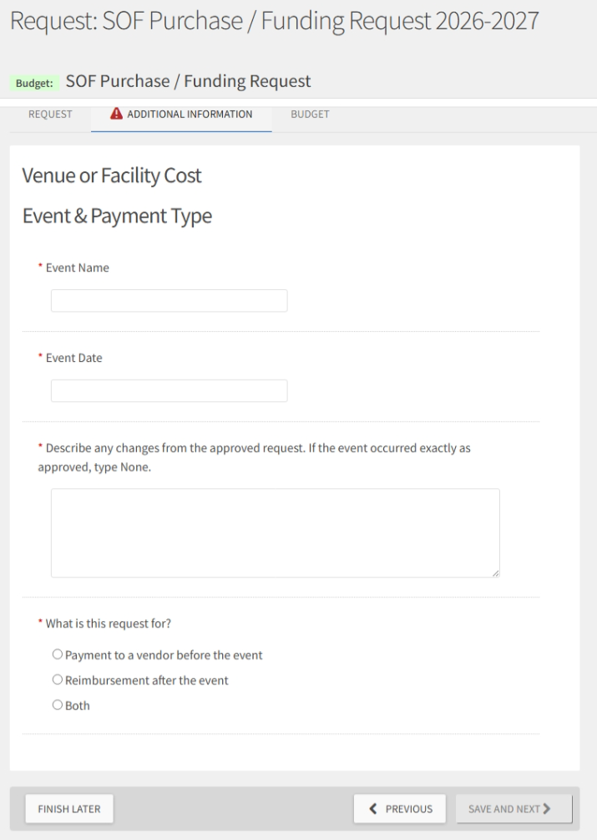
7
Page 2: Event and Payment Type
What actually happened
Enter the event name and the date it actually happened.
Describe any changes from the approved request. If the event occurred exactly as approved, type None. The field is required either way.
Then say what the request is for: payment to a vendor before the event, reimbursement after the event, or both.
Write the description for someone who was not there. More attendees than expected, so more food was ordered, is a usable answer. Changes happened is not.
TigerZone Reconcile Guide | SOF Purchase and Funding Request | 2026-2027
11

Slide 12
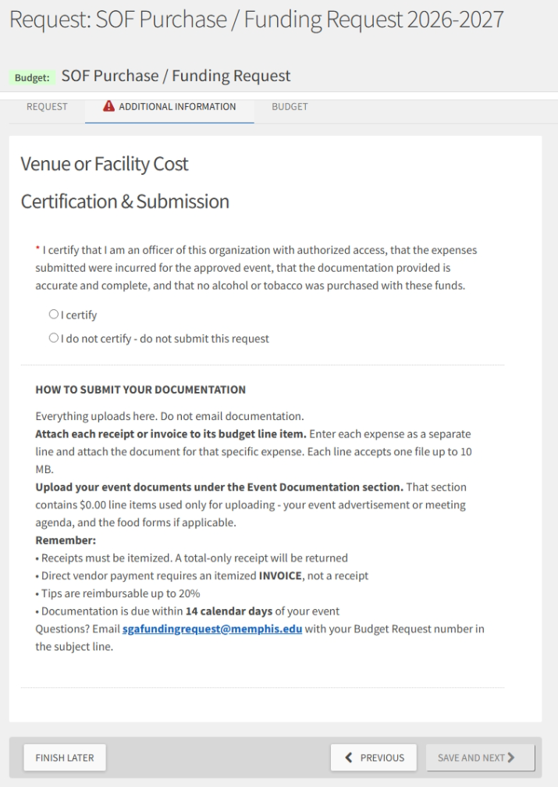
8
Page 3: Certification and Submission
Read, then certify
You certify that the expenses were incurred for the approved event, that your documentation is accurate and complete, and that no alcohol or tobacco was purchased with these funds.
Instructions follow the certification and explain how to attach your documentation.
Certifying is a statement you are making about University funds. Treat it that way.
Selecting the option that says do not submit does not always stop the form. A reviewer sees your answer and returns the request.
TigerZone Reconcile Guide | SOF Purchase and Funding Request | 2026-2027
12

Slide 13
THE BUDGET TAB
Enter your actual expenses
Enter what you actually spent, one line item per expense, in the section that fits it. Attach the itemized receipt or invoice to the line item it belongs to.
Venue and Facilities
Speaker / Performer Fee
Food and Catering
Printing, Signage and Promotional Materials
Supplies and Materials
Equipment Rental
Other
Speaker Travel and Lodging
Event Documentation
Event Documentation is new at this stage and is upload only. Enter $0.00 on each line; those lines do not affect your requested total. Your event advertisement or meeting agenda goes here, and the food forms if food was purchased.
Report actual amounts, not the approved estimates. What you enter here is what you are requesting payment for, not what was originally approved.
Every dollar you report needs documentation behind it. A total only receipt will be returned. Tips are reimbursable up to 20 percent.
Post event documentation goes here, not in an email. Receipts sent by email are not recorded against your request.
TigerZone Reconcile Guide | SOF Purchase and Funding Request | 2026-2027
13

Slide 14
TWO REVIEWS
What happens after you submit
Documentation review
1
A reviewer checks that every expense has an itemized receipt behind it and that your event documentation is present. If something is missing, the request is returned to you with a comment explaining what is needed.
Compliance review and submission
2
A second review confirms the request complies with University financial policy and matches what the Finance Committee approved. From there it is submitted to be paid.
Neither reviewer can change your requested amount. If a number needs to change, you will be contacted.
If your request is returned, the reviewer's comment explains why. Read it before you resubmit.
Export your submitted request as a PDF and keep it. It is your record of what you reported and certified.
TigerZone Reconcile Guide | SOF Purchase and Funding Request | 2026-2027
14

Slide 15
TROUBLESHOOTING
If you get stuck
The page will not advance
A required field is blank. Look for the red warning triangle on the tab, and for fields outlined in red.
I answered everything and it still will not advance
The server may have dropped your answers. Refresh, or sign out and back in, then try again.
I do not see the process
The submission window has not opened or has closed. Check the Available from dates.
I opened several TigerZone tabs
Opening a request from the list opens a new tab. Stale tabs overwrite each other. Close all but one.
My receipt file will not attach
Each budget line accepts one file up to 10 MB. Combine multiple receipts into one file, or split the expense into separate lines.
I missed the 14 day deadline
Documentation submitted after 14 calendar days is denied and funds are not disbursed. Email immediately rather than waiting.
Still stuck? Email sgafundingrequest@memphis.edu with your Request ID.
TigerZone Reconcile Guide | SOF Purchase and Funding Request | 2026-2027
15

Slide 16
Before you submit
✓
You are in the SOF Purchase and Funding Request, not the Programming Request
✓
Your approved request number is entered and correct
✓
Every expense is entered at the amount you actually spent
✓
An itemized receipt or invoice is attached to every line item
✓
Event documentation is uploaded to the Event Documentation section
✓
Changes from the approved request are described, or the field reads None
✓
You are within 14 calendar days of your event
✓
Your status reads Submitted, not Not Yet Submitted
Keep this guide with your submission guide, Quick Reference, and FAQ. Questions? sgafundingrequest@memphis.edu

