Slide 1

STEP BY STEP GUIDE
How to apply for travel funding
SGA Travel Funding in TigerZone
You apply for yourself, from your own profile. Not from your organization.
2026-2027 | University of Memphis | Student Government Association

Slide 2
READ THIS FIRST
Travel works differently
The other SGA funding processes are submitted by an officer on behalf of an organization. Travel is not.
ORGANIZATIONAL FUNDING
TRAVEL FUNDING
SOF Programming and Purchase and Funding
SGA Travel Funding
An officer submits for the organization
You start from the organization's page
Money is paid to or for the organization
Each traveler submits their own request
You start from your own profile menu
A check is mailed to the traveler after travel
Advisors do not submit on behalf of students. If you are not the traveler, you are in the wrong place.
Graduate travel that is not tied to an RSO uses the separate Graduate Student Association process at memphis.edu/gsa/travel.
TigerZone Submission Guide | SGA Travel Funding | 2026-2027
2

Slide 3
THREE THINGS GATE YOUR REQUEST
Before you start
Three trainings
Your conference confirmation
Your deadline
Your organization must be active with RSO training complete, an officer must have completed SGA financial training, and you must have completed SGA Travel training.
Required on every application. Without it your request cannot be reviewed. Upload it in the budget, not by email.
Domestic travel: at least 15 business days before departure. International travel: at least 8 weeks before departure, and a hearing is required.
Funding is capped at $600 per traveler per semester. Two applications per academic year, one per semester, and they cannot be combined into one.
Reimbursement is paid after travel is completed. There are no retroactive requests for travel that has already happened.
TigerZone Submission Guide | SGA Travel Funding | 2026-2027
3

Slide 4
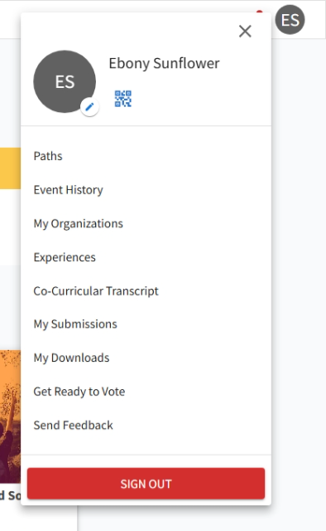
1
Open your profile menu
Top right of any TigerZone page
Select your initials in the upper right corner of TigerZone. This is your own profile, not an organization.
In the menu that opens, select My Submissions.
If you go to your organization's page looking for travel, you will not find it. It is not there.
Everything about travel funding lives under your personal profile, because the request is yours rather than your organization's.
TigerZone Submission Guide | SGA Travel Funding | 2026-2027
4

Slide 5
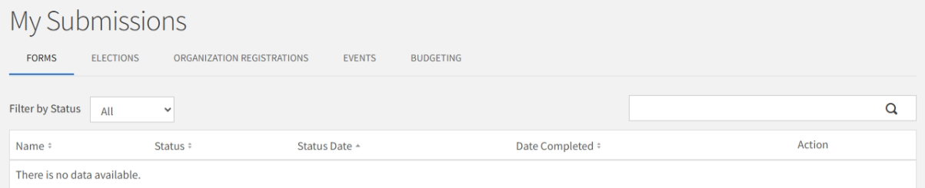
2
Go to the Budgeting tab
My Submissions
My Submissions opens on the Forms tab. Travel is not there.
Select the Budgeting tab across the top.
This page is where every travel request you submit will appear.
Forms, Elections, Organization Registrations, and Events are the other tabs. Only Budgeting holds travel funding.
TigerZone Submission Guide | SGA Travel Funding | 2026-2027
5

Slide 6
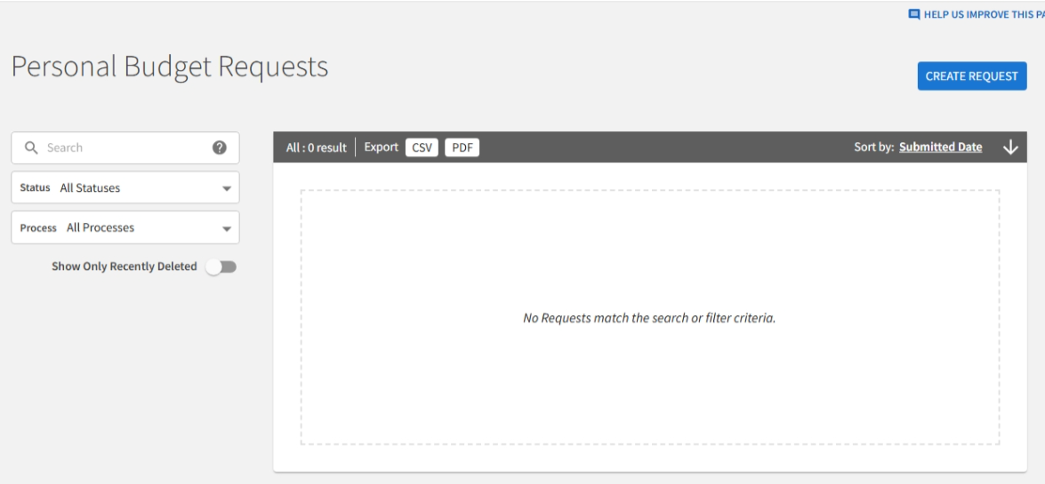
3
Personal Budget Requests
Where your requests live
The Budgeting tab takes you to Personal Budget Requests. The word Personal is the clue that you are in the right place.
Any request you have already started or submitted appears here with its status.
To begin, select the blue CREATE REQUEST button in the upper right.
Saving is not submitting. Anything reading Not Yet Submitted has not reached the SGA Finance Committee.
TigerZone Submission Guide | SGA Travel Funding | 2026-2027
6

Slide 7
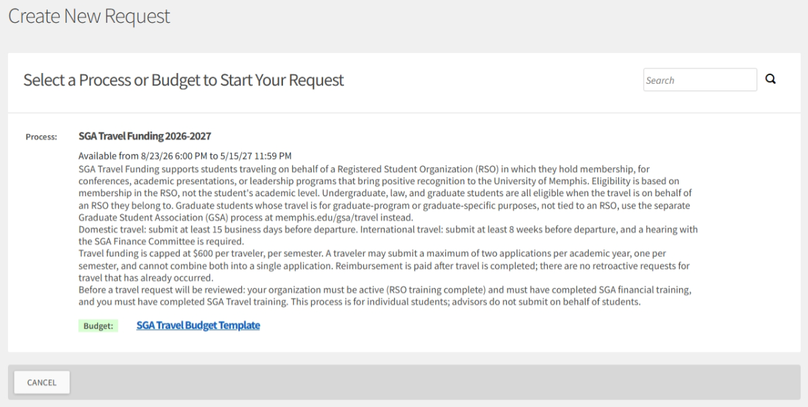
4
Select the process
SGA Travel Funding 2026-2027
Only one process appears here. Read its description before you continue; it states the deadlines, the cap, and the eligibility rules.
Note the Available from dates. If the window is closed, the process does not appear at all.
Below the process, select SGA Travel Budget Template to begin.
There is no dropdown to get wrong on this one. If you reached this screen, you are in the right process.
TigerZone Submission Guide | SGA Travel Funding | 2026-2027
7

Slide 8
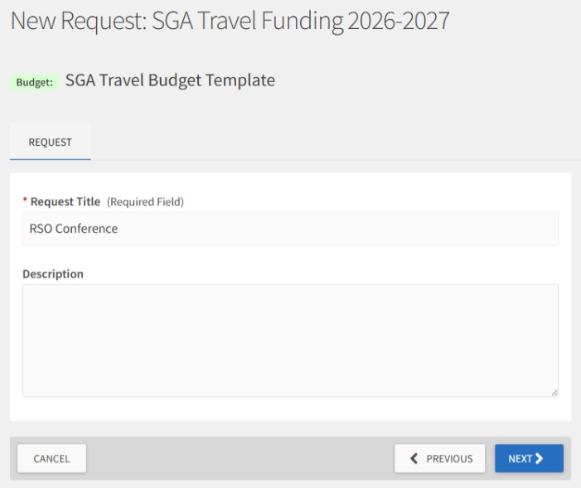
5
Name your request
Request Title and Description
Use the conference or event name. Spell it out; do not use an acronym.
Description is optional here. You will describe the trip in detail later.
Select NEXT to continue.
Your title appears in your request list and in the Committee's queue. Make it something you will recognize in three months.
TigerZone Submission Guide | SGA Travel Funding | 2026-2027
8

Slide 9
WHAT TO EXPECT
The six pages ahead
1
Submission Eligibility
Are you the traveler? Each traveler submits their own request.
2
Campus Eligibility
Which campus you attend. Lambuth students have a separate travel fund.
3
Student Traveler and RSO Info
Your name, U number, contact information, mailing address, RSO, academic level, and your three trainings.
4
Travel and Conference Information
Semester, domestic or international, dates, the conference, and why SGA should fund it.
5
Release of Liability
Initial and date to acknowledge the agreement.
6
Final and Submission
What happens after you submit, and how to attach your documents.
A seventh question appears on page 5 only if you selected international travel. SAVE AND NEXT moves you forward; FINISH LATER saves your progress.
TigerZone Submission Guide | SGA Travel Funding | 2026-2027
9

Slide 10
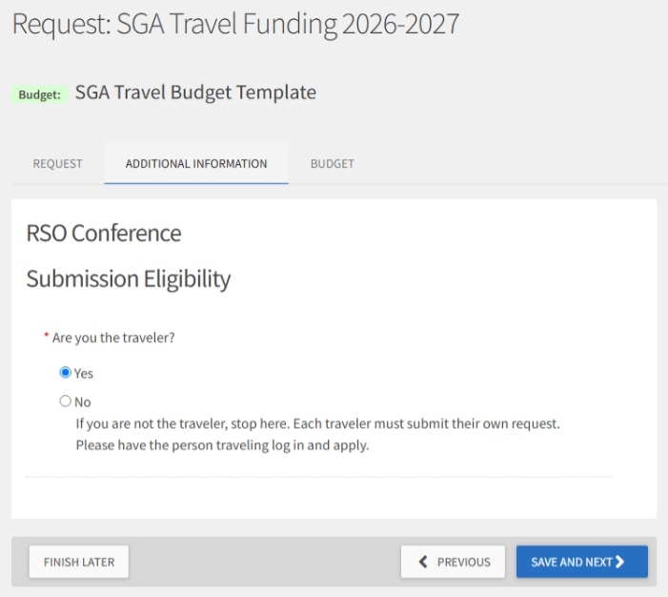
6
Pages 1 and 2: Eligibility
Two questions, two gates
Are you the traveler? If you are not, stop. Each traveler submits their own request, and an advisor may not submit for a student.
Which campus are you enrolled in? SGA Travel Funding through this process is for Main Campus students.
Lambuth students have a separate travel fund. Contact Lambuth Student Services; the contact information is on the question itself.
Neither question stops the form outright. Answering incorrectly does not make you eligible; it means your request is returned at review.
TigerZone Submission Guide | SGA Travel Funding | 2026-2027
10

Slide 11
7
Page 3: Student Traveler and RSO Info
Who you are and how you get paid
Your name, U number, UofM email, and phone.
A mailing address for your check. Do not use a campus or department address. Reimbursement is mailed to you.
The name of the RSO you are traveling on behalf of, and your academic level. All levels are eligible when the travel is on behalf of an organization you belong to.
Then the three training confirmations: RSO training, SGA financial training, and SGA Travel training.
Graduate students are asked for a brief statement describing how the travel relates to their RSO membership.
The mailing address is the one place on this page people cost themselves time. A campus or department address delays your check.
TigerZone Submission Guide | SGA Travel Funding | 2026-2027
11

Slide 12
8
Page 4: Travel and Conference Information
The trip itself
Semester, whether the travel is domestic or international, mode of travel, and your departure and return dates.
The full conference name spelled out, its start and end dates, and where it is being held.
Whether you are presenting, and if so, your topic.
Then the question that carries the most weight: why SGA should fund this trip. Explain why you were asked to attend, the value to the University of Memphis, and your purpose in attending.
Last, whether you have other university funding sources for this trip. If yes, be ready to enter that on the budget page.
Check your own dates before you move on. Departure, return, and both conference dates are entered by hand, and nothing checks them against each other.
TigerZone Submission Guide | SGA Travel Funding | 2026-2027
12

Slide 13
9
Page 5: Release of Liability
Initial and date
Read the statement, then initial and date to acknowledge your agreement.
If you selected international travel on the previous page, an additional international travel registration acknowledgment appears here.
If you selected domestic, that question does not appear at all.
The Release of Liability and Hold Harmless Agreement is also a required pre travel step for every traveler once you are funded.
Initials and date are typed by you. Enter them exactly as you would sign, because this is the acknowledgment of record.
TigerZone Submission Guide | SGA Travel Funding | 2026-2027
13

Slide 14
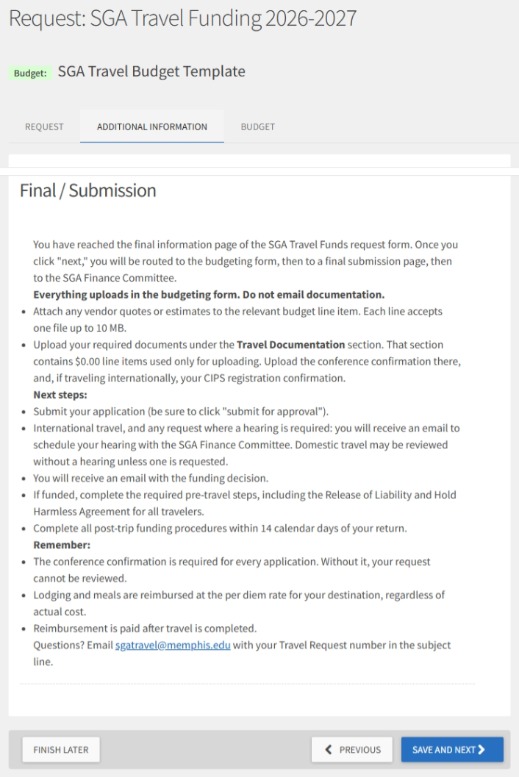
10
Page 6: Final and Submission
Read before you continue
This page is instructions, not questions. It explains what happens after you submit and how to attach your documents.
Everything uploads in the budgeting form. Do not email documentation.
Selecting next takes you to the budget, then to a final submission page, then to the SGA Finance Committee.
Be sure to select submit for approval. A request that stops short of that has not reached anyone.
TigerZone Submission Guide | SGA Travel Funding | 2026-2027
14

Slide 15
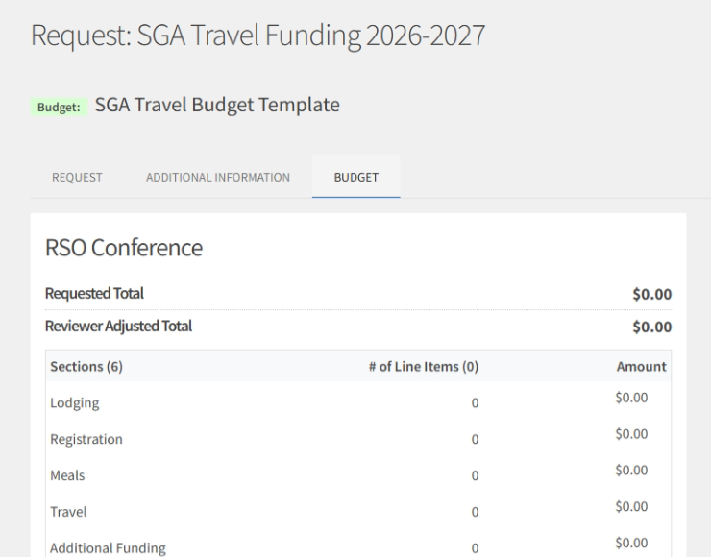
SIX SECTIONS
Build your budget
Enter each cost as a line item under the section that fits it. Attach any vendor quote or estimate to the line item it belongs to.
Lodging
Your actual per night hotel rate
Registration
The per person registration rate
Meals
Only if registration does not include them
Travel
Bus, airfare, or mileage per person
Additional Funding
Any outside funding you are receiving
Travel Documentation
Upload only. Enter $0.00 on each line
Your conference confirmation goes under Travel Documentation, and your CIPS registration confirmation too if you are traveling internationally.
TigerZone Submission Guide | SGA Travel Funding | 2026-2027
15

Slide 16
11
What you enter is not always what you get
Per diem
Lodging and meals are reimbursed at the per diem rate for your destination, regardless of what you actually paid.
Enter your real hotel rate anyway. The Committee needs to see it, and you will need the receipt later.
Meals do not require receipts, because they are paid at the per diem rate rather than actual cost.
Look up your rate at gsa.gov: Travel, then Per Diem Rates, then your city and state.
Your first and last day of travel are paid at 75 percent of the daily meal rate, not the full rate.
This is the part travelers are most often surprised by. A $200 hotel room in a $120 per diem city reimburses at $120.
Report any outside funding under Additional Funding. Reporting it does not automatically reduce your award; the Committee reviews each request individually.
TigerZone Submission Guide | SGA Travel Funding | 2026-2027
16

Slide 17
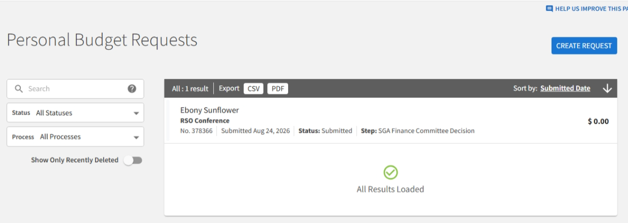
WHAT HAPPENS NEXT
After you submit
International travel, and any request where a hearing is required, gets an email to schedule a hearing with the SGA Finance Committee.
Domestic travel may be reviewed without a hearing, unless one is requested.
You receive an email with the funding decision.
If funded, complete the required pre travel steps, including the Release of Liability and Hold Harmless Agreement for all travelers.
Complete all post trip funding procedures within 14 calendar days of your return.
Reimbursement is paid after travel is completed, by check mailed to the address you provided.
Questions? Email sgatravel@memphis.edu with your Travel Request number in the subject line.
TigerZone Submission Guide | SGA Travel Funding | 2026-2027
17

Slide 18
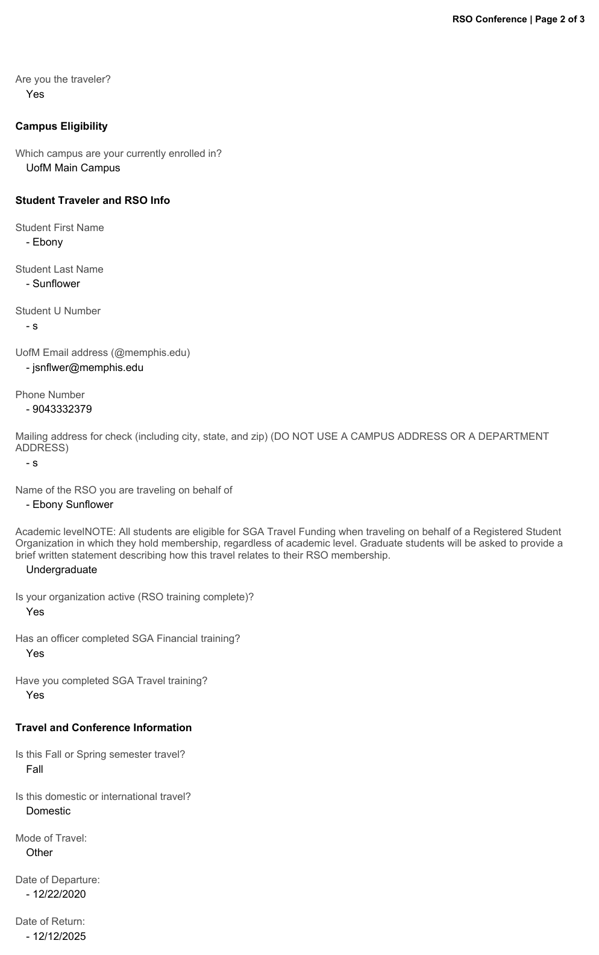
12
Keep a copy of what you submitted
Export the request as a PDF
Open your request from Personal Budget Requests and export it. The PDF captures every answer you gave, your budget, your release, and the request history.
Save it. It is your record of what you asked for and what you agreed to.
You will want it when you complete your post trip steps within 14 calendar days of returning.
The request history at the end timestamps every status change, including a return for revision.
TigerZone Submission Guide | SGA Travel Funding | 2026-2027
18

Slide 19
TROUBLESHOOTING
If you get stuck
I cannot find travel on my organization page
It is not there. Travel is submitted from your own profile: your initials, then My Submissions, then Budgeting.
The page will not advance
A required field is blank. Look for the red warning triangle on the tab, and for fields outlined in red.
I answered everything and it still will not advance
The server may have dropped your answers. Refresh, or sign out and back in, then try again.
I do not see the process
The submission window has not opened or has closed. Check the Available from dates.
I opened several TigerZone tabs
Opening a request from the list opens a new tab. Stale tabs overwrite each other. Close all but one.
My travel already happened
There are no retroactive requests. Apply before you travel, within the deadline for your trip type.
Still stuck? Email sgatravel@memphis.edu with your Travel Request number.
TigerZone Submission Guide | SGA Travel Funding | 2026-2027
19

Slide 20
Before you submit
✓
You are the traveler, submitting for yourself
✓
All three trainings are complete: RSO, SGA financial, SGA Travel
✓
Your conference confirmation is uploaded under Travel Documentation
✓
Your mailing address is where you actually receive mail, not a campus address
✓
Your departure and return dates are correct and in the right order
✓
You are inside your deadline: 15 business days domestic, 8 weeks international
✓
Any outside funding is reported under Additional Funding
✓
You selected submit for approval, and your status reads Submitted
Keep this guide with the SGA Travel Process Map. Questions? sgatravel@memphis.edu

