Slide 1

STEP BY STEP GUIDE
How to submit a funding request
SOF Programming Request in TigerZone
The path changed this year. Funding requests are no longer under Forms.
2026-2027 | University of Memphis | Student Government Association

Slide 2
READ THIS FIRST
Before you start
Officer access
Financial training
Your deadline
You must hold an officer position in TigerZone. Advisors may not submit, and a request submitted by an advisor is denied.
Your organization must have completed SGA financial training this academic year.
Tier One, $1 to $2,499: at least 14 calendar days before the event. Tier Two, $2,500 to $7,500: at least 30 calendar days.
The cap is $7,500 per initiative. There is no aggregate ceiling per organization per semester or per year.
Questions at any point: sgafundingrequest@memphis.edu
TigerZone Submission Guide | SOF Programming Request | 2026-2027
2

Slide 3
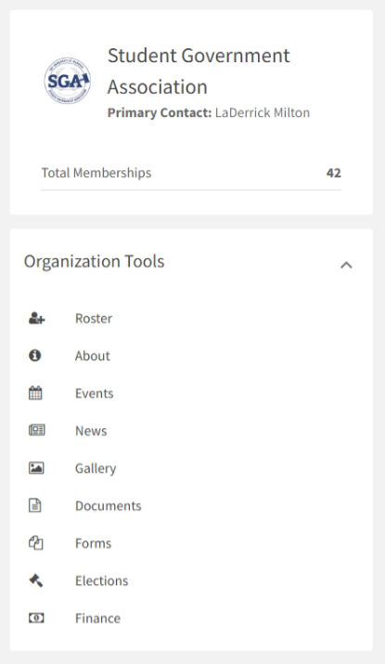
1
Start in your organization
Getting to Finance
From your organization's page, open the tools menu and select Finance under Organization Tools.
This is the biggest change from last year. Funding requests no longer live under Forms.
If you do not see Finance, you may not have officer level access. Ask your president to add you.
Everything now runs through your organization's Finance area.
TigerZone Submission Guide | SOF Programming Request | 2026-2027
3

Slide 4
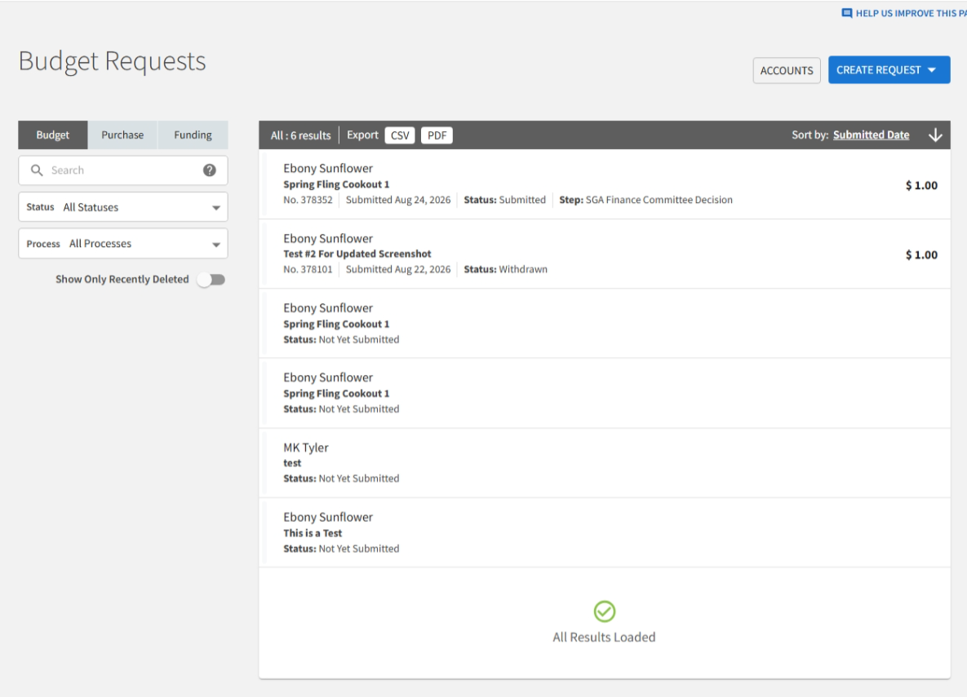
2
The Budget Requests page
Where requests live
Selecting Finance takes you here automatically. This page is your organization's request history.
The tabs at the left, Budget, Purchase, and Funding, filter what you are looking at.
To start a new request, select the blue CREATE REQUEST button in the upper right.
Saving is not submitting. Anything reading Not Yet Submitted has not reached the Finance Committee.
TigerZone Submission Guide | SOF Programming Request | 2026-2027
4

Slide 5
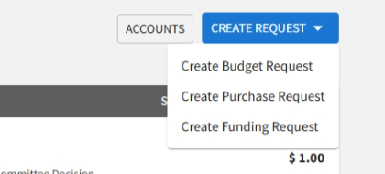
3
Choose your request type
Three options appear
Create Budget Request is what you want. All SGA funding processes live there.
Create Purchase Request and Create Funding Request are separate systems and are not used for SGA funding.
Older forms may still appear in this menu. They are retired and will not reach the Finance Committee.
Always select Create Budget Request. The other options will not get you to the SOF Programming Request.
TigerZone Submission Guide | SOF Programming Request | 2026-2027
5

Slide 6
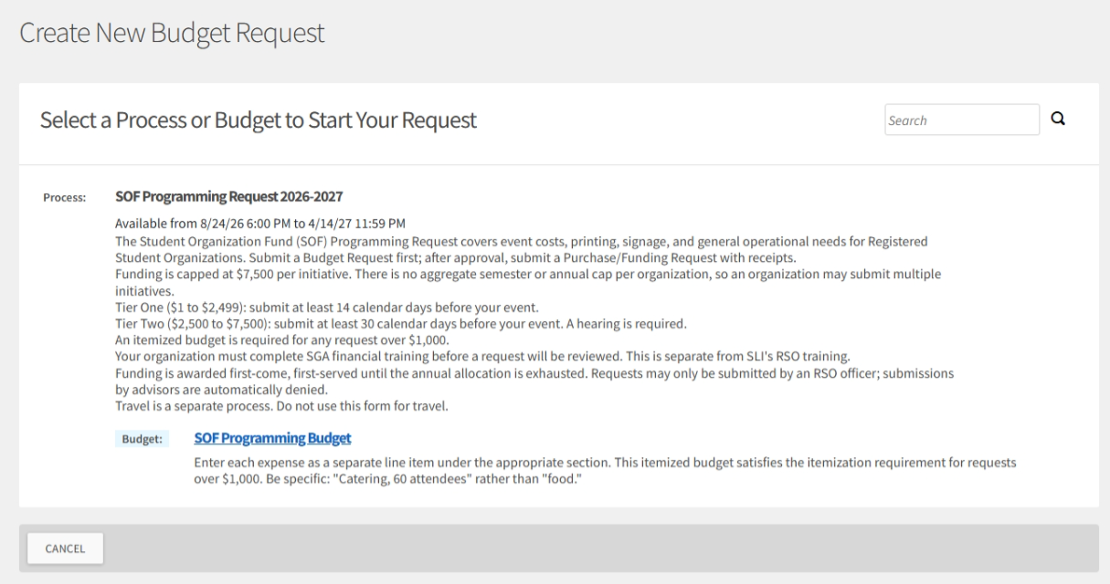
4
Select the process
SOF Programming Request 2026-2027
The process appears with its description and availability window. Read the description; it states the tiers, the deadlines, and the training requirement.
Note the Available from dates. If the window is closed, the process does not appear at all.
If you see No available processes, the window has not opened yet or has closed.
Below the process, select SOF Programming Budget to begin.
If the description ever disagrees with the Quick Reference or the FAQ, the Process Map governs.
TigerZone Submission Guide | SOF Programming Request | 2026-2027
6

Slide 7
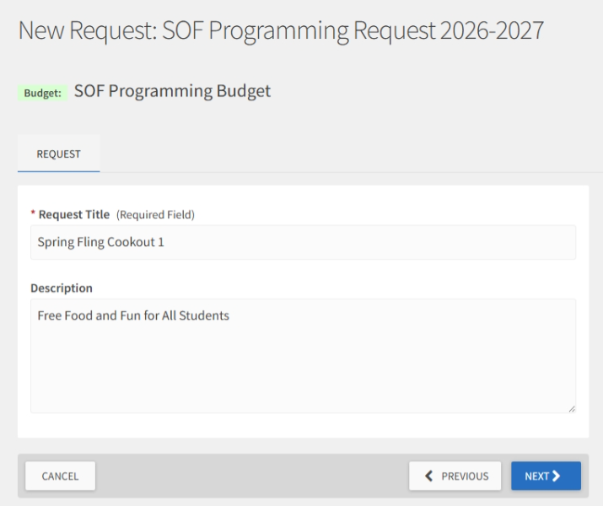
5
Name your request
Request Title and Description
Request Title is required. Use something specific: Fall Welcome Cookout, September 12, rather than Event or Funding.
Description is optional here but useful. A sentence about the event helps the Committee before they reach your budget.
Select NEXT to continue.
Your title appears in your organization's request list and in the Committee's queue. Make it something you will recognize in three months.
TigerZone Submission Guide | SOF Programming Request | 2026-2027
7

Slide 8
WHAT TO EXPECT
The six pages ahead
1
Eligibility
One question. Confirms your organization completed financial training.
2
Organization and Contact
Four questions. Who is submitting and how to reach you.
3
Event Details
Seven questions. What the event is, when, where, and who it serves.
4
SAFA Funding Limitations
Six questions. Confirms your request does not include ineligible expenses.
5
Additional Details
Follow up questions, if your earlier answers call for them, plus a text box.
6
Certification
Instructions to read, then your certification.
SAVE AND NEXT moves you forward. FINISH LATER saves your progress so you can return.
TigerZone Submission Guide | SOF Programming Request | 2026-2027
8

Slide 9
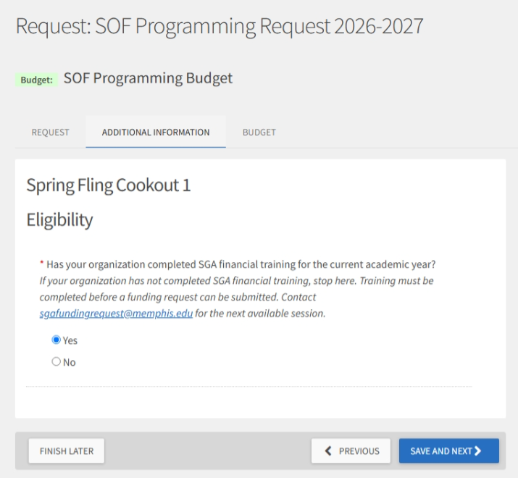
6
Page 1: Eligibility
One question, and it matters
You are asked whether your organization completed SGA financial training this academic year.
Answer honestly. This is the question that determines whether your request can be reviewed at all.
Training is a hard prerequisite. There is no exception form for it.
Answering No does not always stop the form. You may still reach later pages. That does not mean you are eligible. A request from an untrained organization is returned or denied at review.
Not sure whether your organization has trained? Email before you build the request, not after.
TigerZone Submission Guide | SOF Programming Request | 2026-2027
9

Slide 10
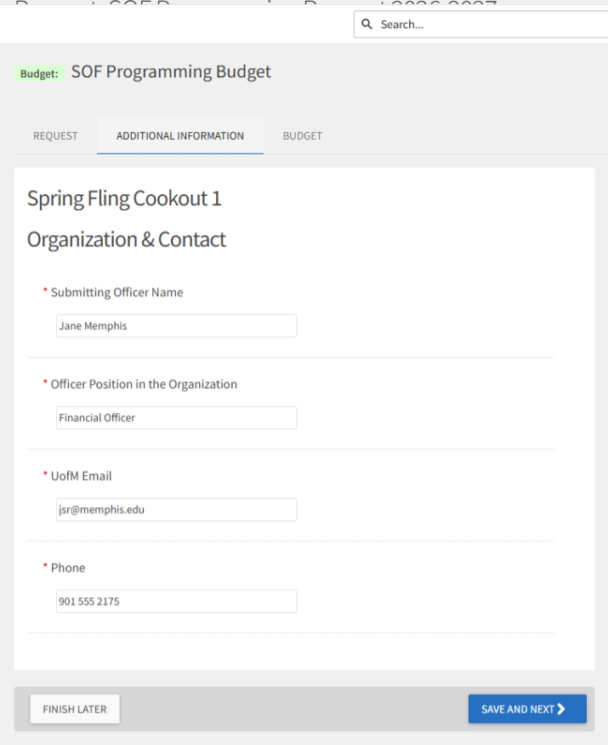
7
Page 2: Organization and Contact
Four questions
Submitting Officer Name and Officer Position must be an officer of the organization.
Advisors may not submit. A request submitted by an advisor is an automatic denial and cannot be fixed after the fact.
UofM Email and Phone are how you will be contacted about this request. Use an address you actually check.
Enter your own name, not your president's, unless you are the president. The Committee contacts the person listed here.
TigerZone Submission Guide | SOF Programming Request | 2026-2027
10

Slide 11
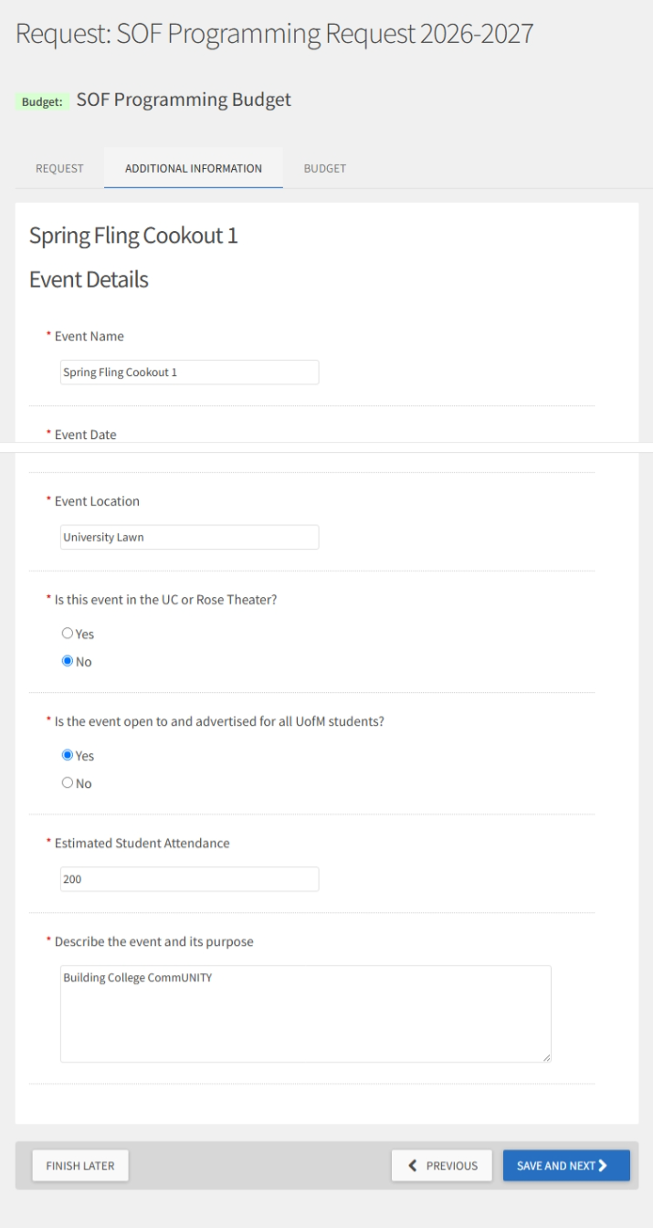
8
Page 3: Event Details
Seven questions
What the event is, when and where it happens, who it serves, and how it benefits University of Memphis students.
Be specific. The Committee is deciding whether Student Activity Fee funds should support this, and they only know what you tell them.
Check your event date against your deadline before you go further. Tier One needs 14 calendar days, Tier Two needs 30.
A late request is not penalized. It is a request that cannot be considered.
TigerZone Submission Guide | SOF Programming Request | 2026-2027
11

Slide 12
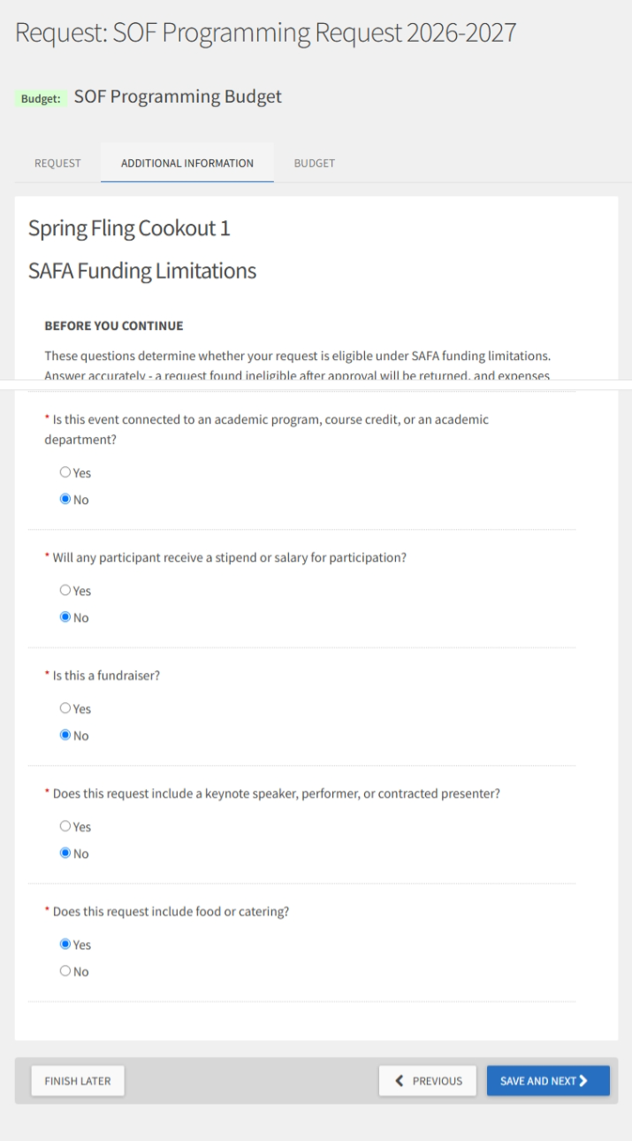
9
Page 4: SAFA Funding Limitations
Six questions
These confirm your request does not include expenses the Student Activity Fee cannot fund.
Read each one. Some expenses that seem ordinary are not fundable, and it is better to find out here than after you have committed.
If you are unsure whether something qualifies, ask before you submit rather than guessing.
Eligibility is not a deadline and cannot be waived. There is no exception form for an ineligible expense.
TigerZone Submission Guide | SOF Programming Request | 2026-2027
12

Slide 13
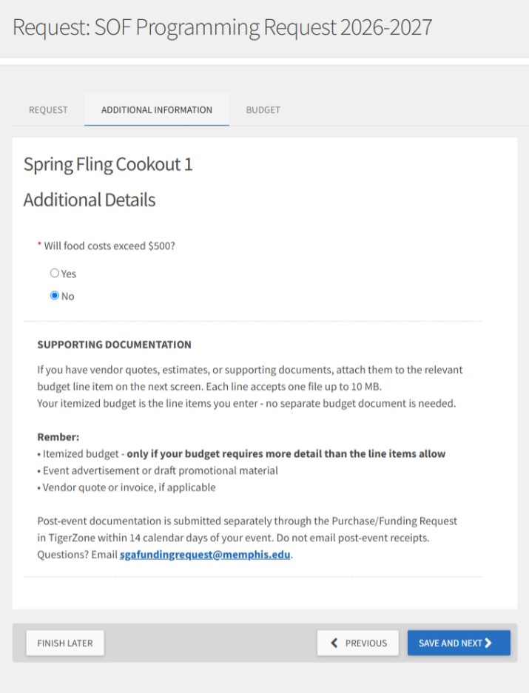
10
Page 5: Additional Details
Follow up questions and a text box
Up to three follow up questions, then a supporting documentation box. Which questions appear depends on your answers on the previous page, so you may see none of them.
Use the box to explain anything the Committee would otherwise have to guess at.
If a required field is blank, the page will not advance and the field is outlined in red.
A red warning triangle on a tab means that tab still has an unfinished required field. It is the fastest way to find what is blocking you.
TigerZone Submission Guide | SOF Programming Request | 2026-2027
13

Slide 14
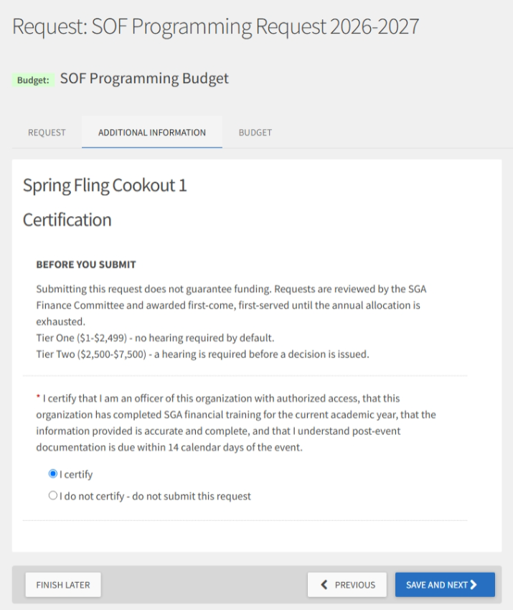
11
Page 6: Certification
Read, then certify
Instructions appear first. Read them; they explain what happens after you submit.
Then you certify that you are an officer with authorized access and that the information you entered is accurate and complete.
Certifying is a statement you are making. Treat it that way.
Selecting the option that says do not submit does not always stop the form. The Committee sees your answer and returns the request.
TigerZone Submission Guide | SOF Programming Request | 2026-2027
14

Slide 15
THE BUDGET TAB
Build your budget
Enter each expense as a separate line item under the section that fits it. Each section has an ADD ITEM button, and a note under the heading with rules specific to that section.
Venue and Facilities
Speaker / Performer Fee
Food and Catering
Printing, Signage and Promotional Materials
Supplies and Materials
Equipment Rental
Other
Speaker Travel and Lodging
Be specific. Catering, 60 attendees is usable. Food is not.
Itemization is required for any request over $1,000, and the budget you build here satisfies that requirement.
Attach a quote or invoice to the line item it belongs to, if you have one.
A red warning reading Budget does not meet the minimum amount of $1.00 appears on an empty budget. It clears as soon as you add a line item.
TigerZone Submission Guide | SOF Programming Request | 2026-2027
15

Slide 16
AFTER YOU SUBMIT
Submit and track your request
Your request appears in your organization's Budget Requests list with the submitter name, title, and status.
Status matters. Not Yet Submitted means saved but not sent, and it has not reached the Finance Committee.
Note your Request ID. Put it in the subject line of any email about this request.
Export the list to CSV or PDF using the buttons above the results. Useful for officer meetings.
If your request is returned, the reviewer's comment explains why. Read it before resubmitting.
After your event you have 14 calendar days to submit documentation through the SOF Purchase and Funding Request. That is a separate process with its own guide.
TigerZone Submission Guide | SOF Programming Request | 2026-2027
16

Slide 17
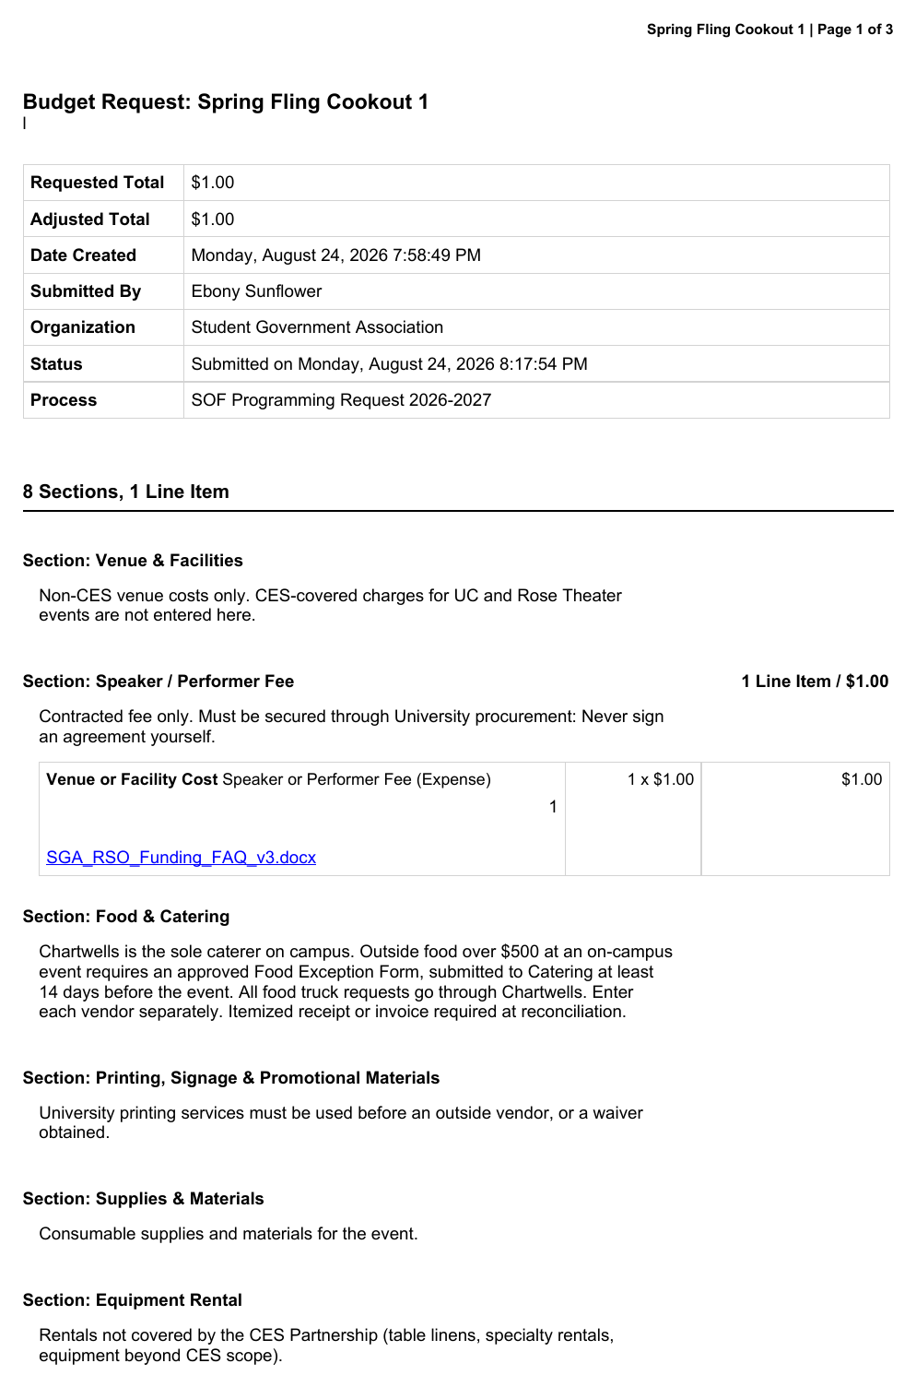
12
Keep a copy of what you submitted
Export the request as a PDF
Open your request from the Budget Requests list and export it. The PDF captures the whole submission: totals, every budget section and line item, every answer you gave, your certification, and the request history.
Save it. It is the record of what you asked for and what you certified, and you will need it when you reconcile after the event.
Bring it to your officer meeting. It is easier to review than the screen, and it shows your treasurer exactly what was committed.
The request history at the end timestamps every status change. If a request is returned, that history is where the record of it lives.
TigerZone Submission Guide | SOF Programming Request | 2026-2027
17

Slide 18
TROUBLESHOOTING
If you get stuck
The page will not advance
A required field is blank. Look for the red warning triangle on the tab, and for fields outlined in red.
I do not see Finance
You may not have officer level access in TigerZone. Ask your president to add you.
No available processes
The submission window has not opened or has closed. Check the Available from dates.
The form stops responding
Refresh the page, or sign out and back in. Avoid leaving several stale tabs open.
Budget does not meet the minimum
Your budget has no line items yet. Add at least one expense.
Still stuck? Email sgafundingrequest@memphis.edu with your Request ID, or book time with the Administrative Associate for a walkthrough.
TigerZone Submission Guide | SOF Programming Request | 2026-2027
18

Slide 19
Before you submit
✓
Your organization has completed SGA financial training
✓
You are an officer. Advisors may not submit
✓
Your request title is specific and recognizable
✓
Your event date meets your tier deadline, 14 or 30 calendar days
✓
Every expense is its own line item, in the right section
✓
Your total is within the $7,500 per initiative cap
✓
Your status reads Submitted, not Not Yet Submitted
Keep this guide with your Quick Reference and FAQ. Questions? sgafundingrequest@memphis.edu

