Slide 1
The School of Social Work
Field Liaison Training
Office of Field Education

Slide 2
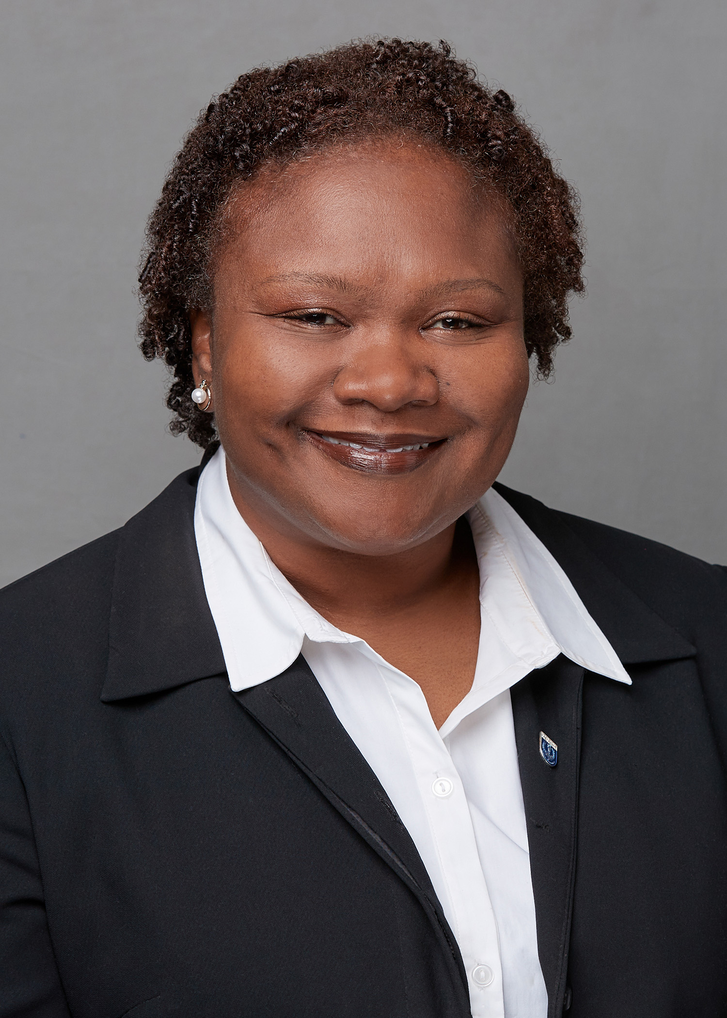
Welcome from the Trainer
Kenya Anderson, Clinical Assistant Professor
Director of BA Field Placement

Slide 3
Purpose of the Training
Overview of the role of the faculty liaison in the social work curriculum and field practicum
Review best practices in field consultation for the University of Memphis
Provide curriculum and program information regarding field practicum and field consultation

Slide 4
Learning Objectives
Participants will learn role of faculty liaisons in field practice
The participant will know the responsibilities of the faculty liaison
Participants will know best practices and tools to use in field consultation at the University of Memphis
Participants will know the steps to follow in the event of urgent concern or emergency

Slide 5
About field practicum
The internship is an important component of the social work program
It is designed to help students integrate their academic learning to understand and develop practice skills for the social work profession
Provides opportunities for students to apply concepts and skills learned in the classroom in a real-world setting
Students build a work history of relevant social work experience
Supervised experience with client groups is a right of every student

Slide 6
Field Practicum: A collaborative
Work in teams is an important skill for social workers
Field practicum allows social work educators to work collaboratively to support learning

Slide 7
Field Flow for Faculty Liaisons
The Field Structure
Field Director/ Coordinator
Liaison
Student
Field Instructor
Student
Agency

Slide 8
Field Coordination
The responsibility of the Field Director
Coordination of all field activities for all engaged
Preparing students for experiential learning
Develop field placements
Plan seminars & meetings
Teamwork is required
Collaboration is essential to success

Slide 9
Field Coordination with Faculty Liaisons
Faculty liaison will be assigned to work with the field instructor and student in relation to the student’s fieldwork performance
Field liaison’s contact email will be available in the student’s IPT webpage
Faculty liaisons should be familiar with the program and course structure
Field coordinators are available to support this role
Contact information for field coordinators should be provided

Slide 10
Role of the Faculty Liaison
The Faculty Liaison serves as a consultant to field instructors and ensures the educational integrity of the field experience for their respective students
Serves as a mediator/problem solver when conflicts arise between the agency and/or the field instructor and the student

Slide 11
Social Work Handbooks & Manuals
Field is signature pedagogy for social work
Program Handbook- Overview of entire program, BASW & MSW
Field Manual for each program
One Field Liaison Manual for both programs
Guide
Reference
Forms

Slide 12
Responsibilities of the Faculty Liaison
Advise students regarding learning in field practice
Relate the program of the School of Social Work to the administration, field instructors, and other significant staff of the agency
Act as the liaison between the agency/institution and the School of Social Work
Consult with the field instructor regarding learning opportunities
Communicate with the field instructor during the semester to serve as a mediator

Slide 13
Faculty Liaison: Field Consultation
Make a minimum of one agency/institution visit per semester (additional visits may be warranted if a problem arises)
The initial visit should be made by mid-semester to determine whether the student is performing at a satisfactory level
If the student’s performance is considered marginal during the semester, the liaison arranges a meeting with the student and the field instructor to discuss ways to improve performance
The student will complete a self evaluation at the end of the semester
The field instructor will complete a final evaluation of the student’s performance at the end of the semester

Slide 14
Field Practicum Tools
Email
Telephone
In-person/Virtual
Website
Handbook
IPT Forms
Field Consultation Report Form
Problem in Field Form
Field Coordination Team: student, liaison, field instructor and field director

Slide 15
Instructional Assets – Supplements
Group Supervision
Volunteer Hours
Supervision with a social work faculty member when their agency field instructor does not meet the minimum requirements for social work supervision
Group supervision is required for student. Consultation does not require group supervisor participation
Volunteer hours: supplemental option for students
Outside of field agency; can complete up to 25 volunteer hours
Best practice: Student should plan to incorporate if unexpected events occur or need arises. Approved and signed by Field Director

Slide 16
Scheduling the Field Consultation
Document details of the meeting; focusing on the student’s progress
Addresses specific grade items for the Field Instruction Course:
Learning plan, time logs, supervision
Faculty liaison completes the form and indicates in further documentation of a mediation plan is needed
Field coordinators and faculty liaisons will communicate in a timely manner regarding problems relevant to the student’s participation in the internship
Tool to support successful course completion; track progress

Slide 17
Field Consultation Report Form
FCRF
Best practices for scheduling
Available in your Intern Placement Tracking (IPT) account under Forms
Complete all items on the form before saving & signing
Sign all completed forms
Inform the Field Director if a Problem in Field Form is needed
Contact the field instructor to schedule
Try to schedule the consultation at a time most convenient
Schedule before or after the supervision weekly meeting
Schedule during the mid-semester period

Slide 18
Social Workers are guided by a Code of Ethics
A professional Code of Ethics protects the welfare of the public from harm that can be done by social workers who act unethically. The public has a right to expect the highest degree of integrity from members of the social work profession

Slide 19
When problems arise…
Use of the available tools and supports is essential to the faculty liaison
Field Consultation Report form is used to document the regularly scheduled semester visit
Remediation of problems should be documented in the Problem in Field Form
Consult with both the student and the field instructor to gain a clearer perspective of the presenting issue
We have a process for remediation and documenting corrective actions (See the program handbook for details)

Slide 20
Written Communication
Related forms will become apart of the student’s official field record
Once forms are signed in IPT, no changes can be made until the Field Director reopens the form
Contact the student’s Field Director with related questions or concerns

Slide 21
Emergency or Urgent Contact
Safety is paramount. Use precautions and alternative methods for conducting meetings, as needed
In the community, dial 911 if you need emergency services
Contact the student’s field coordinator in the event you have questions. Please allow 24-48 hours for a return call or email
Be sure to include the student’s name and a brief statement of concern when leaving a message. Include any time sensitive information
We are a team; you are an integral part of the student’s success team

Slide 22
Intern Placement Tracking (IPT) Instructions for Liaisons
School of Social Work

Slide 23
Introduction
The Intern Placement Tracking (IPT) system is a web-based practicum monitoring system designed to keep track of students placed in internship programs with various agencies. The University of Memphis School of Social Work implemented IPT in order to more effectively track student placements. IPT also provides a paperless solution for tracking and archiving online field forms.

Slide 24
Getting Started: Logging In
The IPT database is how you will complete everything for your practicum. The following is a brief introduction on how to access this database.
Log In Information:
The IPT website is online at: www.runipt.com.
Once you access the webpage, there are three fields that must be completed. The fields are case sensitive. For U of M Social Work students, field liaisons, field instructors, and agencies, the organization ID will always be:
Organization ID: memphis
User Name and Password will be provided to you via email.

Slide 25
Getting Started: Logging In

Slide 26
Changing Username and Password
IPT-Web accounts are automatically created for each agency, supervisor, and student as they are added to the database. These accounts are assigned a default username and password that must be used to log into the account for the first time.
After you create your own password, the default will no longer work. You must use the new username and password for any future access. If you forget the username and/or password they created, the field directors can reset your password to the default, and you can login with the default again and repeat the above first time login process.

Slide 27
Changing Username and Password

Slide 28
Accessing Your Homepage
There are 6 tabs located in the middle of the homepage; Home, Agency List, Field Instructor List, Student List, Group List, and Reports, as well as links on the left; My Forms (not shown below) and Change Password.
After you change your password, it will take you to the homepage. This is the screen you will see every time you log into IPT. There will be different messages/reminders on the home page for students.
My Forms: Ability to view which forms have been released to your students as well as view their progress.

Slide 29
Accessing Your Homepage
Logout: click on button anytime to exit the database
Change Password: Allows you to change your username or password at any time.

Slide 30
Utilizing and Tracking Forms
Through the IPT database, the Field Consultation forms will be released to the student, Field Instructor, and you. Due Dates will be stated in the forms section.
To access forms that are used by the student (s) you are supervising, click on My Forms on your homepage.

Slide 31
Utilizing and Tracking Forms
This is the list of forms currently available to you and your student (you will also receive an email notification when forms have been made available to you).
If you have multiple students, click on the form with the student’s name on it that you wish to view.

Slide 32
Utilizing and Tracking Forms
The Waiting For section tells you which person is working on
The Field Coordinators will be able to access and view the forms as well.
the document/needs to sign the document.
• To view a document, click on View.

Slide 33
Questions or Concerns
If you have any questions or concerns regarding IPT, please do not hesitate to contact the field coordinators. Our information is below:
BA Field Coordinator – Kenya Anderson, kconley@memphis.edu
Asst. MSW Field Coordinator-Maggie Landry malandry@memphis.edu

Slide 34
Questions or Concerns
MSW Field Coordinator – Cherry Malone, ccmalone@memphis.edu

