Slide 1

3515
Field Instructor Training
Kenya Anderson, BA Field Placement Coordinator
Cherry Malone, MSW Field Placement Coordinator
Maggie Landry, MSW Assistant Field Placement Coordinator

Slide 2
Agenda
Welcome/Introduction
Training
Closing

Slide 3
Training Objectives
Outline the function and types of field instruction/supervision
Summarize the BA Program requirements:
  Hours
  Calendar
  Field Curriculum
Summarize the MSW program requirements:
  Hours
  Program Tracks
  Field Curriculum
Discuss protocol for addressing student concerns
Examine Intern Placement Tracking System

Slide 4


The Role of Field Placement as part of the University Curriculum
Field placement is an important component of the social work degree program and is designed to further academic learning by integrating theories, conceptual frameworks, values, and skills into the “real world” social work practice environment.
The overall goal of the BA and MSW field education programs are to facilitate students’ professional socialization, to expand their perspective of social work practice, and to provide the opportunity to apply to “real world” social work situations the knowledge and skills learned in the classroom.
The focus of the field practice experience is evidence-based practice in actual social service settings and the development of students’ understanding of and commitment to the profession.

Slide 5
Council on Social Work Education (CSWE)
Field education is the signature pedagogy in social work education
Like all accredited social work programs, the School of Social Work utilizes a competency-based approach to identify and assess what students demonstrate in practice.

Slide 6
Council on Social Work Education (CSWE) 9 Core Competencies
Demonstrate
Demonstrate Ethical and Professional Behavior
Engage
Engage in Diversity and Difference in Practice
Advance
Advance Human Rights and Social, Economic, and Environmental Justice
Engage
Engage In Practice-informed Research and Research-informed Practice
Engage
Engage in Policy Practice
Engage
Engage with Individuals, Families, Groups, Organizations, and Communities
Assess
Assess Individuals, Families, Groups, Organizations, and Communities
Intervene
Intervene with Individuals, Families, Groups, Organizations, and Communities
Evaluate
Evaluate Practice with Individuals, Families, Groups, Organizations, and Communities

Slide 7
Student Requirements
It is a School of Social Work requirement that every student entering field complete the following:
Must be a member of National Association of Social Workers (NASW) ($60)
  Can purchase membership online
Must have liability insurance ($15)
  Note change: 1,000,000 / 5,000,000
  Can purchase policy online
Must agree to abide by NASW Code of Conduct

Slide 8
Function and types of field instruction/supervision
Cherry Malone

Slide 9

Case Scenario- Examples
My field instructor uses me as a confidante and openly discusses another worker’s shortcomings with me, yet she never approaches the worker about it.
My field instructor degrades me and makes personal comments about me –usually negative– and sometimes in front of other staff.
My field instructor passes work on to me even though I am overwhelmed with my own work. He dumps administrative duties on me that he should be performing. If I do them, it’s credit in the bank for me to get favors from him. I don’t like the game, but it does have its benefits.

Slide 10
Function of Supervision
Provides context for learning and professional development
An opportunity to step back from the immediate, intense experience of the work we do and consider what the experience really means
Allows the supervisee to examine their thoughts and feelings about their work and identify interventions that best meet the need of the client being served
Goal is to create an environment in which the supervisee can do their best thinking and subsequent performance

Slide 11
Function of Supervision (cont.)
A cluster of functions -- administrative, educational and supportive -- performed within the context of a positive relationship by a person (supervisor) to whom authority has been delegated to direct, coordinate, enhance and evaluate the on-the-job performance of the supervisee(s) for whose work s/he is held accountable.
The primary goal of supervision is the establishment of an on-going relationship in which the supervisor designs specific learning tasks and teaching strategies related to the intern’s development as a professional. The supervisor empowers the intern to enter the profession by helping him/ her understand the core competencies of the profession. The supervisor guides the relationship to help him/her achieve success.

Slide 12
Administrative Supervision
Administrative supervision is oriented towards an agency or organization’s policy and public accountability. It is here that objectives are translated into tasks to be performed by social workers. The major responsibility of the administrative supervisor is to ensure that the work is performed.
Objective | Task
Intern recruitment & selection | Intern orientation & placement
Work planning | Work assignment
Work delegation | Monitoring, reviewing and evaluating work
Coordination of work | Communication with intern

Slide 13
Educational Supervision
Educational supervision (also called clinical supervision) establishes a learning alliance between the supervisor and supervisee in which the supervisee learns therapeutic skills while developing self-awareness at the same time. It is also concerned with teaching the knowledge, skills, and attitudes important to clinical tasks by analyzing the social worker’s interaction with clients. The supervisor teaches the social worker what he/she needs to know to provide specific services to specific clients.
Goal of Supervisor | Outcome for Intern
Emphasis is on professional development of intern | Identification of knowledge and skills necessary to do the work
Provision of teaching/training/ learning resources | Socialization to professional values and identity

Slide 14
Supportive Supervision
Supportive supervision is concerned with increasing job performance by decreasing job related stress that interferes with work performance. The supervisor increases the social worker’s motivation and develops a work environment that enhances work performance by providing the following:
Recognition
Approval
Reassurance
Encouragement
Flexibility
Opportunity to express concerns
Gain perspective

Slide 15
Developmental Stages of Internship
Stage | Intern’s Feelings, Behaviors & Thoughts | Field Instructor Strategies
Anticipation | Excitement Anxiety about self, supervisor, co-workers, field site, clients, life context Worry about fitting in and having the knowledge necessary to do well | Discuss learning objective Be clear about expectations Allay anxiety by discussing fears openly Plan and structure supervision time Provide encouraging feedback Challenge faulty assumptions about the work

Slide 16
Developmental Stages of Internship (cont.)
Stage | Intern’s Feelings, Behaviors & Thoughts | Field Instructor Strategies
Disillusionment | Unexpected emotions Ethical issues and hard work expose a different side of practice outside of the classroom Questioning adequacy of skills Understanding breadth of demands Disappointment with supervisor/co-workers, clients or tasks | Help student work through challenging issues Challenge students to face and explore ethical issues Model the process of ongoing learning and inquiry Help the student see the difference between classroom and real world Expose student to positive models of effective practitioners

Slide 17
Developmental Stages of Internship (cont.)
Stage | Intern’s Feelings, Behaviors & Thoughts | Field Instructor Strategies
Confrontation | Expectations have to be revisited Students must explore interpersonal and intrapersonal issues Confidence should be increasing as greater competence in the work | Field instructor can provide encouragement and support to student Assure and model commitment to excellence in work Help in the understanding of the need for advocacy
Competence | Shift to identifying with professional vs. student More productive in the work roles Capable of completing more complex tasks Investment in work | Introduce student to professional community Discuss career and job strategies Create more advanced learning tasks Help student attend professional trainings

Slide 18
Developmental Stages of Internship (cont.)
Stage | Intern’s Feelings, Behaviors & Thoughts | Field Instructor Strategies
Culmination/Termination | End of field placement Termination with clients Case management issues Redefine relationship with supervisor, co- workers, faculty, peers Ending studies Post internship plans | Assist the student in termination Help student feel pride in work Recount the learning that has occurred Assure student they are prepared for practice Consider writing a letter of reference for student Refer possible job opportunities

Slide 19
Field Instructor’s/Supervisors Expectations of Student
Always be professional: That includes being on time, maintaining a professional appearance, attitude and attire, being reliable, and respectful.
Cooperation: The ability to be cooperative and willing to work and learn alongside co-workers, colleagues, and peers is essential to a successful internship.
Initiative: Interns are expected to complete whatever duties they are assigned. More importantly, however, is an intern’s ability to be resourceful and to look around, see what needs to be done, and do it if they can.
Willingness to learn: Learning about the job, assigned duties, the agency and the agency culture is important. Supervisors appreciate interns who know when to say “I don’t know” or “I need help”.
Willingness to follow directions: Following directions and being able to work on well-established routines without direction are valuable skills supervisors expect.
Open and receptive to feedback: Among the many functions of a supervisor is to provide constructive feedback. An intern’s ability to take in feedback and integrate it into their learning and overall performance will go a long way in your internship and future professional experience in the field.
Ultimately, field instructors want students that are willing to learn, explore, and embrace. They want someone they will be proud to call a colleague.

Slide 20
Student’s Expectations of Field Instruction/Supervision
Training: Provide training necessary for student to do the assigned tasks and duties. Students expect to be taught how to effectively accomplish the task at hand.
Communication: Clearly articulate expectations of the student. Explain any important policies, rules, and regulations of the agency that the student should know. Additionally, clearly state any consequences should the student not follow rules and regulations, or if they don’t live up to what is expected of them.
Professional development: Help them develop new skills.
Be available: for consultation on difficult cases and guidance. Redirect their efforts: when they make a mistake or need help to perform their work more effectively.
Keep them in the loop: Inform the student of any changes in the their duties and responsibilities, and about anything else which affects the student and their work.
Provide feedback and evaluation: Evaluate the student’s performance including providing feedback on what they are doing well and make suggestions on how they can improve.
Ultimately, students want someone who will listen, teach and guide them into embracing and fulfilling their burgeoning professional identity.

Slide 21
BA Program
Kenya Anderson

Slide 22
Important Documents
All documents related to field (Field Manual, learning plan, time logs, evaluations, etc.) can be found in Intern Placement Tracking (IPT)
A live demonstration of IPT will be conducted later in the presentation.

Slide 23
BA Student Options
2 Consecutive Semesters
  Plan to work between semesters
  Seminar I – Tuesday or Wednesday evenings, Online
  Seminar II – Wednesday evenings or Online
Block (1 Semester)
  Must have a GPA > 3.25 to qualify
  Seminar I – Wednesday afternoons
  Seminar II – Wednesday evenings
  Please note: Block placement depends on approval from the Field Director & is based on agency placement availability; not available in the summer semester.

Slide 24
BA Student Required Field Hours
COVID-19 REDUCED HOURS
Required Hours
Field Calendar
SWRK 4830 – 3 credit hours
  120 hours in the agency
SWRK4840 – 2 credit hours
SWRK4831 – 4 credit hours
  220 hours in the agency
SWRK4841 – 2 credit hours
Total = 340 hours
Temporary for AY 2020-2021
Spring/Summer – 15.5 hrs/wk (30 wks)
Spring Block – 29 hrs/wk (16 wks)
Summer/Fall – 15 hrs/wk (25 wks)
Fall/Spring – 13 hrs/wk (35 wks)
Fall Block 31 hrs/wk (15 wks)
Note: These numbers represent average weekly hours per semester

Slide 25
Student Assignments in Seminar
SWRK 4840
  Field Journal
  Agency Paper
  Case Presentation
  Portfolio
  Problem Formulation
SWRK 4841
  Field Journal
  Case Presentation
  Research Project Presentation of Findings

Slide 26
Steps to BA Field Placement
Attend
Attend Field Forum
Pass
Successfully pass 9 core social work courses with a C or higher
Complete and submit
Complete and submit field practicum application with an attached resume
View
View video, “A Day In The Life of A Social Worker”
Review
Review the Council on Social Work Education (CSWE) 9 Core Competencies
Schedule
Schedule individual meeting with Director of Field Placement
Receive
Receive potential placement and schedule interview
Interview
Interview with agency and if both parties are in agreement, identify start date and any necessary paperwork that must be completed.

Slide 27
MSW Program
Cherry Malone and Maggie Landry

Slide 28
Important Documents
All documents related to field (Field Manual, learning plans, time logs, evaluations, etc.) can be found in Intern Placement Tracking (IPT)

Slide 29
Specialization Curriculum
The MSW program at the University of Memphis offers two specializations: 1) Advanced Practice with Children and Families and 2) Advanced Practice with Adults and Families.
The goal of each specialization is to advance the generalist practice content in a manner that prepares students to utilize evidence‐based, ethically‐informed social work practices to help either children/youth or adults and families promote, restore, and maintain social functioning.

Slide 30
1st Year MSW Field Hours
1st Year MSW
SWRK 7051 Foundation Field Placement I – 160 (14-16 hrs a week)
SWRK 7052 Foundation Field Placement II –180 (16-18 hrs a week)
Total Hours: 340 (COVID-19 REDUCED HOURS)

Slide 31
Seminar Class
Students are required to participate in field seminar classes
1st year MSW Full-Time (7051/7052)
Have seminar class monthly throughout the semester (MUST complete SWRK 7001 course before starting field)
Will start field mid-September (tentative)
In class one Thursday a month (1:30pm-4:30pm) they will get field hours for class
1st year MSW Extended Study (7051/7052)
Extended Study students have completed SWRK 7001 and will start field in August
In class one Monday a month (5:30-8:30pm) or, online and they will get field hours for class

Slide 32
Student Assignments in Seminar
SWRK 7051- Community Immersion Assignment & Psychosocial Assessment, Journal entries, discussion boards
SWRK 7052- Psycho-educational Assignment
  Student will need the Field Instructor’s assistance to accomplish this assignment. Student needs a client that he/she could interview, practice diagnosing, and delivering the diagnosis to the client or role-play with field/task instructor. Journal entries & discussion boards

Slide 33
MSW Student Schedule
Students are typically in class on Tuesday and Thursday
Students should never miss class for field hours
Students typically complete field hours on Monday, Wednesday (1/2 day) , and Friday
Some students may choose to complete their field hours during the evening and over the weekend (some agencies offer evening and weekend placements)
Some students will also have to attend supervision on campus every other week (dates TBD)

Slide 34
Student Required Field Hours
2nd Year MSW
COVID-19- REDUCED HOURS!!!
  SWRK 7053 Advanced Field Placement III – 250 (18-20 hrs a week)
  SWRK 7054 Advanced Field Placement IV – 250 (18-20 hrs a week)
  SWRK 7055 Integrative Field Seminar I (3-4 seminars per semester)
  SWRK 7056 Integrative Field Seminar I (3-4 seminars per semester)
        ________
  Total Hours: 500

Slide 35
Seminar Class & Assignments
2nd year MSW students (7055/7056)
  2nd year students can start field in August
  In class one day of the month or online, and they will get field hours for class
SWRK 7055- Behavior Change Project
SWRK 7056- Self-Reflection Assignment
Journal Entries
Discussion Boards

Slide 36
Hours and Liaison Visits
Both BA & MSW Programs
Kenya Anderson & Maggie Landry

Slide 37
Rule About University Holiday
“Students are entitled to observe holidays listed on the University of Memphis calendar and to holidays and hazardous weather closings observed by the agency – even when these fall on field practice days. However the student remains responsible for making up these hours at some other time such that s/he completes the required number of hours for the placement.”
To view academic calendar and University Holidays https://www.memphis.edu/registrar/calendars/academic/ay2021.php

Slide 38
Working Between Semesters
Students are to follow the calendar of the university regarding holidays, etc. However, it is vitally important that students coordinate any planned absences with the field instructor and prepare the client(s) sufficiently regarding these breaks. Students are allowed to serve in the placement during holidays and breaks in the academic schedule if they and the field instructor work out such an agreement.

Slide 39
University Initiated Events
Students will have activities that are offered and required during their educational programming
The expectation is the student will attend these activities
Here are some examples
  Social Work Day on Hill
  Field Seminar Classes (throughout the year)
  Agency Day
  Professional conference/ research with U of M
  Research Poster Presentations
  Symposium
  Grant-related trainings

Slide 40
Opportunities for Volunteer Hours
There are opportunities for students to obtain extra field hours by participating in School of Social Work activities and community-based social work activities. Ex. Social Work Day on the Hill, SSWO movies, volunteering, etc.
Students are also allowed to accrue 50 hours (due to COVID-19) a semester towards field in on-line modules/ CEU’s/ Professional development opportunities, social service volunteer projects.

Slide 41
Student Time Logs & Work Hours
Students will keep up with weekly time logs that reflect their activities and the competencies that are linked to those activities
MSW students will reflect class/seminar hours in their time logs also
Field instructors should sign the time logs weekly
The required number of hours for a scheduled field day is 7-1/2 but can vary by agency/institution. Student plan for less than four (4) hours at-a-time at the field site.
The exceptions to this are illness of the student, or important personal matters, that require one to leave the site unexpectedly. Such absences should not happen regularly, and should become matter for corrective action if this privilege is abused.

Slide 42
Work Hours (cont.)
Appropriate use of field placement hours includes preparation done for contact with the client(s), process recording, summaries done for agency/institution purposes, staff conferences, supervisory sessions, other meetings that are part of the learning experience, travel time to and from client contacts, and work on related seminar assignments (particularly the behavior change project/case assessment / research project).

Slide 43

Supervision
Students should meet with and be supervised by the Field Instructor at least one hour a week
Faculty from the School of Social Work will provide regular student supervision for agencies that do not have a social worker on staff
As part of the CSWE accreditation standards, every Agency Field Instructor should have a Resume and Field Instructor Information Sheet on file with the School of Social Work.
Group Supervision is provided by School of Social Work faculty

Slide 44
Addressing Student Concerns
Create a documentation system for all your student interns. It can be as simple as a note pad or more complex like a file system. This will allow you to track observed patterns in performance and help in the overall evaluation process at the end of each semester.
Identify and address the issue at first sign.
Early intervention is essential.
Every effort is made to assure that students’ rights to due process are protected, as well as protecting the interests of the agency and client.
Allow the student time for corrective action and for resolution.
Assess recent progress (within 2 weeks) with continued documentation.
Evaluate response.

Slide 45
Addressing Student Concerns (cont.)
If concerns arise with a student, please attempt to directly address them with him/her. If you would like support, the Field Liaison and/or Field Director can assist you with addressing student concerns.
If concerns persist, directly contact the Field Director to discuss next steps.
  It is important to remember that you are not alone.
Possible outcomes:
1. Identified problems are resolved and placement continues.
2. Identified problem continues and a formal conference is scheduled.
3. In extenuating circumstances or at the request of the agency, the student will be reassigned to a new field agency (or possibly dismissed from field and the program depending on the severity of the issue).

Slide 46
Liaison Visits
The faculty liaison serves as a consultant to field instructors and ensures the educational integrity of the field experience for his/her respective students.
The faculty liaison also serves as a mediator/problem solver when conflicts/concerns may arise between the agency and/or the field instructor and the student. If a conflict/concern does arise the Liaison and/or Field Director will assist by completing a Problem in Field Form.
Field Liaison visits should happen (at a minimum) once a semester and they will complete a Field Consultation Report Form
The Field Liaison provides an evaluation of the field placement at the end of the semester and makes recommendations about placement planning with the respective agency/institution for subsequent semesters.

Slide 47

Intern Placement Tracking (IPT)
Both BA and MSW Programs
Cherry Malone

Slide 48
Intern Placement Tracking
The Intern Placement Tracking (IPT) system is a web-based practicum monitoring system designed to keep track of students placed in internship programs with various agencies. The University of Memphis School of Social Work implemented IPT in order to more effectively track student placements. IPT also provides a paperless solution for tracking and archiving online field forms.

Slide 49
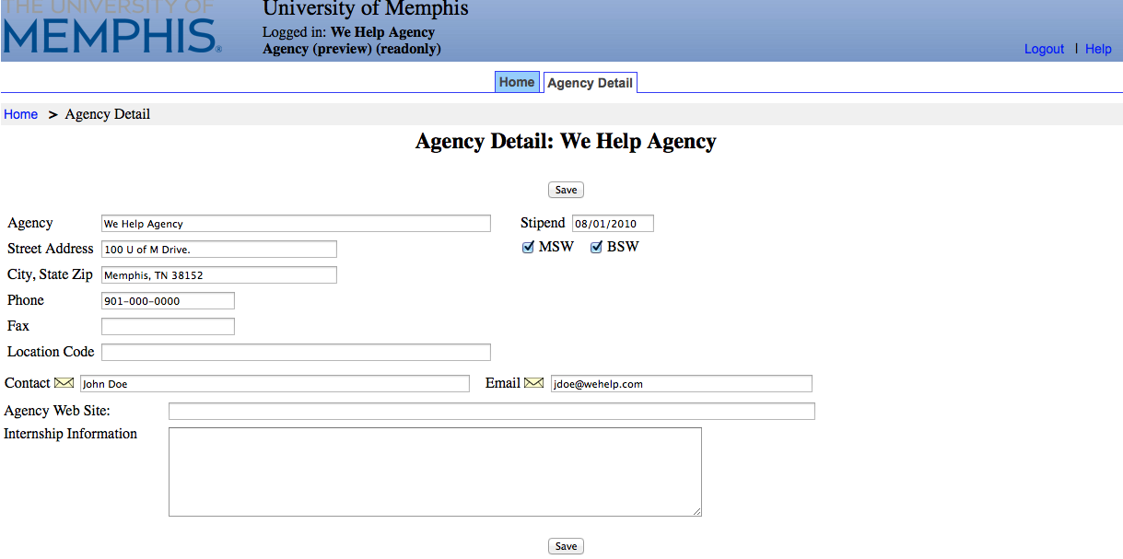
Agency Information
In IPT, every agency is also in the system. Students can see information about the different agencies. One person has access to view/edit information regarding their agency.
1. If you have access to edit your agency, there will be more than one tab on the homepage, Agency Detail tab
2. To view/edit the agency, click on Agency Detail tab

Slide 50
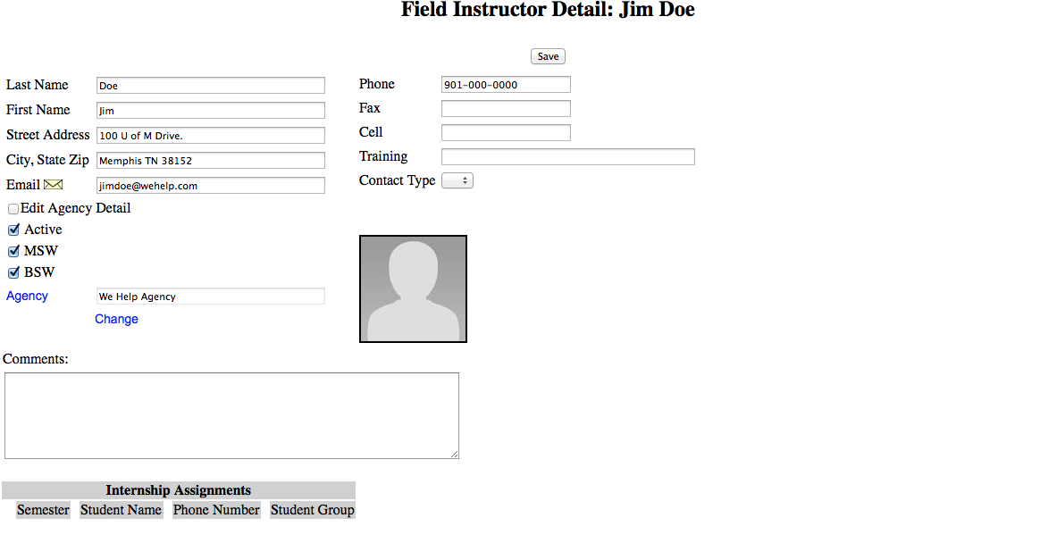
Field Instructor Information
From the Homepage, click on Field Instructor Detail tab. Information is completed per the field instructor application.
*Feel free to update information and please add a picture.
*Please remember to click the “save” button when you are done making changes.

Slide 51
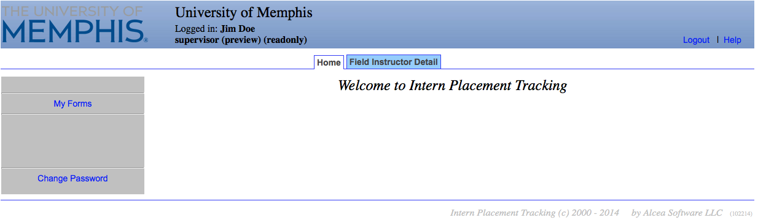
Utilizing and Tracking Forms
Through the IPT database, forms will be released to the student. If there are due dates, it will be stated in the forms section.
To access forms that are used by the student (s) you are supervising, click on My Forms on your homepage.

Slide 52
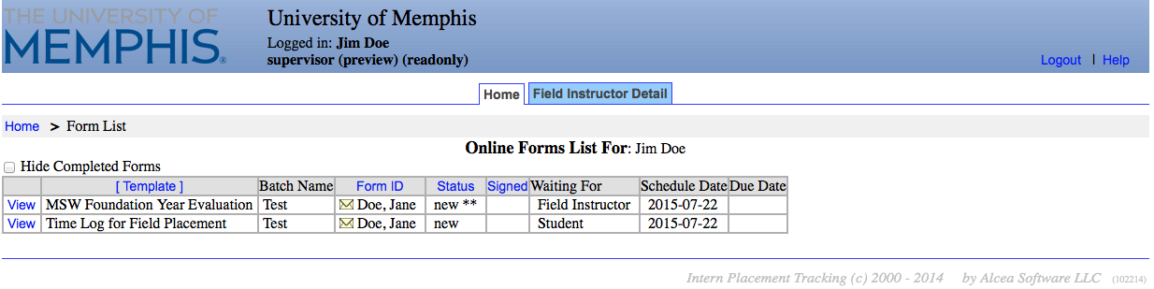
Utilizing and Tracking Forms
This is the list of forms currently available to you and your student
If you have multiple students, click on the form with the student’s name on it that you wish to view.
The Learning Plan, Time Logs, and Evaluations will be in this section

Slide 53
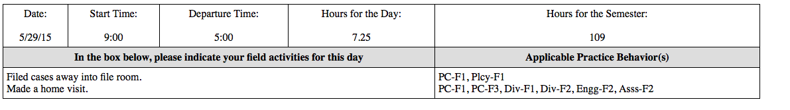
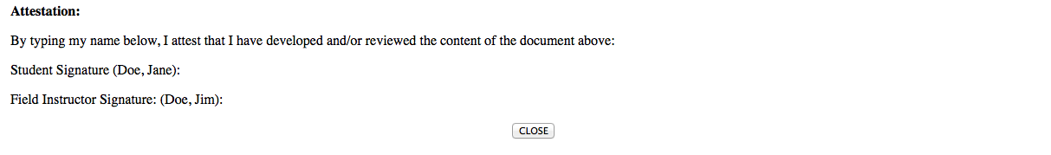
Time Logs
When you click View on the Time Log form, it pulls up the student’s form.
Field Instructors can verify hours and sign the form.

Slide 54
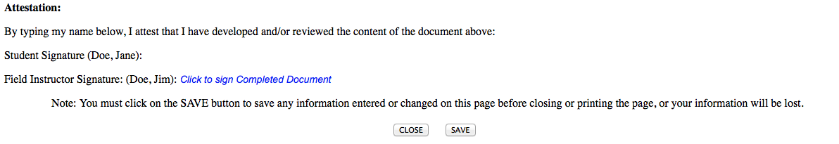
Time Logs
Field Instructors should get an email from IPT stating that the student has signed the form and it is waiting on the field instructor to sign the form.
When you scroll down, you will see the rest of the form. Field Instructors sign the form by clicking on Click to Sign Completed Document.

Slide 55
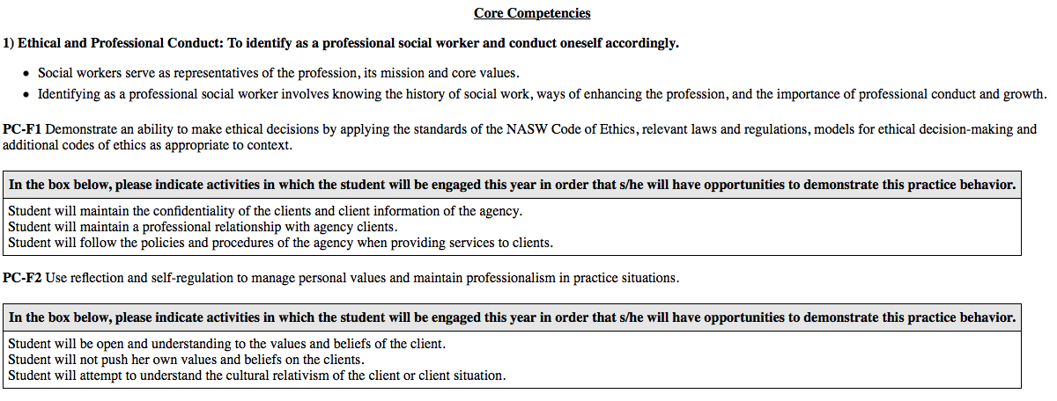
Learning Plan
The field instructor and student can collaboratively complete the learning plan. A learning plan must be completed each year, on every student, and it is based on the CSWE Competencies.
There are 9 competencies with corresponding practice behaviors in the learning plan.
Field Instructors should get an email from IPT stating that the student has signed the form and it is waiting on the field instructor to sign the form.
When you scroll down, you will see the rest of the form. Field Instructors sign the form by clicking on Click to Sign Completed Document.

Slide 56
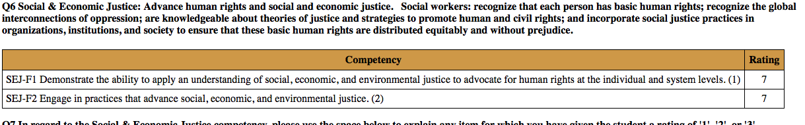
Evaluation
Toward the end of the semester, you will complete an evaluation of the student’s performance.
The student can view the evaluation, comment on the evaluation and sign it.

Slide 57
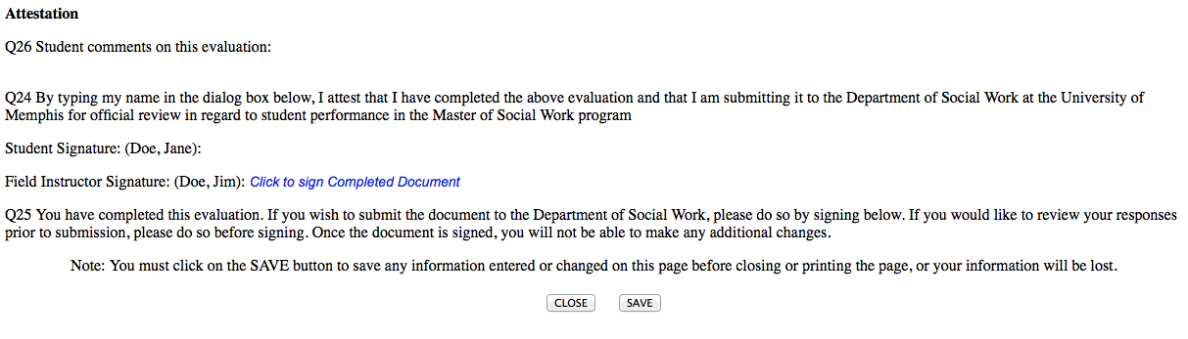
Evaluation
Field Instructors should get an email from IPT stating that the student has signed the form and it is waiting on the field instructor to sign the form.
When you scroll down, you will see the rest of the form. Field Instructors sign the form by clicking on Click to Sign Completed Document.

Slide 58
FI Benefits
Discounted CEU’s and contact hours
  on-line trainings
Access to student project findings
Participation in “Field Instructor of the Year” event
Access to the University Library materials (see a Field Coordinator)
Career Page and Trainings

Slide 59




Questions?

Slide 60
Resources
Use the eBook reference at: Social Work Instructor’s Survival Guide- http://ezproxy.memphis.edu/login?url=http://search.ebscohost.com/login.aspx?direct=true&db=nlebk&AN=1092684&site=eds-live&scope=site
TigerLink: where employers connect with Tiger Talent: https://www.memphis.edu/careerservices/
University libraries: https://www.memphis.edu/libraries/

Slide 61
Contact Information
Kenya Anderson, LMSW (BA Field Director)
678-3400 / 678-2981 (fax)
117 McCord Hall
kconley@memphis.edu
Cherry Malone, LMSW (MSW Generalist Practice Year Field – 1st year students)
678-3515 / 678-2981 (fax)
223 McCord Hall
ccmalone@memphis.edu
Maggie Landry, LMSW, LSSW (MSW Specialization Year Field – 2nd year students)
678-4619 / 678-2981 (fax)
Bldg. 29 #224
malandry@memphis.edu

