Slide 1

3515
Field Instructor Training
Kenya Anderson, BA Field Placement Coordinator
Cherry Malone, MSW Field Placement Coordinator
Maggie Landry, MSW Assistant Field Placement Coordinator

Slide 2
Agenda
Welcome
Training
Closing

Slide 3
Training Objectives
Outline the function and types of field instruction/supervision
Discuss what “supervision” as a field instructor means
Discuss protocol for addressing student concerns
Summarize the BA Program requirements:
  Hours
  Calendar
  Field Curriculum
Summarize the MSW program requirements:
  Hours
  Program Tracks
  Field Curriculum
Examine Intern Placement Tracking System
  How to fill out forms
Discuss where to find additional information for questions you may have

Slide 4


The Role of Field Placement as part of the University Curriculum
Field placement is an important component of the social work degree program and is designed to further academic learning by integrating theories, conceptual frameworks, values, and skills into the “real world” social work practice environment.
The overall goal of the BA and MSW field education programs are to facilitate students’ professional socialization, to expand their perspective of social work practice, and to provide the opportunity to apply to “real world” social work situations the knowledge and skills learned in the classroom.
The focus of the field practice experience is evidence-based practice in actual social service settings and the development of students’ understanding of and commitment to the profession.
Notes:
Change clip art

Slide 5
Internships Are…
More than just logging hours
Part of the core curriculum for the social work degree
Mutually agreed upon learning from experience
Setting the student up for success as a professional
  Even if they already work as a professional/are using employment as field internship
Structured, competency-based learning

Slide 6
Employment Internships with COVID-19 Policies
Employment internships should still have the student looking through the lens of a student/intern, NOT as an employee.
If you are supervising an employee as an intern, make sure to evaluate them as a student learner
COVID-19 policy change, valid until May 2022:
  Students using employment as internship can log employment hours as internship hours (normally they have to be separate)
  Field instructor can be employment supervisor
  Supervision time needs to be separate for internship vs. employment supervision

Slide 7
Council on Social Work Education (CSWE)
Field education is the signature pedagogy in social work education
Like all accredited social work programs, the School of Social Work utilizes a competency-based approach to identify and assess what students demonstrate in practice.

Slide 8
Council on Social Work Education (CSWE) 9 Core Competencies
Demonstrate
Demonstrate Ethical and Professional Behavior
Engage
Engage Diversity and Difference in Practice
Advance
Advance Human Rights and Social, Economic, and Environmental Justice
Engage
Engage in Practice-informed Research and Research-informed Practice
Engage
Engage in Policy Practice
Engage
Engage with Individuals, Families, Groups, Organizations, and Communities
Assess
Assess Individuals, Families, Groups, Organizations, and Communities
Intervene
Intervene with Individuals, Families, Groups, Organizations, and Communities
Evaluate
Evaluate Practice with Individuals, Families, Groups, Organizations, and Communities

Slide 9
Student Requirements
It is a School of Social Work requirement that every student entering field complete the following:
Must be a member of National Association of Social Workers (NASW) ($60)
Must have liability insurance through NASW Assurance Services ($15)
  Note change: $1,000,000 / $5,000,000
Must agree to abide by NASW Code of Conduct
NASW Membership and Liability Ins. policy must be on file with field office

Slide 10
Function and types of field instruction/supervision
Maggie or Cherry

Slide 11
Field Instructor Responsibilities
Look at the field manual from the school
Look at student curriculum to see which courses your student intern has taken/hasn’t taken yet
  If you want more info, please reach out to your field director or look on our website
Review and sign off on time logs in a timely manner
  Student must also submit time logs in a timely manner
    This could be a topic to discuss in your weekly supervision
Complete evaluations as they become available
Be prepared to discuss progress/difficulties/performance respective to the placement during liaison meetings

Slide 12
Evaluation Process
Create an environment/culture of safety in having student be open/honest about concerns/questions they may have
  Build a professional relationship between student and FI
  Students are often afraid to say anything negative for fear of retaliation
  Fis can be afraid to say anything negative for fear of inconveniencing field team/affecting relationship with the school
    Retaliation should not be a concern when discussing problems in field for either student or field instructor
Remember that students are still learners, even if employed by the agency
Performance evaluation – where is there need for growth? Where is there great strengths?
Student might not get all 9’s/8’s/7’s– and THAT’S OKAY!
  Please write comments to explain anything 6 or below, so the field team has context for their grades

Slide 13
Communication
Communication with your student intern is essential for the learning process.
Don’t bottle things up!
  If there’s a problem, make sure to reach out.
  Document, document, DOCUMENT!
    The more detail the field team has, the better prepared we are to help out
    We may be able to give context to issues
    We need documentation to justify our actions (if a new placement is needed)

Slide 14
The Liaison Visit
Liaison meeting happens at least once per semester.
Assigned Field Liaison should be your first point of contact if problems arise, after trying to solve the problem directly with your student
Liaison meeting is essentially an informal progress evaluation
  “Do you feel you’re meeting all of your competencies from your learning plan?”
  “Are you completing time logs?”

Slide 15
Impacts on Coursework
If your student is close to completing their required hours early on in the semester:
  Adjust the schedule (if available) to continue on a lighter schedule each week
Students should not just end their time with you
  Impacts liaison visits
  Impacts evaluations
  Impacts coursework – field journals, discussion boards, etc.
Field placement is a COURSE. Student should not end “class” early just because they are done with the work.
  Case-by-case basis, as approved by the field director (pregnant, medical emergency, family emergency, etc.)

Slide 16

Case Scenario- Examples. What would you do?
I completed most of my hours during the first semester of my two-semester internship. My field instructor wants me to continue with my “normal” schedule despite me being almost finished. I said I was concerned about that because of COVID. We agreed that I’d finish out the semester remotely. It’s the end of the semester, and my field instructor just completed my evaluation. There was a comment on my evaluation that said they would have preferred that I stuck it out in person.
I have disability accommodations on campus, but I’m not getting those accommodations at my field agency. My field director knows about this, but I’m still having problems at my agency.
Notes:
1: talk about vaccinations (voluntary for students, employers/agencies can require it for interns/employees)
2: did the student disclose their needs during interview? Did the student self-disclose to their FI? Faculty cannot disclose disabilities of students without a written disclosure/consent form (most of the time, we don’t have that…). Students are told to discuss with field director and field instructor what accommodations can/cannot transfer to the agency.

Slide 17
Supervision
A standing appointment for supervision is essential to the success of your student intern
  Specific day and time each week that doesn’t change
Supervision must happen at least once per week for a minimum of one full hour
Supervision could include going over current tasks, navigating any difficulties with current tasks/cases, reviewing techniques or protocol, thoughts/feelings about how the student is doing (and how they think they’re doing), mutual trainings on topics of interest, discussion of time logs/learning plan/competencies targeted for completion
Notes:
The most common answer to the liaison visit question ‘when is your supervision?’ – “whenever” or “they can come to me whenever they need to”

Slide 18
Supervision cont’d.
Differences between professions (if FI is not a social worker)
  Changes or differences in the way social workers think/address problems vs. the way other professions think/address problems
Weekly supervision must still happen between field instructor and student even if the field instructor is not a social worker
  Student is enrolled in group social work supervision outside of the agency, but is not necessarily discussing topics related to their actual internship. Most group supervision topics are general/broad in nature. Agency-specifics should be discussed between student and agency field instructor.

Slide 19
Function of Supervision
Provides context for learning and professional development
An opportunity to step back from the immediate, intense experience of the work we do and consider what the experience really means
Allows the supervisee to examine their thoughts and feelings about their work and identify interventions that best meet the need of the client being served
Goal is to create an environment in which the supervisee can do their best thinking and subsequent performance
Notes:
kenya

Slide 20
Function of Supervision (cont.)
A cluster of functions -- administrative, educational and supportive -- performed within the context of a positive relationship by a person (supervisor) to whom authority has been delegated to direct, coordinate, enhance and evaluate the on-the-job performance of the supervisee(s) for whose work s/he is held accountable.
The primary goal of supervision is the establishment of an on-going relationship in which the supervisor designs specific learning tasks and teaching strategies related to the intern’s development as a professional. The supervisor empowers the intern to enter the profession by helping him/ her understand the core competencies of the profession. The supervisor guides the relationship to help him/her achieve success.
Notes:
Students are still learners, even if they are employed by the internship agency.

Slide 21
Administrative Supervision
Objective | Task
Intern recruitment & selection | Intern orientation & placement
Work planning | Work assignment
Work delegation | Monitoring, reviewing and evaluating work
Coordination of work | Communication with intern
Administrative supervision is oriented towards an agency or organization’s policy and public accountability.
It is here that objectives are translated into tasks to be performed by social workers.
The major responsibility of the administrative supervisor is to ensure that the work is performed.

Slide 22
Educational Supervision
Educational supervision (also called clinical supervision) establishes a learning alliance between the supervisor and supervisee in which the supervisee learns therapeutic skills while developing self-awareness at the same time.
It is also concerned with teaching the knowledge, skills, and attitudes important to clinical tasks by analyzing the social worker’s interaction with clients.
The supervisor teaches the social worker what he/she needs to know to provide specific services to specific clients.
Goal of Supervisor | Outcome for Intern
Emphasis is on professional development of intern | Identification of knowledge and skills necessary to do the work
Provision of teaching/training/ learning resources | Socialization to professional values and identity

Slide 23
Supportive Supervision
Supportive supervision is concerned with increasing job performance by decreasing job related stress that interferes with work performance. The supervisor increases the social worker’s motivation and develops a work environment that enhances work performance by providing the following:
  Recognition
  Approval
  Reassurance
  Encouragement
  Flexibility
  Opportunity to express concerns
  Gain perspective

Slide 24
Developmental Stages of Internship
Stage | Intern’s Feelings, Behaviors & Thoughts | Field Instructor Strategies
Anticipation | Excitement Anxiety about self, supervisor, co-workers, field site, clients, life context Worry about fitting in and having the knowledge necessary to do well | Discuss learning objective Be clear about expectations Allay anxiety by discussing fears openly Plan and structure supervision time Provide encouraging feedback Challenge faulty assumptions about the work
Notes:
Anxiety about the interview. “Not knowing everything”. Don’t know about the climate/culture of the agency. Questions self and goals.

Slide 25
Developmental Stages of Internship (cont.)
Stage | Intern’s Feelings, Behaviors & Thoughts | Field Instructor Strategies
Disillusionment | Unexpected emotions Ethical issues and hard work expose a different side of practice outside of the classroom Questioning adequacy of skills Understanding breadth of demands Disappointment with supervisor/co-workers, clients or tasks | Help student work through challenging issues Challenge students to face and explore ethical issues Model the process of ongoing learning and inquiry Help the student see the difference between classroom and real world Expose student to positive models of effective practitioners
Notes:
Internal processes of performance and learning. Connecting with other staff. Questions self/skills – “will I say the wrong thing?” “I don’t think I’ll be able to do this!” “This sounds like too much”

Slide 26
Developmental Stages of Internship (cont.)
Stage | Intern’s Feelings, Behaviors & Thoughts | Field Instructor Strategies
Confrontation | Expectations have to be revisited Students must explore interpersonal and intrapersonal issues Confidence should be increasing as greater competence in the work | Field instructor can provide encouragement and support to student Assure and model commitment to excellence in work Help in the understanding of the need for advocacy
Competence | Shift to identifying with professional vs. student More productive in the work roles Capable of completing more complex tasks Investment in work | Introduce student to professional community Discuss career and job strategies Create more advanced learning tasks Help student attend professional trainings
Notes:
Confrontation: Realistic expectations are needed. I thought I wouldn’t have to do anything extra (for job as internship). Needs to revisit expectations to form learning process. I’ve never been good at research/macro. I don’t think I can work with elderly. INTER VS. INTRA
Competence: able to make the decisions independently – can make those split-second decisions in the moment without needing to ask supervisor. More comfortable with self/skills. Communicates clearly with supervisor AFTER the event/decision was made for/with the client, and asks for feedback on how to navigate more smoothly next time (if applicable)

Slide 27
Developmental Stages of Internship (cont.)
Stage | Intern’s Feelings, Behaviors & Thoughts | Field Instructor Strategies
Culmination/Termination | End of field placement Termination with clients Case management issues Redefine relationship with supervisor, co- workers, faculty, peers Ending studies Post internship plans | Assist the student in termination Help student feel pride in work Recount the learning that has occurred Assure student they are prepared for practice Consider writing a letter of reference for student Refer possible job opportunities
Notes:
Bittersweet feelings of terminating with clients. Bittersweet feelings of terminating the student/supervisor relationship.
Talk about the parallels – new beginnings vs. terminating what they’re comfortable in.

Slide 28
Field Instructor’s/Supervisors Expectations of Student
Always be professional: That includes being on time, maintaining a professional appearance, attitude and attire, being reliable, and respectful, maintaining open and professional communication.
Cooperation: The ability to be cooperative and willing to work and learn alongside co-workers, colleagues, and peers is essential to a successful internship.
Initiative: Interns are expected to complete whatever duties they are assigned. More importantly, however, is an intern’s ability to be resourceful and to look around, see what needs to be done, and do it if they can.
Willingness to learn: Learning about the job, assigned duties, the agency and the agency culture is important. Supervisors appreciate interns who know when to say “I don’t know” or “I need help”.
Willingness to follow directions: Following directions and being able to work on well-established routines without direction are valuable skills supervisors expect.
Open and receptive to feedback: Among the many functions of a supervisor is to provide constructive feedback. An intern’s ability to take in feedback and integrate it into their learning and overall performance will go a long way in your internship and future professional experience in the field.
Ultimately, field instructors want students that are willing to learn, explore, and embrace. They want someone they will be proud to call a colleague.

Slide 29
Student’s Expectations of Field Instruction/Supervision
Training: Provide training necessary for student to do the assigned tasks and duties. Students expect to be taught how to effectively accomplish the task at hand.
Communication: Clearly articulate expectations of the student. Explain any important policies, rules, and regulations of the agency that the student should know. Additionally, clearly state any consequences should the student not follow rules and regulations, or if they don’t live up to what is expected of them.
Professional development: Help them develop new skills.
Be available: for consultation on difficult cases and guidance.
Redirect their efforts: when they make a mistake or need help to perform their work more effectively.
Keep them in the loop: Inform the student of any changes in their duties and responsibilities, and about anything else which affects the student and their work.
Provide feedback and evaluation: Evaluate the student’s performance including providing feedback on what they are doing well and make suggestions on how they can improve.
Ultimately, students want someone who will listen, teach and guide them into embracing and fulfilling their burgeoning professional identity.

Slide 30
BA Program
Kenya Anderson

Slide 31
Important Documents
All documents related to field (Field Manual, learning plan, time logs, evaluations, etc.) can be found in Intern Placement Tracking (IPT)
A live demonstration of IPT will be conducted later in the presentation.

Slide 32
BA Student Options
2 Consecutive Semesters
  Plan to work between semesters
  Seminar I – Tuesday or Wednesday evenings, Online
  Seminar II – Wednesday evenings or Online
Block (1 Semester)
  Must have a GPA > 3.25 to qualify
  Seminar I – Wednesday afternoons
  Seminar II – Wednesday evenings
  Please note: Block placement depends on approval from the Field Director & is based on agency placement availability

Slide 33
BA Student Required Field Hours
COVID-19 REDUCED HOURS
Required Hours
Field Calendar
SWRK 4830 – 3 credit hours
  180 hours in the agency
SWRK4840 – 2 credit hours
SWRK4831 – 4 credit hours
  280 hours in the agency
SWRK4841 – 2 credit hours
Total = 340 hours
Temporary for AY 2021-2022
Spring/Summer – 15.5 hrs/wk (30 wks)
Spring Block – 29 hrs/wk (16 wks)
Summer/Fall – 15 hrs/wk (25 wks)
Fall/Spring – 13 hrs/wk (35 wks)
Fall Block 31 hrs/wk (15 wks)
Note: These numbers represent average weekly hours per semester

Slide 34
Student Assignments in Seminar
SWRK 4840
  Field Journal
  Agency Paper
  Case Presentation
  Portfolio
  Problem Formulation
SWRK 4841
  Field Journal
  Policy Assessment
  Critical Thinking Proposal/Presentation

Slide 35
Steps to BA Field Placement
Attend
Attend Field Forum
Pass
Successfully pass 8 core social work courses with a C- or higher
Complete and submit
Complete and submit field practicum application with an attached resume
View
View video, “A Day In The Life of A Social Worker”
Review
Review the Council on Social Work Education (CSWE) 9 Core Competencies
Schedule
Schedule individual meeting with Director of Field Placement
Receive
Receive potential placement and schedule interview
Interview
Interview with agency and if both parties are in agreement, identify start date and any necessary paperwork that must be completed.

Slide 36
MSW Program
Cherry Malone and Maggie Landry

Slide 37
Important Documents
All documents related to field (Field Manual, learning plans, time logs, evaluations, etc.) can be found in Intern Placement Tracking (IPT) and on website

Slide 38
Specialization Curriculum
The MSW program at the University of Memphis offers one specialization: Advanced Practice Across Systems
The goal of specialization is to advance the generalist practice content in a manner that prepares students to utilize evidence‐based, ethically‐informed social work practices to help promote, restore, and maintain social functioning.

Slide 39
1st Year MSW Field Hours
1st Year MSW
SWRK 7051 Foundation Field Placement I – 160 (14-16 hrs a week)
SWRK 7052 Foundation Field Placement II –180 (16-18 hrs a week)
Total Hours: 340
(COVID-19 REDUCED HOURS)

Slide 40
Seminar Class
Students are required to participate in field seminar classes
1st year MSW Full-Time (7051/7052)
Have seminar class monthly throughout the semester (MUST complete SWRK 7001 course before starting field)
Will start field the week of October 1st (possibly sooner)
In class one Tuesday a month (9:30-12:30), and they will get field hours for in-person class
1st year MSW Extended Study (7051/7052)
Extended Study students have completed SWRK 7001 and will start field in August
In class online

Slide 41
Student Assignments in Seminar
SWRK 7051- Community Immersion Assignment & Psychosocial Assessment, Journal entries, discussion boards
SWRK 7052- Psycho-educational Assignment
  Student will need the Field Instructor’s assistance to accomplish this assignment. Student needs a client that he/she could interview, practice diagnosing, and delivering the diagnosis to the client or role-play with field/task instructor. Journal entries & Discussion boards

Slide 42
MSW Student Schedule
Students are typically in class on Tuesday and Thursday
Students should never miss class for field hours
Students typically complete field hours on Monday, Wednesday, and Friday
Some students may choose to complete their field hours during the evening and over the weekend (some agencies offer evening and weekend placements)
Some students will also have to attend supervision on campus every other week (dates TBD)

Slide 43
Student Required Field Hours
2nd Year MSW
COVID-19- REDUCED HOURS
  SWRK 7053 Advanced Field Placement III – 250 (18-20 hrs a week)
  SWRK 7054 Advanced Field Placement IV – 250 (18-20 hrs a week)
  SWRK 7055 Integrative Field Seminar I (3-4 seminars per semester)
  SWRK 7056 Integrative Field Seminar I (3-4 seminars per semester)
        ________
  Total Hours: 500

Slide 44
Seminar Class & Assignments
2nd year MSW students (7055/7056)
  2nd year students can start field in August (earlier with permission of field director)
  In class one Thursday of the month (1:30-4:30pm) or online
  Can count in-person seminar as internship hours
SWRK 7055- Behavior Change Project, journal entries, discussion boards
SWRK 7056- Self-Reflection Assignment, journal entries, discussion boards

Slide 45
Hours and Liaison Visits
Both BA & MSW Programs
Kenya Anderson & Maggie Landry/Cherry Malone

Slide 46
Rule About University Holiday
“Students are entitled to observe holidays listed on the University of Memphis calendar and to holidays and hazardous weather closings observed by the agency – even when these fall on field practice days. However the student remains responsible for making up these hours at some other time such that s/he completes the required number of hours for the placement.”
To view academic calendar and University Holidays https://www.memphis.edu/registrar/calendars/

Slide 47
Working Between Semesters
Students are to follow the calendar of the university regarding holidays, etc. However, it is vitally important that students coordinate any planned absences with the field instructor and prepare the client(s) sufficiently regarding these breaks. Students are allowed to serve in the placement during holidays and breaks in the academic schedule if they and the field instructor work out such an agreement.

Slide 48
University Initiated Events
Students will have activities that are offered and required during their educational programming
The expectation is the student will attend these activities
Here are some examples
  Social Work Day on Hill
  Field Seminar Classes (throughout the year)
  Agency Day
  Professional conference/ research with U of M
  Research Poster Presentations
  Symposium
  Grant-related trainings

Slide 49
Opportunities for Volunteer Hours
There are opportunities for students to obtain extra field hours by participating in School of Social Work activities and community-based social work activities. Ex. Social Work Day on the Hill, SSWO movies, volunteering, etc.
Students are also allowed to accrue 50 hours per semester towards field in on-line modules/ CEU’s/ Professional development opportunities, social service volunteer projects.
  This is increased from the normal 25hrs/semester, due to COVID-19

Slide 50
Student Time Logs & Work Hours
Students will keep up with weekly time logs that reflect their activities and the competencies that are linked to those activities
MSW students will reflect class/seminar hours in their time logs also
Field instructors should sign the time logs weekly, as soon as possible after student submits them (IPT should send automated email when this happens)
The required number of hours for a scheduled field day is 7-1/2 but can vary by agency/institution. Student plan for less than four (4) hours at-a-time at the field site.
The exceptions to this are illness of the student, or important personal matters, that require one to leave the site unexpectedly. Such absences should not happen regularly, and should become matter for corrective action if this privilege is abused.

Slide 51
Work Hours (cont.)
Appropriate use of field placement hours includes preparation done for contact with the client(s), process recording, summaries done for agency/institution purposes, staff conferences, supervisory sessions, other meetings that are part of the learning experience, travel time to and from client contacts, and work on related seminar assignments (particularly the behavior change project/case assessment/critical thinking proposal).

Slide 52

Supervision
Students should meet with and be supervised by the Field Instructor at least one hour a week
  If you are a FI but not a social worker, you still need to meet with your student for on-site supervision despite the student getting SW supervision from a faculty member.
Faculty from the School of Social Work will provide regular student supervision for agencies that do not have a social worker on staff
As part of the CSWE accreditation standards, every Agency Field Instructor should have a Resume and Field Instructor Information Sheet on file with the School of Social Work.
Group Supervision is provided by SSW faculty
Notes:
Change clip art

Slide 53
Addressing Student Concerns
Create a documentation system for all your student interns. It can be as simple as a note pad or more complex like a file system. This will allow you to track observed patterns in performance and help in the overall evaluation process at the end of each semester.
Identify and address the issue at first sign.
Early intervention is essential.
  Reach out to your liaison and/or field director.
Every effort is made to assure that students’ rights to due process are protected, as well as protecting the interests of the agency and client.
Allow the student time for corrective action and for resolution.
Assess recent progress (within 2 weeks) with continued documentation.
Evaluate response.

Slide 54
Addressing Student Concerns (cont.)
If concerns arise with a student, please attempt to directly address them with him/her. If you would like support, the Field Liaison and/or Field Director can assist you with addressing student concerns.
If concerns persist, directly contact the Field Director to discuss next steps.
  It is important to remember that you are not alone
Possible outcomes:
Identified problems are resolved and placement continues.
Identified problem continues and a formal conference is scheduled.
In extenuating circumstances or at the request of the agency, the student will be reassigned to a new field agency (or possibly dismissed from field and the program depending on the severity of the issue).

Slide 55
Liaison Visits
The faculty liaison serves as a consultant to field instructors and ensures the educational integrity of the field experience for his/her respective students.
The faculty liaison also serves as a mediator/problem solver when conflicts/concerns may arise between the agency and/or the field instructor and the student. If a conflict/concern does arise the Liaison and/or Field Director will assist by completing a Problem in Field Form.
Field Liaison visits should happen (at a minimum) once a semester and they will complete a Field Consultation Report Form
The Field Liaison provides an evaluation of the field placement at the end of the semester and makes recommendations about placement planning with the respective agency/institution for subsequent semesters.

Slide 56

Intern Placement Tracking (IPT)
Both BA and MSW Programs
Cherry Malone

Slide 57
Intern Placement Tracking
The Intern Placement Tracking (IPT) system is a web-based practicum monitoring system designed to keep track of students placed in internship programs with various agencies. The University of Memphis Department of Social Work implemented IPT in order to more effectively track student placements. IPT also provides a paperless solution for tracking and archiving online field forms.

Slide 58
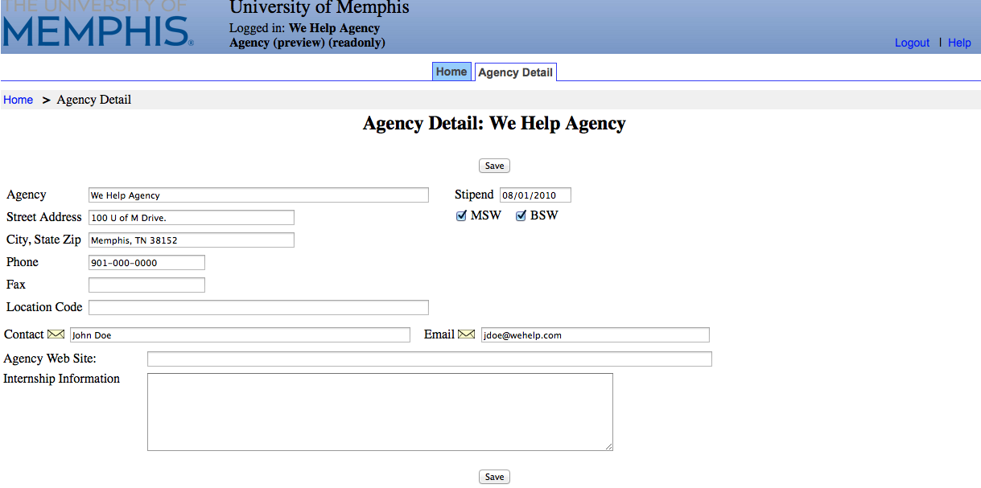
Agency Information
In IPT, every agency is also in the system. Students can see information about the different agencies. One person has access to view/edit information regarding their agency.
1. If you have access to edit your agency, there will be more than one tab on the homepage, Agency Detail tab
2. To view/edit the agency, click on Agency Detail tab

Slide 59
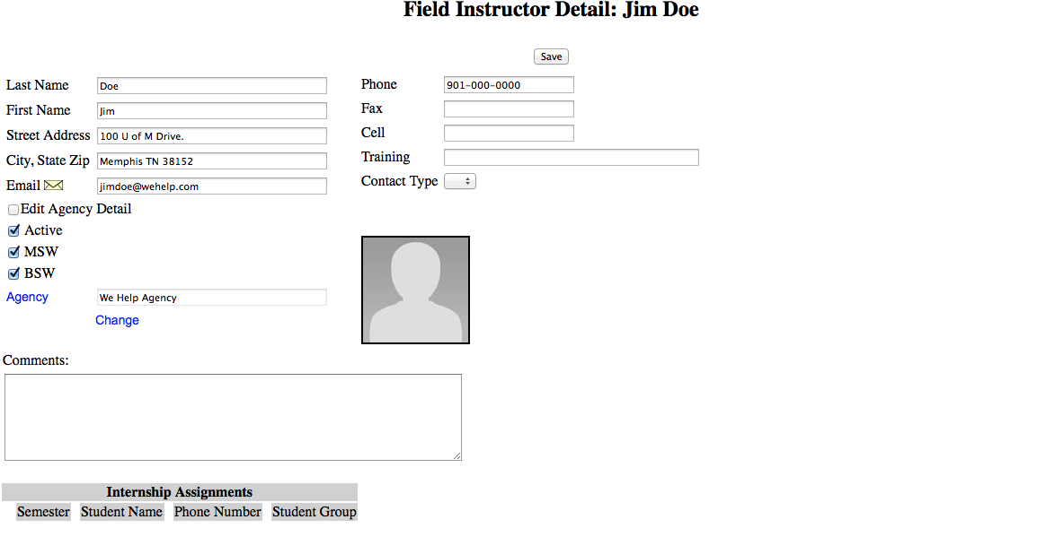
Field Instructor Information
From the Homepage, click on Field Instructor Detail tab. Information is completed per the field instructor application.
*Feel free to update information and please add a picture.
*Please remember to click the “save” button when you are done making changes.

Slide 60
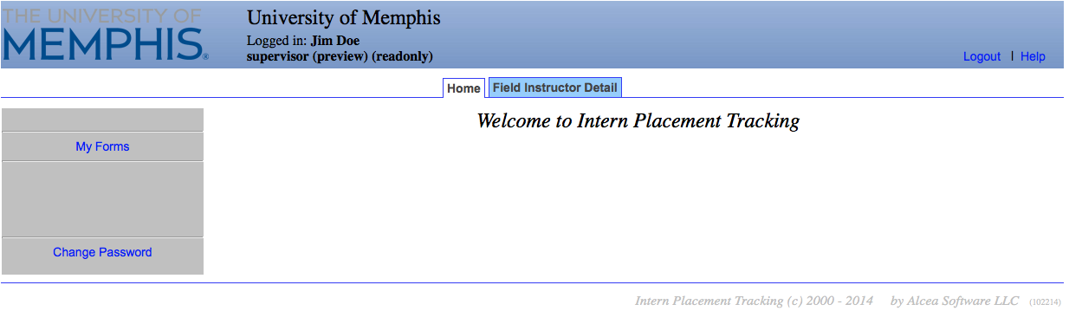
Utilizing and Tracking Forms
Through the IPT database, forms will be released to the student. If there are due dates, it will be stated in the forms section.
To access forms that are used by the student (s) you are supervising, click on My Forms on your homepage.

Slide 61
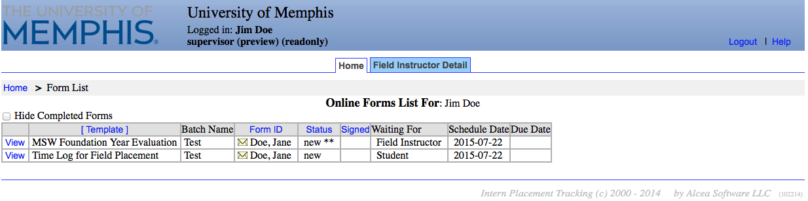
Utilizing and Tracking Forms
This is the list of forms currently available to you and your student
If you have multiple students, click on the form with the student’s name on it that you wish to view.
The Learning Plan, Time Logs, and Evaluations will be in this section

Slide 62
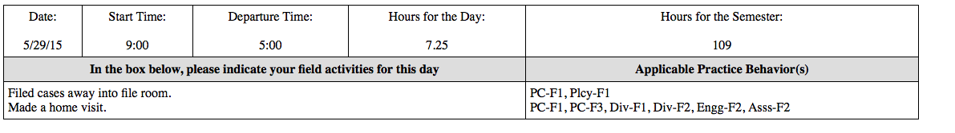
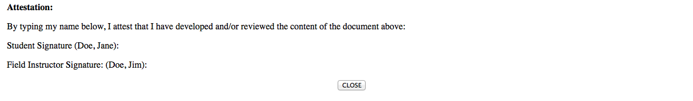
Time Logs
When you click View on the Time Log form, it pulls up the student’s form.
Field Instructors can verify hours and sign the form.

Slide 63
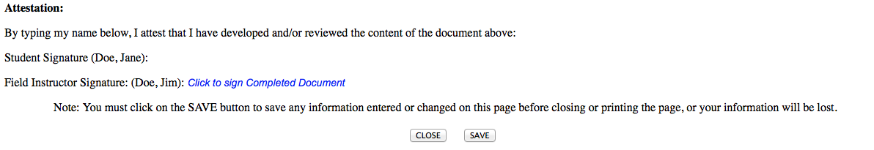
Time Logs
Field Instructors should get an email from IPT stating that the student has signed the form and it is waiting on the field instructor to sign the form.
When you scroll down, you will see the rest of the form. Field Instructors sign the form by clicking on Click to Sign Completed Document.

Slide 64
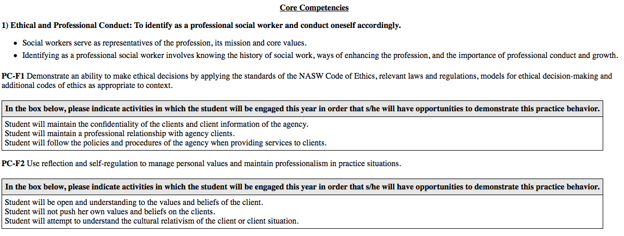
Learning Plan
The field instructor and student can collaboratively complete the learning plan. A learning plan must be completed each year, on every student, and it is based on the CSWE Competencies.
There are 9 competencies with corresponding practice behaviors in the learning plan.
Field Instructors should get an email from IPT stating that the student has signed the form and it is waiting on the field instructor to sign the form.
When you scroll down, you will see the rest of the form. Field Instructors sign the form by clicking on Click to Sign Completed Document.

Slide 65
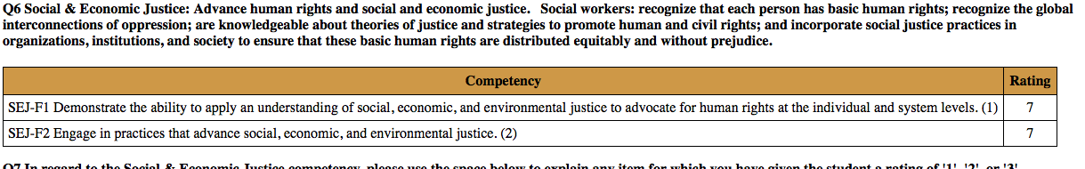
Evaluation
Toward the end of the semester, you will complete an evaluation of the student’s performance.
The student can view the evaluation, comment on the evaluation and sign it.

Slide 66
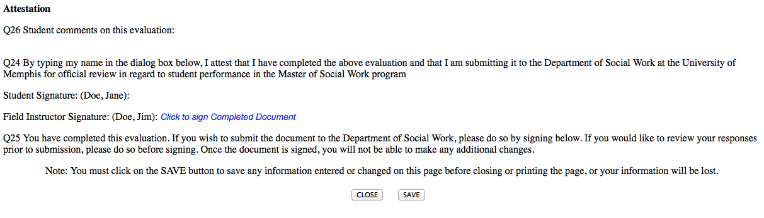
Evaluation
Field Instructors should get an email from IPT stating that the student has signed the form and it is waiting on the field instructor to sign the form.
When you scroll down, you will see the rest of the form. Field Instructors sign the form by clicking on Click to Sign Completed Document.

Slide 67
Field Instructor Benefits
Discounted CEU’s and contact hours
  on-line trainings
Access to student project findings
Participation in “Field Instructor of the Year” event
Career Page and Trainings

Slide 68
Resources
Use the eBook reference at: Social Work Instructor’s Survival Guide (field director can email a copy)
TigerLink/HandShake: where employers connect with Tiger Talent - https://www.memphis.edu/careerservices/
University libraries - https://www.memphis.edu/libraries/
CEU opportunities

Slide 69




Questions?

Slide 70
Contact Information
Kenya Anderson (BA Field Director)
678-3400 / 678-2981 (fax)
kconley@memphis.edu
Cherry Malone (MSW Generalist Practice Year Field – 1st year students)
678-3515 / 678-2981 (fax)
ccmalone@memphis.edu
Maggie Landry (MSW Specialization Year Field – 2nd year students)
466-6689 / 678-2981 (fax)
malandry@memphis.edu

